Slide 1
Realizing Inclusive cities through young leaders’ empowerment
By James Aniyamuzaala Rwampigi
Disability Rights advisor ,UN Habitat Youth advisory Board.
Email:jamesani09@gmail.com

Slide 2
Structure of presentation:
State of Young people in the World.
Demographic Dividend opportunity.
Young leaders’ Empowerment and Inclusive Urban Development.
Reference.

Slide 3
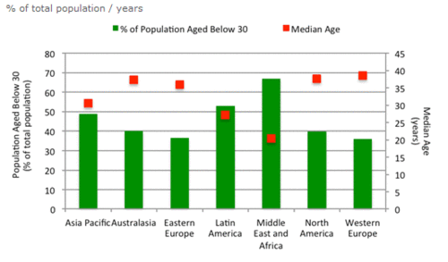
State of the young people in the world.
Source: Euromonitor International from national statistics/UN
http://blog.euromonitor.com/2012/02/special-report-the-worlds-youngest-populations.html

Slide 4
State of the young population
3.5 billion below 30 years in 2012 (50.5% of the estimated 7 billion)
89.7% in emerging and developing economies
Millions below 30:India :704, China :497, USA :127, Pakistan 126 .
70% of the Sub-Saharan region’s population
Half of Uganda population below 15 years in 2012.

Slide 5
Median age: Niger 15, Uganda 15.7and Mali 16.2%
Ageing population: Japan 45.2, Germany 44.1, Italy 43.1
Birth rates: 20.9 per 1000 people in Developing economies & 11.2
Fertility rates:3.1 children Developing Economies and 1.8 developed.
54% of the World’s population reside in Urban areas(UNDESA,2014).

Slide 6
Demographic Dividend Opportunity .
Window stretches from 30-40 years (Sarah,2012).
Working age population estimated growth at 9.8% by 2020 MDC,LDC
Power to make decision :Next population and consumer trends (sarah 2012).
By 2020, 3.6 billion people in the world will be aged below 30.
Opportunity to build strong economy .Drivers of Innovation(WEF,2015).
Number of global household grow by 1.9%.

Slide 7
Challenges
Inadequate education policies and system (Sarah,2012).
Limited investment in infrastructure and Job creation (Sarah,2012).
12.6% youth Unemployment or 73.6 million in 2013 (ILO,2013).
Discrimination and inaccessible environment (Dr Paul Harpur,2014).

Slide 8
Young leaders’ Empowerment & Inclusive Urban Development.
Rethink approaches to Inclusion :Diversity Vs Disability,(Dr Paul Harpur,2014).
Sex,Age,Disaability Disaggregated Data (SADDD) and Research (DFID,2015).
Digital accessibility empowerment as a tool for inclusion (Microsoft,2016).
Prioritizing wider & inclusive Young leaders’ participation and outreach.
Center Disability Rights as an economic issues Vs Benefits for all.

Slide 9
Reference
DFID,2015,Disability Framework, https://www.gov.uk/government/uploads/system/uploads/attachment_data/file/554802/DFID-Disability-Framework-2015.pdf
World Economic Forum, 2015,The forum of global young leaders’ annual report. http://www3.weforum.org/docs/WEF_YGL15_Annual_Report.pdf
Sarah Boumphrey, 2012,World’s youngest population special report, Euromonitor. http://blog.euromonitor.com/2012/02/special-report-the-worlds-youngest-populations.html
ILO, 2013,The global employment trends for youth, http://www.ilo.org/wcmsp5/groups/public/---dgreports/---dcomm/documents/publication/wcms_212423.pdf
DESA, 2014, World Urban Propsects, https://esa.un.org/unpd/wup/Publications/Files/WUP2014-Highlights.pdf
Dr Paul Harpur,2014, Combating Prejudice in the Workplace with Contact Theory: The Lived Experiences of Professionals with Disabilities, http://dsq-sds.org/article/view/4011/3544
Forrester and Microsoft,2016,Assessing the values of Assistive technologies for organisations.Total economic impact, https://mscorpmedia.azureedge.net/mscorpmedia/2016/06/Microsoft-TEI-Accessibility-Study_Edited_FINAL.pdf

Slide 10
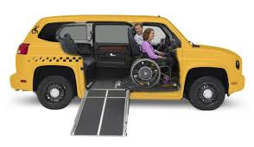
What is good for Persons with Disabilities is good for everybody.
THANKS

