Slide 1
Accessibility, a socio -economic imperative: using transportation as an example
Janett JIMENEZ SANTOS

Slide 2

INTRODUCTION
Sustainable Development Goals
Art 9. Accesibility - CRPD

Slide 3

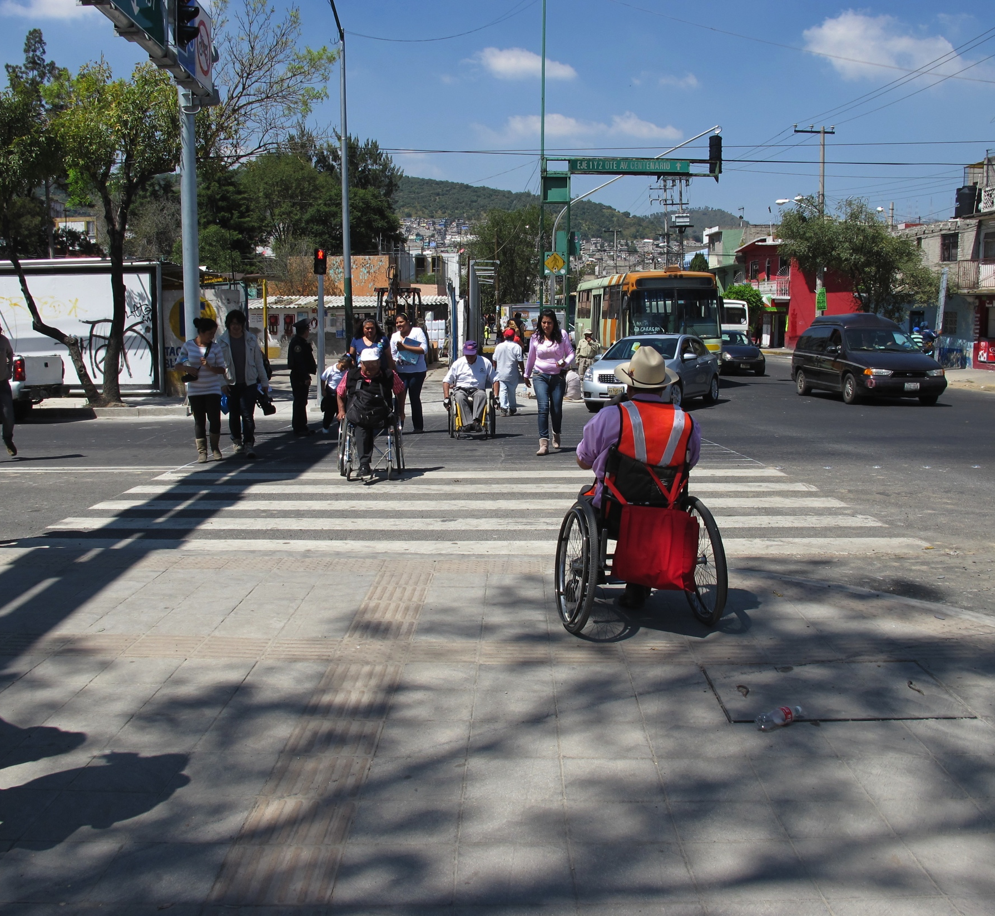
CHALLENGES
1. Awareness
2. Accessibility standards

Slide 4
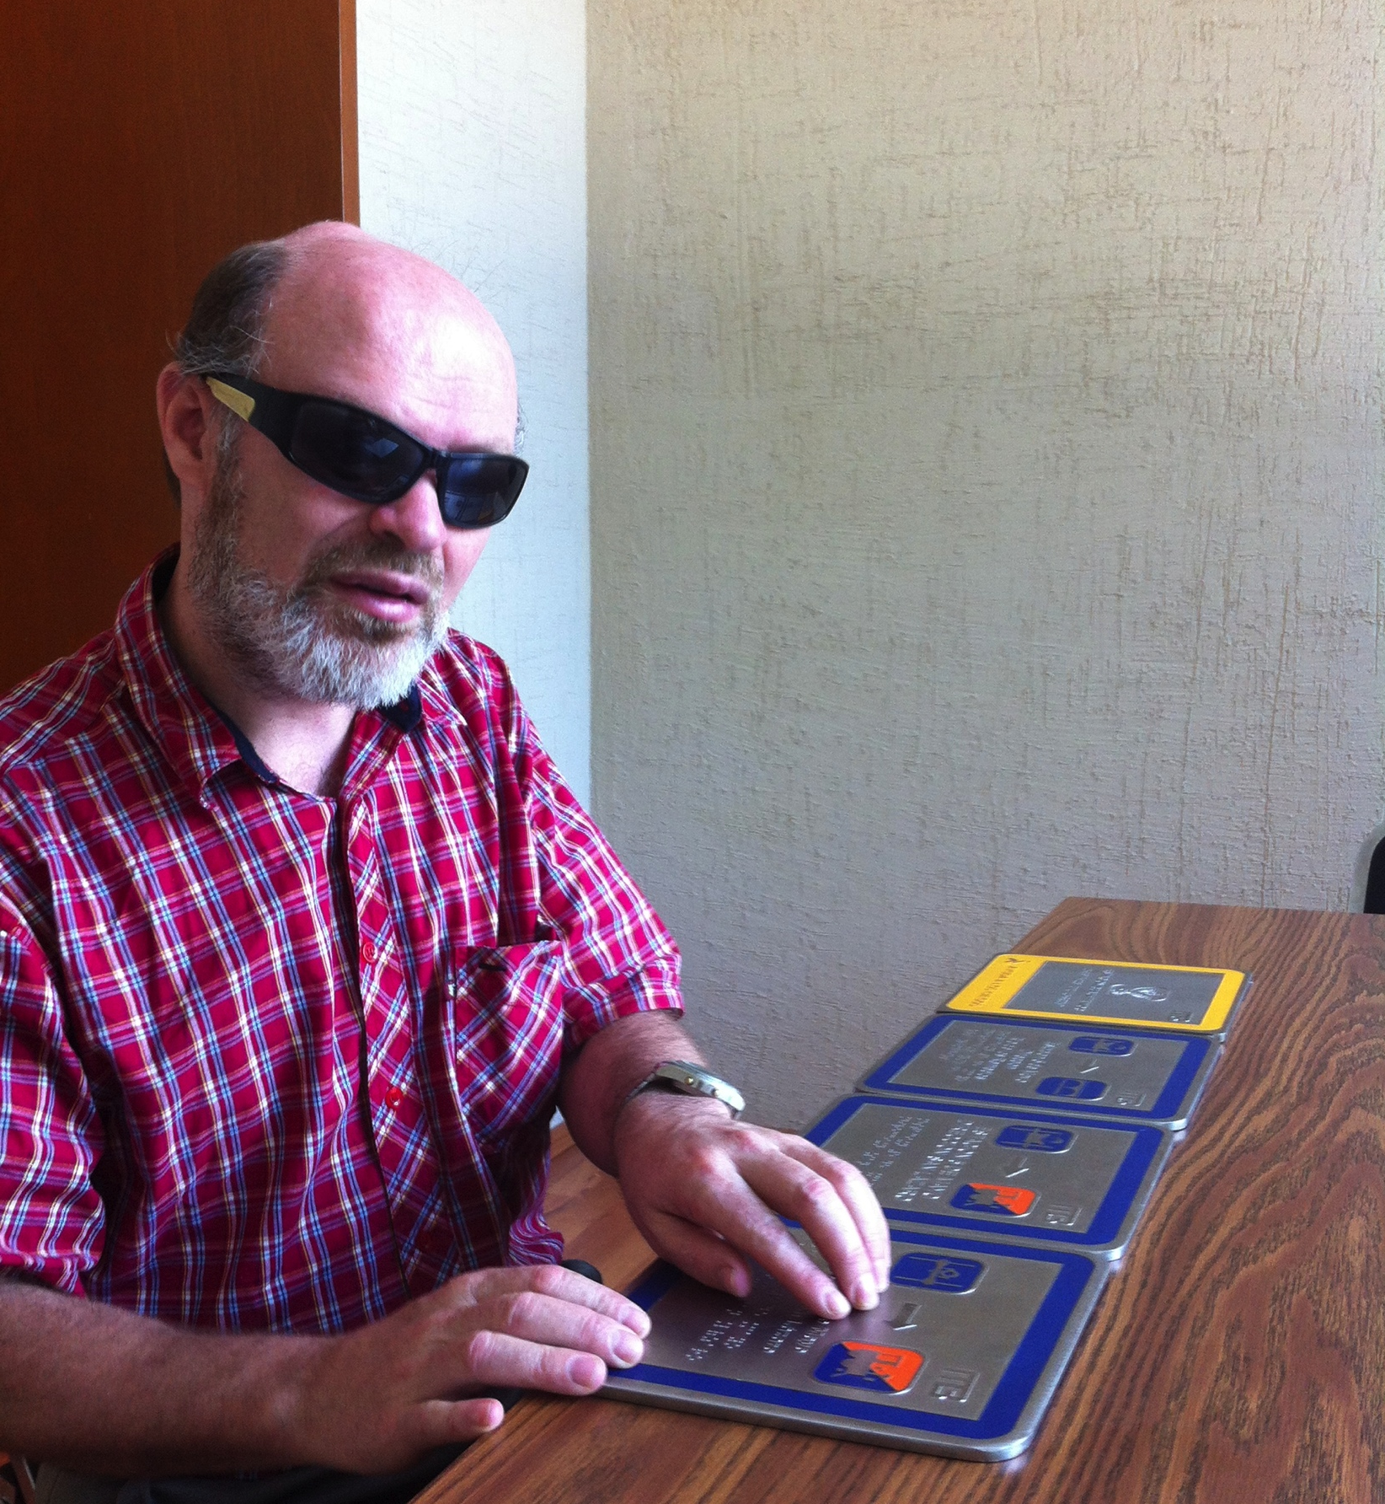
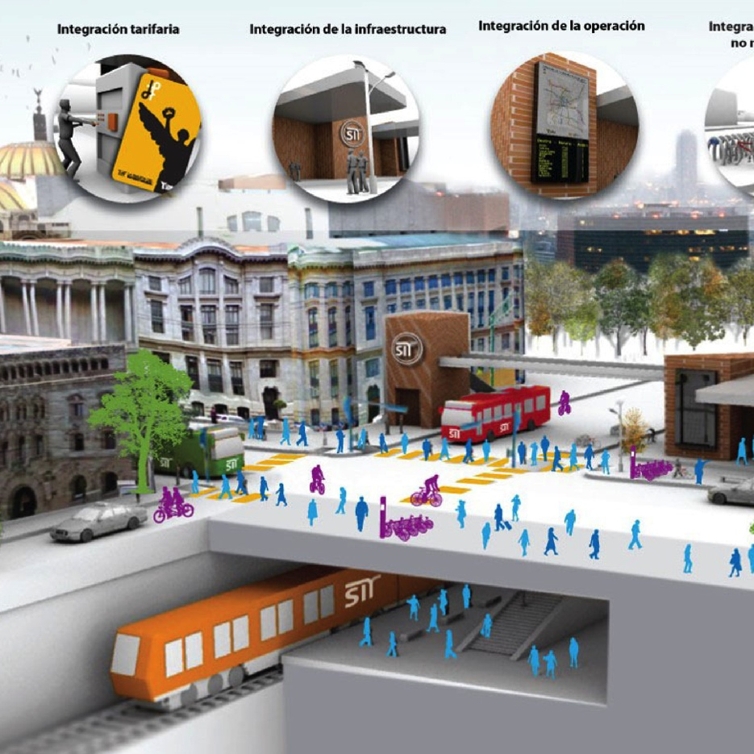
CHALLENGES
3. Suppliers of products
4. Transfer points
http://es.slideshare.net/sibrt/semovi-mxico-luis-enrique-fuentes-polticas-pblicas-dirigidas-a-mejorar-la-calidad-de-los-sistemas-de-satisfaccin-del-usuario

Slide 5
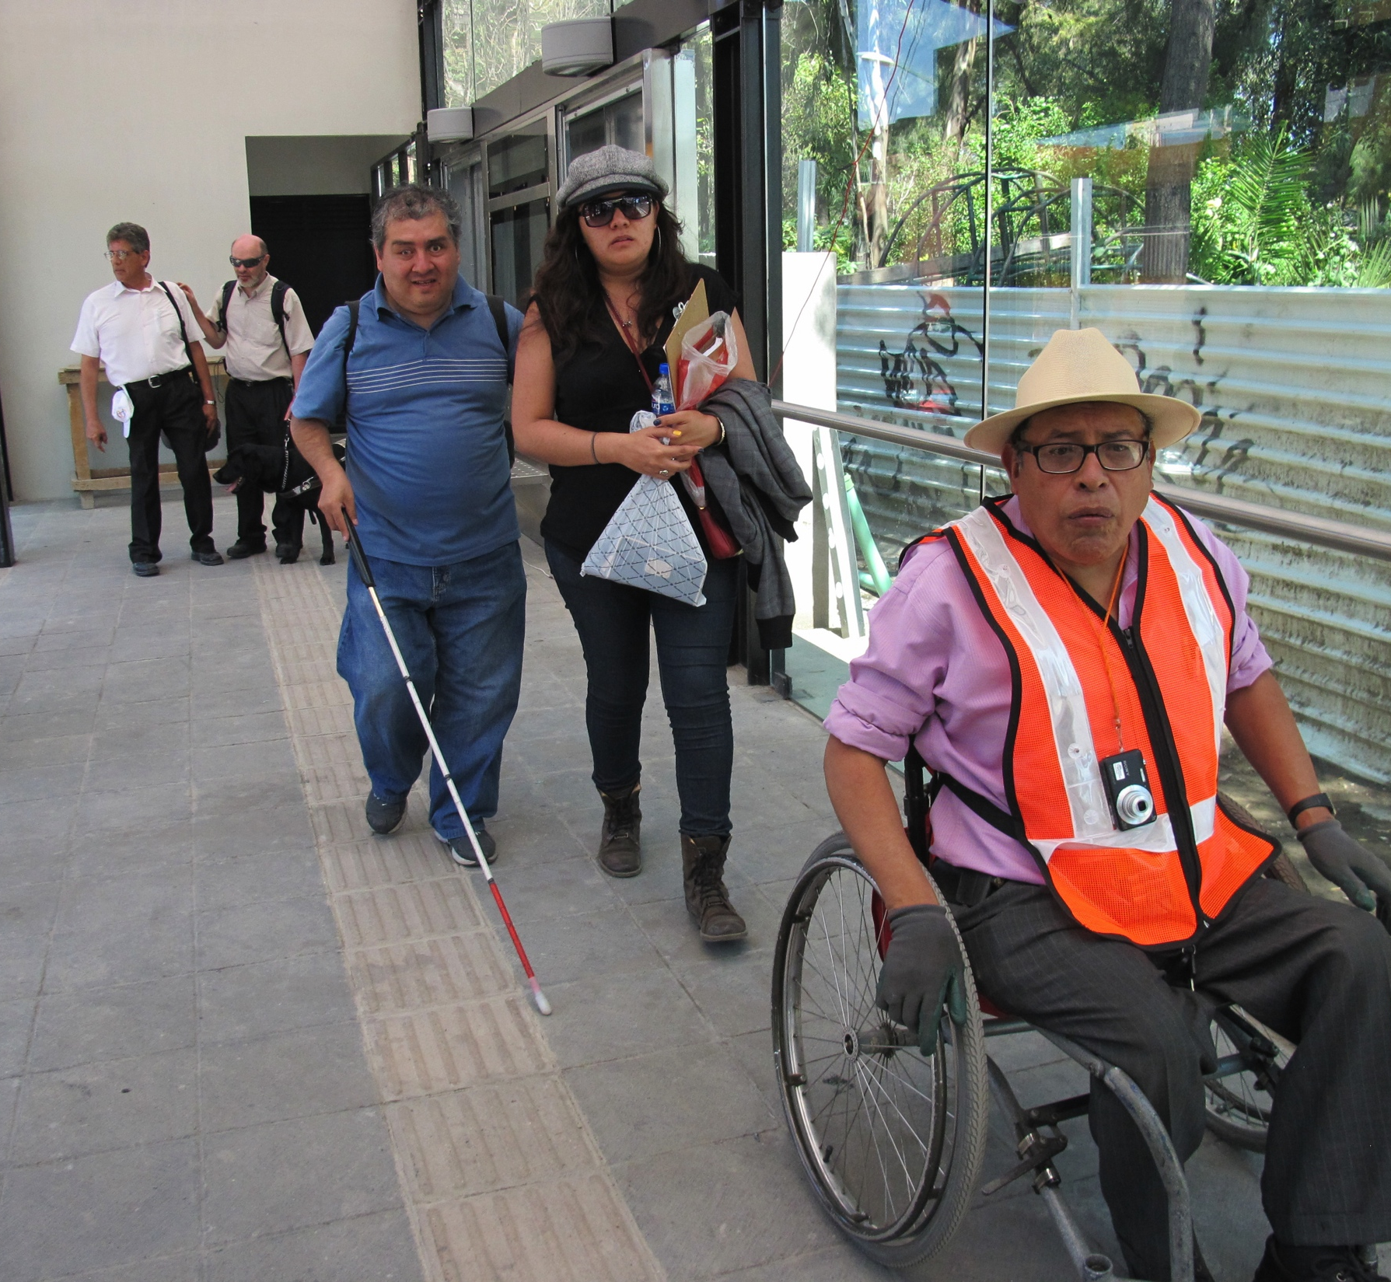

CHALLENGES
5. Disability group
6. Monitoring accessibility

Slide 6

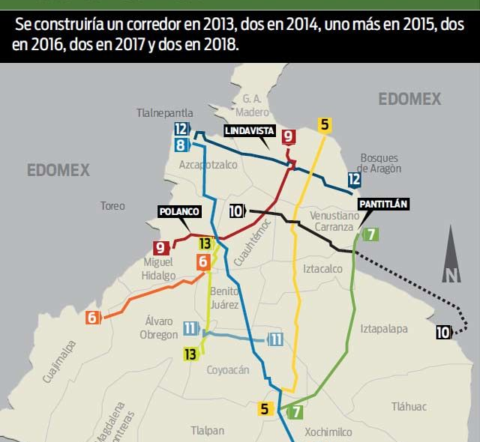
CHALLENGES
7. Policies and procedures
7. Integrated Accessible Transportation Plan

Slide 7

Source:
https://dribbble.com/shots/1567097-Bridging-The-Gap

