Slide 1


League of Historical and accessible cities
A European example of sustainable tourism and accessibility

Slide 2
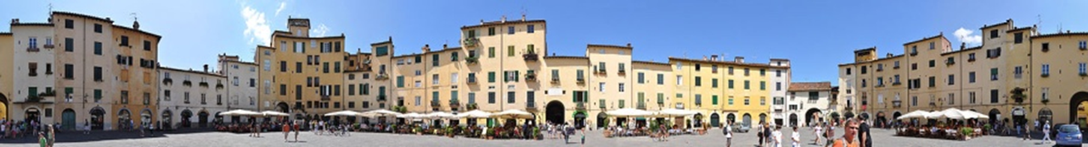
LHAC – League of Historical and Accessible Cities
WHAT?
11 foundations in 6 cities to implement a full accessible itinerary in the city center.
WHY?
To solve the issue: Heritage protection vs. Accessibility
To promote sustainable tourism for all
To inspire other entities and being an hub to exchange for good practices and know-how

Slide 3

LHAC – League of Historical and Accessible Cities
FOR WHOM? Accessible 4 All:
PwD, their family and friends, old people, pregnant women, travelers with heavy luggage, people with temporary injuries etc.
HOW?
Common strategy (external consulting by Vía Libre) and open perspective, space for creativity and innovation on the local level
Each foundation manages its own project and share successes, problems and challenges
Following the principles of universal design - holistic concept
https://www.youtube.com/watch?v=CToTZQOJUQA

Slide 4
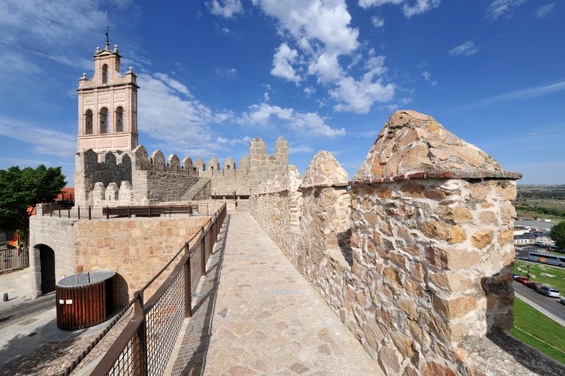
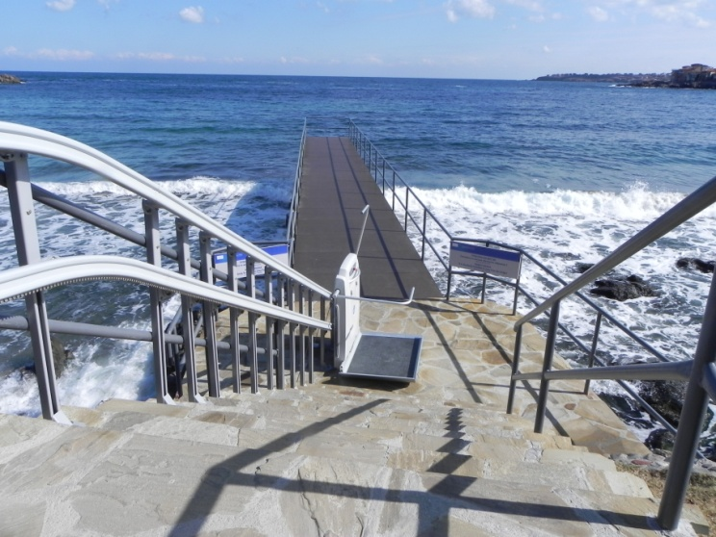
Network of Cities
AVILA – Spain
LUCCA – Italy
MULHOUSE – France
SOZOPOL – Bulgaria
TURIN – Italy
VIBORG – Denmark

Slide 5
Chronology
March – July 2010
General work plan and projects settings. Partners searching
Sept 2010 – Oct 2013
Oct 2013
Publication of the good practices guide
Site visits and peer-learning exchange
Project launch: 6 accessible itineraries in 6 historical cities
Dec 2014
Conference on accessibility
Sept 2010
Implementation of the itineraries in the 6 cities
2015-2016
Dissemination of results

Slide 6


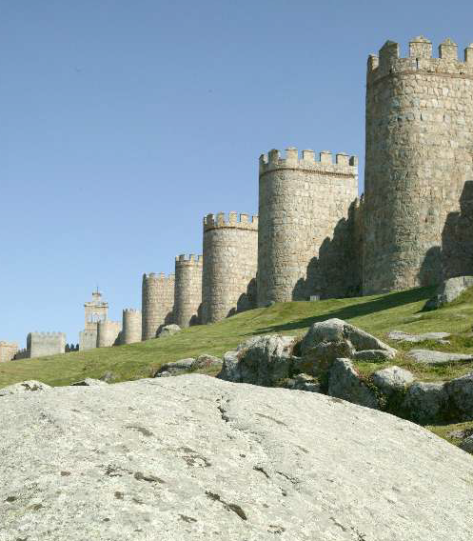
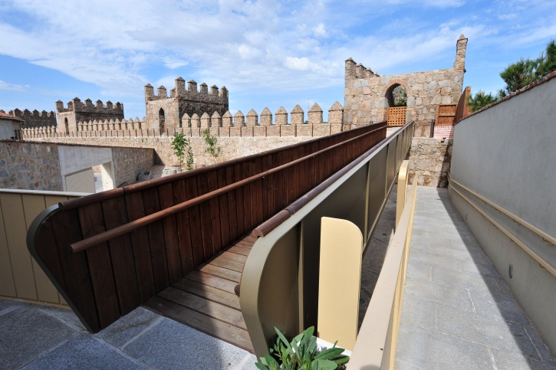
AVILA – España
ONCE Foundation
Ávila City Council
Awarded the most accessible city in 2011 by the European Commission

Slide 7

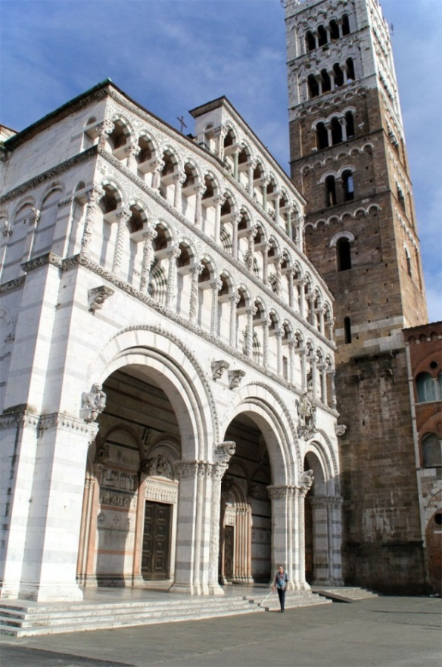

LUCCA - Italy
Banca del Monte di Lucca Foundation together with local associations that work in the field of disability, local authorities, experts and research center
Innovative technologies (smart cane)
Training Courses
► Interviews: https://www.youtube.com/watch?v=OUzvDzDCUcs
► Presentation: https://www.youtube.com/watch?v=ooMe0UqB25w
► Video: https://www.youtube.com/watch?v=8jOASITA8ho

Slide 8

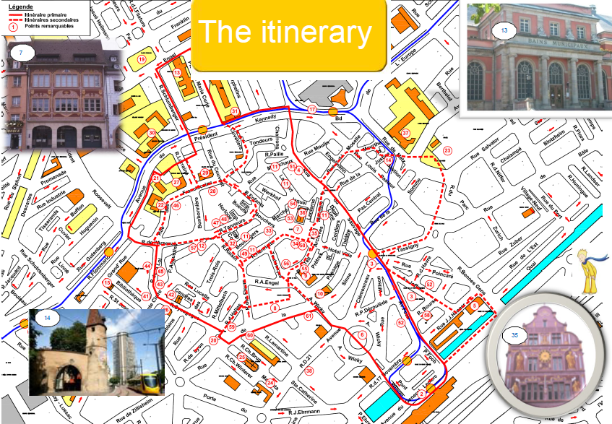



MULHOUSE – France
Reunica Foundation and a work team (foundations, local bodies, the Ministry of Culture, architects and associations of people with disabilities).
Methodology- the accessibility key (visual sign), maps of the city according to the different kinds of disability

Slide 9

SOZOPOL– Bulgaria
Sozopol Foundation has significant experience in development and implementation of projects related to providing access for people with disabilities to cultural heritage and natural sites.
Since 2003 has developed great expertise in the use of EU structural funds and realised a great number of projects.

Slide 10


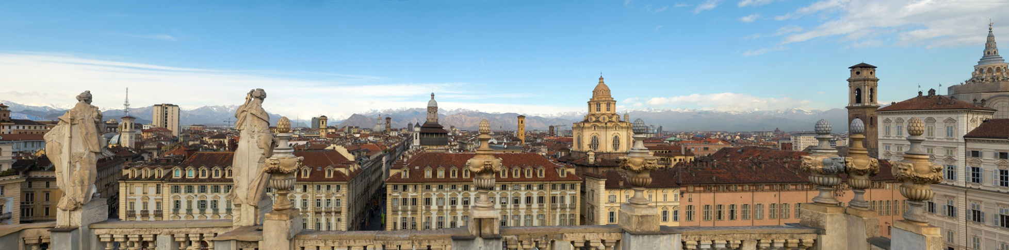
TURIN – Italy
2006 Paralympic Games in Turin:
the trigger for accessibility in the city
ToTo4All App:
4 accessibility settings (Mobility, Partially Sighted, Blind and Auditory).
A circular itinerary of 30 points of historical, cultural and artistic interest.
► Video TOTO4All: https://www.youtube.com/watch?v=1GW_v3IojsE&feature=youtu.be

Slide 11

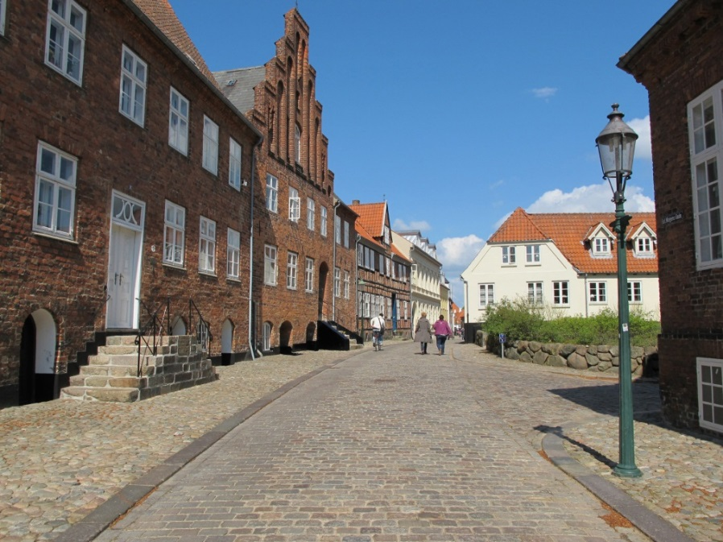



VIBORG - Denmark
Realdania Foundation has established a Consortium with other Danish foundations.
Contest Methodology:
1) Choosing the city
2) Choosing the most appropriate accessibility urban plan
http://www.youtube.com/watch?v=OuQT0sNKlhc

Slide 12
Innovative Aspects
New forms of collaboration between different actors at local/national/international level ,
Focus on beneficiaries - involved through their representative associations
Mutual learning as a way to overcome difficulties – LHAC as a hub for good practice and know-how exchange among the foundations and the cities involved in the project.
Holistic methodology to ensure all aspects of accessibility are faced and considered.
Customized and local-based solutions rather than global solutions - an open platform, encouraging participants to find the best suited approach to the city of their choice.
Innovative accessibility solutions and a methodology that can be disseminated and transferred.

Slide 13
LHAC – The numbers
7,300,000 Euros of total investment
245 Accessible Tourist offices and structures
112 Accessible sites of historical interest (museums, monuments, churches etc.)
11 Foundations
88 Organisations involved
92 Accessible urban public spaces (gardens, parks, squares, markets, etc.)
66 Accessible public buildings (libraries, schools, theatres, banks, post offices etc.)
50 Experts in accessibility and planning
46 NGOs and associations
44 Innovative technological tools and services improving the access to information implemented (smart cane, audio guides, cyber passes, tactile maps, websites, etc.)
15 Km length itineraries
6 Historical towns
5 Training courses delivered
1 Technical accessibility consultancy

Slide 14
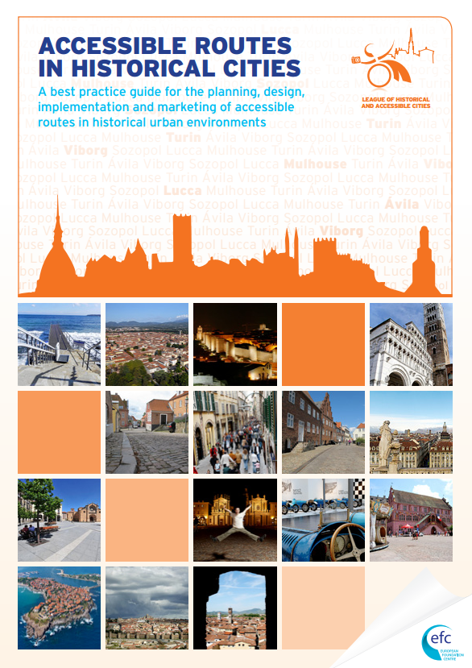
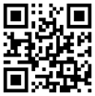
For further information visit our website: www.lhac.eu

