Slide 1
Mental Health, Well-being & Disability A New Priority in SDGs
Takashi Izutsu, Ph.D.
The University of Tokyo
Notes:
Thank you very much, Ambassador. It is great honour that I can work with you.
As a co-organizer, first of all, I would like to thank Ambassador Mateo for his continuous support, and the distinguished panelists, the secretariat of this event, esp. Akiko, Robert and Atsuro, and all the participants, for making this important event possible.
Thank you very much.
Today, I would like to briefly share the current global situation regarding mental health, well-being and disability.

Slide 2
Annual Number of Death
Million
Preventing Suicide, WHO. 2014; World Report on Violence and Health, WHO. 2002
Notes:
I would like to start with the annual number of death.
According to WHO, every year about 800,000 people die due to suicide.
This is equivalent to the number of death due to war and murder combined.
We have, for example, the security council and PKO for war, and police and judicial systems for murder.
However, many countries face extremely limited resources and system to respond to suicide and other mental health issues.

Slide 3
Facts
1 in 4 people will experience a mental health condition
Among adolescent girls, suicide is the leading cause of death
80% of persons with mental illness do not receive appropriate treatment in developing countries
Persons with severe mental illness die 20 years earlier
Depression is the leading cause of disability in YLD
Direct & indirect costs of mental illness exceed 4% of GDP
Mental Health Action Plan, WHO. 2013; World Report on Disability, WHO. 2011; Making Mental Health Count, OECD. 2014
Notes:
The WHO states that 1 out of 4 people will experience a mental health condition at least once in their life time.
Suicide is the 3rd cause of death among adolescents, and among adolescent girls, suicide is the leading cause of death.
In developing countries, 80% of persons with severe mental illness do not receive appropriate treatment.
Though there are misunderstandings that mental health is not related to death, according to OECD, persons with severe mental illness die 20 years earlier.
The Global burden of disease study shows that depression is the leading cause of disability in the years lived with disability indicator.
And the Economic cost is huge; Direct and indirect costs of mental illness exceeds 4% of GDP

Slide 4
Budget Allocation for Mental Health in Health
Mental Health Atlas, 2011, WHO 2011
Notes:
Despite these facts, situation around mental health and disability has been quite challenging.
For example, the budget allocation for mental health in national health budget has been quite low.
Among low income countries, only 0.5% of the health budget is spent for mental health.

Slide 5
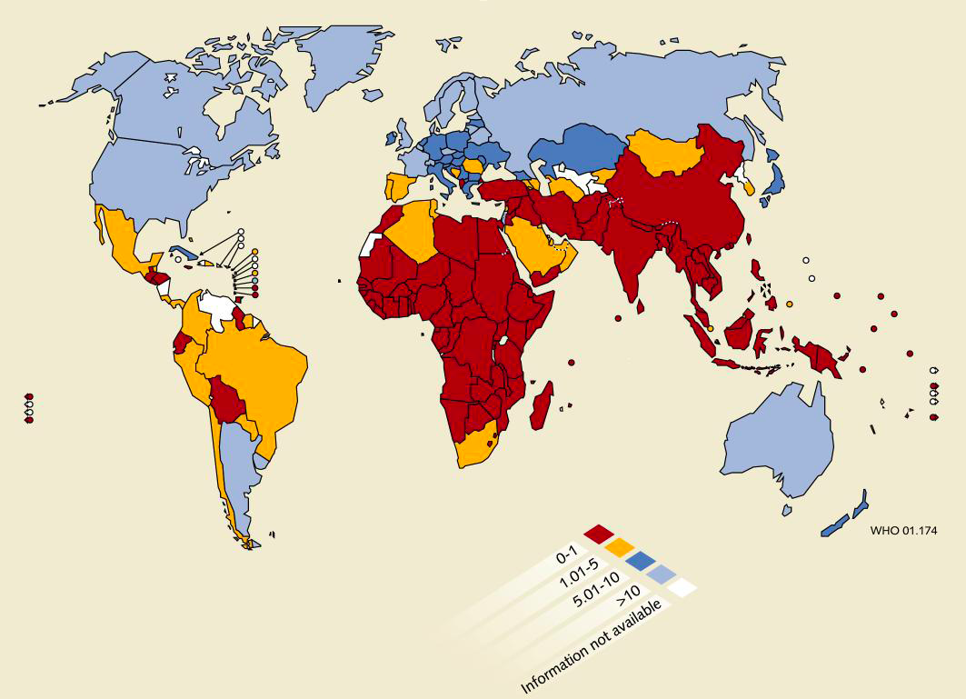
Number of Psychiatrists
WHO 2011
No psychiatrist in 40 countries
Notes:
Human resources for mental health and disability has been also extremely limited.
Taking psychiatrist as an example, WHO says about 40 countries do not have any psychiatrists.
Social workers, community workers and human rights advocates are also much lacking.

Slide 6
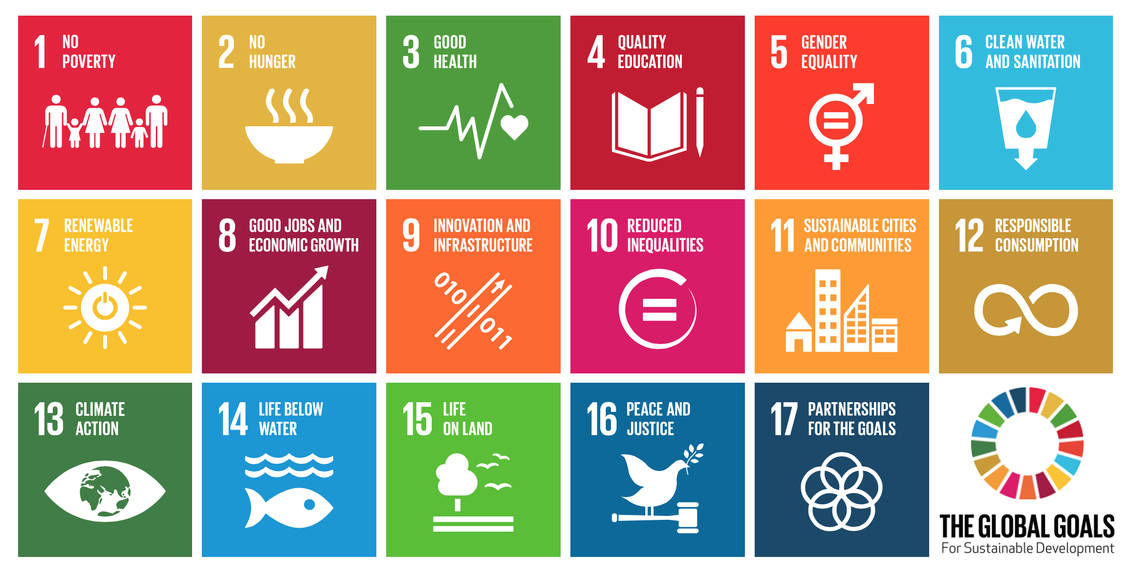
Sustainable Development Goals (UN、2015)
Goal: 2030
Notes:
Though mental health, well-being and disability have long been marginalized or ostracized in the international community despite its huge impact on our lives,
it is drastically changing this year, 2015, `since mental health and disability are included in the Sustainable Development Goals SDGs.
This is a big achievement accomplished by persistent and strong efforts by member states, UN system, NGOs, academia and many people including persons with disabilities and their families worldwide.

Slide 7
Sustainable Development Goals (SDGs) (UN, 2015)
Goal 3. Healthy lives & promote well-being for all at all ages
3.1 Reduce maternal mortality ratio
3.2 End preventable deaths of newborns & children under 5 3.3 End epidemics of AIDS, TB, malaria & communicable dx
3.4 Reduce mortality from non-communicable diseases and
promote mental health and well-being
3.5 Strengthen prevention & treatment of substance abuse
3.6 Halve global deaths & injuries from road traffic accidents
3.7 Ensure universal access to SRH
3.8 Achieve UHC
3.9 Reduce deaths from hazardous chemicals and pollution
Notes:
Mental health and well-being is included in the Goal 3 of the SDGs, which is on good health.
Among 9 health targets, Target 3.4 is on “Reducing mortality from NCD and promote mental health and well-being”
In addition, Prevention and treatment of substance abuse is included in Target 3.5.
Further, disability is included in 5 Goals in the SDGs.

Slide 8
World Conference on Disaster Risk Reduction Sendai Framework for DRR (UN, 2015)
Priority 4: Enhancing disaster preparedness for effective response, and to ‘Build Back Better’ in recovery, rehabilitation and reconstruction.
33 (o) To enhance recovery schemes to provide psychosocial support and mental health services for all people in need
(C) UN
Notes:
In addition to the SDGs, this year, mental health and disability were integrated into another important global framework.
The Sendai Framework for DRR 2015-2030 adopted at the World Conference on DRR WCDRR includes “provision of psychosocial support and mental health service for all people in need” as part of a priority.

Slide 9
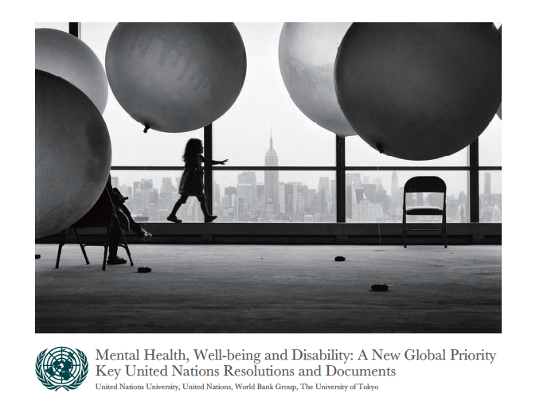
Mental Health, Well-being and Disability: A New Global Priority: Key UN Resolutions and Documents (UTokyo, 2015)
Comprehensive Mental Health Action Plan 2013-2020
(WHO, 2014)
IASC Guidelines on Mental Health and
Psychosocial Support in Emergency Settings
(IASC, 2007)
Mental Health Gap Action Programme (WHO, 2010)
mhGAP Humanitarian Intervention Guide (WHO, 2015)
Psychological First Aid: Guide for Field Workers (WHO et. al., 2011)
Notes:
The SDGs and the Sendai Framework, together with CRPD, have finally shed light on this neglected but critically important area at the global level.
And various stakeholders are now getting together for action to realize mental well-being and inclusion for all.
There are useful tools and guidelines developed by the UN system which can be utilized in this efforts, and all of them are available through internet.
Finally mental health, well-being and disability became a global priority.
I hope we can continue our collective efforts, hand in hand, to achieve our common goal of well-being, accessibility and inclusion. Thank you very much.

