Slide 1
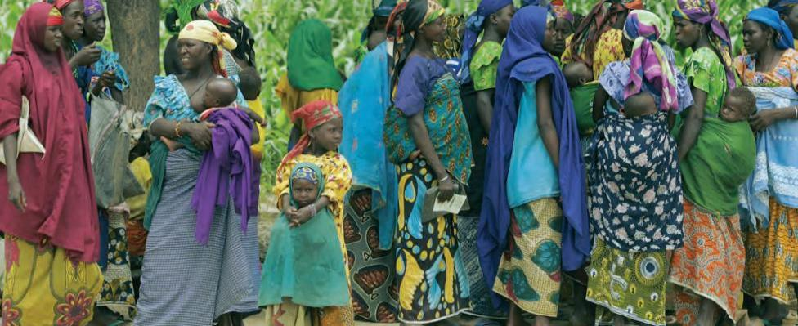
Global Mental Health, Well-being & Disability
A New Priority in SDGs and beyond
Atsuro Tsutsumi, Ph.D., United Nations University
Takashi Izutsu, Ph.D., World Bank Group
Akiko Ito, United Nations
Notes:
Thank you, XX.
I would like to talk about current states of mental health, mental well-being and disability as a new priority in SDGs and beyond.

Slide 2
Number of Death / Year
World Health Report, WHO 2001; World Report on Violence and Health, WHO 2002
Notes:
First, I would like to start with a shocking number.
Annual suicide death is about 1 million.
War related death is about a third of suicide death, and murder related death is about half.
In our world, suicide death is higher than death related to war and murder combined.
We have security council and PKO, or military in countries for war, and countries have police and law enforcement system.
However, do we have system for suicide prevention?

Slide 3
Number of Death / Year
Suicide is
the leading cause of death among
young girls
in the world.
World AIDS Day Report 2011, UNAIDS 2011; World Malaria Report 2012, WHO 2012; Maternal Death Surveillance and Response: Technical Guidance, WHO 2013; World Health Report 2001, WHO 2001
Notes:
This is another comparison of suicide death with MDG priorities.
Comparing with AIDS, malaria, and maternal mortality, suicide prevention should be more prioritized.
Globally, suicide is the leading cause of death among young girls.

Slide 4

Facts
1 / 2 will experience mental ill-health in their life
1 / 5 @ primary health care settings have a mental disorder
80% of persons with serious mental disorders in developing countries do not receive appropriate treatment
Persons with severe mental disorders die 20 years earlier
Persons with mental or intellectual disabilties often experience severe human rights violations
Depression is the leading cause of disabilities (YLD)
Direct + indirect cost of
mental ill-health > 4% of GDP
World Health Report 2001, WHO 2001; World Report on Disability, WHO 2011; Making Mental Health Count, OECD 2014
Notes:
Now I would like to share some facts related to mental well-being and disability.
According to OECD, 1 out of 2 people experience mental illness in their lives.
And 1 out of 5 patients who visit primary health care settings have a mental disorder.
This means health workers on the ground have a huge pressure of treating mental disorders in many cases without being provided training, system to support, or essential drugs.
As a result, about 80% of persons with mental disorders in developing countries do not receive appropriate treatment.
And these people with severe mental disorders die 20 years earlier than those without such conditions.
These persons with mental or intellectual disabilities often face severe human rights violations such as abuse or sexual violence, forced sterilization, or even murder.
Though persons with mental or intellectual disabilities are often neglected, for instance, depression is the leading cause of disabilities according to the years lived with disabilities statistics.
Lastly, the economic impact of not addressing issues related to mental health is huge: direct and indirect cost of mental ill-health is more than 4% of GDP,

Slide 5
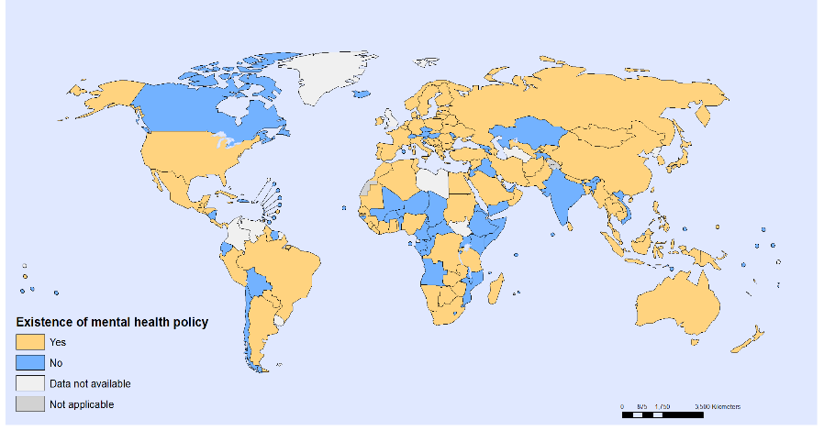
Countries without Mental Health Policy
Global Health Observatory WHO 2014
Notes:
Countries in blue do not have mental health policy.
About half of countries do not have mental health policies in the world.

Slide 6
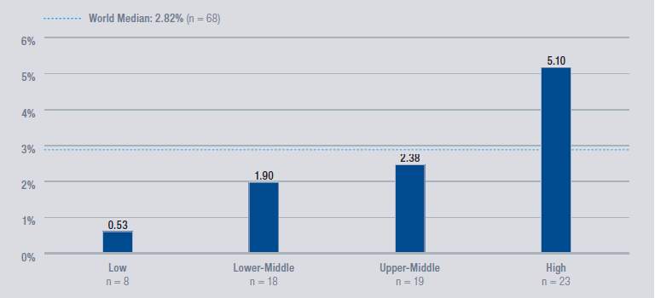
Budget Allocation for Mental Health in Health
Mental Health Atlas, 2011, WHO 2011
Notes:
Budget allocation for mental health within national health budget tend to be very low.
Among low income countries, less than 1% is allocated for mental health, and even among lower-middle and upper-middle income countries, mental health is only about 2% of the health budget which is way too small.

Slide 7
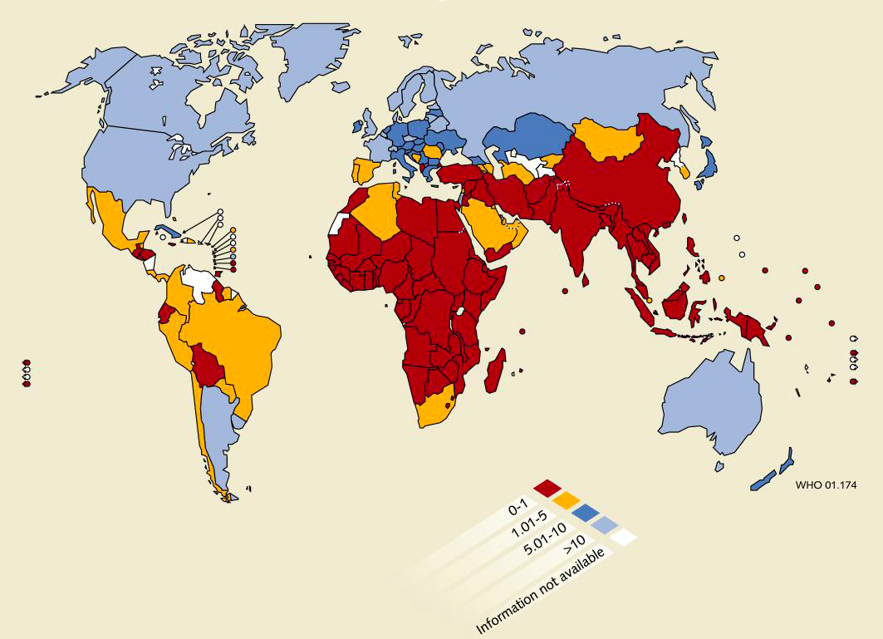
Number of Psychiatrists
WHO 2011
No psychiatrist in 40 countries
Notes:
This figure shows the number of psychiatrists. Countries in red have less than 1 psychiatrist in 100, 000 people.
40 countries do not have any psychiatrist.

Slide 8
Past UN Efforts on
Mental Well-being & Disabilities 1
WHO Constitution (UN, 1946): Definition of Health
Int’l Covenant on Economic, Social and Cultural Rights (ICESCR) (UN, 1966): Definition of Right to Health
The Declarations on the Rights of Mentally Retarded Persons
(UN, 1971)
The Principles for the Protection of Persons with Mental Illness and the Improvement of Mental Health Care (UN, 1991)
Convention on the Rights of Persons with Disabilities (UN, 2006) (incl. “ … mental and intellectual impairments”)
Notes:
For the issues related to mental well-being and disability, UN system has made several important efforts in the past.
For example, the WHO Constitution which defined “health” stated health is a state of physical, mental and social well-being.
Similarly, the international Covenant on Economic, Social and Cultural Rights/ICESCR which is one of the most important human rights tools defined right to health as right to physical and Mental health.

Slide 9
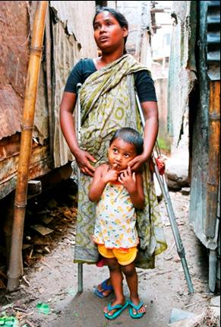
Right to Health
UN International Covenant on Economic, Social and Cultural Rights（ICESCR） (1966)
“It is the right of everyone,
to enjoy the highest attainable
standard of physical and
mental health” (Right to Health)
Definition of Right to Health
also includes Mental Health
Notes:
So when we talk about right to health, right to mental health should be always included.

Slide 10
Past UN Efforts on
Mental Well-being & Disabilities 1
WHO Constitution (UN, 1946): Definition of Health
Int’l Covenant on Economic, Social and Cultural Rights (ICESCR) (UN, 1966): Definition of Right to Health
The Declaration on the Rights of Mentally Retarded Persons
(UN, 1971)
The Principles for the Protection of Persons with Mental Illness and the Improvement of Mental Health Care (UN, 1991)
Convention on the Rights of Persons with Disabilities (UN, 2006) (incl. “ … mental and intellectual impairments”)
Notes:
Then the UN General Assembly adopted “declaration on the rights of mentally retarded persons” in 1971 and “the principles for the protection of persons with mental illness and the improvement of mental health care” in 1991.
These made significant steps forward in the international community, however, at the same time, since it has been a long time since they were adopted, some concepts in these are outdated.
Then, in 2006, CRPD was adopted which includs mental and intellectual impairments.

Slide 11
Past UN Efforts on
Mental Well-being & Disabilities 2
IASC Guildelines on Mental Health & Psychosocial Support in Emergency Settings (IASC, 2007) (OCHA, UNICEF, UNHCR, UNFPA, WFP, WHO + NGOs + UNESCO)
UN-WHO Policy Analysis on Mental Health & Development (2010)
World Autism Awareness Day, World Down Syndrome Day (2007, 11)
UN Expert Group Meeting on Mental Well-being, Disability & Development (2013)
UN High-level Meeting on Disability and Development (2013)
UN Expert Group Meeting on Mental Well-being, Disability & Disaster Risk Reduction (2014)
Post-2015 Agenda + UN High-level Meeting on Mental Health??
+ World Bank Int’l Conference on Mental Health 2015
Notes:
In 2007, key humanitarian response actors got together under UNOCHA’s leadership with WHO’s technical guidance, and the IASC Guidelines on Mental Health & Psychosocial Support in Emergency Settings was published as an outcome of UN – NGO collaboration and coordination.
In 2010, UN DESA and WHO jointly issued the policy analysis on mental health and development which set foundation to include mental well-being and disability in the development agenda.
General assembly adopted the World Autism Awareness day in 2007 and the World Down Syndrome Day in 2011 which made a significant contribution to awareness raising.
Last year, UN DESA, UNU and partners facilitated the UN Expert Group Meeting on Mental Well-being, Disability & Development which recommended to include mental well-being and disability in the post 2015 development framework.
In 2013, the UN High-level meeting on disability and development was also held in NY at the head of state level.
And last week, UN DESA, UNU and partners held another Expert Group Meeting, UN EGM on Mental well-being, disability and DISASTER RISK REDUCTION.
Based on these efforts, now the international community is discussing integration of mental well-being and disability in the post 2015 agenda, as well as a possibility of the UN high level meeting on mental health. The world bank group is planning to hold an international conference on mental health next year.

Slide 12
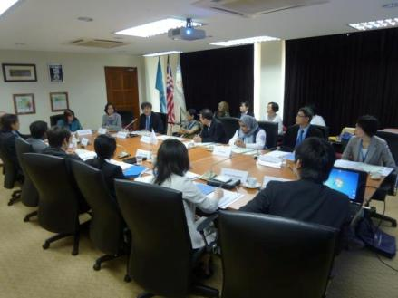
United Nations Expert Group Meeting on Mental Well-being, Disability and Development (2013)
1st UN Expert Group Meeting on mental well-being & disability in the UN history
Recommended (1) integration of mental well-being into all development efforts as a key indicator for sustainable development, (2) Strengthening protection & promotion of rights of persons with mental or intellectual disabilities as a key priority.
Notes:
The UN EGM on Mental well-being, disability and development was the 1st in kind in the UN history.
The EGM recommended 2 key messages.
First, importance to integrate mental wellbeing into all development efforts as a key indicator for sustainable development, especially post-2015 development agenda.
Secondly, the expert group recommended to strengthen protection and promotion of rights of persons with mental or intellectual disabilities.

Slide 13
United Nations Expert Group Meeting on Mental Well-being, Disability and Disaster Risk Reduction (2014)
Recommended to
(1) Recognize mental well-being & disability as priority in DRR
(2) Include “mental well-being to optimize resilience” in HFA2
(3) Include mental disabilities in all disability-inclusive DRR
(4) Develop guidelines on mental well-being/disability in DRR
(5) Establish multi-stakeholder focus group on mental well-being/disability in DRR
Notes:
The expert group on mental well-being and disability, and disaster risk reduction was held as a process to prepare for the world conference on disaster risk reduction planned in 2015 in Sendai.
The expert group recommended to:
First, recognize mental well-being and disability as a priority in DRR
Second, include mental well-being to optimize resilience in hyogo framework for action 2
Third, include mental or intellectual disabilities in all the disability-inclusive DRR
Fourth, develop global guidelines on mental well-being and disability in DRR
Lastly, to establish a multi-stakeholder focus group on mental well-being and disability in the UN system

Slide 14
Toward the Post-2015 Development Agenda
“There is emerging consensus that the post-2015 agenda should
address … the emerging burden of NCD, including mental health,
and injuries” (WHO & WB, 2014)
Proposed Targets for a Health-related Post-2015 Goal (SDGs):
1. Reduce maternal mortality
2. End newborn/<5 child deaths
3. End AIDS, tuberculosis, malaria & other communicable D. epidemic
4. Reduce NCD and promote mental health & well-being
5. Strengthen substance abuse prevention & tx.
6. Halve injuries from traffic accident
7. SRH
8. UHC
9. Reduce deaths & illnesses from pollution
Notes:
IN the discussion to develop post-2015 development agenda, there has been emerging consnsus that the post-2015 agenda should include mental well-being and disability.
As a result, the proposed targets for SDGs by Open working group includes:
“reduce noncommunicable diseases and promote mental health & well-being” as well as “strengthen substance abuse prevention and treatment” in its draft.

Slide 15
The Way Forward
Mental health/well-being as part of SDGs : Prepare for implementation
Integrate mental health/well-being into other development priorities, too (Disaster Risk Reduction: HFA2, etc.)
Do not leave behind rights of persons with mental or intellectual disabilities in disability-inclusive development
Develop multi-stakeholder working group in the UN system and develop guidelines as well as monitoring mechanism (indicators/SG report?)
Scale up knowledge sharing (both success & failure) among countries and capacity building.
Notes:
So now, the way forward
Mental health and well-being is currently included in the draft SDGs. We need to ensure it will be included in the final SDGs, and we need to start preparing for its implementation.
IN addition, it is very important to include mental well-being & disability in other development priorities too such as hyogo framework for action 2.
Further it is necessary to take measures not to leave rights of persons with mental or intellectual disabilities behind in all the disability-inclusive development efforts.
And it would be very useful to develop a multi-stakeholder working group on mental well-being and disability in the UN system and develop guidelines as well as monitoring mechanism.
For that, we need to scale up knowledge sharing regarding successes and failures to learn from other countries’ experiences.

Slide 16


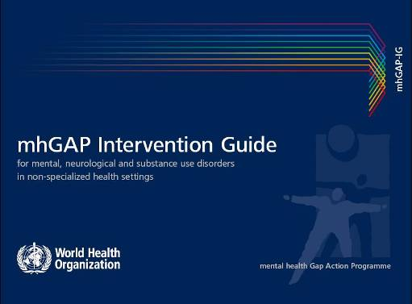


Global Resources
Mental Health Action Plan 2013-2020
(WHO, 2014)
IASC Guidelines on Mental Health and
Psychosocial Support in Emergency Settings
(IASC, 2007)
Mental Health Gap Action Programme
(WHO, 2010)
Psychological First Aid: Guide for Field Workers (WHO et. al., 2011)
Outcome Document of UN Expert Group Meeting on Mental Well-being, Disability and Development (UN, UNU, 2013)
Notes:
There are already solution packages which you can download from webcites.
I hope we can now get together and start working on promotion of mental well-being and disability as a key priority in sustainable development.

Slide 17

Thank you
Notes:
thankyou

