Slide 1
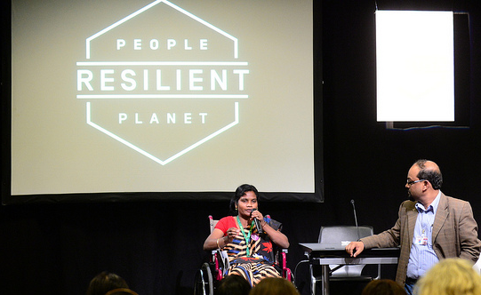

INTERNATIONAL DAY OF PERSONS WITH DISABILITIES 2014
Inclusion Saves Lives

Slide 2
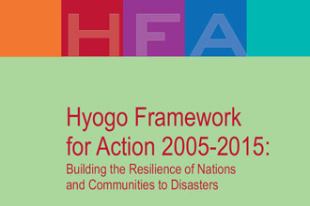
UNISDR and the Hyogo Framework for Action

Slide 3
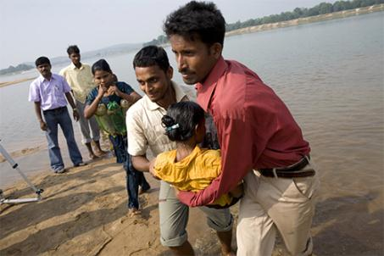
Disasters and Disabilities
Persons with disabilities are highly exposed to disasters
The death rate of persons with disabilities in the 2011 Great East Japan Earthquake and Tsunami was more than double the rate of the entire population
The earthquake in
Haiti in 2010
disproportionally
affected persons with
disabilities
Studies after Hurricane Katrina found that approximately one-third of those who did not leave their homes during the disaster had a disability.
© Benoit Marquet/Handicap International

Slide 4
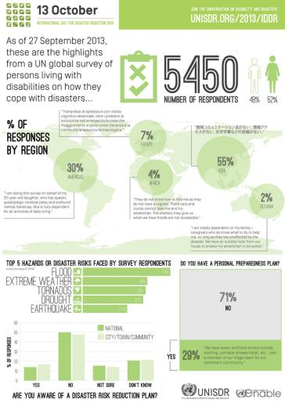
Last year, in occasion of the International Day for Disaster Risk Reduction, UNISDR run the first-ever UN global survey on persons living with disabilities and how they cope with disasters.
5,717 people from 137 countries
took the survey, helping UNISDR
to understand and address their needs.
Evacuation challenge:
- hearing (39%)
- seeing (54%),
- walking or climbing steps (68%)
- communicating (45%)

Slide 5
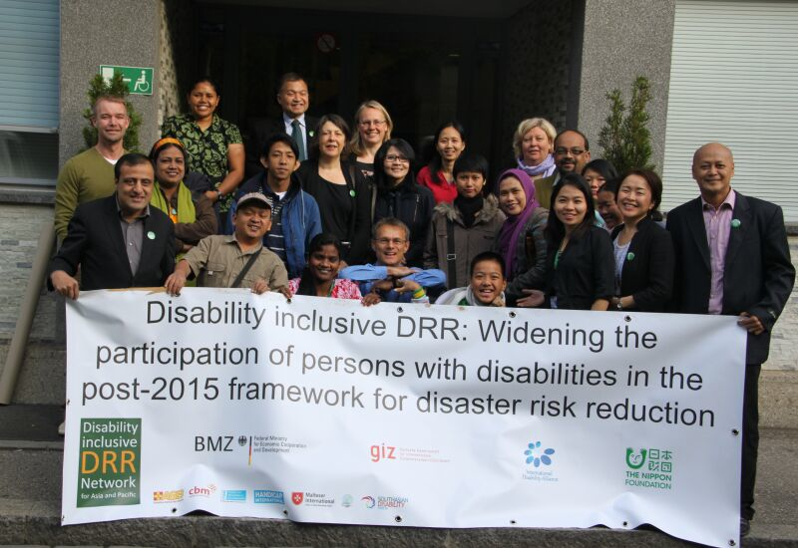
The needs of persons with disabilities should be included in disaster risk reduction planning at the community, national, and international level

Slide 6
These challenges could be overcome with new technologies.
Early warning systems & Communication
Portable light-emitting warning device
Wristwatch-type vibrating terminal
Smartphones
Text/emails
Video/audio/phones
Notes:
The light-emitting device is a system which alerts you in emergency situations. Lights can be of different colors according to the type of emergency.
Similar to the light, the watch alerts you by vibrating.
Smartphone’s applications have been developed to detect earthquakes. When a earthquake is about to strike, the app alerts you by ringing, vibrating or texting.
When available, send a text or email to communicate your position. Vocal messages can be sent by blind people.

Slide 7

Third World Conference on Disaster Risk Reduction
UNISDR is promoting the inclusion of knowledge and experiences of persons with disabilities at the Third World Conference on Disaster Risk Reduction, Sendai 14-18 March 2015.

Slide 8
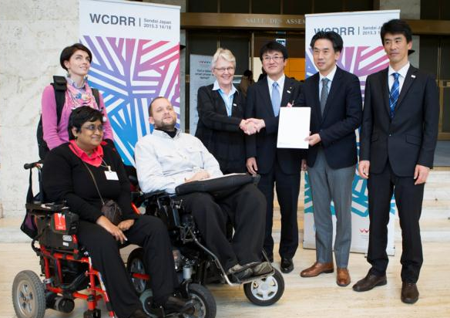
UNISDR and the Nippon Foundation signed an agreement on 18 November 2014 that will make the 3rd UN World Conference on Disaster Risk Reduction (WCDRR) accessible and inclusive for persons with disabilities.
The agreement will provide real-time captioning in English and Japanese and international or Japanese sign language interpretation for various sessions of the conference.
Accessibility will be prioritized for conference venues, transportations and accommodations.

Slide 9
In Sendai - Accessibility at the WCDRR
In accordance with the Convention on the Rights of Persons with Disabilities, reasonable accommodation will be provided for persons with disabilities.
Substantive accessibility
  - Disability inclusive sessions
  - Disability caucus identified as an “other important stakeholder group”
Information accessibility
  - Provide conference background & outcome documents in accessible format
  - Emergency evacuation manual to be in accessible format
  - Remote participation by persons unable to travel
  - Obtain AA rating for website from an independent audit
Physical accessibility
  - Accessible venues to ensure active participation
  - Closed captioning to be provided for key sessions
  - Logistical arrangements for travel of persons with disabilities

Slide 10

Provisional Programme
Resilient People. Resilient Planet

Slide 11
Thank you
See you in Sendai
www.wcdrr.org
palm@un.org

