Slide 1
Mental Well-being and Disability: Toward Accessible and Inclusive Sustainable Development Goals
Harry Minas
Head, Global and Cultural Mental Health Unit Centre for Mental Health
Melbourne School of Population and Global Health
UN New York
2 December 2014

Slide 2
Mental Disorders
Disability

Slide 3
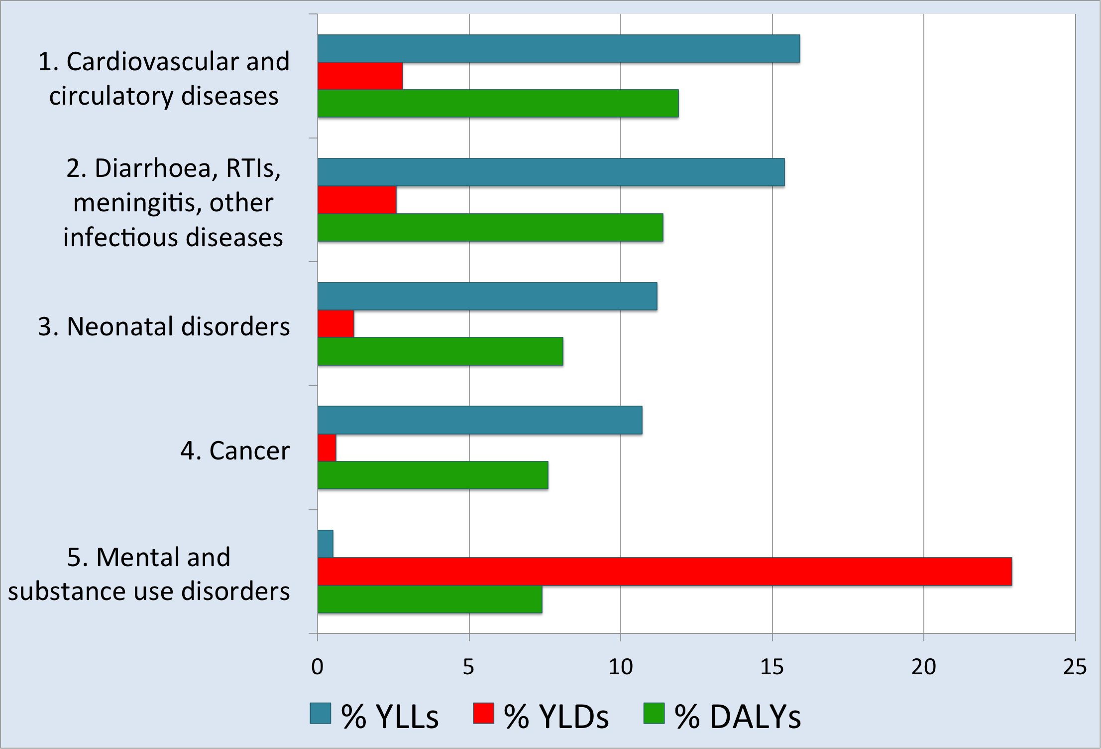

Slide 4
Why invest in mental health & disability?
The World Economic Forum estimates that chronic disease will cost the global economy more than US$47 trillion between 2010 and 2030.
One third (US$16 trillion) is attributed to mental disorders.
Most of this cost is due to persistent disability – direct treatment and social care and lost productivity
Reducing premature mortality and disability from mental disorders by one third would save approximately US$5 trillion over 20 years.

Slide 5
Mental Disorders
Disability
Non-Communicable
Disorders
Poverty

Slide 6
Mental Disorders
WHO Mental Health Action Plan
Disability
CRPD and
WHO Disability Action Plan
WHO NCDs
Action Plan
Non-Communicable
Disorders
UN SDGs
Poverty

Slide 7
Mental Disorders
WHO Mental Health Action Plan
Disability
CRPD and
WHO Disability Action Plan
Governance
Investment
Leadership
Evidence
WHO NCDs
Action Plan
Non-Communicable
Disorders
Mental Health Target
UN SDGs
Poverty

Slide 8
APEC Health Asia Pacific 2020 strategy
“Recognizing that health is central to development;
that it is a prerequisite for, an outcome of, and
effective indicator of sustainable development;
that health and health equity are integral to public policies of all sectors; that the value of
health capital in an economy dwarfs any other
form of capital…”
APEC Roadmap to Promote Mental Wellness
in a Healthy Asia Pacific (2014-2020)

Slide 9
Mental Health System
Development in Vietnam
Initiatives in:
- Governance
- Investment
- Leadership
- Evidence
Mental Disorders
National Mental Health
Strategy 2015-2020 (vision to 2030)
WHO Mental Health Action Plan
National Strategy for Prevention
and Control of NCDs 2014-2020
Disability
CRPD and
WHO Disability Action Plan
Governance
Investment
Leadership
Evidence
WHO NCDs
Action Plan
Non-Communicable
Disorders
Convention on the Rights of Persons with Disabilities (CRPD) ratified by the National Assembly
28 November 2014
Mental Health Target
UN SDGs
Health Information System Development Strategic Plan 2014
National survey of mental health and social care facilities/services
Annual burden of disease estimates
Poverty

Slide 10
The Asia Pacific Region is ready to act on a clear SDG mental health target… (as several regions are)
Regional organisations
Asia Pacific Economic Cooperation Forum
Association of South-East Asian Nations
National governments
Sub-national governments
A clear mental health target will focus, expand and accelerate such action

Slide 11
Open Working Group
Goal 3: Ensure healthy lives and promote well-being for all at all ages
Target 3.4
By 2030 reduce by one-third premature mortality from non-communicable diseases (NCDs) through prevention and treatment, and promote mental health and wellbeing.
Suggested revision of Target 3.4
By 2030 reduce by one-third premature mortality and disability from non-communicable diseases (including mental disorders), through promotion, prevention, treatment, rehabilitation and social care, and protection of human rights.

Slide 12
www.FundaMentalSDG.org
Target
‘The provision of mental and physical health and social care services for people with mental disorders, in parity with resources for services addressing physical health.’
Indicators
1) To ensure that service coverage for people with severe mental disorders in each country will have increased to at least 20% by 2020 (including a community orientated package of interventions for people with psychosis; bipolar affective disorder; or moderate-severe depression).
2) To increase the amount invested in mental health to at least 5% of the total health budget by 2020, and to at least 10% by 2030 in each low and middle income country.

Slide 13
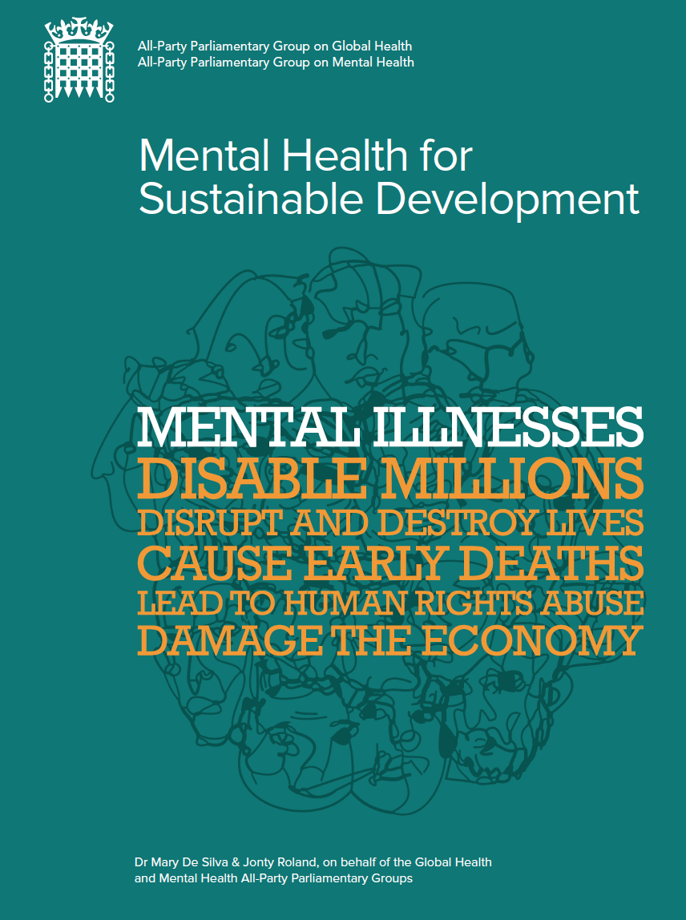
The proposed FundaMentalSDG target has been adopted by the UK All-Party Parliamentary Group on Mental Health as Recommendation 4 in its report (November 2014)

Slide 14
Lesson from the MDGs
Increased political
attention and commitment
More coherent, collaborative and focused action by:
Governments
Service providers
Persons with mental disorder
Civil society organisations
Educators
Researchers
Multi- and Bilateral Donors / Aid Agencies
Major Philanthropic Agencies
Clear focus on measuring
and achieving the target
Mental Health
SDG Target
and Indicators
Increased investment – from all sources
More coherent program of work
Focus for collaborative action across sectors, stakeholders

Slide 15
Two Possible Mental Health Targets
Revised 3.4
By 2030 reduce by one-third premature mortality and disability from non-communicable diseases (including mental disorders) through promotion, prevention, treatment, rehabilitation and social care, and protection of human rights.
FundaMentalSDG
Provide mental and physical health and social care services for people with mental disorders, in parity with resources for services addressing physical health.

Slide 16
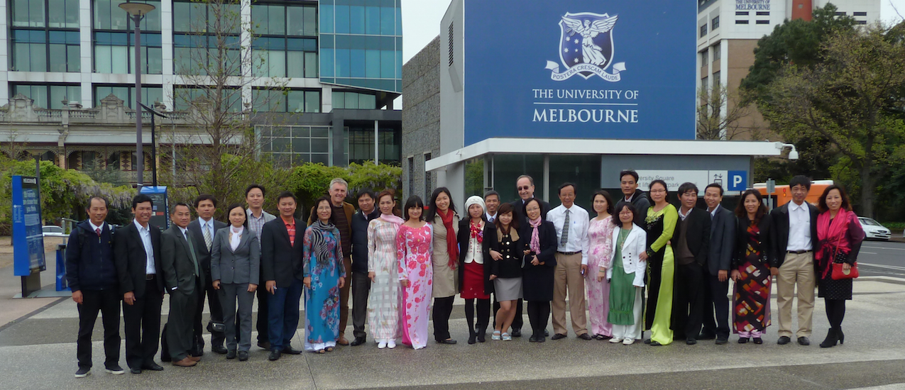
Thank you for your attention Harry Minas h.minas@unimelb.edu.au

