Slide 1
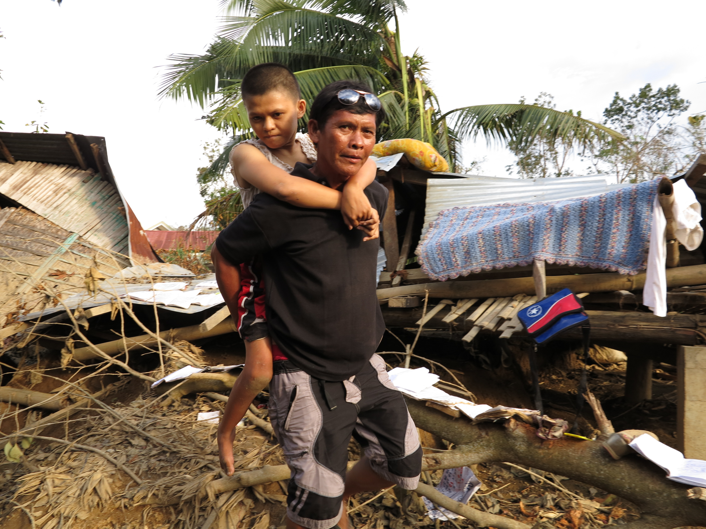
The promise of technology, DRR and persons with disabilities
Dr. Elizabeth Lockwood
CBM International
December 3, 2014
Notes:
All photos are CBM’s from Emergency Responses in Pakistan (2011) flood (Sanghar City, Sindh) and the Philippines (2013) Typhoon Haiyan

Slide 2
Inclusive emergency response
Notes:
When disasters/conflicts happen, CBM, with our partners, can identify people living with disabilities among the affected population and meet their immediate needs of food, water, shelter and healthcare.
After the initial emergency response, CBM remains in the affected area to support, plan and develop long-term programmes that promote the inclusion of persons with disabilities into all aspects of community life such as:
Access to education and vocational training.
Advocacy to ensure the voices of persons living with disabilities are heard and their needs are acted upon in planning and reconstruction.
Caption: Members of CBM Emergency Response Unit in the Philippines after Typhoon Haiyan, being shown the database used to map most at-risk families and link them with mainstream services. © CBM/John Javellana

Slide 3
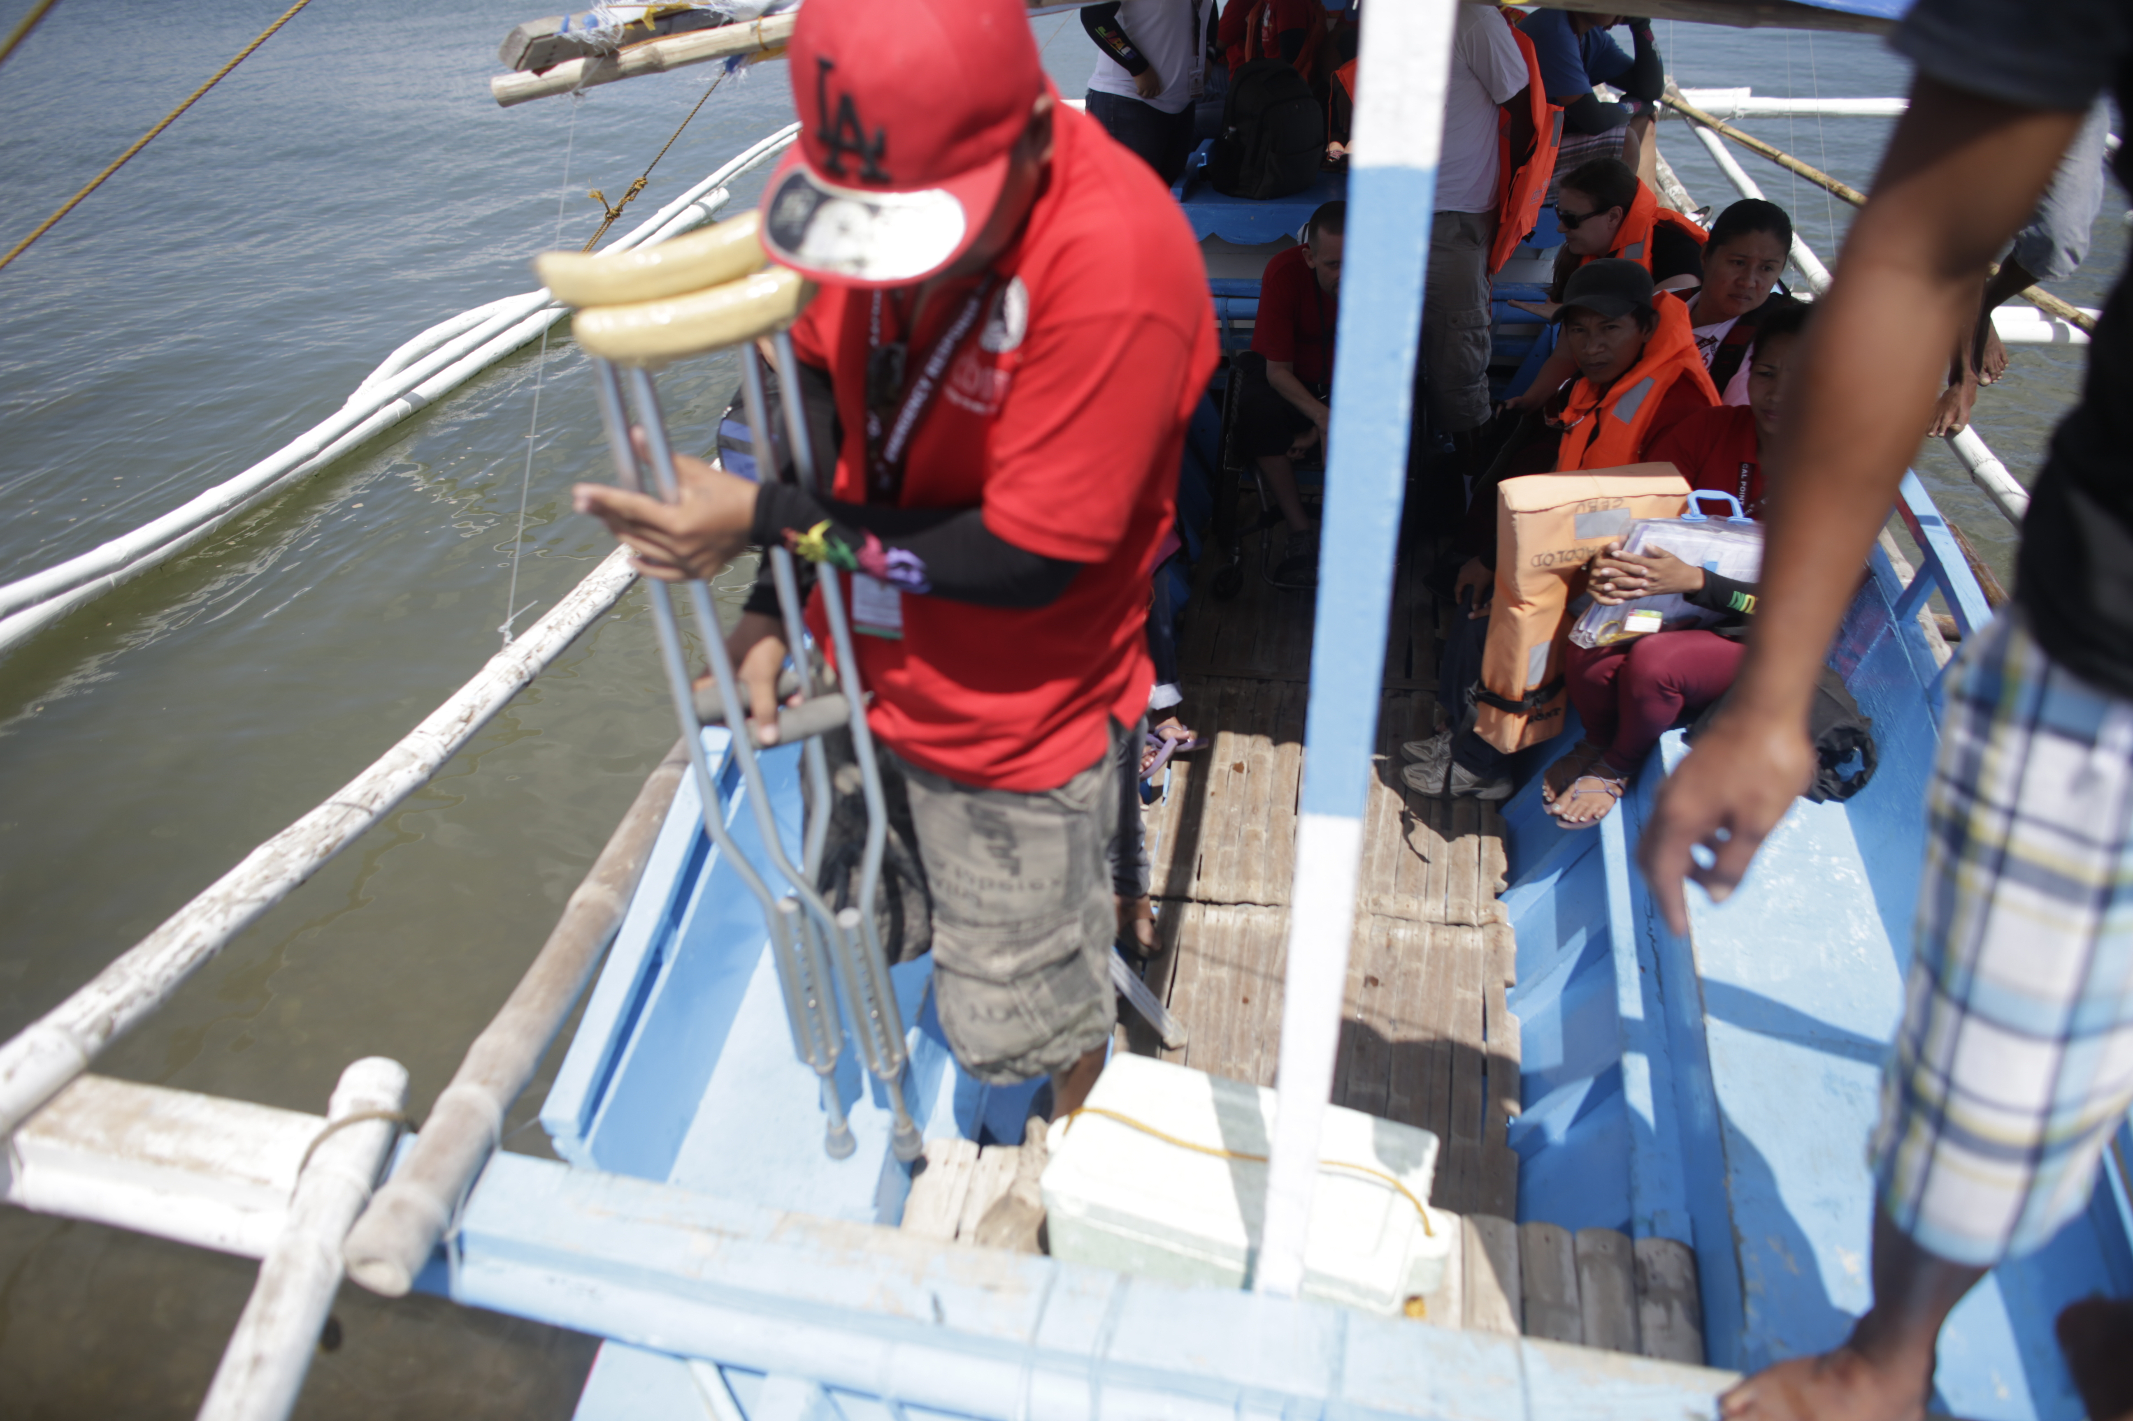
Background
Persons with disabilities are a resource in building resilience
Persons with disabilities are most at-risk during disasters
Accessible technology is necessary for full inclusion and maximum resilience for all
Notes:
Persons with disabilities are both a resource in building resilience and a group most at-risk during disasters.
Technology is becoming increasingly important in all humanitarian action, so to ensure full inclusion and maximum resilience for all, it must be developed with emphasis on accessibility.
Persons with disabilities comprise an estimated 15% of the world’s population and are some of the people most at-risk during disasters. Persons with disabilities are also recognised as a resource of knowledge and experience that can help build resilience of their communities. It is essential therefore, that persons with disabilities have access to and can benefit equally from technology as it develops.
Discrimination
Failure to develop technology in an inclusive, accessible way is discriminatory; it will exclude people with disabilities from lifesaving work and weaken communities as a whole.
Technology development and accessibility are mutually beneficial, and a barrier-free environment helps to ensure full and equal participation in society by all, regardless of age, gender or ability.

Slide 4
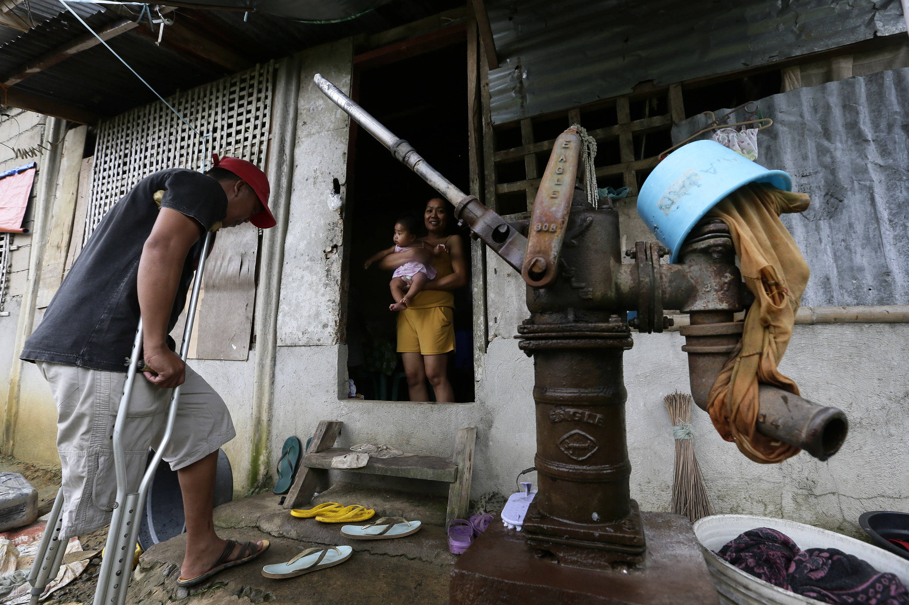
Accessible Technology Examples
Assistive devices
Smartphones and cellular data networks
Internet
Built environment
Notes:
Examples of access in technology include
Assistive devices – from wheelchairs to screen readers, the capacity of specific assistive devices providing greater independence and access to society
Smartphones and cellular data networks – increase access to mobile and online information for all users
Internet – accessible websites allow all users to access and share information
Built environment – when planning incorporates the Principles of Universal Design, it is more accessible for everyone

Slide 5
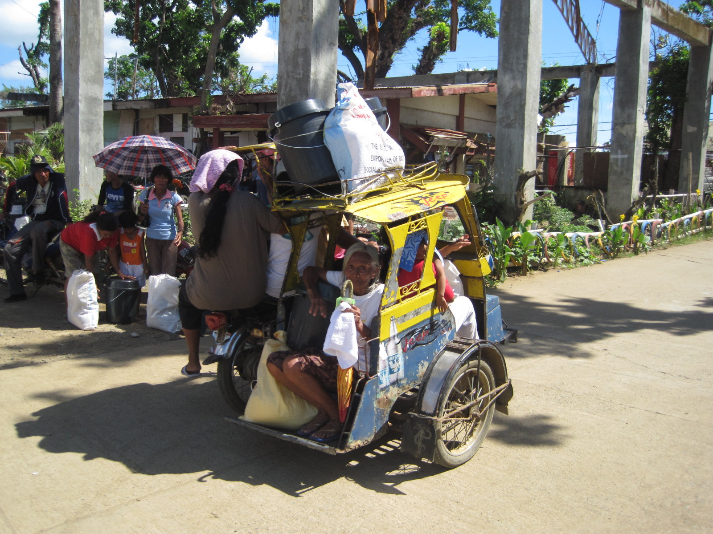
Technology in DRR and Emergency Response
Examples
Database systems to “map” most at-risk families within communities
Warning systems via sirens, loudspeakers, radio, TV, Internet, mobile phones, and J-alert
ICT during response, mobile phones for cash transfers and drones
Social media
Notes:
From early warning systems to resilient infrastructure, technology is playing an increasingly important role at all stages of humanitarian action.
Examples in DRR include development of database systems to ‘map’ most at-risk families within communities and use of latest materials, software and design techniques when planning evacuation routes and emergency shelters.
When disasters happen, technology is again invaluable, from traditional methods of warning messages via sirens, loudspeakers, radio and television, to internet, mobile phones and cutting-edge automated nationwide early warning systems, such as Japan’s J-alert that immediately warns residents of a tsunami and massive earthquake.
In responding, fast and efficient information and communications technology (ICT) is essential, and during rebuilding greatest resilience is achieved by embracing latest expertise. Specifically, mobile technology can facilitate cash transfers (in Kenya) and although the use of drones in humanitarian responses is in its infancy, its potential is clear.
Social media in particular is one technology which is rapidly being utilised as a channel for exchange of information and a tool to mobilise and coordinate people. E.g., unified hashtags, maps of immediate needs, and crowd-sourcing

Slide 6
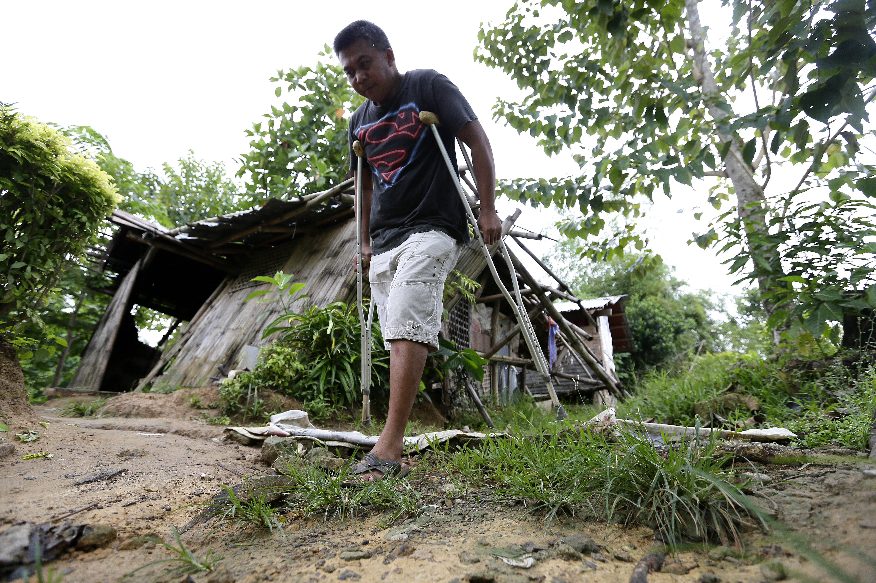
Challenges & Recommendations
Challenges
Power and communication signals are often lost
Equipment temporarily unusable
Most at-risk often have least access to latest devices
Way Forward
Ensure that technology is accessible, reliable and affordable for all
Include persons with disabilities in all DRR phases
Strengthen research and development on accessible technological solutions
Notes:
Challenges:
During emergency situations power and communication signals are often lost, rendering equipment temporarily unusable
People who are most at risk are often the poorest in their communities, so may have least access to latest devices
Recommendations:
Ensuring that technology used in humanitarian action is developed in an accessible way will mean that people with disabilities can fully participate in DRR measures and emergency responses. Thus accessible technology must be reliable and affordable. Only with full inclusion in this way can community resilience and disaster relief and recovery work reach their full potential.
Include persons with disabilities in all phases of the DRR processes and technological development in DRR: from policy-making of ICT accessibility to the implementation and monitoring of accessible websites.
Strengthen research and development on accessible technological solutions for persons with disabilities in DRR planning and implementation

Slide 7
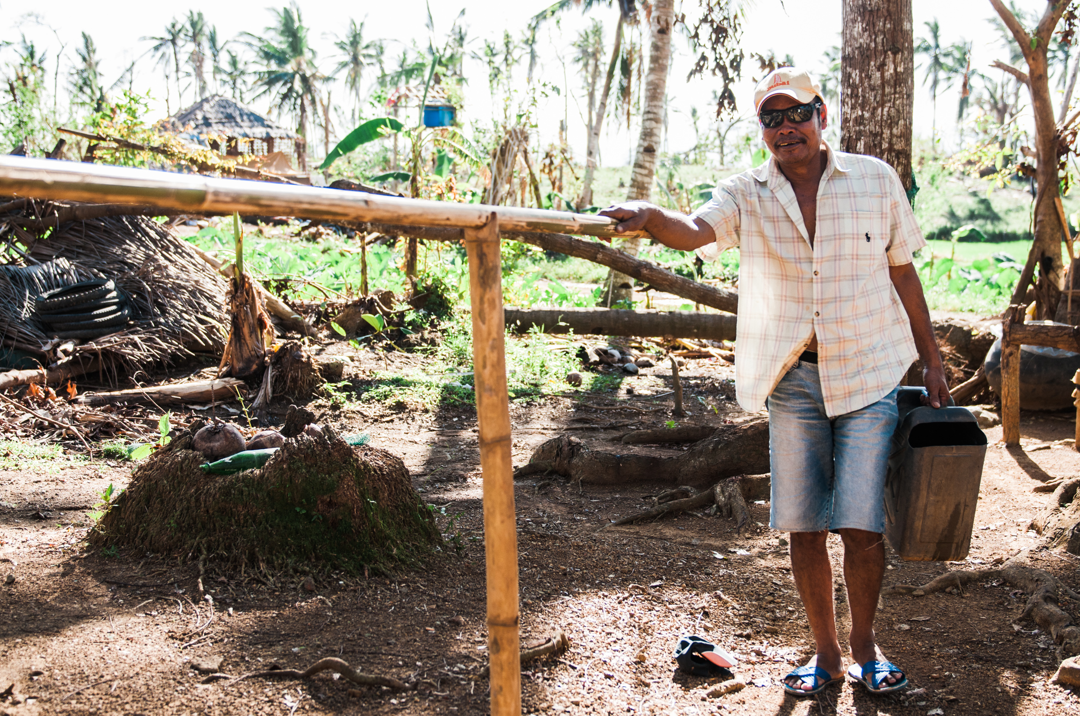
Thank you!
“Persons with disabilities are an essential resource in building community resilience. CBM calls for accessibility to be prioritised in the development of all technology used in humanitarian action.”
- Valérie Scherrer, Director Emergency Response Unit, CBM
More information: http://www.cbm.org/
Contact: elizabeth.lockwood@cbm.org

