Slide 1
Enabling work environments presented by
Betty Dion
Founder
The Global Alliance on Accessible
Technology and Environments (GAATES)
December 3, 2014.
United Nations
New York
Notes:
*

Slide 2

GAATES
The Global Alliance on Accessible
Technologies and Environments
GAATES is the leading international organization dedicated to the promotion of accessibility of electronic and communication technologies, accessibility of the built environment and inclusive disaster risk reduction.
www.GAATES.org

Slide 3
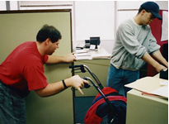
Employment
Key Element of Sustainable Development

Slide 4
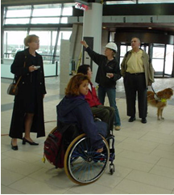
Enabling Work Environment

Slide 5
UN CRPD – Guiding Development
Article 27 Work and Employment
Article 2 General Obligation – Universal Design
Article 9 – Accessibility
Article 11 – Situations of Risk and Humanitarian Emergencies

Slide 6
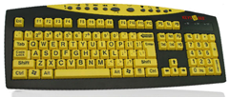
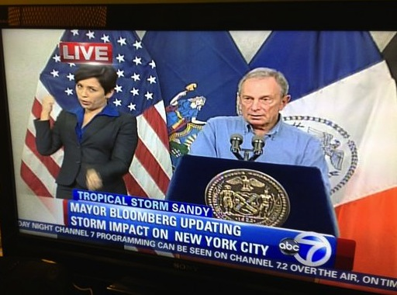
Enablers - Technologies: Leveling the Playing Field
For Persons with Disabilities
For Persons without Disabilities

Slide 7
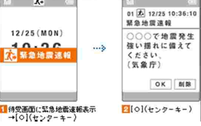
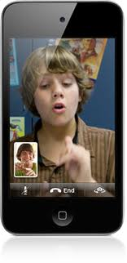
Enabler - Mobile Phones-
Audio and Text

Slide 8
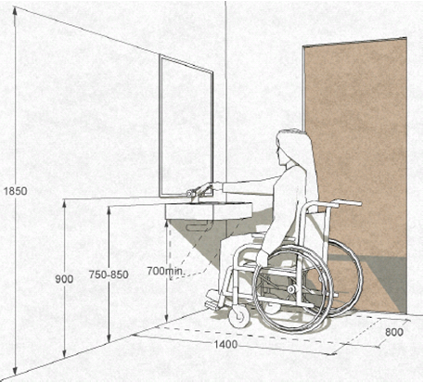
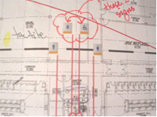
Enablers
Universal Design

Slide 9
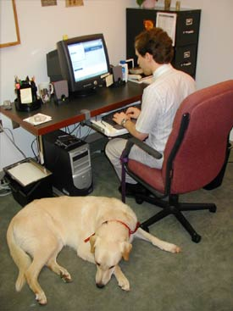
Enablers
Information and
Communication
Technologies

Slide 10
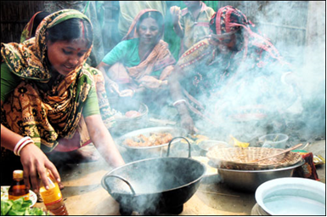
Enablers
  Reasonable Accommodation

Slide 11
Benefits of Sustainable Employment
Promoting Well Being of the Work Place
Positive Disability Awareness Raising
Increased Employment of Persons with Disabilities
Economic Independence
Reduced Dependency on the State

Slide 12
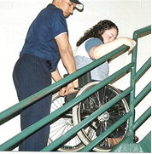
Well Being
Safe Workplace
Emergency
Preparedness

Slide 13
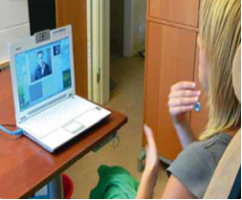
Awareness Raising

Slide 14
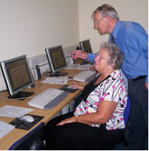
Economic Independence

Slide 15

Reduced Dependence on the State
Jenita

Slide 16


Addressing Obstacles
Cost
Assistive Technologies

Slide 17
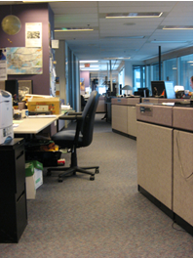
Costs
Universal Design
Workplace (1%)

Slide 18
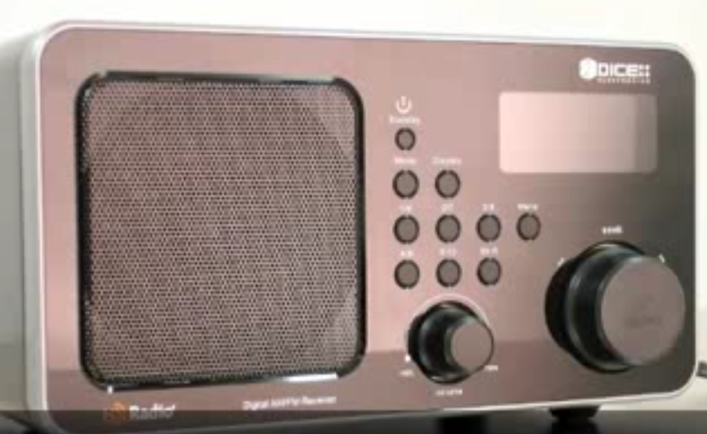
The Future is Technology

Slide 19
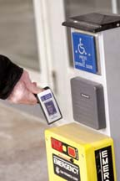
Automatic Door Openers, Security Systems

Slide 20
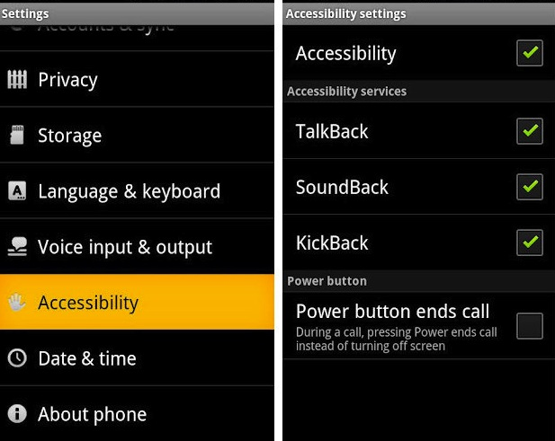
Smart Phone Technologies
Mobile Phones

Slide 21
Accessibility of Mobile Phones
Voice Over
Zoom
Large Text
Invert Colors
Hearing Aids
Guided Access
Assistive Touch
Facetime
Siri

Slide 22
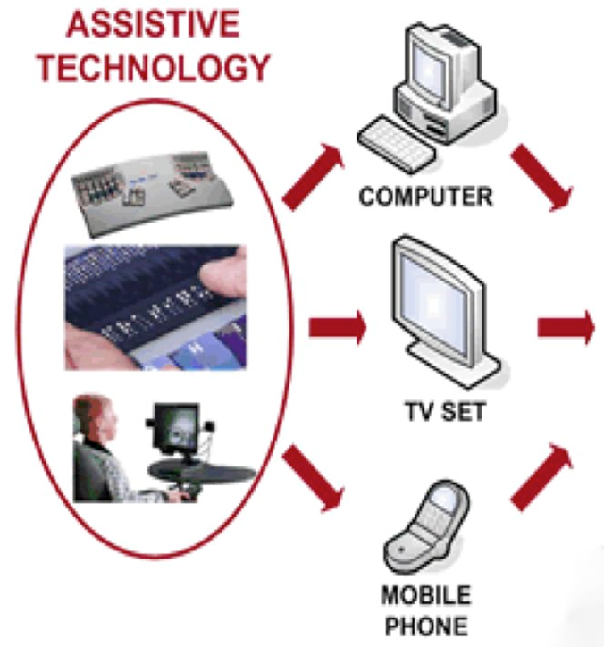
Assistive Technologies in Communication

Slide 23
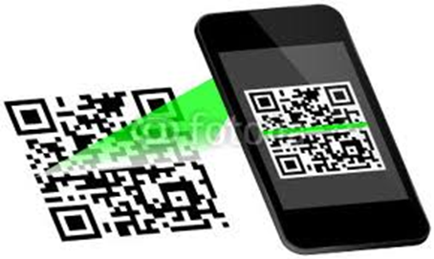
Scanners

Slide 24
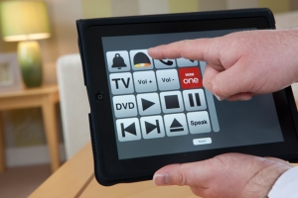
Personal Environmental Control

Slide 25
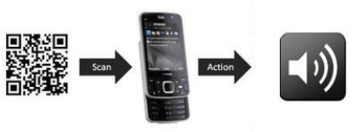
Interactive Signage
Proposed wireless communication and wayfinding

Slide 26
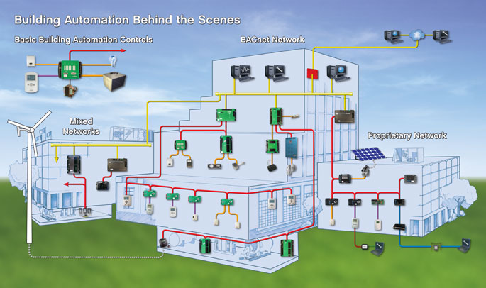
Building Technologies

Slide 27
QUESTIONS
GAATES website:
www.GAATES.org
www.GlobalAccessibilityNews.com
www.Facebook.com/GAATES
Twitter: GAATES_GAN

