Slide 1


SDGs & Assistive Technology
Dr Diane Bell (WHO Consultant), Mr Gopal Mitra (UNICEF)
11-12 December 2017, New York
GATE | Department of Essential Medicines & Health Products

Slide 2
Topics
Introduction and Inputs received
Gopal Mitra
Sources used
Diane Bell
Key messages
Diane Bell / Gopal Mitra
Key recommendations
Gopal Mitra / Diane Bell
Guidance required
Diane Bell / Gopal Mitra
Discussion
All

Slide 3
Introduction
Assistive Technology is a cross-cutting issue, applying to a range of SDGs like ending poverty, education, employment etc.
Therefore, we were asked to prepare a longer submission for SDG 10 (inequality) and prepare shorter submissions for the other SDGs.
  Focus on this input and touch on the others
Working Group / Review Group
Process/methodology followed

Slide 4
INPUTS RECEIVED
SDG | TOPIC (AT in relation to……) | AUTHOR/S
1 & 2 | Poverty and Hunger | Shaun Grech, Manchester University
1.5, 11.5 & 13 | Disasters, humanitarian crises & climate change | Gregor Wolbring, University of Calgary
4 | Education | Tsitsi Chataika, University of Zimbabwe Gauthier de Beco, University of Leeds
6 | Water and sanitation for PWD’s | Gregor Wolbring, University of Calgary
7 | Energy and Persons with Disabilities | Gregor Wolbring, University of Calgary
8 | Employment | Maria Jakovljevic, University of Zadar

Slide 5
INPUTS RECEIVED
SDG | TOPIC (AT in relation to……) | AUTHOR/S
9.c | Access to ICT | David Banes
10 | Combating inequalities – Assistive Products | Johan Borg, Diane Bell & Gopal Mitra
11 | Inclusive & accessible cities/human settlement | Rosaly Correa-de-Araujo, Global Health Affairs, Health & Human Services
Notes:
4 Chapters for which we did not receive any inputs.

Slide 6
INPUTS NOT RECEIVED
Slide Hidden
SDG | TOPIC (AT in relation to……) | AUTHOR/S
3 | Health | Ireland
10 | Multiple discrimination – persons with mental/psychosocial disabilities | Ireland
3.7 & 5.6 | Sexual and reproductive health and rights | South Africa
5 | Gender equality and empowerment of women with disabilities | South Africa

Slide 7


Sources
Used

Slide 8
Sources Used
Academic:
  Published, peer-reviewed books
  Published, peer-reviewed journal articles
Reports & Website information:
  UN
  WHO (GATE)
  World Bank
  UNICEF as well as UNESCO & ITU
Other:
  Seminar proceedings
  INGO press releases & mid-term review reports
  Parliamentary reports & other publications e.g. committee reports

Slide 9
Terminology
Assistive technology:
Is the application of organized knowledge and skills related to assistive products, including systems and services.
Assistive technology is a subset of health technology.
Assistive products:
Any external product (including devices, equipment, instruments or software), especially produced or generally available, the primary purpose of which is to maintain or improve an individual’s functioning and independence, and thereby promote their well-being.

Slide 10
KEY MESSAGES
(SDG 10) COMBATING INEQUALITIES – ASSISTIVE PRODUCTS
By enabling people living with impairments to participate in all areas of life, affordable access to assistive products is a precondition for reducing inequalities with regards to human rights and the SDGs.
Explanation of Assistive Products (AP) e.g. spectacles, hearing aids; facilitators that increase an individual’s performance and a means to lessen the gap between functional requirements of an individual’s surroundings and his or her capabilities.
Legislation on AP: States should support the development, production, distribution and servicing of AP, plus disseminate knowledge and ensure access – pertinent that both Standard Rules & CRPD acknowledge role of AT
Benefits of AP: showcases empirical evidence; argues that provision of AP can be cost-effective as it can reduce the needs and costs for other services, enable users to earn an income, or facilitate or reduce the need for support by family members.
Notes:
*affordable access to AP is a precondition for reducing inequalities wrt human rights & the SDG’s
*explanation of AP – increase performance/functioning of an individual; enhance capabilities
*lack of legislation wrt Assistive Technology generally
*benefits of AP

Slide 11
KEY MESSAGES
(SDG 10) COMBATING INEQUALITIES – ASSISTIVE PRODUCTS
APs and the SDGs: APs have been found to be instrumental and effective in facilitating the achievement of all SDGs and the realization of human rights.
Needs for AP: reliable data not readily available at a country level (1 in 10)
International advancements: WHO (GATE, APL), UNICEF (catalogue), ICRC
Progress made – CRPD:
  lack of adequate monitoring mechanisms to ensure the practical implementation of AT measures and relevant legislation.
  Two global surveys: 1/3 of gov’s did not provide financially for AT,
  huge unmet need
  Major barriers – lack of awareness, costs, availability, governance, services, products, accessibility, human resources and economic resources.
Notes:
*Builds the case for AP’s and the realization of the SDG’s
*Need for reliable and readily available data on AP need, usage etc. at a country level
*Global advancements – work of UN and other agencies
*Although some progress made in terms of the CRPD, still some key issues in relation to AT – mention 3

Slide 12
KEY MESSAGES
(SDG 10) COMBATING INEQUALITIES – ASSISTIVE PRODUCTS
How UN agencies can support countries to ensure compliant provision of AT to achieve the SDGs e.g. support gov’s to develop and implement adequate policies and programs on AT.
Conclusions and way forward:
  Compliance with the AT provisions of the CRPD requires time and progressive realization
  Need more bilateral and international co-operation
Box 1: work of UNICEF, UNDP, ILO and other agencies – provision of AT
List of urgent actions provided re implementation of Article 32 (next slide)
Notes:
*The chapter then moves onto how UN agencies can further support MB to ensure compliant provision of AT

Slide 13
KEY RECOMMENDATIONS
COMBATING INEQUALITIES – ASSISTIVE PRODUCTS
ANALYSIS/EVIDENCE | SYSTEMIC ACTION | DELIVERY
Estimate needs and map resources | Ensure user involvement and participation | Set up AT service provision
Strengthen data, evidence and research | Adopt legislation, policies and strategies | Provide funding and increase affordability
 | Establish partnerships | Train personnel
 | Guide CRPD reporting | Supply products
 | Adopt a General Comment
Notes:
*The chapter ends with a list of urgent actions that need to be implemented at a country level
*Divided into 3 themes: Analysis/Evidence, Systemic Action and Delivery

Slide 14

QUESTIONS / ASPECTS TO CLARIFY

Slide 15
KEY MESSAGES
EDUCATION
Assistive devices and technology plays a critical role when educational institutions are serious about promoting quality inclusive education.
CRPD lists the provision of AP amongst its general obligations, and provides that “universal design” is not intended to exclude such devices.
CRPD requires State Parties to guarantee all forms of assistance (including AT) to persons with disabilities in order to ensure they have access to information.
State Parties have to equip their education systems through the provision of AT that meets the various needs of the learners with disabilities, so that they can develop their skills and abilities on an equal basis with other children. AT such as Braille, hearing aids etc. assist with ‘levelling the playing fields’.
A number of countries provide for assistive products (devices) in their national educational policies.
Some AP are covered by national health and rehabilitation programmes.

Slide 16
KEY MESSAGES
Slide Hidden
EDUCATION
Assistive devices should be made available at an affordable price to their families, be age-appropriate and serve them throughout their educational life-cycle. (in line with CRPD’s Article 24)
Only 5 to 15% (1 in 10) of the population in need have access to assistive products at a global level with the problem being more acute in LMIC.
This lack of access is often due to high costs and lack of awareness, availability, trained personnel, policy and financing = lack of access to education and employment.
The access of children with disabilities to quality education becomes compromised due to lack of access to AT.
The OHCHR refers to the inclusion of AT or assistive products in IEP (individual education plans) for children with disabilities.

Slide 17
KEY RECOMMENDATIONS
EDUCATION
AP are frequently produced abroad, creating additional costs for their transportation, plus customs and excise duties etc.
There is a dire need for governments to increase the local production and distribution of low cost AT that meet the individual needs of all learners.
This needs to be driven through national policy and programmes.
Teachers need to be adequately trained in the use of AT and inclusive teaching methodologies.
Gov’s need to understand accessibility, AT and disability as cross-cutting issues if the situation and implementation of SDG 4 is to address the needs of all learners.
Affordable access to AT needs Gov’s commitment to adequate and sustained financing as well as efficient procurement & service delivery systems.

Slide 18
KEY MESSAGES
EMPLOYMENT
Little evidence regarding the employment of persons with disabilities, including the use of AT.
As infrastructure and AT have proven to be a baseline for the advancement of disability employment, expertise and financing from and coalitions with developed countries have become a prerequisite for SDG 8 realization.
Although African countries are starting with integration of SDG 8 and disability employment as reflected in the National Development Plan 2030 and the Global Goals in Africa, many do not provide assistive products and do not employ persons with disabilities.
From analyzing programmes, documents and trends, it is clear that the employment of persons with disabilities and the availability of AT indicates slow progress, especially in developing countries.

Slide 19
KEY RECOMMENDATIONS
EMPLOYMENT
There is a need for financial support and strategies to support SDG 8 and AT enactments.
The growth of sustainable financing systems must be supported to ensure the sound application of AT as cash transfers are not a sustainable instrument to address the needs of persons with disabilities (WB, 2016)
Legislation needs to be enforced towards the obligatory provision of AT in all work environments for all persons in need.
Reduce physical and environmental barriers to inclusive employment.
Investments in AT as well as ICT, the empowerment of innovation & entrepreneurship competencies, together with a redistribution of human, research & financial resources are paramount in resolving disability employment is needed.

Slide 20
KEY MESSAGES
ACCESS TO ICT
Assistive Products for ICT is used in education, employment, healthcare, residential homes and domestic settings. (all ages, wide range of disabilities) e.g. pointing devices and screen readers.
Importance of ICT – opens up a wide range of services, transforms existing services, particularly for persons with disabilities.
Lack of enabling legal and regulatory frameworks essential in ensuring use of ICT by people with a disability.
Many national programs to support access to technology e.g. G3ICT, but access still limited e.g. relay services for deaf users (26%)
Specific reference to Article 26

Slide 21
KEY RECOMMENDATIONS
ACCESS TO ICT
The technology that is used by persons with a disability is shifting rapidly.
To build a sustainable ecosystem for the use of accessible technology there is a need to anticipate trends and change e.g. wearable technologies.
Such rapid change has capacity to support needs of persons with a disability more effectively but, if unregulated, their needs remain unmet with reduced choices and opportunities.
Need for both national and international policy recognizing that technology evolution should be aligned to principles of inclusive or universal design.
In addressing the global digital divide, and as new technologies emerge, UN agencies remain uniquely placed to stimulate local development of accessible ICT, including local language text to speech or voice recognition solutions.

Slide 22
QUESTIONS / ASPECTS TO CLARIFY

Slide 23
KEY MESSAGES
INCLUSIVE & ACCESSIBLE CITIES/HUMAN SETTLEMENTS
Making cities and human settlements accessible and inclusive for all people, in particular for persons with disabilities, is critical for sustainable urban development as well as for promoting independent living, and full and equal participation in society – AT can help to facilitate an individuals’ participation.
Housing is a key component – universal design principles should be incorporated from the outset in plans e.g. including AT such as induction loop systems and braille on controls in elevators.
AT enables persons with impairments to access their cities and communities including public transportation, and allows for better integration/participation in community activities.
Also socio-economic benefits, can reduce direct health and welfare costs and enable a more productive workforce and result in economic growth.
Notes:
*Work through the Key Messages

Slide 24
KEY RECOMMENDATIONS
INCLUSIVE & ACCESSIBLE CITIES/HUMAN SETTLEMENTS
The challenge remains to promote widely the view that the provision of accessible and usable products, services and environments is an investment that benefits all and is reflected in value chains rather than to be viewed as social consumption for targeted populations.
Specific focus should be given to gathering data and monitoring the situation of persons with disabilities in urban settings and the barriers they experience including negative social attitudes; enhancing accessibility of services including access to Assistive Technology etc.
Particular attention should be given to the incorporation of effective AT in national policies and programs to ensure persons with disabilities have increased access to assistive products and are able to live independently by carrying out their daily tasks and participating in society.

Slide 25
KEY MESSAGES
ENERGY AND PERSONS WITH DISABILITIES
Energy poverty of persons with disabilities discussions are not linked to discourses around AT, despite the fact that many assistive products e.g. daisy players, vibrating alerting devices etc. need power/energy to function.
As such, being energy poor impacts the use of AT and ultimately the independence of a person with a disability that needs the assistive product.
No national policies or programs explicitly covering persons with disabilities and AT in relation to access/usage of energy were found.
No UN activities explicitly covering persons with disabilities and AT in relation to access/usage of energy were found.

Slide 26
KEY RECOMMENDATIONS
ENERGY AND PERSONS WITH DISABILITIES
Persons with disabilities in general and access to or use of AT has to be conceptualized within Energy discourses, for example:
  ISO9999 or the WHO Priority Assistive Products List (APL) could be looked at through an energy-demanding AT lens (recently done)
Data needs to be generated regarding the situation of persons with disabilities on the impact of energy in relation to assistive technology, and the situation around energy poverty and AT.

Slide 27
KEY MESSAGES
DISASTERS, HUMANITARIAN CRISES & CLIMATE CHANGE
The Sendai Framework for Disaster Risk Reduction refers to “universal design” which could be seen to cover AT.
The Incheon Strategy acknowledges that “there are increasing opportunities for promoting and protecting the rights of persons with disabilities, including through the use of new technologies for enhancing accessibility….”
BUT, they do not state WHAT technologies and they do not link it to AT.
Lack of data on persons with disabilities and AT in relation to disasters etc.
The UNISDR 2013 Survey on Living with Disabilities and Disasters does not engage further with the role of technology (nor AT) – only mentions social media and phone.
Some sources highlight the problematic situation of AT after a disaster due to higher demands due to injury, or lost and broken AP.
Notes:
*Work through the Key Messages systematically

Slide 28
KEY MESSAGES
Slide Hidden
DISASTERS, HUMANITARIAN CRISES & CLIMATE CHANGE
The 2016 Charter on Inclusion of persons with disabilities in Humanitarian Action strives to ensure that services and humanitarian assistance are equally available for and accessible to all persons with disabilities and guarantees the availability, affordability and access to specialized services, including Assistive Technology.
A Working Session on the Proactive Participation of persons with disabilities in Inclusive Disaster Risk Reduction for ALL also refers to the provision of AT and reasonable accommodation.
The High Level Political Forum Ensuring that no-one is left behind position paper by persons with disabilities 2016 mentions many aspects around SDGs but little on technology, outside ICT and nothing on AT.

Slide 29
KEY MESSAGES
Slide Hidden
DISASTERS, HUMANITARIAN CRISES & CLIMATE CHANGE
The Post Disaster Needs Assessment Guide mentions destroyed technology but not technology in relation to persons with disabilities, such as AT.
GAATES outlined the AT of Early Warnings and Accessible Broadcasting.
Hearing aids are seen as a case of an AP moderating the effectiveness of a disaster mitigation intervention.
In relation to implementation of accessibility & universal design, in many developing countries, standards and building codes still do not include accessibility requirements.
No national policies and programmes related to AT and DRR can be found.
The UNISDR 15-year roadmap – no data exists regarding how the different indicators are explicitly applied to persons with disabilities, and does not refer to AT.

Slide 30
KEY RECOMMENDATIONS
DISASTERS, HUMANITARIAN CRISES & CLIMATE CHANGE
There is a need to further raise public awareness of the importance of disability inclusion (including access to AT) and investment in the improvement of environmental accessibility.
Data on persons with disabilities is needed, including sub-characteristics e.g. needs related to AT.
A list of technologies, including a list of AT, should be compiled that reflects the need for AT in different stages of DRR (Disaster Risk Reduction) so one can plan, including needed funding for the provision of AT.
One could derive the list from the ISO9999 Assistive Products for persons with disabilities (2016), relevant to DRR.
The S&T Roadmap to Support the Implementation of the Sendai Framework for DRR 2015-2030 should be used also to generate a list of need AT to get a clear idea of the need so that progress can be measured.
Notes:
*Work through the Key Recommendations systematically

Slide 31
DISCUSSION POINTS

Slide 32
DISCUSSION POINTS
Standardized terminology i.e. AT and AP
No current input wrt AT, refer to:
  Tebbutte, E., Brodmann, R., MacLachlan, M. & Khasnabis, C. (2016). Assistive products and the Sustainable Development Goals (SDGs).
    For example: SDG 5. Achieve gender equality and empower all women and girls
    Target 5.b: Enhance the use of enabling technology, in particular information and communications technology, to promote the empowerment of women
    Example: Women with disabilities in South Australia identified the importance of accessible ICT to reduce isolation, to access information, and to contribute to decision making within their communities (Jennings [19]).
Notes:
*Work through the Key Recommendations systematically

Slide 33
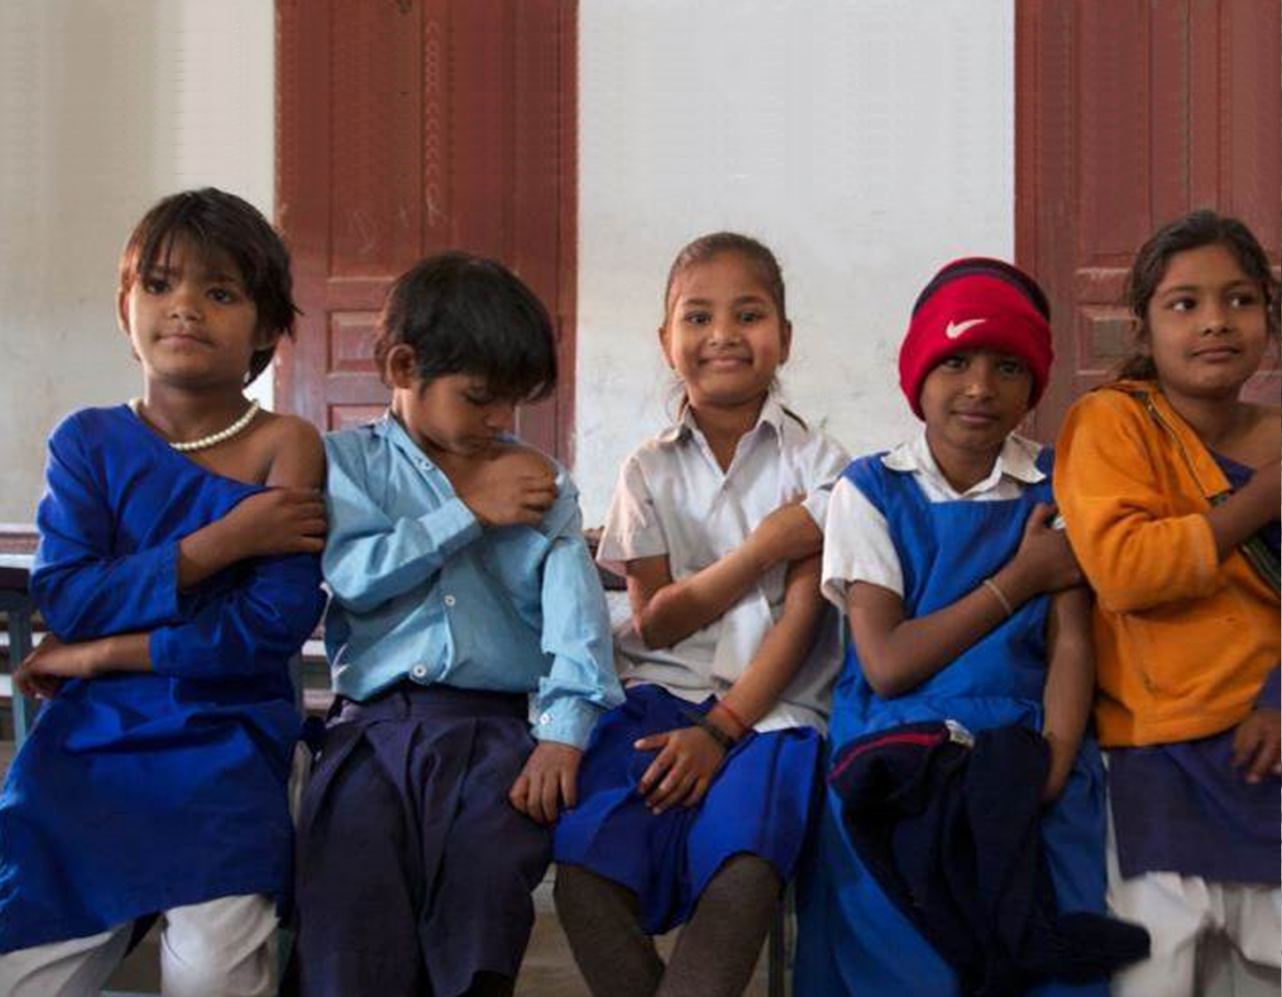
Thank you
WHO
20, Avenue Appia
1211 Geneva
Switzerland
D. Bell, WHO Consultant & G. Mitra, UNICEF

Slide 34
KEY MESSAGES
Slide Hidden
POVERTY AND HUNGER
“Access” does not mean “accessibility” – ensuring that measures to eliminate hunger and poverty are accessible, goes beyond mere coverage, to include HOW people gain access, and to ensure they have the means to do so, including access to adequate and appropriate Assistive Technology (AT).
Some countries are increasingly including the issue of disability in poverty reduction efforts through policy interventions focusing on:
  The social inclusion of PWDs alongside access to basic services.
Lack of data makes it difficult to examine the extent to which policies and programmes address the needs and demands of PWD’s, including access to AT.

Slide 35
KEY MESSAGES
Slide Hidden
POVERTY AND HUNGER
Disability is also featuring increasingly in the discourse of donors claiming to work towards disability inclusive development with donations of assistive products, especially wheelchairs, featuring in the work of many charities and NGOs, especially disability-focused ones.
  Often of poor quality, not meeting minimum standards, not suitable for the terrain, may cause pain and are hence unuseable and consequently discarded.
Eradication of poverty & hunger are key commitments of the SDGs, especially in relation to the poor and vulnerable people, however, no direct references to disability in Goals 1 and 2.
Without universal coverage of AT, equality itself is compromised, a principle that cuts across all the SDGs.

Slide 36
KEY RECOMMENDATIONS
Slide Hidden
POVERTY AND HUNGER
Effective disability inclusive development and provision of appropriate AT needs to be personally, contextually, socially and culturally informed, adapted and responsive to the needs and demands of PWDs.
This includes the provision of adequate, affordable, personalized and adapted assistive products, alongside long-term financial and technical support which is critical in poverty reduction efforts as well as enhancing well-being.
It also includes recognition and understanding of the complex and heterogeneous meanings of disability and the needs and demands of persons with a range of different impairments, including for AT – a process that must be co-led by PWDs, willingness to change and be flexible.
The UN has restated the need for development policies and programmes focused on poverty reduction, which includes equal opportunities in employment and social protection for PWDs. This includes timely and adapted access to adequate AT.

Slide 37
KEY RECOMMENDATIONS
Slide Hidden
POVERTY AND HUNGER
Policies and measures including universal social protection and universal health coverage, which includes AT, are not only a means to an end (poverty reduction) but a question of rights, well-being and survival.
This requires sensitization and education not only of policy-makers, but also all those working in health and development, and to move towards well-coordinated and informed cross-sectoral strategies and practices.
Need not only more research data, but also informed, strategic, contextualized and responsive efforts at including & targeting PWDs and their families on their own terms.

Slide 38
KEY MESSAGES
Slide Hidden
WATER AND SANITATION FOR PWD’S
Key documents e.g. CRPD, Goal 6 of SDG’s, do not include the role of AT in making Water, Sanitation and Hygiene (WASH) accessible.
It is recognized that technologies are needed to fulfil the SDGs, however documents covering the importance of this do not use the term AT.
The UN Human Rights Council in 2016 noted that various problems still exist wrt basic human rights to safe drinking water and sanitation, but the doc does not indicate whether there is a problem regarding the technology, including AT development or on the implementation side, and the doc does not ask for collaboration with developers.
Problems in how technologies, including AT, are engaged within the SDG discourse is also evident as no list exists which clearly spells out which AT might fall under Goal 6, what the status is of a given AT in relation to a given Goal 6 problem and which AT needs more attention than others.

Slide 39
KEY MESSAGES
Slide Hidden
WATER AND SANITATION FOR PWD’S
The UN Sec General 2017 Progress report on the SDGs does not provide data on the situation of PWDs but the report also does not give data on the state of technologies in relation to the SDGs, including AT.
The new list of indicators does not include technologies in general or AT/Assistive Products in particular, as indicators.
It is not yet clear whether national efforts have increased under SDG Goal 6 initiatives and whether national harmonizations have taken place.
A 2016 briefing note for the House of Parliament, UK on water & sanitation technologies needed to serve the global population does not talk about technology in general or AT in particular to make WASH accessible for PWDs.

Slide 40
KEY RECOMMENDATIONS
Slide Hidden
WATER AND SANITATION FOR PWD’S
A systematic approach is needed to map the reality of AT as they relate to Goal 6.
Data on technology in general, including AT, is needed to think about cost and probability of success and what is still missing. No trend can be ascertained so far due to lack of data.
Some national policies/programmes highlight the role of AT, but authors Desai et al also indicate that systemic generation of data is needed on the use of Assistive Technology.
The most pressing task is to generate data so one knows exactly where problems still exist and why, including whether a problem is linked to technology in general, or AT, in particular.

