Slide 1


2018 Flagship Report on Disabilities & Development

Slide 2

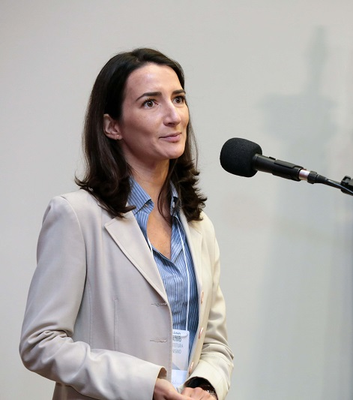

Task team
Tessy Aura– UN-Habitat, Human Rights Officer
Marja Edelman – UN-Habitat, with substantive experience in housing and sustainable development
Michael Szporluk – Independent consultant on disability rights and international development

Slide 4
SDG 11: Make cities and human settlements inclusive, safe, resilient and sustainable for persons with disabilities
Ensure access for all to adequate, safe and affordable housing and basic services including:
        Health facilities
        Water and sanitation,
        Transportation in particular to health facilities, water, sanitation,
        Public spaces
        Public transport
        Housing,
        Education and,
        Public information and communication through policies and programmes
Participatory, integrated and sustainable human settlements planning and management in all countries

Slide 5
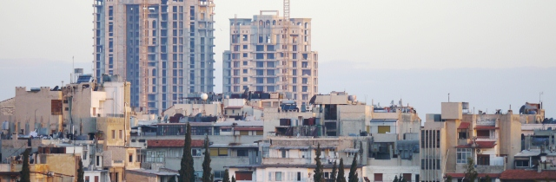
UN-Habitat’s Mandate
A better Urban Future
Promote socially and environmentally sustainable human settlements development and the achievement of adequate shelter for all.
        Health affordable, accessible, culturally adequate, infrastructure, services, facilities, etc

Slide 6
Alignment with sdgs
SDG 4: Guaranteeing equal and accessible education by building inclusive learning environments and providing the needed assistance for persons with disabilities
SDG 8: Promoting inclusive economic growth, full and productive employment allowing persons with disabilities to fully access the job market
SDG 10: Emphasizing the social, economic and political inclusion of persons with disabilities
SDG 11: Creating accessible cities and water resources, affordable, accessible and sustainable transport systems, providing universal access to safe, inclusive, accessible and green public spaces
SDG 17: Underlining the importance of data collection and monitoring of the SDGs, emphasis on disability disaggregated data

Slide 7
International legislation background
With regards to achieving SDG 11 - there are several human rights framework that serve as a foundation for all interventions
Relevant Human Rights Articles
CRC
ICESCR
ICCPR
CRPD
CEDAW

Slide 8
International legislative background
The right to an adequate standard of living, including the right to adequate housing (ICESCR art 11).”
Convention on the rights of persons with disabilities
      Does not create new rights
      Addresses the gaps eminent in implementation of the rights in other treaties specifically pertaining to persons with disabilities.
      accessibility is an unconditional right and thus that resource limitations cannot be used as an excuse for inaction or retrogressive steps. (CRPD GC 2)

Slide 9
The convention on the rights of persons with disabilities
Article 10 - Right to Life
Article 14 - Liberty and security of the person
Article 15 - Freedom from torture or cruel, inhuman or degrading treatment or punishment
Article 16 - Freedom from exploitation, violence and abuse
Article 17 - Integrity of the person
Article 18 - Liberty of movement and nationality
Article 12 - Equal recognition before the law
Article 19 -To live independently and be included in the community
Article 21 - Freedom of expression and opinion, and access to information
Article 22 - Respect for privacy
Article 23 - Home and family
Article 24 - Education
Article 25 - Health
Article 27 - Work and Employment
Article 28 - Adequate standard of living and social protection
Article 29 - Participation in political and public life
Article 30 - Participation in cultural life, recreation, leisure and sport

Slide 10
Why is it even important to have this?
disability-based discrimination has had a particular severe effect in “housing, transport, cultural life, and access to public places and services.
Marginalized and further relegated to the “back” if not included from the beginning

Slide 11
Urban Accessibility: Status & Trends - Global
insufficient questions relevant to disability, leads to an underestimation of the number of persons with disabilities in the country.
over 10 million refugees and displaced persons in the world today - 3.5 million refugees of them live with disabilities in refugee camps and urban slums
For every child killed due to violent conflict, three are injured and permanently impaired
14.6% of the total population in urban areas is comprised of persons with disabilities
Although aging does not entail impairment – we are finding that majority do live in cities – so accessibility could prove a challenge as the society ages

Slide 12
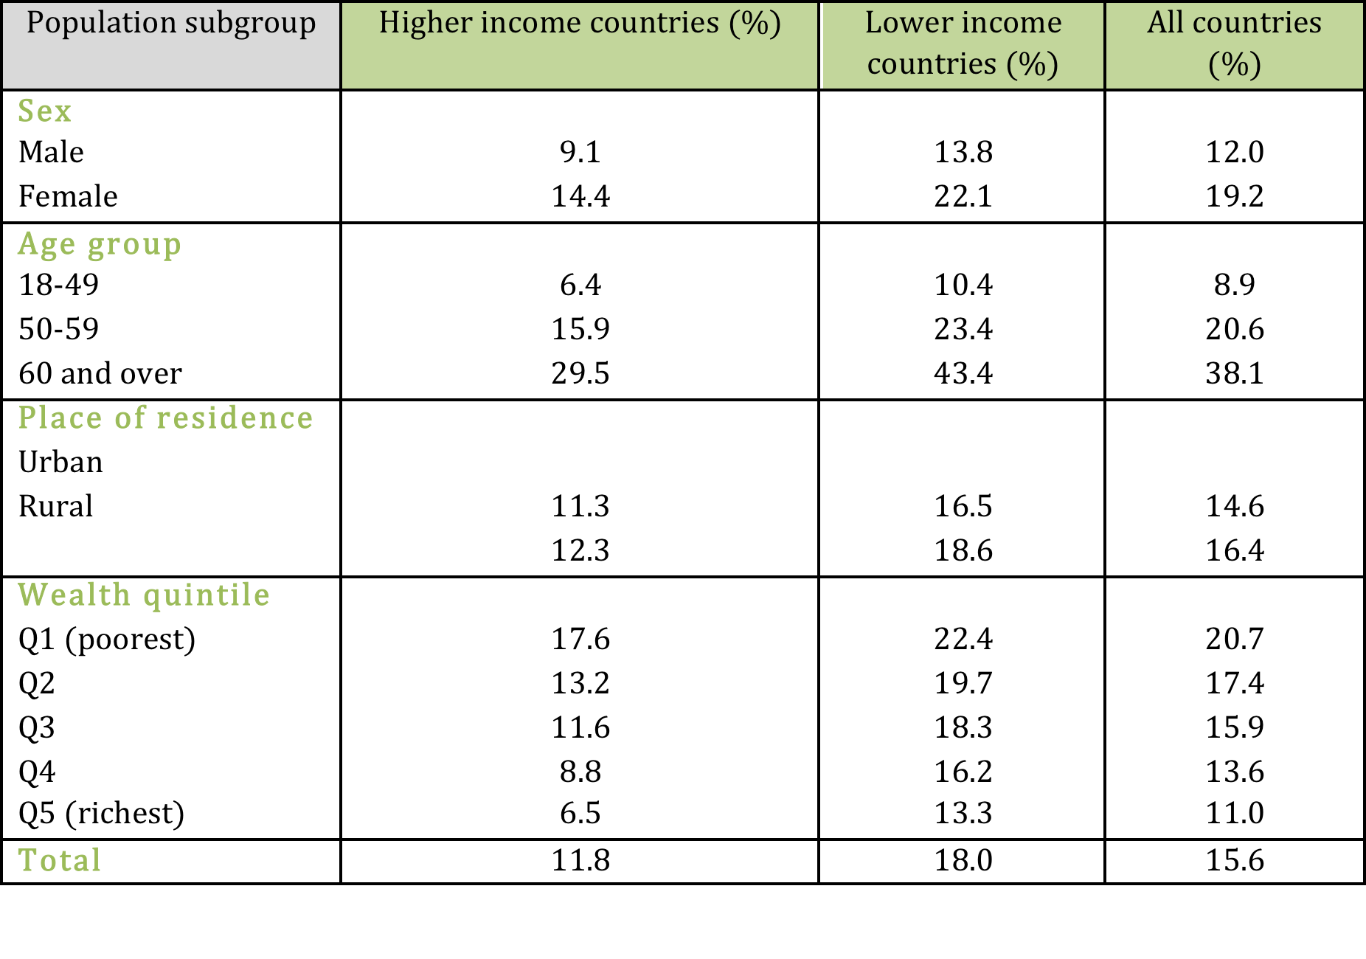
Disaggregated data for Disability prevalence
across all countries, women, the poor and older people had higher prevalence of disability. (For all these groups, the rate was higher in lower income countries) (59 countries)

Slide 13
Urban Accessibility: Status & Trends – Regional
Pakistan - 13.4 per cent of the country population are living with disability.
      only 29 per cent of people with disabilities are employed in Pakistan
23.91 per cent of the Brazilian population considered to be persons with disabilities (2010)
      The majority of which (84.34 per cent) live in urban areas
  In Lesotho about 70000 people were living with disabilities (2007)
  Dominican Republic - 74 per cent of the total persons with disabilities were currently living in urban areas. (36 per cent were unemployed)
  public urban transportation in the African region mostly do not facilitate integration for persons with disabilities
    in Botswana, existing building in urban areas do not provide access for people with disabilities
  In Asia and Pacific countries - limited mobility constrains persons with disabilities’ access to public, health services and facilities.
      Privately owned cars a rising trend

Slide 14
National policies/Programmes
A total of 187 State parties have ratified the CRPD – but as we have seen the global condition and position of persons with disabilities are still lagging where policies have otherwise excelled
numerous State Parties that have made efforts toward increasing access, inclusion and the participation of persons with disabilities through:
        through adopting a national disability strategy and plan of action,
        enabling access to all common systems and services,
        strengthening and supporting research and data quality and availability on disability,
        increasing public awareness and understanding about disability,
        investing in programmes and services for people with disabilities, and
        providing adequate funding and improving affordability.

Slide 15
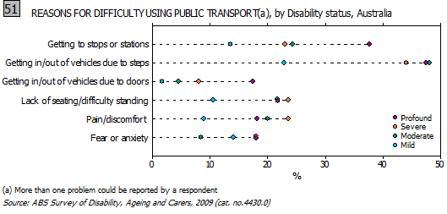
australia
National Disability Strategy 2010-2020 seeks to enhance the life for persons with disabilities
inclusivity and accessibility of public transportation
82% of people with a reported disability had public transport available in their local area (2009)
the costs of using public transportation are subsidized through the use of concession cards for older persons, persons with disabilities, etc

Slide 16
NEPAL
a national policy and action plan on disability (2006)
Seeks to establish “inclusive, obstacle free and rights-based society for people with disability, and to include them in the mainstream of national development.
Disability Service National Coordination Committee is comprised of persons with disabilities as well as their supporting organizations in order to ensure effective representation
commits to a campaign to raise awareness and sensitize the population on disability
Setting quotas for trainings and employment to increase employment of people with disability in public and private sectors (“10% quota reservation for trainings and 5% quota for employment in every sector including governmental and non-governmental sectors”)
implementing a policy of “providing free fare, concessions, and seat reservation in public transportation vehicles for people with disability and their assistants

Slide 17
Ethiopia
Policies relevant to PWDs in Ethiopia
Constitution
Building Proclamation, No. 624/2009
National Plan of Action of Persons with Disabilities (2012-2021)
The government is responsible for ensuring rehabilitation and support services for people with disabilities
provides for accessibility in the design and construction of any building to ensure suitability for physically impaired persons.
Aims toward comprehensive rehabilitation services, equal opportunities as well as full participation in the life of their families, communities and the nation.

Slide 18
African Disability alliance (ADA)
uses international frameworks and networks to ensure resources, policies and strategies that prioritize person with disabilities are available, effective and implemented.
implemented numerous programmes and projects that mainstream the inclusion and persons with disabilities at the country and regional level
The Architecture for an African Disability Rights Mechanism (AADRM)
An Alliance-based Strategy for Formulating a Disability Strategy for Africa (2011- 2019)
Communities of Practice in Disability Advocacy for Mainstreaming (COPDAM)
Improving the quality of life of people with Disabilities in Africa through policies and strategies related to human rights for persons with disabilities (CRPD and the AU African Charter for Human and People’s Rights)
strengthening and capacitating the alliance for effective participation in political and societal dialogues on inclusion of disability in Africa
The development of national disability mainstreaming plans for government ministries with monitoring frameworks in 5 African countries (Lesotho, South Africa, Madagascar, Malawi, Zambia and Zimbabwe)
governments and CSOs with increased knowledge and have shared best practise in disability inclusion in policies, plans and programmes

Slide 19
Access Living of Metropolitan Chicago
aims to eradicate the separation and exclusion of low-income earning persons with disabilities
There was law that only granted them social services they depended on in institutions like nursing homes.
Filed a law suit.
Results
State committed funds for rental assistance and for modifying homes to make them more affordable and accessible
State is changing its system of evaluating people for admission into institutions, i.e. nursing homes which will decrease the state’s reliance upon these institutions.
State agreed to provide the services and funding needed for people with disabilities to live independently in the community
State required to move persons with mental illness into the community and to create units of supportive housing

Slide 20
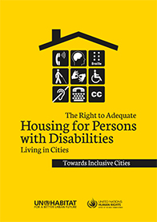
A Few of Our activities
a study that reviews the literature on the meaning and impact of the right to adequate housing for persons with disabilities in cities.
outlined major types of barriers that persons with disabilities encounter (physical inaccessibility, lack of access to transportation services, insecurity of tenure, among others)
Identified trends in relation to policy and legal framework and national and sub-national solutions to the realization of the rights of persons with disabilities.

Slide 21
improving access and Mobility for Groups in Vulnerable Situations (Nairobi)
        to create knowledge and awareness on value for investment in increased access and mobility for older members of society, PWDs, expectant mothers, children and the sick among
        Private investors
        government agencies,
        matatu owners and their crew and
        general public
Capacity Building that will eventually lead to different body building for public transportation
Showcasing best practices in the city

Slide 22
A/HRC/35/L.30/Rev.1
Promotion and protection of all human rights, civil, political, economic, social and cultural rights including the right to development
Azerbaijan,* Brazil, Ecuador, El Salvador, Thailand:* draft resolution
Highlights and reaffirms UN- Habitat's role as the focal point for all urbanization and human settlement matters within the UN system.
Sources the NUA especially with regards to the SDGs and leaving no one behind by ensuring that those who are most affected by policies and development are included and allowed to participate meaningfully in the making and rolling out of said policies and development.

Slide 23
recommendations
States to ensure that programs and services are fully accessible.
        Mandating universal designs
        Provision of reasonable accommodations; and
        Eliminating disability based discrimination.
        Undertake accessibility audits
        Ensure that private entities that offer facilities and services which are open or provided to the public take into account all aspects of accessibility for persons with disabilities
        appropriate measures to support freedom of expression and opinion - improve participation and access to resources and opportunities

Slide 24
RECOMMENDATIONS
important to eradicate discrimination in legislation and policies that have the effect of further limiting ability to participate.
Note and resolve policies or initiatives that further lead to the denial of persons with disabilities right to live independently and in community

