Slide 1

Disability Statistics and Data on
Social Protection
UNDESA-UNESCO Expert Group Meeting on
Disability Data and Statistics
Hasheem Mannan
Senior Research Fellow
Nossal Institute for Global Health
Melbourne School of Population and Global Health
University of Melbourne
(hmannanh@unimelb.edu.au)

Slide 2

Context
UN Convention on the Rights of Persons with Disabilities
Article 28 - Adequate standard of living and social protection
28 (2) (b)
To ensure access by persons with disabilities, in particular women and girls with disabilities and older persons with disabilities, to social protection programmes

Slide 3
Context: UNCRPD Reporting Guidelines
Article 16 - Freedom from exploitation, violence and abuse
Social protection measures to assist and support persons with disabilities, including their families and caregivers
Article 27 - Work and employment
Measures taken to ensure their access to basic services and social protection

Slide 4
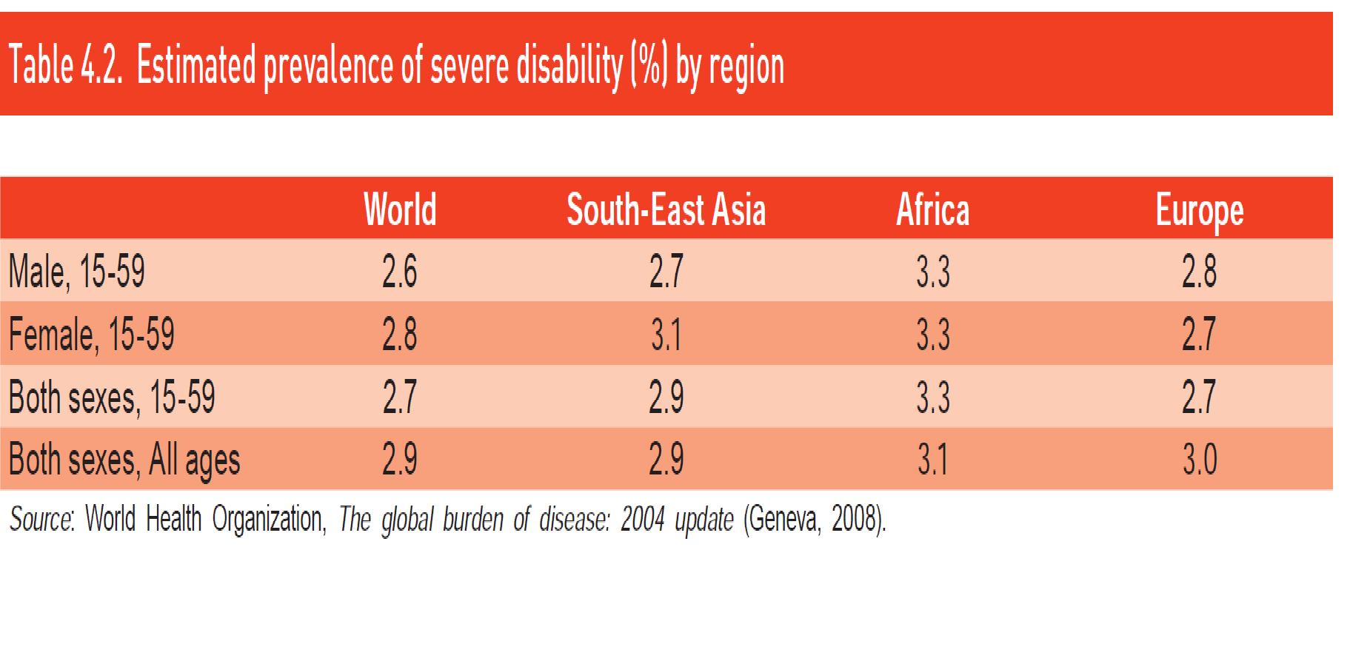
Social Protection: Coverage

Slide 5
Context: Recent Studies
Mleinek and Davis (2012) suggest that the inclusion of disability issues in social protection policies depends on a complex mix of factors including “political will, appropriate legislation, economic resources and implementation mechanisms” (p. 6).
GIZ’s justification for their support of disability inclusion in Indonesia’s social protection policy is that only inclusive policies will “promote abilities and … enable beneficiaries to lead a dignified, self-determined life” (Mohr in Mleinek & Davis, 2012, p. 3).

Slide 6
Context: Recent Studies
Justification for the inclusion of people with disabilities in social protection programmes is their “susceptibility to chronic poverty and social exclusion” (Palmer, 2013, p. 151; Schneider et al, 2011b, p. 38).
Data and policy evaluations relating to disability inclusion in countries’ social protection policies and strategies are scarce (Mont, 2010 p. 322).
Source: Rohwerder, B. (2014). Disability inclusion in social protection (GSDRC Helpdesk Research Report 1069).

Slide 7
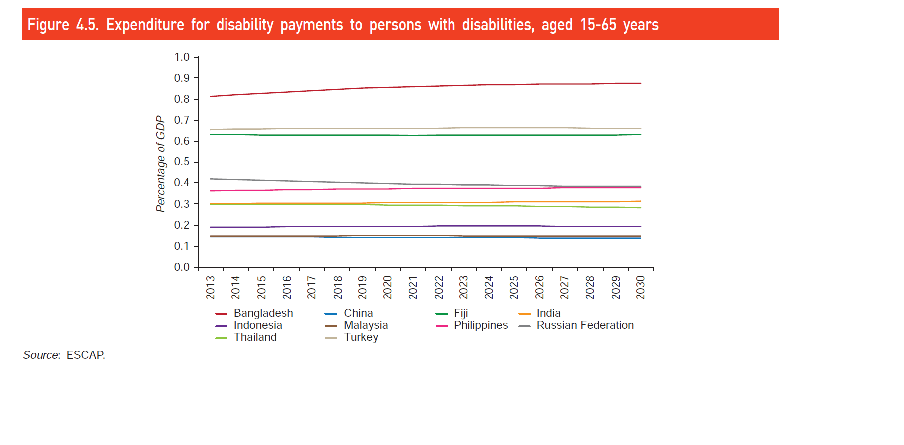
ESCAP Study: Providing income security for persons with disabilities

Slide 8
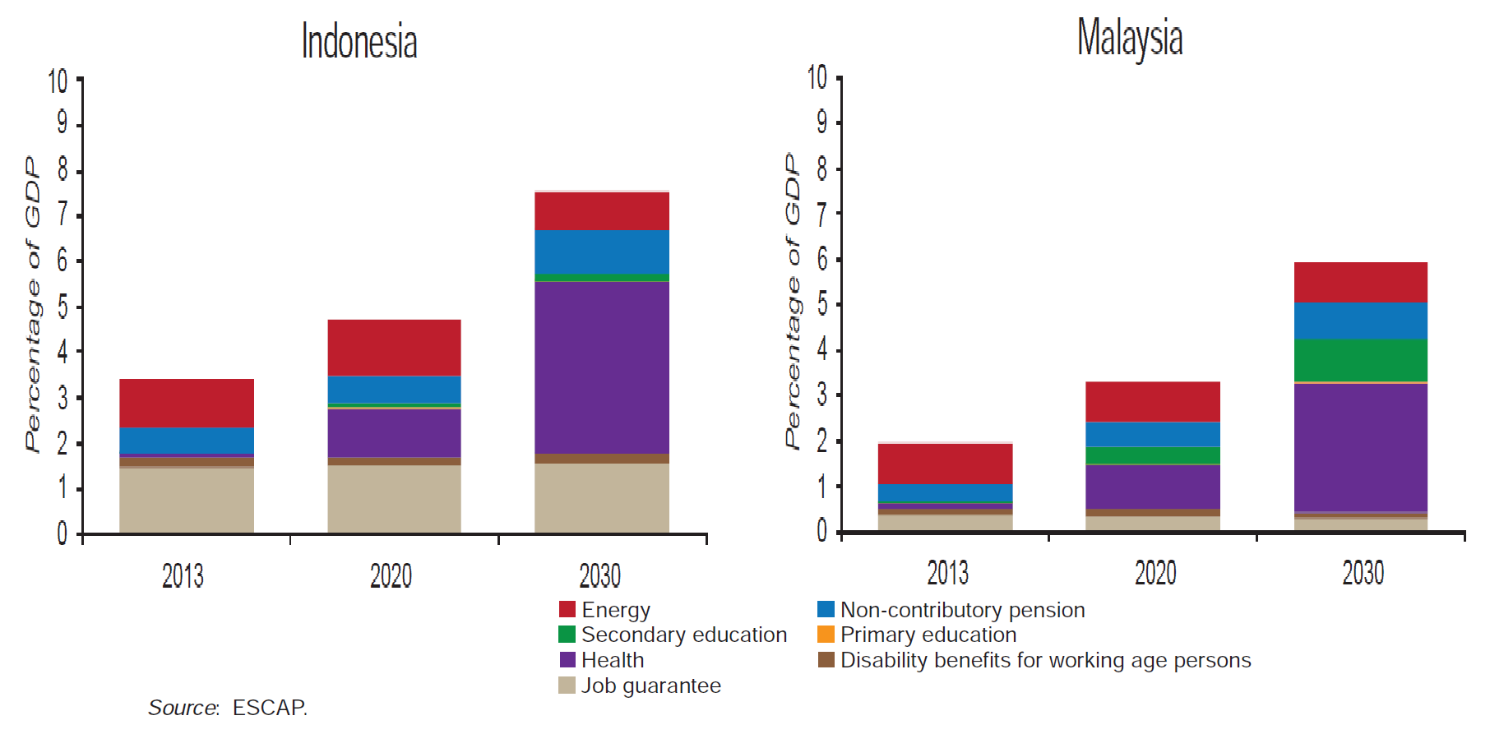
Total investment and expenditure for proposed policy package

Slide 9
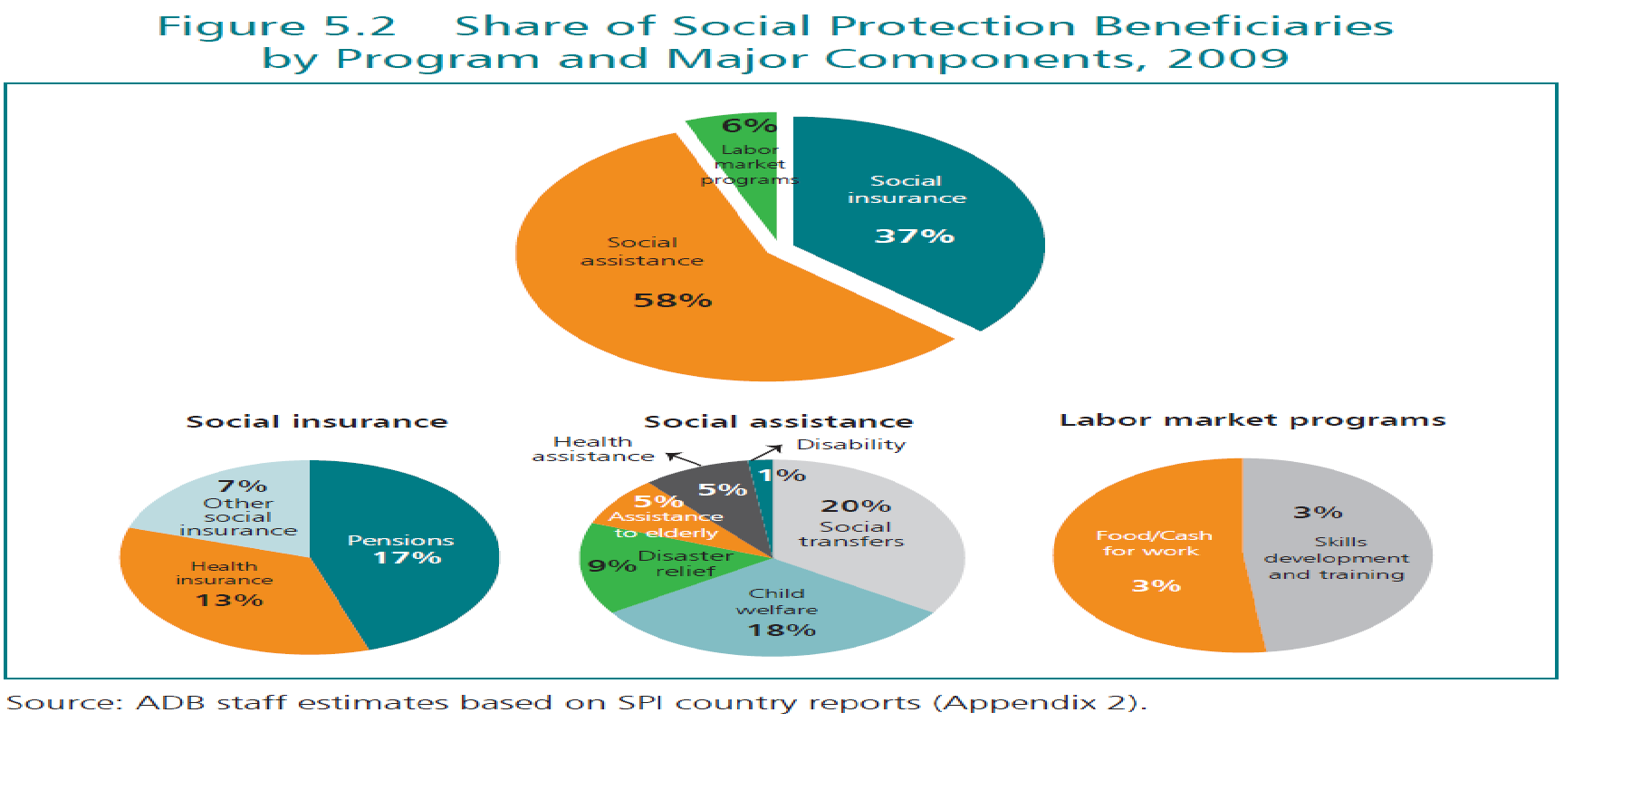
ADB Study on Social Protection

Slide 10
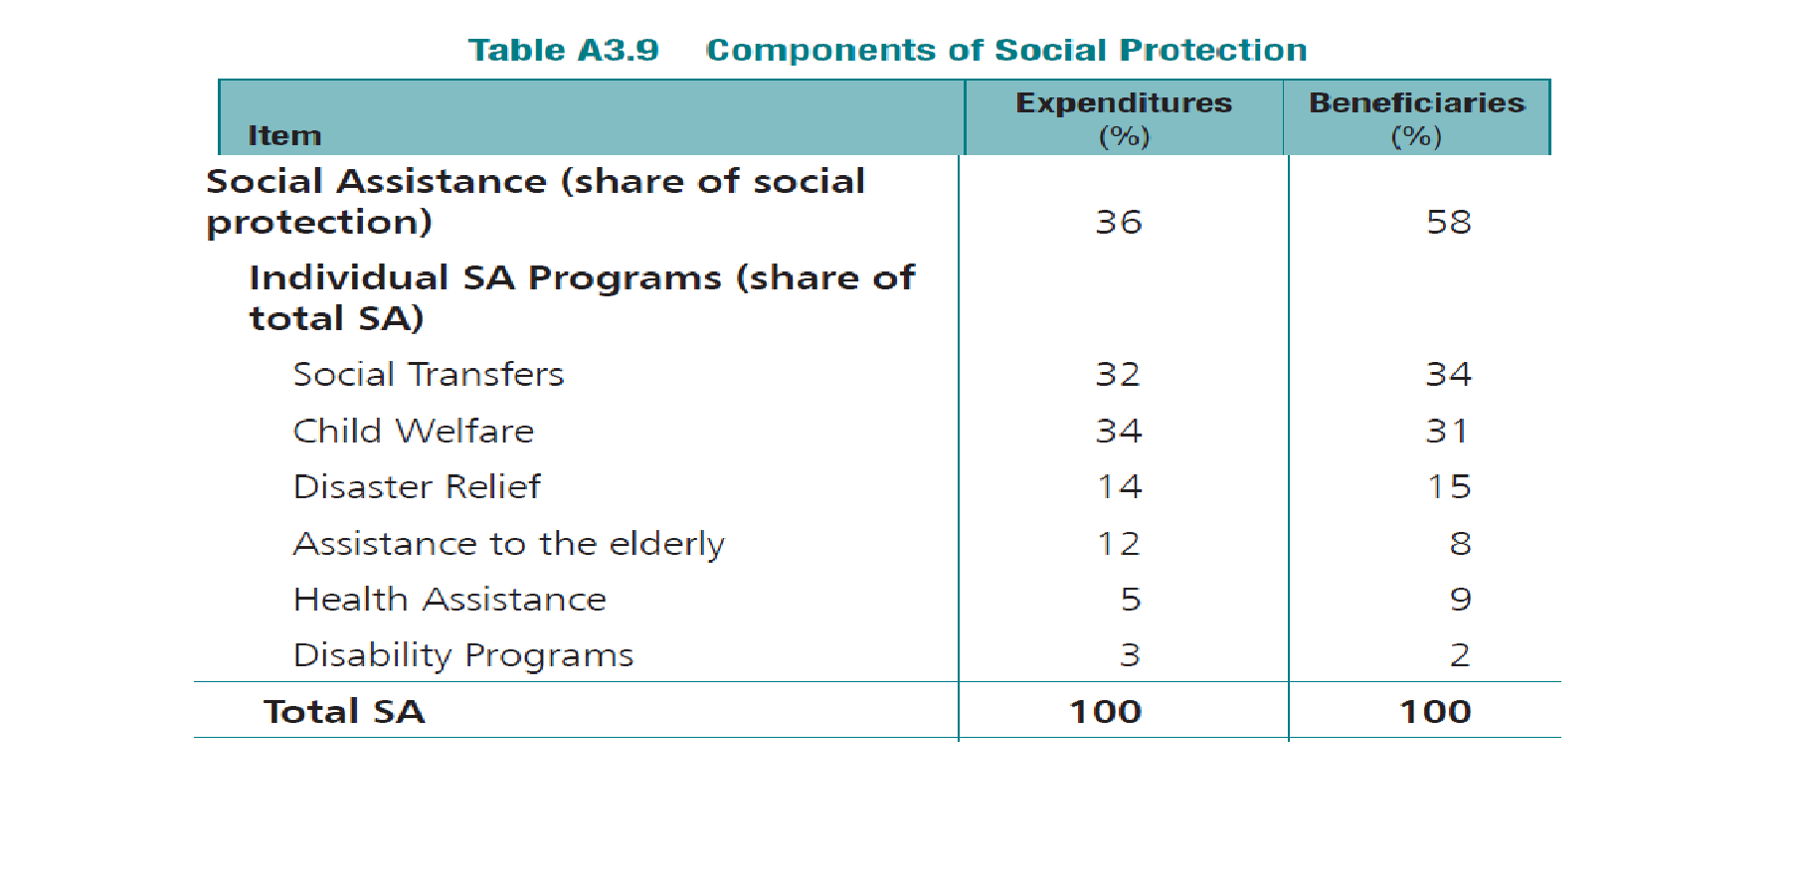
ADB Study on Social Protection

Slide 11
Disability Benefits
Disability benefits are the smallest subcomponent of social protection, with only 2%–3% of spending and beneficiaries.
Indeed, many countries in Asia and the Pacific provide only negligible benefits to disabled people.
Source: Asian Development Bank, The social protection index. 2013

Slide 12
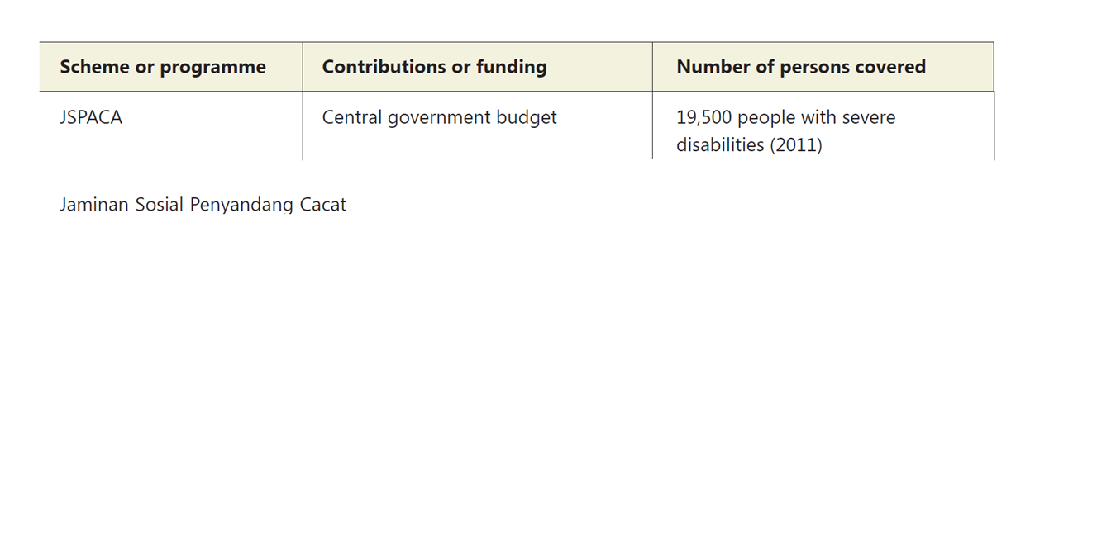
Indonesian Experience (JSPACA- ASODKB)

Slide 13
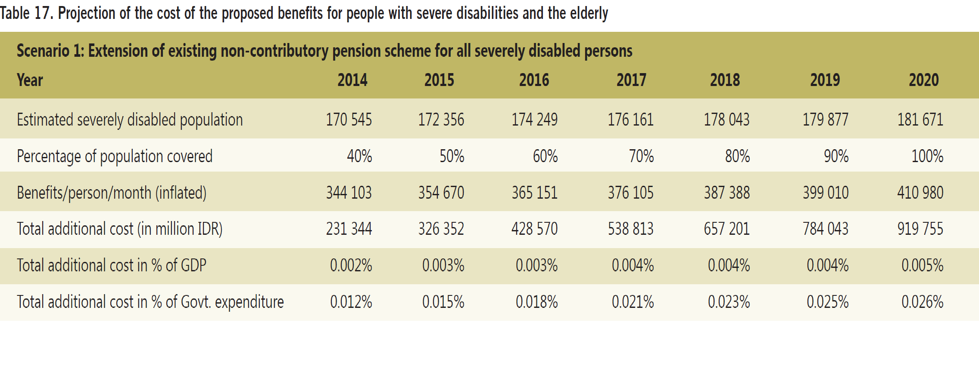
Indonesian Experience: ILO Social Protection Assessment

Slide 14
FOUR GROUPS WITH DIFFERENT NEEDS:
THE POOR, VULNERABLES, MIDDLE CLASS, RICH
Growth of Per capita Expenditures, 2008-2012
+Rp 250.000/kap/bl
+Rp 370.000/kap/bl
+Rp750.000/kap/bl
12%
40%
80%
Poor
Vulnerables
Middle Class
Rich
29 mil.
70 million
100 million
50 million
Poverty
Alleviation
& Social Protection
Social Protection, Business Climate & Market Access
Business
Climate
Sumber: BPS & TNP2K

Slide 15
NATIONAL TARGETING SYSTEM USING UNIFIED DATABASE
Eligibility Criteria
Social Protection Program
Program Eligibility Criteria is s et by each program.
E.g. for PKH. Minister of Social Affairs sets as:
extreme poor households with elementary
school age children or pregnant mothers
Unified Database
For Poverty Allev & Social Protection
Data by name & address,
containing the lowest 40% of population
Beneficiary List of
Social Protection Programs
Beneficiary List of
Social Protection Program
Names and addresses of eligible beneficiaries
of the Social Protection Program
Beneficiary List of
Social Protection Program
Beneficiary List of
Social Protection Program
Program eligibility can be formulated using different criteria:  Geographical (e.g. based on indicators of poverty, education, health, etc.)  Benefitting unit (e.g. individuals, households, family)  Economic status (extreme poor, poor, near poor, vulnerable)  Demographic status (sex, age, education status, types of works, etc.)

Slide 16
SINGLE REGISTRY IMPROVES
PROGRAM COMPLEMENTARITY
In the
Unified Database:
+ 25 mil. Households
(+ 96 mil. People)
Health Insurance: + 86,4 million people
Raskin/BSM/BLSM – KPS:
+ 15,5 million households
PKH: + 3 juta RT
    Household ranking with
    PMT Index = f (household & regional characteristics)
    The household characteristics includes housing conditions and status of ownership, assets, number of household members, level of education, working status, etc. → specific for each Kabupaten/Kota
16

Slide 17
Type of disability
0. No disability
1. Physical disability
2. Blind
3. Deaf
4. Mute
5. Deaf & mute
6. Blind & physical disability
7. Blind, deaf & mute
8. Deaf, mute & physical disability
9. Deaf, mute, blind & physical disability
10. Retardation mental disability
11. Former mental disorder patient
12. Physical & mental disability
HOUSEHOLD CHARACTERISTICS:
STANDARD Household & Individual Characteristics
Relationship with the family head
Gender
The Month-Year of Birth
Marital Status
Identity card ownership
Type of disability
Chronic disease
School participation: highest grade attended, highest certificate owned
Working/assisting work for a week
Field of business of the main occupation
Position status in the main occupation
Housing conditions
Assets ownership
Program participation

Slide 18
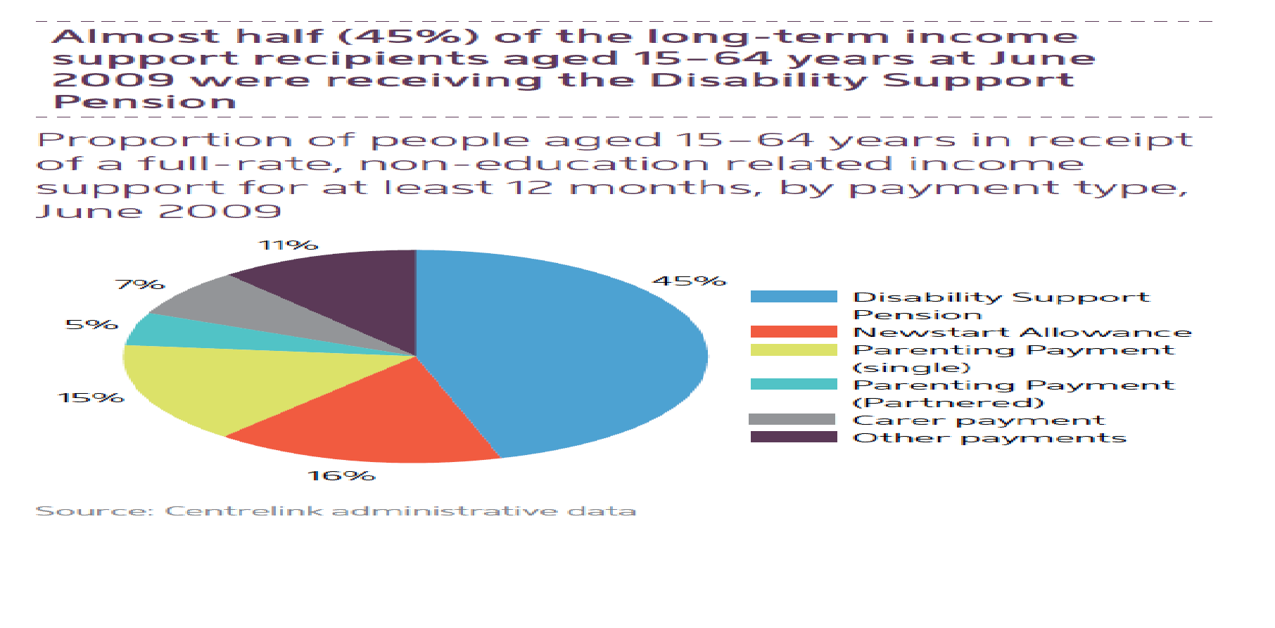
Australian Study on Social Inclusion

Slide 19
Australian Study on Social Inclusion
Close to half (48%) of those in receipt of a payment for at least 12 months had a disability.
The vast majority of these people were receiving Disability Support Pension.
Less than half (49%) of all people with disability aged between 15 and 64 years were employed in 2003, compared with 77% of those without disability

Slide 20
Australian Study on Social Inclusion
In 2006–07, 61% of people using disability employment services found employment
  People with a physical or psychiatric disability
  Aboriginal and Torres Strait Islander Australians
  Those born in non-English speaking countries have poorer outcomes
  Source: Social Inclusion in Australia: How Australia is faring (2010). Australian Social Inclusion Board, Australian Government

Slide 21
Challenges and opportunities
Lack of data leading to expensive and unreliable targeting.
Proper targeting system requires follow up assessments and monitoring
Benefit sometimes worth less than the cost of travelling to receive it.
People with disabilities, living in remote areas, are unaware of social protection schemes.
Source: Mleinek, H. & Davis, M. (2012). Disability and Social Protection in Indonesia

Slide 22
Opportunity to address: Baseline and Longitudinal
Determining and implementing eligibility criteria for social protection measures
What extent should social protection efforts for persons with disabilities be mainstreamed into general social protection programs?
What extent of transitional supports enable persons with disabilities to become productive citizens?
Should there be cash or in-kind supports (example energy, housing, personal devices, personal assistance)?
Highlighted recently by studies including: People with disabilities in Indonesia: Empirical facts and implications for social protection policies. Demographic Institute Faculty of Economics, University of Indonesia. April 2013

