Slide 1


Global policy framework and standards on ICT accessibility
UNDESA/DSPD FPRUM
DISABILITY INCLUSION AND ACCESSIBLE URBAN DEVELOPMENT
Nairobi, Kenya 28 October 2015
Susan Schorr, Head, Special Initiatives Division
INTERNATIONAL TELECOMMUNICATION UNION – ITU

Slide 2



Introduction to ITU
Meet us
ABOUT ITU
1865 2015
ITU is the United Nations specialized agency for information and communication technologies (ICTs)
Promoting global collaboration for a connected world

Slide 3


ITU work on
ICT ACCESSIBILITY
Why ICT accessibility is important for ITU
ICTs are fundamental to enable the independent living of persons with disabilities
Communication / social integration
Access to key public services
Health
Education
Government services
Access job market, including becoming entrepreneurs / Social and economic development
ICTs are a powerful equalizer of abilities, empowering persons with disabilities to fulfill their potential, dreams and ambitions. To achieve this impact ICTs have to be accessible
Strategic Target: Enabling environments ensuring accessible telecommunication/ICT for persons with disabilities should be established in all countries by 2020

Slide 4
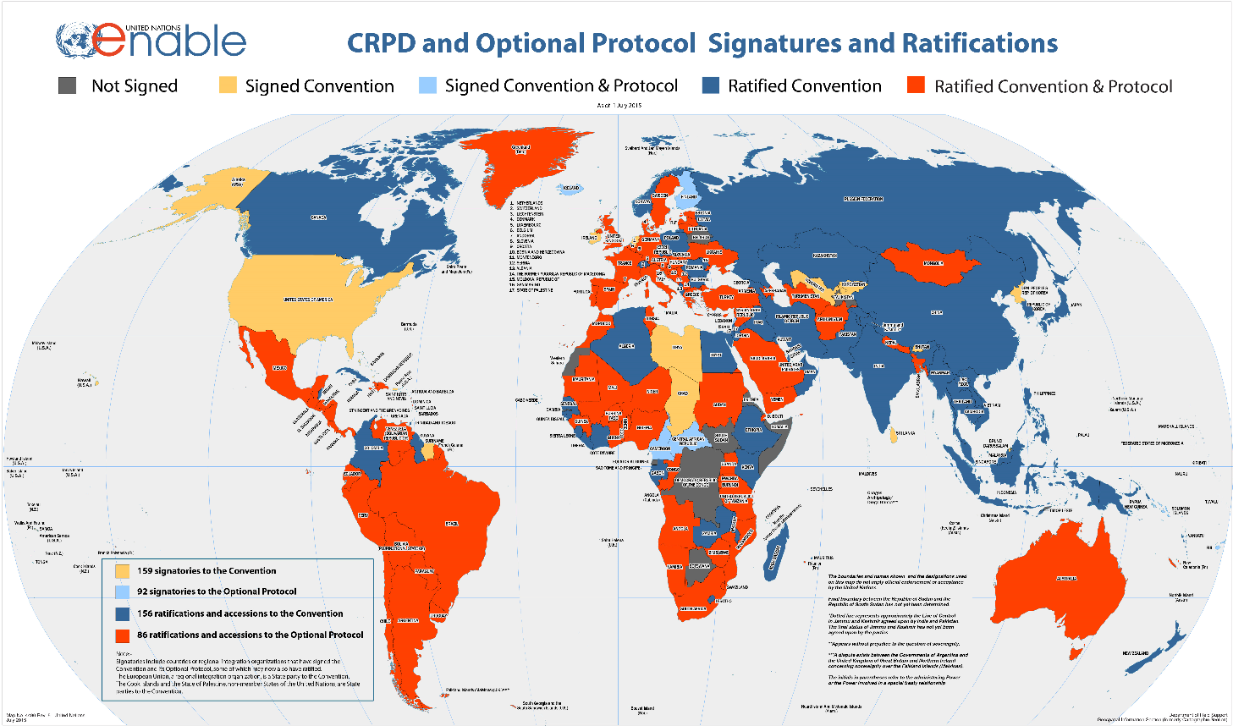
ICT ACCESSIBILITY - UNITED NATIONS
U.N. Convention on the Rights of Persons with Disabilities - CRPD
160 signatories; 159 ratifications

Slide 5
ICT ACCESSIBILITY - UNITED NATIONS
U.N. Convention on the Rights of Persons with Disabilities - CRPD Article 9
To enable persons with disabilities to live independently and participate fully in all aspects of life, States Parties shall take appropriate measures to ensure to persons with disabilities access, on an equal basis with others . . . to information and communications, including information and communications technologies and systems . . .
These measures, which shall include the identification and elimination of obstacles and barriers to accessibility, shall apply to . . . Information, communications and other services, including electronic services and emergency services.

Slide 6
ICT ACCESSIBILITY
Accessibility means what the user requires to gain functional access to ICT
If you cannot see a typical screen you need a way to understand what is on it:
Screen readers Audio description Tactile markers
Text to speech (TTS) Screen magnifiers
Gesture-based screen readers
If you cannot hear the information, you need a way to get that information:
Captioning and signing Video relay services SMS and MMS
Hearing aid compatibility Speech to text
Volume adjustment
i.e., provide alternative but equivalent ways of accessing ICTs

Slide 7
How to transpose ICT Accessibility provisions in the CRPD into national law?
States Parties have ICT policies, legislation and regulations
These key legal instruments must be updated to achieve the goal of promoting ICT accessibility
States Parties Disability laws also have to be updated to promote ICT accessibility
Updating States Parties Public Procurement laws may be one of the most effective ways to ensure the availability of accessible ICTs

Slide 8
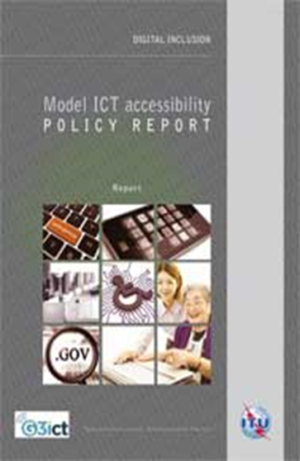
ITU work
ICT ACCESSIBILITY
Model ICT Accessibility Policy Report
Provides policy guidelines and legal and regulatory framework
Designed to help countries develop their own accessibility policies and regulations
Modular design includes stand-alone sections on:
Model ICT legal, policy and regulatory framework
Model ICT accessibility framework on public access
Model mobile communications accessibility policy framework
Model television/video programming accessibility framework
Model web accessibility policy framework
Model accessible ICT public procurement policy framework
www.itu.int/en/ITU-D/Digital-Inclusion/Pages/Reports.aspx

Slide 9
ITU work
ICT ACCESSIBILITY
Model ICT Accessibility Policy Report
Key elements of national ICT accessibility policies
Awareness raising among key stakeholders – creating awareness about the need to promote ICT Accessibility (Governments, Mobile Operators, Broadcasters, Private Sector, NGOs etc)
Identify key steps to remove barriers to ICT use - by persons with different kinds of disabilities and different ICT devices and platforms (web, mobile, TV)
Get specific on how to achieve ICT accessibility – e.g accessible mobile devices, emergency communications, TV services, after care
Consultation with persons with disabilities in policy making- create a committee on persons with disabilities and embracing the principle of ‘nothing about us without us’.
www.itu.int/en/ITU-D/Digital-Inclusion/Pages/Reports.aspx

Slide 10
Model ICT Accessibility Policy Report
Key elements of national ICT accessibility policies
Promote availability of accessible ICTs- use commercially available solutions
Raise awareness that accessible devices and services exist
- train staff on accessible features and how to serve customers with disabilities
- reach out to organizations of persons with disabilities to raise awareness
Build partnerships between academia and industry for solutions
- develop voice recognition and text-to speech interfaces in local languages
- web accessibility testing
Set clear targets, annual reporting on implementation of targets
Conduct periodic review to update policies in light of technological developments

Slide 11
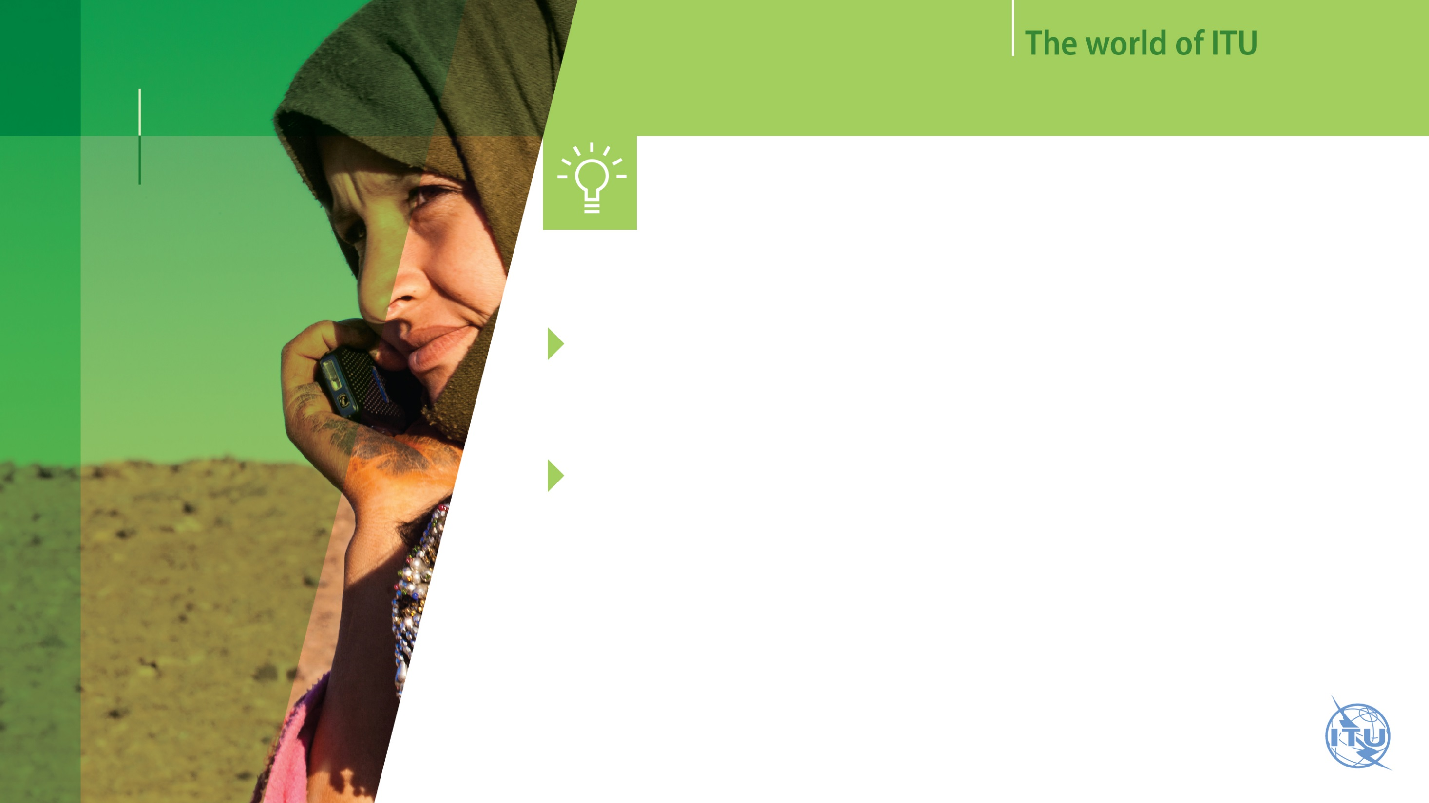


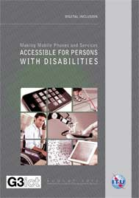

Introduction to ITU
ITU work on Accessibility
Development ITU - D
MAJOR ACHIEVEMENTS IN ICT ACCESSIBILITY
e-Accessibility Policy Toolkit for Persons with Disabilities (ITU and G3ict)
MAKING TV ACCESSIBLE
(ITU and G3ict)
MAKING MOBILE PHONEWS AND SERVICES ACCESSIBLE
(ITU and G3ict)
MODEL ICT ACCESSIBILITY POLICY REPORT (ITU and G3ict
www.itu.int/en/ITU-D/Digital-Inclusion/Pages/Reports.aspx

Slide 12


ICT ACCESSIBILITY
Thank you for your attention!
For more information:
www.itu.int/en/ITU-D/Digital-Inclusion/
www.itu.int/accessibility
susan.schorr@itu.int

