Slide 1


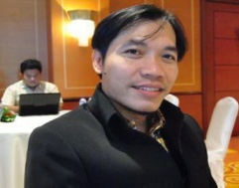
DISABILITY INCLUSIVE (URBAN) DEVELOPMENT
IN SOLO CITY AND SURROUNDING
# TOWARDS DISABILITY FRIENDLY CITY #
Speaker: Sunarman Sukamto
Organization: CBR Development and Training Center (CBR-DTC) Solo
Country: INDONESIA
-----------------
UN Convention Center, Nairobi, Kenya, 28 -30 October 2015

Slide 2
Why Disability Inclusive Development (Main Issues in the context of Solo City and surrounding) :
PWDs (including whom with mental health / psicosocial disability and affected by leprosy) experience stigma and discrimination in all aspect of life and all sectors of development in their daily life.
Women and children with disability experience multiple abuse and exploitation in many forms.
The system and structure of the massive developments marginalize PWDs.
How Disability Inclusive Development (Context of Solo City and Surronding) :
In Policy Making Level (Main Strategy) :
Strengthen the Local Government Structure and System through Establishment the Disability Advocacy Team (DAT) with the Local Government Departments / Office / Units.
The DAT has reguler coordination meeting to develop program and budget to reasonable accomodate the disability rights in the development agendas of local government (cross-cutting issues).
In Grassroots Level (Main Strategy) :
Strengthen the Full and Effective Participation of PWDs in the System and Structure of Local Government through Establishment of many Self-Help Groups of PWDs. Some SHGs unite to be DPO.
The leaders of the SHGs / DPOs Involve and Influence the System and Structure of Local Government.

Slide 3
The Progresses as 2015 :
Local Regulations on Disability Rights are Created and Enforced.
Base Line Data and Mappping of PWDs are Continously Developed.
CBR and inclusive development principles are adopted.
Standard of accessibility is applied.
Students with disabilities (physical, visual, hearing, intellectual, autism) participatte in more than 500 reguler schools nearest to their home (quantitative and qualitative in progress).
Disability Advocacy Team (DAT) is functioning as coordination mecahnism to mainstream disability rights into their annual (on going) program and budget (cross-cutting and multi sectors).
SHGs / DPOs are active in local government structure and system (development planning in all level, regulation / policy making, and political agendas).
More than 200 houses of PWDs to be renovated by using government budget.
More than 200 PWDs works in more than 50 companies with reasonable standard of income and protection (equal with other non PWDs).
About 50% of 69.000 PWDs include in health insurance.

Slide 4
The Progresses as 2015 (Continue...) :
More public services and facilities are accessible (quantitative and qualitative in progress).
Abuse and exploitation issues of women and children with disabilities are continously addressed to ensure social protection and legal justice.
Program and budget for disability are increased (quantitative and qualitative).
Solo and other Districts surrounding Solo are declared as Inclusive City or Disability Friendly.
Sign language is accepted and promoted.
Solo City operates and ensures about 60 bus shelters, 30 rapid transit busses, three railway stations, 54 traffic lights, four pelican crossings, four city walks, its tourism bus and airport are accessible.
Modified motorcycles, driving license, and accident insurance for persons with disabilities.

Slide 5
The Main Challenges :
National Government Level :
There is Human Right National Action Plan, however requires political will and commitment.
Has not been a priority issue, remain seen as a social area.
Rehabilitation concept is not optimal; should be the issue of the development of all sectors (multi stakeholder).
Data and mapping of PWDs is confusing / overlapping.
Local Government Level :
Local government staffs are vulnarable to move to other department / unit.
Disability is seen as development issues; however political interest is dominant.
Grassroots Level :
Need time in capacity and character building of the leaders among PWDs.
Practical needs orientated is still dominant among PWDs.

Slide 6
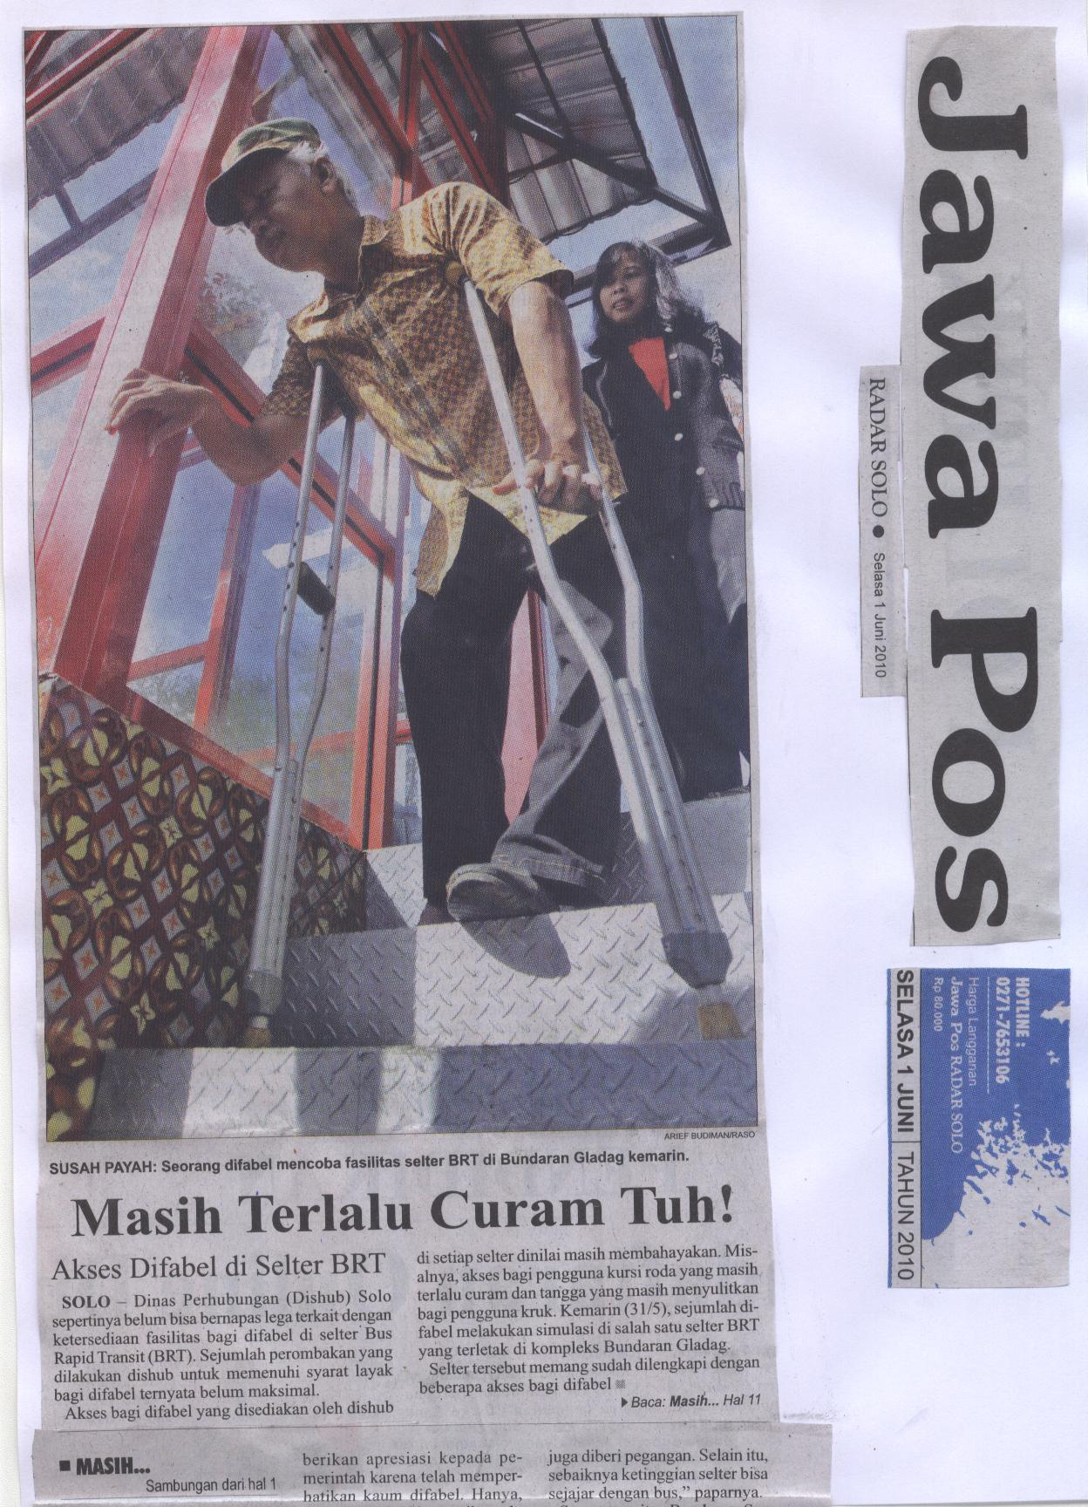
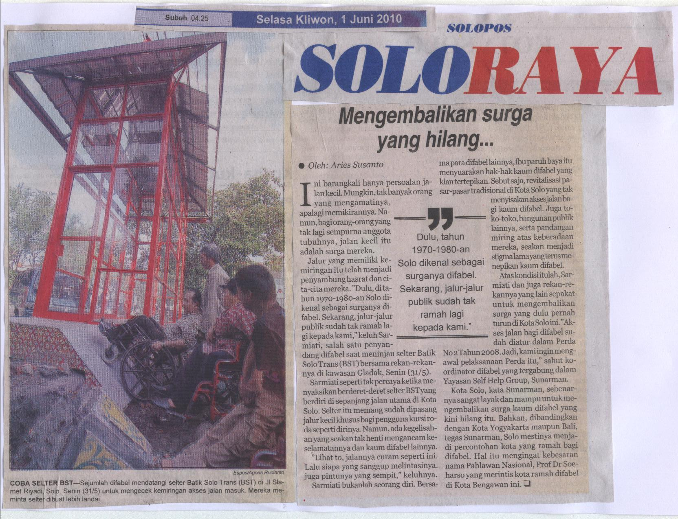
Accessibility Monitoring by SHGs / DPOs
Followed by Problems Solving Meeting Attended by Relevant Multi Stakehodlers

Slide 7
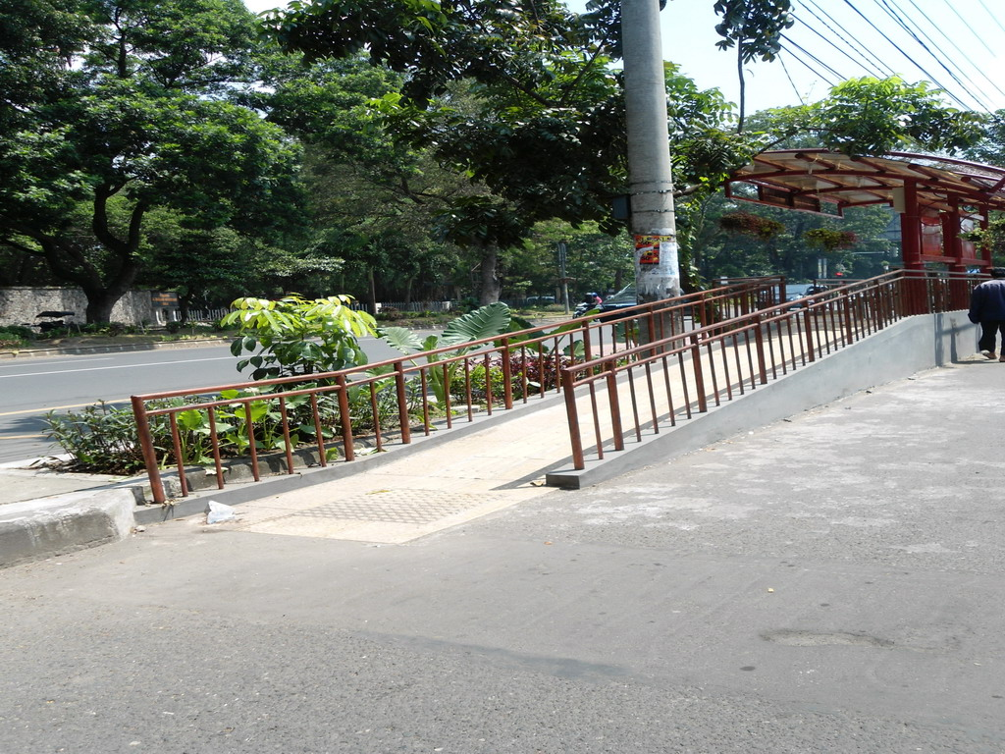
Example of Accessibility of Bus Shelter

Slide 8
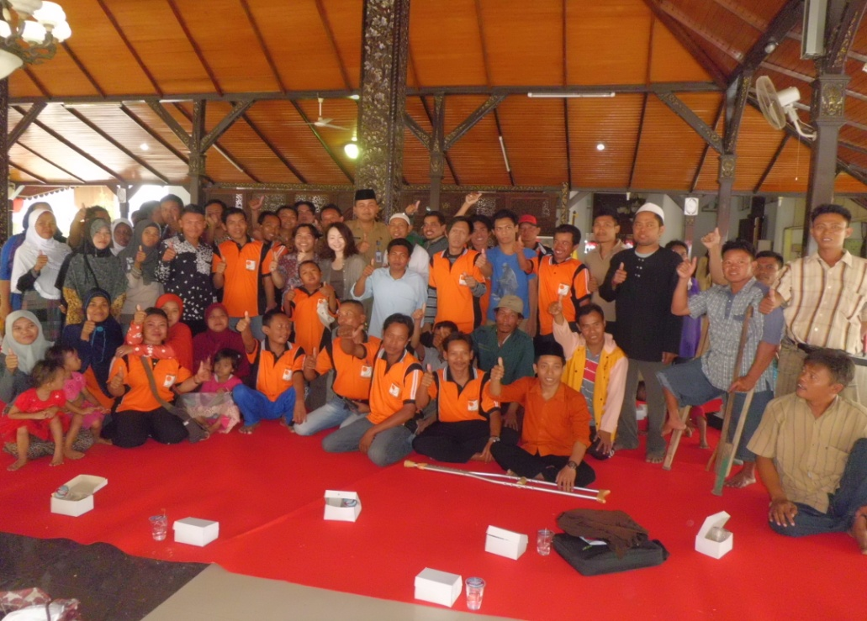
Thank you...
See you...

Slide 9
CBR DTC Solo at Glance
CBR DTC Solo was established in 1978 started to develop CBR concept as approach to disability issues in many rural areas. The ideas were proved successful in reaching and serving the persons with disabilities, particularly children with disability living in rural areas. Many CBR programs were implemented in many villages.
Taking into account the lesson learn of the long experiences of CBR implementation from 1978 – 2008 (30 years), the CBR DTC Solo since 2009 develop a metamorphose from village based CBR movement into advocacy model of CBR. Start from 2010, a massive advocacy to involve and influence the government system and structure has begun. Disability Advocacy Team (DAT), as the methamorphoses of CBR team, has initiated in many local governments with the UNCRPD and New CBR Guidelines as the main spirit and values to accomodate disability issues into cross-cutting issues in development.
CBR DTC Solo has progressive organizational development alongwith the massive advocacy of the rights of PWDs in Indonesia and beyond.
Address of CBR DTC Solo: Mendungan RT. 001 RW. 005 No. 29 Pabelan, Kartasuro, Sukoharjo, Solo (57162) Phone / Fax.: +62 271 7653029 Email : maman_shg@yahoo.com / mamansun@gmail.com / cbr.centersolo@gmail.com
Web.: www.pprbmsolo.org

Slide 10
Sunarman Sukamto
He is active in disability movement since he was a student.
He is now the director of CBR Development and Training Center (CBR-DTC) Solo. He is advocacy committee of Indonesia CBR Alliance. He is also the deputy chairman of Asia Pacific CBR Network.

