Slide 1
Public Procurement
Dónal Rice (MSc)
UNDESA/DSPD FORUM
DISABILITY INCLUSION AND ACCESSIBLE URBAN DEVELOPMENT
In collaboration with UN-Habitat | UN Office Nairobi | 28-30 Oct 2015

Slide 2
Agenda
Introduction to public procurement
Importance of public procurement
Overview of the policy landscape for accessible public procurement
Stages of accessible ICT public procurement
Key resources

Slide 3
Introduction to public procurement
The Public Procurement System is a function of government that involves using government resources (public funds) to obtain goods, works and services to meet the the needs of the government as it carries out its responsibilities to the citizens.
(Dr. Gonzalo de la Cruz Salas)

Slide 4
Importance of public procurement
The World Trade Organization estimates that on average public procurement accounts for 10-15% of a country’s Gross Domestic Product (GDP)
In the European Union the figure is as high as 16-17% of GDP.
“Public procurement is one of
the most flexible and far-reaching
legislative instruments available
to the Government”
(Gelderman, 2010)
Notes:
Gelderman, K. Ghijsen, P. Schoonen, J. 2010. "Explaining Non-compliance with European Union Procurement Directives: A Multidisciplinary Perspective." Journal of Common Market Studies 48 (2):243-264. doi: http://onlinelibrary.wiley.com/journal/10.1111/%28ISSN%291468-5965/issues.

Slide 5
Use of PP to achieve social goals
Socially responsible public procurement
Examples:

Slide 6
Accessible ICT PP can:
Improve inclusion of persons with disability in education, employment, economic and social life
Deliver better value for money for governments and public authorities
Incentivise manufacturers and suppliers to innovate and produce better, more accessible technology
Improve over-all quality of ICTs by making them more user-friendly

Slide 7
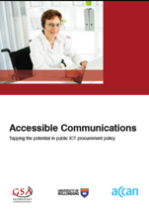
Influence on industry
Industry is heavily influenced by the rules and regulations set by governments. A representative from software developer Adobe is quoted as saying
“When government says you need to build technology a certain way, for vendors like ourselves that’s a very compelling maxim. We need to build products that can be sold to the government. It’s not very practical for us to build multiple versions of our products”
(Marsan, 2001 cited in D’Aubin, 2007 and Astbrick 2012)
“Accessible Communications: Tapping the potential In public ICT procurement policy” (Gunella, A., Tibben, Wi., 2012) provides indepth analysis of accessibility of different public procurement regimes around the world including the United States of America, Japan, European Union, Canada, Ireland and the United Kingdom

Slide 8
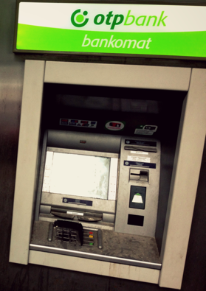
UN Convention on the Rights of Persons with Disabilities
Article 9 on accessibility
Article 24 on education
Article 32 (a) of the CRPD on “International Cooperation”
Case of of Nyusti and Takács v. Hungary
Taken under optional protocol
Committee required accessibility to be considered in furure procurment
Eleventh session
Emphasises the importance of accessibility in public procurement
Notes:
The Eleventh Session of the Committee on the Rights of Disabilities noted that disability laws “often fail to include ICT in their definition of accessibility” and that State parties (to the Convention) must ensure “their public procurement procedures incorporate accessibility requirements.” (paragraph 32)
Article 32 (a) of the CRPD on “International Cooperation” requires that international development programmes are inclusive of and accessible to persons with disabilities. In support of this aim, this policy may be used for procurement utilizing both monies received from international aid programmes and monies from domestic revenues.
Committee on the Rights of Persons with Disabilities. “General comment No. 2 (2014) Article 9: Accessibility”. Available at http://tbinternet.ohchr.org/_layouts/TreatyBodyExternal/SessionsList.aspx?Treaty=CRPD. Accessed 13th January 2015

Slide 9
Public Procurement in Europe
2014:
New public Procurement Directives
To be transposed by early 2016
Accessibility must be included as a Technical Specification (mandatory requirement) in ALL procurements
First European Standard on Accessibility
EN 301 549 “Accessibility requirements suitable for public procurement of ICT products and services in Europe”
Harmonised with Section 508 standards
Notes:
Directive 2014/24/EU of the European Parliament and of the Council of 26 February 2014 on Public Procurement and Repealing Directive 2004/18/EC
Article 42 of the new Public Procurement Directive on Technical Specifications significantly strengthens the obligations of public bodies, except in ‘duly justified cases’ to ‘take into account accessibility criteria for persons with disabilities or design for all users.’ It also expands the beneficiaries to be either members of the ‘general public or staff of the contracting authority’.

Slide 10
EN 301 549 - Accessibility requirements suitable for public procurement of ICT products and services in Europe
Structure:
Intro
Scope
Definitions
Clause 4 - Functional performance statements (FPS)
Clause 5 – 13 “Generic Requirements” Technical accessibility requirements (TAR)
Annex A - WCAG 2.0
Annex B – Relationship between FPSs and TARs
Annex C - tests

Slide 11
Functional Performance Statements
Usage without vision
Usage with limited vision
Usage without perception of colour
Usage without hearing
Usage with limited hearing
Usage without vocal capability
Usage with limited manipulation or strength
Usage with limited reach
Minimize photosensitive seizure triggers
Usage with limited cognition

Slide 12
Key stages of public procurement
Preparatory study
Writing the Call for Tender
Selection criteria – critical for the procurement of development services or bespoke systems
Technical specifications – use the standard
Award criteria
Asking for verification of compliance
Contract awarding and maintenance

Slide 13
Key resources 1

Slide 14
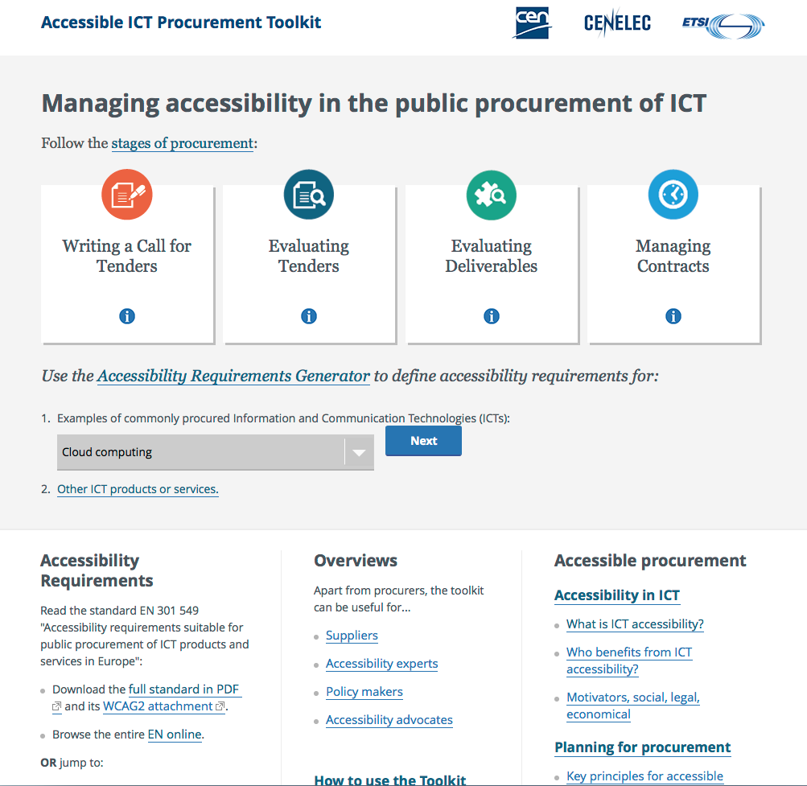
http://mandate376.standards.eu

Slide 15
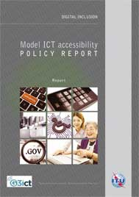
Key resources 2
The G3ict/ITU “Model ICT accessibility policy report” contains six chapters.
Chapter 6: chapter “Accessible ICT public procurement policy framework ”

Slide 16
Online Training: Public Procurement of accessible ICT products and services
Notes:
This training is targeted at managers, ICT staff and employees from government organisations including central procurement agencies, ICT companies, civil society bodies representing persons with disabilities and academia, who are interested in understanding the implementation and regulation of public procurement of accessible ICTs including international standards. Other institutions and individuals that are dedicated to building their capacity related to accessible ICTs are also welcome to participate.

Slide 17
Online Training: Public Procurement of accessible ICT products and services
12th October - 27th November 2015
7 weeks
Module 1: Introduction to the accessibility of ICTs: key concepts and definitions
Module 2: International Policy and Regulation for Public Procurement
Module 3: International standards suitable for use in the public procurement of accessible ICTs

Slide 18
Online Training: Public Procurement of accessible ICT products and services
Module 4: Introduction to the stages of procurement & the preparatory study
Module 5: Accessibility as a criterion in the Request for Tender
Module 6: Requesting and verifying evidence of conformity
Module 7: Accessibility in contract clauses and contract management
Module 8 : Use of public procurement toolkits and advisory documents
Module 9: Developing an accessible ICT Procurement Policy
Register at https://academy.itu.int

