Slide 1
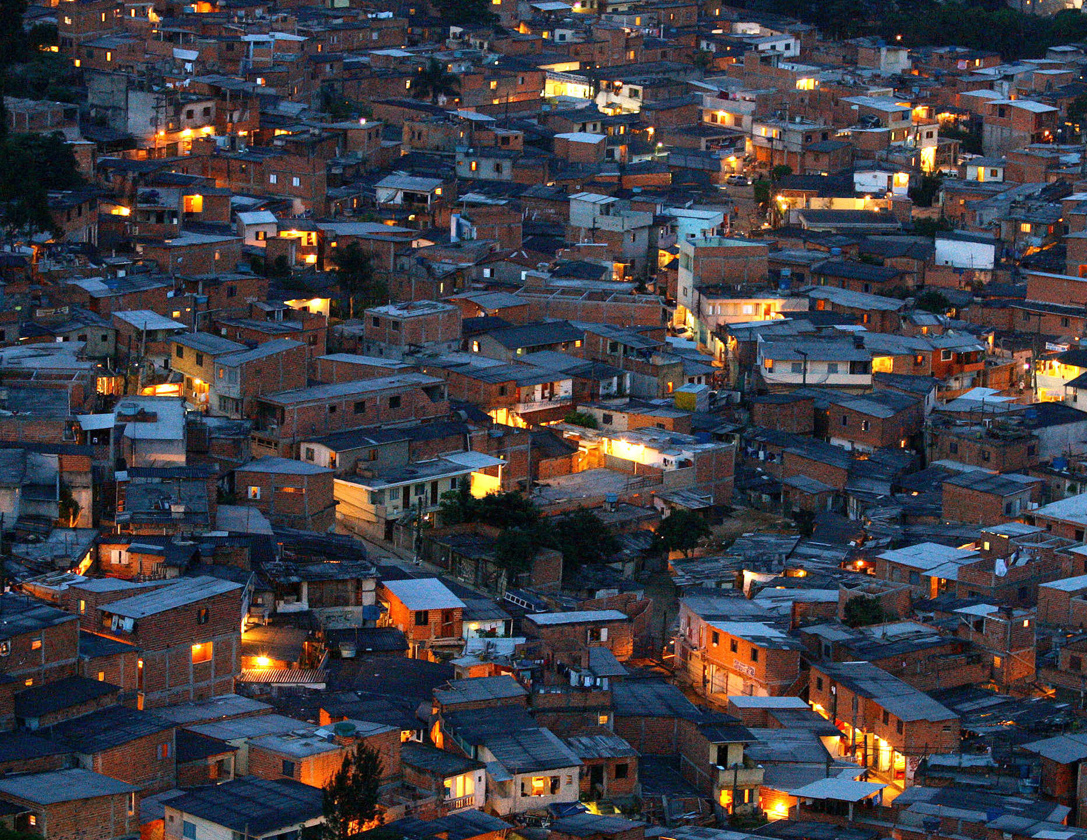

UNDESA-DSPD FORUM
DISABILITY INCLUSION AND ACCESSIBLE URBAN DEVELOPMENT
Repositioning Housing at the Centre of Cities, towards Urban Inclusion
28 October 2015 Nairobi, UNON
Housing and Slum Upgrading Branch

Slide 2
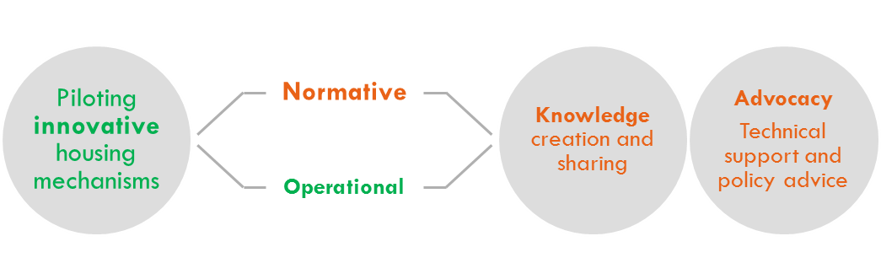

UN-Habitat Mandate
UN-Habitat is committed to supporting governments to promote sustainable urbanisation and adequate housing for all

Slide 3
UN-Habitat Strategic Frameworks

Slide 4
Housing at the Centre of the New Urban Agenda
Habitat II
Habitat III
2012
2013
2016
Review of Global Shelter Strategy
Regional assessments
Global review
Roadmap for GHS
Towards a new Global Housing Strategy
Principles and Framework
Resolution 24/9
Piloting in selected countries
Housing at the Centre
of the New Urban Agenda
Strengthened link with urbanisation and urban planning practice
Awareness, commitment and involvement of governments beyond enablement
People-centered planning – ‘place matters’
ADVISORY SERVICES
+
TECHNICAL SUPPORT
CAPACITY BUILDING
+
KNOWLEDGE INFORMATION
ADVOCACY
+
AD HOC SUBSTANTIVE ACTIVITIES
POLICY
CITIES
PEOPLE

Slide 5
2016 Habitat III
The development of a New Urban Agenda
Offers the opportunity to rethink the role of housing in the development agenda and within the new strategic thinking of UN-Habitat on planned urbanisation
Also an opportunity to engage policy makers on adequate housing provision, for all, and for the public sector to lead by example

Slide 6
“Housing at the Centre”
Positioning Housing at the Centre – of urbanisation, national development agendas, cities and communities, people-centered
A paradigm shift – in housing policy, urban planning and building practices
A strengthened role of governments – through strong institutions, policy and regulatory frameworks
National and local authorities need to be at the helm – of policy design and implementation
This also means directly intervening – in the different areas of housing provision - including infrastructure and land, to address the specific challenges and needs of the most vulnerable

Slide 7
Global Housing Strategy
A Global collaborative movement towards adequate housing for all based on the principles of Human Rights and Inclusion
Strengthen the role of governments in housing policy, regulation and intervention
Reflect the views from community groups and civil society
Provide technical support and assistance to the overall policy making and implementation process

Slide 8



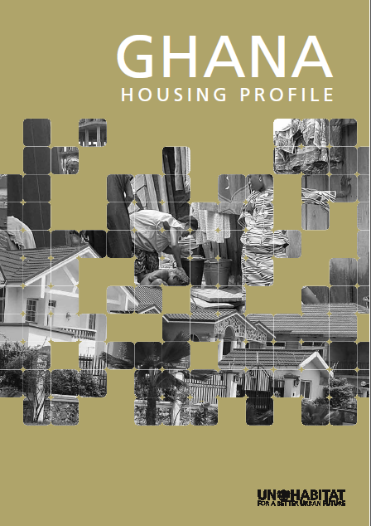



Global Housing Strategy Process
Housing sector assessment
Output: Housing Sector Profiles
Policy reform and implementation
Output: Action plan and roadmap for policy implementation
Programme design
Supporting the design of specific and tailored housing responses according to country needs and priorities
www.unhabitat.org

Slide 9
Housing Diversity and Inclusion in the Global Housing Strategy
Housing inclusion and diversity integral to success in the GHS
Housing sector assessment
Housing profile Existing challenges and needs of vulnerable group
Policy reform and implementation
Action plan Housing reform focusing on special needs and challenges
Programme design
Housing programmes Housing programmes to support housing diversity
Diversity and inclusion component
Diversity and inclusion component
Diversity and inclusion component

Slide 10
Global Housing Strategy Collaborations
Housing sector assessment
Completed 16 Housing Profiles in Africa, Asia and Latin America
Policy reform and implementation
Currently implementing housing strategies in six countries (Djibouti, Ghana, Mozambique, Lesotho, Zambia, Myanmar)
Programme design
Housing programme design in human rights, inclusive housing finance, as well as housing design, green and alternative building materials

Slide 11
UN-Habitat, Accessible Housing and Disability Inclusion

Slide 12
UN-Habitat’s Integrated Approach to Housing
Housing Finance
Housing Rights and Human Rights
Housing Finance
CURATIVE
PREVENTIVE
Green Housing
Housing Diversity and Culture

Slide 13
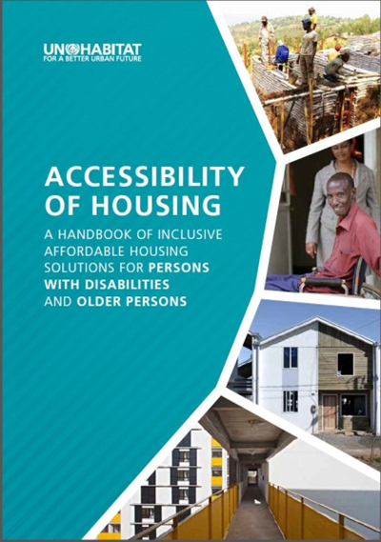
Global Housing Strategy’s Work on Disability Inclusion and Accessible Housing
From the perspective of Sustainable
Housing Design: Handbook on Inclusive
Affordable Housing Solutions for Persons
with Disabilities
From the perspective of Human Rights
in cities: The Right to Adequate Housing for
Persons Living with Disabilities in Cities –
Towards Inclusive Cities - UNHRP
Promote, at country level, innovative and inclusive housing approaches to achieve the progressive realisation of adequate housing for all, considering their diversity

Slide 14

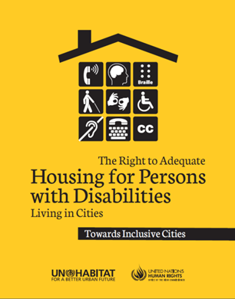
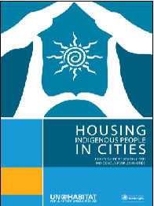
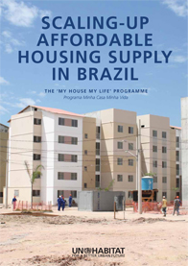
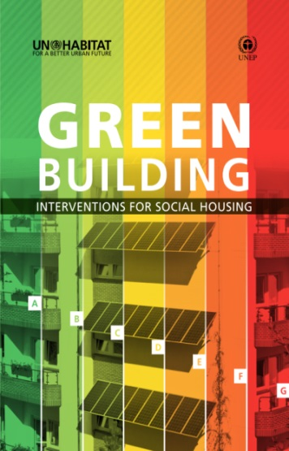
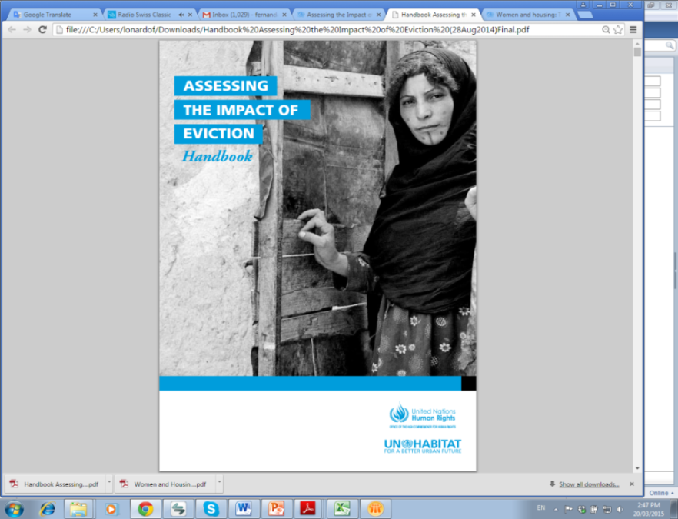
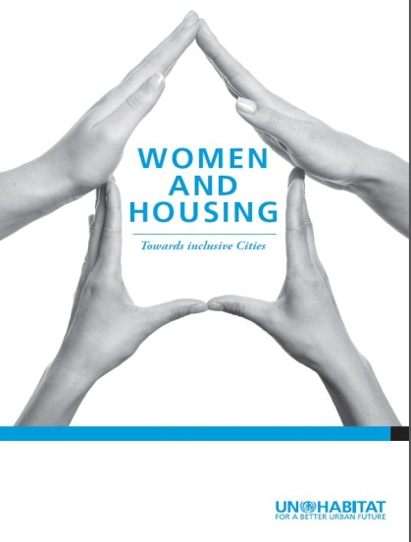
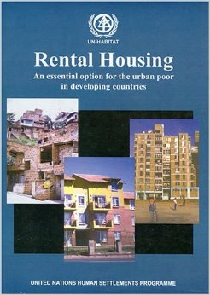
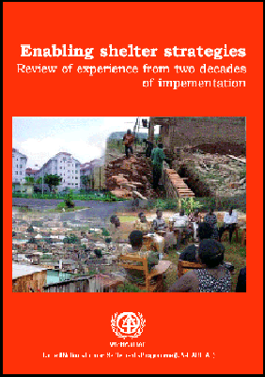
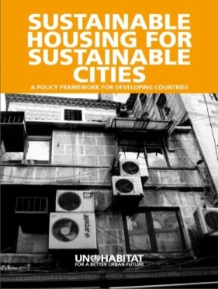
Knowledge Creation and Sharing

Slide 15
Christophe.Lalande@unhabitat.org
Housing and Slum Upgrading Branch

