Slide 1
Leveraging Mobile
For Accessible Smart Cities
DESA/DSPD Forum on Disability and Development: “Disability Inclusive and Accessible Urban Development”
29 October 2015 UN Convention Center in Nairobi Kenya
By Axel Leblois
President and Executive Director, G3ict

Slide 2
Why Focus on Mobile?
Most widely available ICT device worldwide – 7 billion SIM cards in service
Everything digital ends up interfacing with mobile phones, tablets or wearable wireless devices
Internet of Things: from 4.5 billion connected devices today to 50 billion connections in 2020 (Gartner Group)
Mobile devices by virtue of their embedded accessibility features are the best way for persons with disabilities to interact with their environment

Slide 3
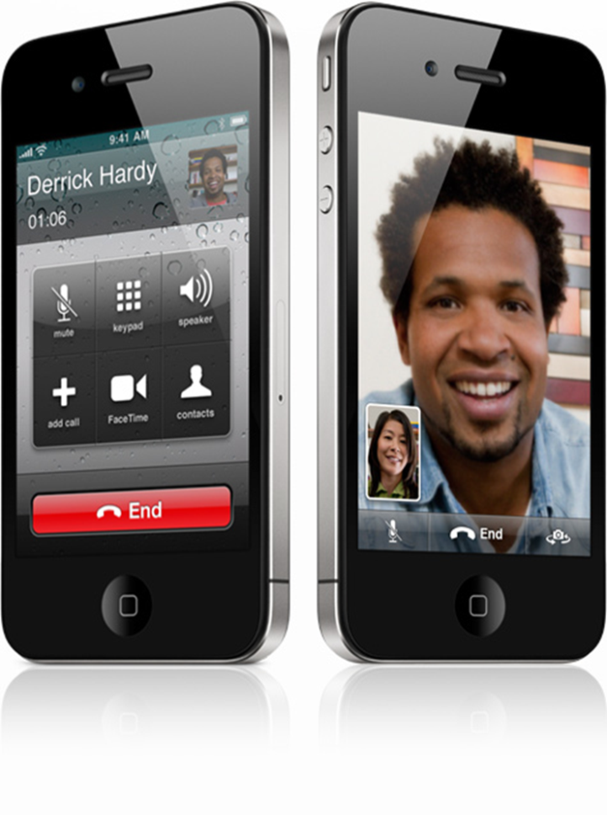
Smartphones all carry accessibility features and more intuitive interfaces for easier usage by persons with disabilities
Visual
Text-to-Speech
Hearing
Video Relay Service with sign language
Speech
Peer-to-peer video for sign language
Dexterity
Voice recognition for controls and input
Cognition
Icon interface

Slide 4
Accessibility Innovation and Lower Costs Are Driven by Global Market Scale
Mobility + Networks Bandwidth + Processing Power + Memory + GPS + NFC + Camera + Gyroscope + Microphone + Biometrics + Kinetics +Miniaturization
=
Unprecedented Accessibility and Assistive Solutions Available to Persons with Disabilities
Anywhere, Anytime

Slide 5
How can city governments leverage the mobile opportunity for persons with disabilities?

Slide 6
Step One: Making Existing e-Government Apps and Services Accessible to All
Persons with disabilities should have unrestricted access to the same services provided electronically to all citizens
Mobile is the most used device to access e-government services around the world
City governments must:
Ensure that existing e-government web sites are compliant with W3C mobile and accessibility guidelines (80% overlap)
When developing mobile apps, ensure that they are accessible and use the embedded accessibility features of the main mobile operating systems (iOS, Android, Windows)
Check everything digital in the city for accessibility, preferably with a dedicated organization

Slide 7

Step 2: Ensure the Accessibility of Critical Mobile Services for Independent Living
Examples:
Public transportation systems
Bus schedules and positioning systems are available via accessible mobile apps
Emergency response centers
Accept, acknowledge and respond to SMS sent by deaf callers

Slide 8
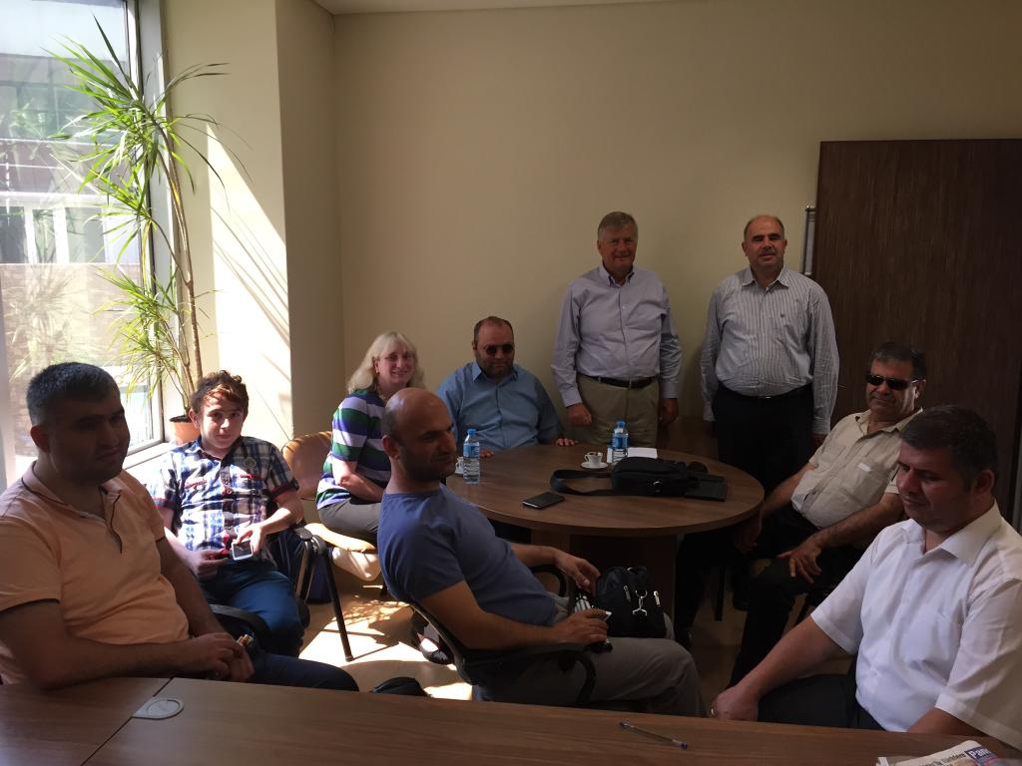
Good Practice: City of Istanbul ICT Accessibility Commission
Constituted to guide the City in promoting the accessibility of all its e-services
Meets weekly, chaired by government official
All 7 members are IT engineers with disabilities knowledgeable on ICT accessibility, on loan by their companies
Examine web sites, apps, transportation systems, social services, emergency response
Proposes and promotes solutions

Slide 9
Step 3: Engage Civil Society in Deploying Mobile Services for Persons with Disabilities
Mobile operators: Can offer Smart Spaces technology with path finding apps and beacon technology
At home care services: Can leverage IoT technologies and remote monitoring with sensor technology to optimize safety and services
Banks: Can leverage mobile banking to better serve customers with disabilities
Grassroots organizations: Can provide disability specific crowd sourced information for physically accessible services (toilets, restaurants etc.)

Slide 10
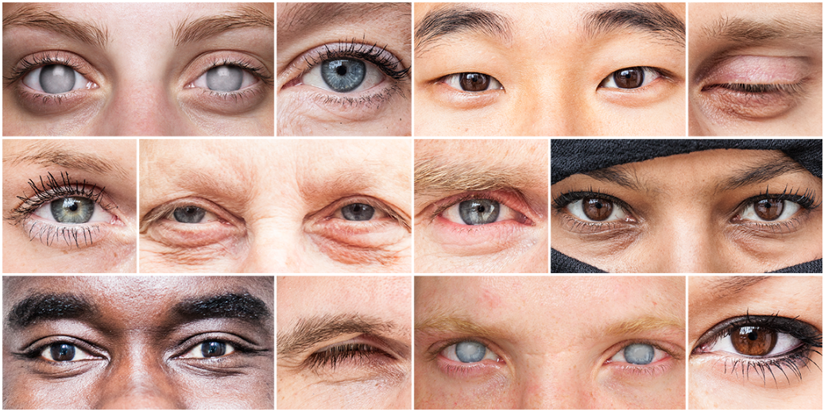
Good Practice in Crowdsourced Services: Be My Eyes
301,095 Sighted volunteers
23,376 Blind users
A Network of Eyes: Be My Eyes is an app that connects blind people with volunteer helpers from around the world via live video chat
Uses live video for instant help to identify situation or information captured by phone

Slide 11
Good Practice in Social Services: Japan National Post Office Watch Service
Japan Post: a government-owned holding company that runs 24,000 post offices as well as one of the world’s biggest banks and Japan’s largest insurer.
Post Office Watch service: employees check in on elderly clients, offer them consultation services and report back to family members.
Post now distributes free tablets to elderly persons with the support of a joint venture between IBM and Apple.
Apps are designed to help connect Japan’s millions of seniors with healthcare services and with their families, with a target of serving 4 to 5 million families by 2020.

Slide 12
In Summary:
The sky is the limit in leveraging the accessibility of mobile devices to enhance urban living for persons with disabilities
Input of persons with disabilities in setting priorities and evaluating solutions is an essential success factor
City governments must engage with multiple stakeholders to promote innovative urban apps and services
Potential of IoT for persons with disabilities, a great promise for future urban environments

Slide 13
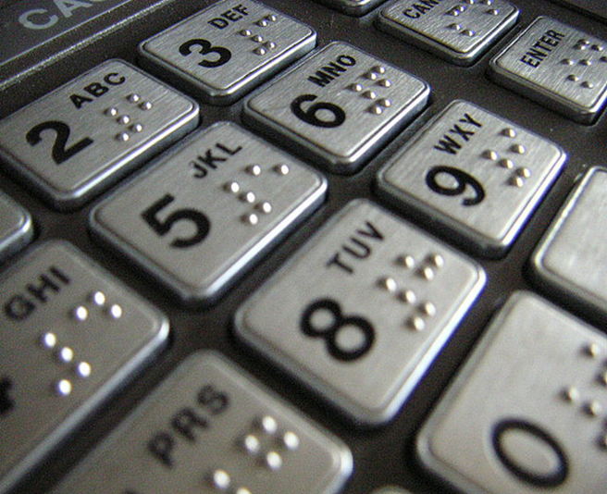
Thank You for your Attention!
www.g3ict.org
axel_leblois@g3ict.org
Thank You
For Your Attention!
www.g3ict.org
www.e-accessibilitytoolkit.org
www.m-enabling.com
axel_leblois@g3ict.org
Notes:
13

