Slide 1
Accessible Transportation Issues and Trends
Ann Frye
Ann Frye Ltd

Slide 2
What are the biggest mobility problems?
Source: GAATES survey

Slide 3
Who has the most difficulty getting around?

Slide 4
What are the top priorities for action?
Better attitude and staff awareness/need for training;
Legislative support and control mechanisms/enforcement and monitoring of access improvements;
More attention to making the pedestrian environment accessible;
More accessible public transport (buses in particular).
Source: GAATES survey

Slide 5
What can make a real difference?
Accessibility is often a low priority for Governments;
It is seen as an optional extra, not as a necessity;
We need to re-think the economic and fiscal basis for accessibility. We could:
Re-position accessibility as a benefit rather than a cost;
Include access to transport as an official measure of economic progress.

Slide 6
The economic power of tourism
“Due to the ageing population in industrialized countries, the rate of
disability among people with the capacity to travel is increasing,
adding to the demand for an accessible environment, transport and
services - which adds to the market value of the accessible tourism
segment. “
Source: UNWTO

Slide 7
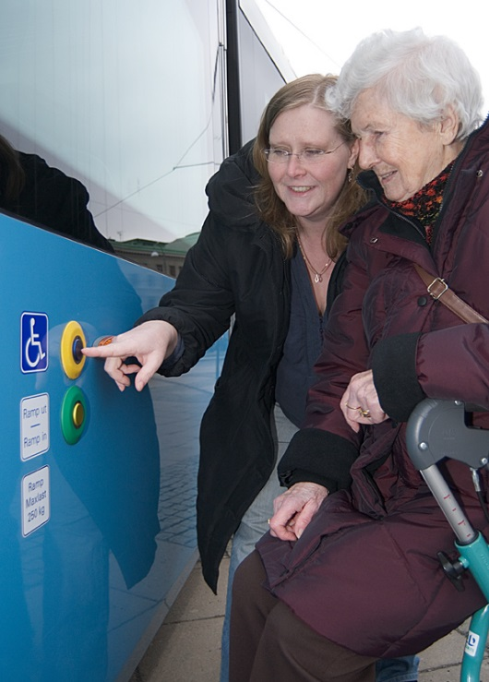
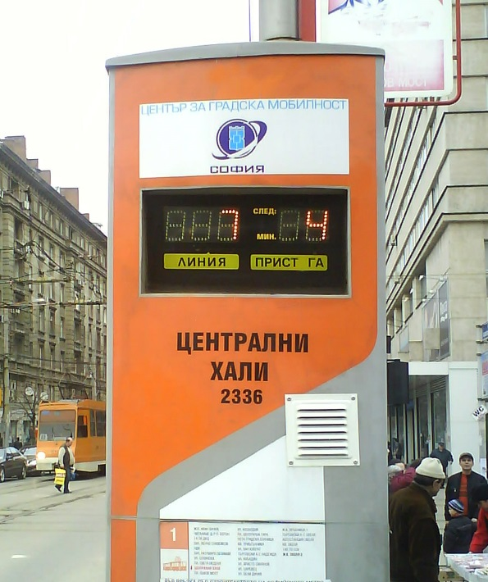
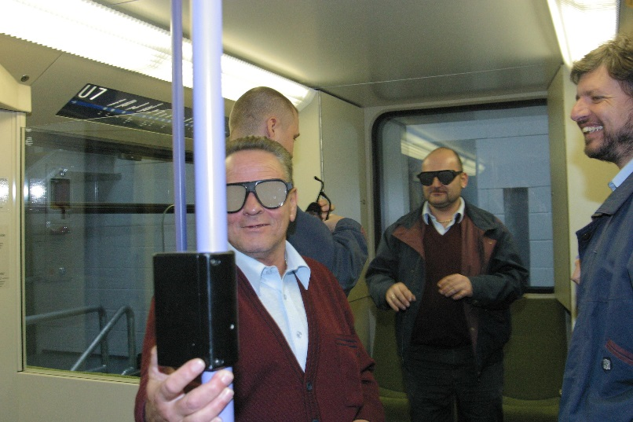
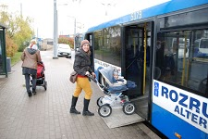
Getting it right isn’t always expensive!
Travel training for older and disabled people;
Awareness training of drivers and other transport staff;
Engaging with disabled people to agree priorities;
Applying universal design principles.

Slide 8
Make sure it’s fit for purpose
We still lack consistent and meaningful indicators of accessibility;
Too often progress is measured by numbers of adapted buses or bus stops, not by the number of people able to travel;
Developing countries tend to adopt standards drawn up by international bodies and focussed on different economies: they are often inappropriate.

Slide 9
What is working well?
Joint working between different sectors of Government is also important. Good examples include:
In the US: Bringing key Government Departments together with a shared agenda of liveable communities;
In Norway: Government wide commitment to Universal Design;
In parts of China: formalising annual consultation between city construction authorities and older and disabled people.

Slide 10
What will really make a difference?
Greater alignment between agencies working on accessibility;
Re-positioning the economic status of accessibility as a benefit not a cost;
Promoting wider international understanding of the need for accessibility;
Developing meaningful indicators of accessibility;
Highlighting the need for training of transport professionals;
Using the economic power of tourism to fund improvements.

Slide 11
What will really make a difference ? (2)
Re-orientating research effort towards practical application and implementation;
Focusing on knowledge transfer that is appropriate to local needs: setting up an international knowledge transfer database;
Creating a template for stronger stakeholder engagement to re-enforce and monitor laws , including the UN Convention.

Slide 12
ann@annfrye.co.uk
Ann Frye
Ann Frye Ltd

