Slide 1
CURRENT STATUS, KEY CHALLENGES FACED AND KEY LESSONS LEARNEDIN LOCAL AND NATIONAL CONTEXTS IN PLANNING/CONSTRUCTING ACCESSIBLE CITIES AND THEIR INFRASTRUCTURES AND BASIC PUBLIC SERVICES
FOR ALL THE CASE OF NIGERIA BY:
ADEBUKOLA ADEBAYO
FOUNDER & DIRECTOR GENERAL, HUMAN AND ORGANIZATIONAL RESOURCES DEVELOPMENT CENTRE (HORDC), LAGOS, NIGERIA.
PAPER PRESENTED AT:
2015 UNDESA/DSPD FORUM ON DISABILITY AND DEVELOPMENT
Theme: Disability Inclusion and Accessible Urban Development In
Collaboration With UN Habitat
(UN Convention Center Nairobi, 28-30 Oct 2015)

Slide 2
GENERAL BACKGROUND
The mainstreaming of inclusivity and accessibility needs of persons with disabilities into laws, policies and programmes of government at national and sub-national levels in Nigeria is relatively new.

Slide 3
GENERAL BACKGROUND
CONTINUED
Before the commencement of Nigeria’s new democratic dispensation in 1999, disability issues was virtually treated as medical and charity issues. Therefore, the only government department in charge of disability was the Directorates of Rehabilitation established within national and state ministries of social development.

Slide 4
GENERAL BACKGROUND
CONTINUED
Even between 1999 and 2008, governments at national and sub-national levels in Nigeria hardly thought that disability had any connection with issues like physical planning and urban development let alone with sectors like transportation, housing, infrastructural development. At best, in Nigeria, it was easier to link disability strictly and only with sectors like education and health.

Slide 5
GENERAL BACKGROUND
CONTINUED
However, the situation began to change slightly upon the creation of the UN Convention on Rights of Persons with Disabilities in 2006 which sparked-off more advocacies by civil society groups and disabled people’s organizations with support from major international development partners and the eventual signing and ratification of the CRPDand its Optional Protocol in 2010.

Slide 6
GENERAL BACKGROUND
CONTINUED
At the moment, there are no national legal and policy frameworks which holistically guide the mainstreaming of inclusion and access of persons with disabilities across key sectors including physical planning and urban development as well as in key services like transportation, housing, health, education, etc.

Slide 7
GENERAL BACKGROUND
CONTINUED
Although a National Rehabilitation Policy is being implemented by the Federal Ministry of Women Affairs and Social Development with some broad multi-sectoral policy approach, evidences have shown that this task of inclusion and access for persons with disabilities has significantly overwhelmed a poorly staffed, poorly funded and incapacitated Directorate for Rehabilitation in the Federal and State Ministries statutorily charged with the responsibility of ensuring inclusion of persons with disabilities in all laws, policies and programmes of government within their jurisdiction.

Slide 8
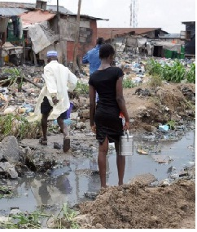
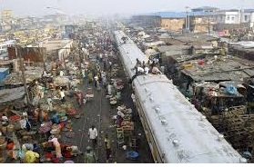
GENERAL BACKGROUND CONTINUED
In addition, Nigeria, like many other third world nations are faced with the huge challenge of poorly planned and constructed towns and cities (even for non-disabled populations) and infrastructural underdevelopment and deficits. Meaning that in the first place, the physical environment is generally poorly planned, inaccessible and lacks adequate infrastructure for the entire citizens including persons with disabilities.

Slide 9
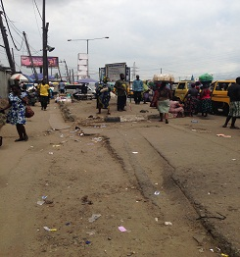
GENERAL BACKGROUND CONTINUED
Inaccessible Rough Terrain

Slide 10
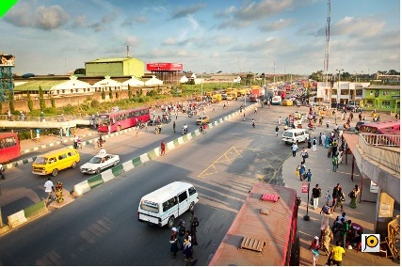
GENERAL BACKGROUND CONTINUED
Even when some form of town re-planning, city remodeling/renewal or infrastructural development/rehabilitation takes place, there is apparent low awareness and low capacity on the part of public officials and civil servants to mainstream inclusivity and accessibility requirements and needs of persons with disabilities due to lack of legal and policy frameworks which would have provided regulations and guidelines.

Slide 11
SOME GOOD EXAMPLES
In the absence of a holistic national initiative, some sub-national (state) governments are taking bold steps to promote and protect rights of persons with disabilities especially their inclusivity and accessibility rights and needs.

Slide 12
SOME GOOD EXAMPLES
CONTINUED
Between 2010 and 2011, civil society advocacies payed-off when the Lagos state government enacted the first and most comprehensive state-level disability law, “The Lagos State Special People’s Law” and established the Lagos State Office for Disability Affairs (LASODA) in 2012 to implement the law.

Slide 13
SOME GOOD EXAMPLES
CONTINUED
The creation of this legal framework in Lagos state heralded the beginning of what is now popularly regarded as “the Inclusive Lagos”.

Slide 14
SOME GOOD EXAMPLES
CONTINUED
The Lagos State Special People’s Law provides for inclusion and access for persons with disabilities in virtually all spheres of life and sectors in the state: physical planning and urban development, infrastructural development, housing, transportation, telecommunications, information, education, health, sports and recreation, employment, etc.

Slide 15
SOME GOOD EXAMPLES
CONTINUED
In terms of physical planning and urban development,infrastructuraldevelopment/rehabilitation, housing, transportation and related matters, the law sets a five (5) year moratorium (between 2011 and 2016) after which government and all citizens should have fully complied with all inclusivity and accessibility requirements as prescribed in the Law; failure to which appropriate sanctions as prescribed in the law will be imposed.

Slide 16
SOME GOOD EXAMPLES
CONTINUED
The enactment of the Special People’s Law in 2011 has influenced the review of other relevant laws especially the Lagos State Physical Planning and Urban Development Law which now provides a set of “building codes” which contains specific prescriptions for inclusivity and accessibility provisions in every public buildings and infrastructures including roads, pedestrian bridges, bus shelters, jetties, public car parks, events places and recreation centers, etc.

Slide 17
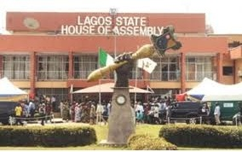
SOME GOOD EXAMPLE S CONTINUED
The first test case for the Lagos State Special People’s Law was the redesigning and construction of the new Lagos State House of Assembly building in 2012 to make inclusivity and accessibility provisions for persons with disabilities. Afterwards, efforts have been on-going to ensure that the development, construction and rehabilitation of major public infrastructure in Lagos state substantially complies with provisions of the Special People’s Law and the Physical Planning and Urban Development law respectively. Other examples of compliance include:

Slide 18
SOME GOOD EXAMPLES
All new government and public buildings are built with substantial compliance with inclusivity and accessibility requirements;

Slide 19
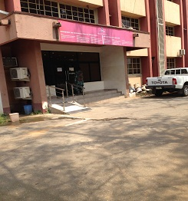
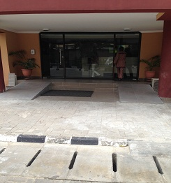
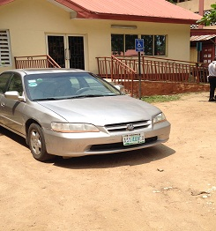
SOME GOOD EXAMPLES CONTINUED
Entrances to all government building within the State Secretariat have been rehabilitated and provided with ramps;

Slide 20
SOME GOOD EXAMPLES
CONTINUED
The state government managed mass transport scheme popularly called the Bus Rapid Transport (BRT) under the Lagos State Metropolitan Area Transport Authority (LAMATA) make provisions for accessible bus shelters and has just acquired accessible buses for persons with disabilities. Currently, Persons with disabilities are not charged any fees when they use the BRT.

Slide 21
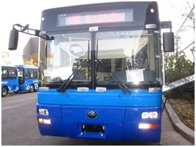
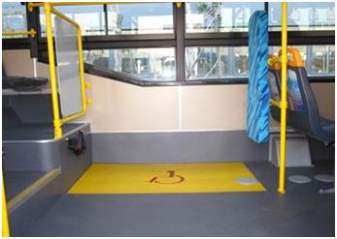
ACCESSIBLE
BUS
Newly procured accessible Mass Transit Buses By LAMATA

Slide 22
SHORTCOMINGS AND PERSISTENT CHALLENGES IN THE IMPLEMENTATION OF INCLUSIVE AND ACCESSIBLE PHYSICAL PLANNINGAND URBAN DEVELOPMENT:
The absence of an accurate disability data-base (DDB) in Lagos and Nigeria as a whole has made inclusive physical planning and urban development virtually difficult. The on-going National Identity Card scheme and the Continuous National Voters Registration process have both failed to make

Slide 23
SHORTCOMINGS AND PERSISTENT CHALLENGES IN THE IMPLEMENTATION OF INCLUSIVE AND ACCESSIBLE PHYSICAL PLANNINGAND URBAN DEVELOPMENT:CONTINUED
The case of Lagos state Residency Registration process when it commenced was similar. However, due to persistent advocacies in Lagos state, a proper provisions to effectively capture disability status of the citizens so as to make adequate provisions for them during planning. collaboration has been initiated between relevant MDAs, commencing the process to properly register persons with disabilities.

Slide 24
SHORTCOMINGS AND PERSISTENT CHALLENGES IN THE IMPLEMENTATION OF INCLUSIVE AND ACCESSIBLE PHYSICAL PLANNINGAND URBAN DEVELOPMENT:CONTINUED
The absence and inadequacy of enabling disability legal and policy frameworks remains a major challenge. This challenge is more obvious at the national level; as there are currently no policy direction, regulations and guidelines to compel compliance.

Slide 25
SHORTCOMINGS AND PERSISTENT CHALLENGES IN THE IMPLEMENTATION OF INCLUSIVE AND ACCESSIBLE PHYSICAL PLANNINGAND URBAN DEVELOPMENT:CONTINUED
However, the Lagos state experience is being used as a success case study to stimulate similar developments in other states and at the federal level.

Slide 26
SHORTCOMINGS AND PERSISTENT CHALLENGES IN THE IMPLEMENTATION OF INCLUSIVE AND ACCESSIBLE PHYSICAL PLANNINGAND URBAN DEVELOPMENT:CONTINUED
At the moment, disability bills have reached appreciable legislative levels in several other states while the national bill narrowly missed being signed into law during the last administration which ended in May 29^{th,} 2015. Efforts are on-going to ensure that the new government gives assent to the bill which has been passed by the National Assembly.

Slide 27
SHORTCOMINGS AND PERSISTENT CHALLENGES IN THE IMPLEMENTATION OF INCLUSIVE AND ACCESSIBLE PHYSICAL PLANNINGAND URBAN DEVELOPMENT:CONTINUED
The persistence of obvious public awareness and human capacity gaps have greatly limited the pace and quality of inclusive and accessible physical planning and urban development in Nigeria.

Slide 28
SHORTCOMINGS AND PERSISTENT CHALLENGES IN THE IMPLEMENTATION OF INCLUSIVE AND ACCESSIBLE PHYSICAL PLANNINGAND URBAN DEVELOPMENT:CONTINUED
The whole idea and practice of social inclusion and the mainstreaming of disability issues into the broad spectrum of socio-political, economic, technological, environmental and infrastructural activities is generally new in Nigeria.

Slide 29
SHORTCOMINGS AND PERSISTENT CHALLENGES IN THE IMPLEMENTATION OF INCLUSIVE AND ACCESSIBLE PHYSICAL PLANNINGAND URBAN DEVELOPMENT:CONTINUED
The entire Nigerian
public including actors on the supply side of policy are just virtually learning on the skills and methodologies of disability-based social inclusion. Due to Nigeria’s peculiarities, the public awareness and capacity building process has been largely slow.

Slide 30
SHORTCOMINGS AND PERSISTENT CHALLENGES IN THE IMPLEMENTATION OF INCLUSIVE AND ACCESSIBLE PHYSICAL PLANNINGAND URBAN DEVELOPMENT:CONTINUED
However, the rising levels of civil society advocacies with support from international development partners is helping to step up public awareness and build capacities of all stakeholders.

Slide 31
SHORTCOMINGS AND PERSISTENT CHALLENGES IN THE IMPLEMENTATION OF INCLUSIVE AND ACCESSIBLE PHYSICAL PLANNINGAND URBAN DEVELOPMENT:CONTINUED
Similarly, due to capacity gaps, there is a seeming lop-sidedness of physical planning and urban development projects and activities towards physical disabilities while other disability types (blind, deaf and intellectual disabilities) are not adequately captured in the design of projects.

Slide 32
SHORTCOMINGS AND PERSISTENT CHALLENGES IN THE IMPLEMENTATION OF INCLUSIVE AND ACCESSIBLE PHYSICAL PLANNINGAND URBAN DEVELOPMENT:CONTINUED
For instance, blind and deaf persons are still confronted with the challenges of accessing public information on signages, road signs and maps, public utility user guides, etc. Also, accessibility needs of blind and deaf persons on roads, public buildings, etc are yet to be achieved.

Slide 33
SHORTCOMINGS AND PERSISTENT CHALLENGES IN THE IMPLEMENTATION OF INCLUSIVE AND ACCESSIBLE PHYSICAL PLANNINGAND URBAN DEVELOPMENT:CONTINUED
Again, due to capacity and technology gaps, there is persistence in the challenge of accuracy and precision especially in measurements of accessibility features of infrastructures such as ramp slopes, wheelchair accessible door-ways, etc.

Slide 34
SHORTCOMINGS AND PERSISTENT CHALLENGES IN THE IMPLEMENTATION OF INCLUSIVE AND ACCESSIBLE PHYSICAL PLANNINGAND URBAN DEVELOPMENT:CONTINUED
The challenge of poor funding for disability projects have not been effectively overcome due to poor prioritization of disability issues. For instance, the use of accessible buses and trains are considered too “expensive” to acquire and maintain.

Slide 35
SHORTCOMINGS AND PERSISTENT CHALLENGES IN THE IMPLEMENTATION OF INCLUSIVE AND ACCESSIBLE PHYSICAL PLANNINGAND URBAN DEVELOPMENT:CONTINUED
DPOs and CSOs in Nigeria are mostly confronted with the challenges of funding and institutional capacities to sustain effective policy reviews, monitoring and evaluation, as well as massive public awareness.

Slide 36
SHORTCOMINGS AND PERSISTENT CHALLENGES IN THE IMPLEMENTATION OF INCLUSIVE AND ACCESSIBLE PHYSICAL PLANNINGAND URBAN DEVELOPMENT:CONTINUED
Inclusive and accessible physical planning and urban development will not be achieved in holistic terms if we concentrate on efforts to mainstream inclusivity and accessibility requirements into development of new towns, cities and infrastructures.

Slide 37
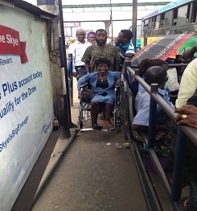
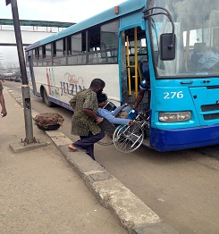
SHORTCOMINGS
There is urgent need to map out plans to rebuild or rehabilitate the vast very inaccessible existing towns, cities, infrastructure and services.

Slide 38
SHORTCOMINGS AND PERSISTENT CHALLENGES IN THE IMPLEMENTATION OF INCLUSIVE AND ACCESSIBLE PHYSICAL PLANNINGAND URBAN DEVELOPMENT:CONTINUED
For instance, in Lagos state there are several roads, pedestrian bridges, public buildings, industrial and housing estates, transport services, etc which require rebuilding, remodeling or rehabilitation to ensure that they are inclusive of, and accessible to persons with disabilities.

Slide 39
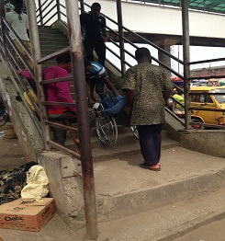
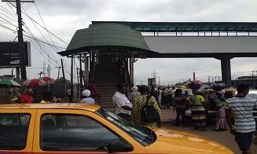
SHORTCOMINGS

Slide 40
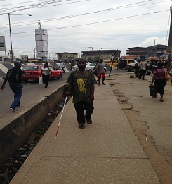
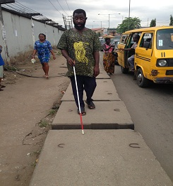
SHORTCOMINGS
Inaccessible Rough Terrains and Open Drainage

Slide 41
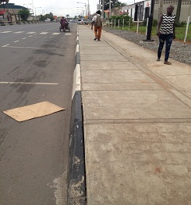
SHORTCOMINGS
All new roads and pedestrian bridges constructed and rehabilitated between 2012 till date are provided with ramps and accessible sidewalks;

Slide 42
OTHER LESSONS LEARNED
It is observed that beyond the achievement of the enactment of a disability law and establishment of a disability agency in Lagos state, there is need to advocate for the review of the Lagos state long term development planning instrument, “the State Development Plan” in which should be embedded a disability-inclusive and accessible Urban Development Master Plan.

Slide 43
OTHER LESSONS LEARNED
CONTINUED
an inclusive and accessible urban development programme (especially in a country with high infrastructural deficit and highly distorted urban planning like Nigeria) is highly capital intensive. It will therefore require the setting-up of a “Special Fund” drawn from international development agencies, private sector and the budget of the state government.

Slide 44
OTHER LESSONS LEARNED
CONTINUED
Similarly, from the Lagos state experience in Nigeria, it is observed that governments in poor countries may appear reluctant to expend so much to rebuild or remodel infrastructure and cities just to enhance inclusion and accessibility for PWDs.

Slide 45
OTHER LESSONS LEARNED
CONTINUED
As such, beyond the conduct of advocacies, innovative and strategic approaches are required to identify cost effective methods of inclusive and accessible urban development in poor countries.

Slide 46
CONCLUSION
The local and national experiences of inclusive and accessible physical planning and urban development in Nigeria exposes the two evidential extremes:

Slide 47
CONCLUSION CONTINUED
where the absence or inadequacy of legal and policy frameworks at the national level is denying persons with disabilities their right to an inclusive and accessible environment .

Slide 48
CONCLUSION CONTINUED
and the case where at the sub-national level, the availability of legal and policy framework is helping to drive the growth of an inclusive and accessible city.

Slide 49
CONCLUSION CONTINUED
This experience point to the fact that legal, policy and institutional frameworks are key requirements to effectively drive and sustain inclusive practices in the development, rebuilding and rehabilitation of new and existing towns, cities, infrastructure and services for the benefit of persons with disabilities.

Slide 50
CONCLUSION CONTINUED
Once the major legal, policy and institutional issues are resolved, the more specific issues with low public awareness and low human capacity will be substantially resolved.

Slide 51
CONCLUSION CONTINUED
It is equally necessary that any legal, policy and institutional options should sufficiently permit the effective participation of persons with disabilities themselves in the determination of their needs.

