Slide 1
National and local experience (urban policy and practices) on promoting e-accessibility/e-government for participation and inclusions of persons with disabilities in urban development context THE CASE OF NIGERIA BY ADEBUKOLA ADEBAYO FOUNDER AND DIRECTOR GENERAL , HUMAN AND ORGANISATIONAL RESOURCES DEVELOPMENT CENTER(HORDC), LAGOS , NIGERIA
PAPER PRESENTED AT
2015 UNDESA/DSPD FORUM ON DISABILITYAND DEVELOPMENT
THEME: Disability Inclusion and Accessible Urban
Development
In Collaboration with UN Habitat
(UN Convention Center Nairobi, 28-30-2015)

Slide 2
GENERAL BACKGROUND
The advent of ICT and its use in the management of government activities and process in Nigeria is relatively new; spanning less than three decades. However, Nigeria offers one of the fastest growing ICT markets in the world. Growing from less than 400,000 phone lines before 2000 to over 100,000,000 lines as at 2015.

Slide 3
GENERAL BACKGROUND CONTINUED
The level of awareness and use of internet services has also increased rapidly with millions of websites owned by individuals, private and public as well as governmental organizations. This is greatly complemented by the array of social media platforms widely subscribed to by Nigerians in their tens of millions.

Slide 4
GENERAL BACKGROUND CONTINUED
Nigeria has made significant progress in the provision of online services and the use of ICT to drive the delivery of government operations, functions, activities and services. However, the country has not fully reached the transactional and network stage.

Slide 5
GENERAL BACKGROUND CONTINUED
Certainly, the quality of ICT services is still low and the scope of coverage is still relatively poor when compared with the potential human and material resources Nigeria is endowed with and the vastness of her size and population.

Slide 6
GENERAL BACKGROUND CONTINUED
With regard to inclusion and access for persons with disability to ICT, the level of awareness, access to and use of ICT in the Nigerian disability communities also rapidly increasing.

Slide 7
GENERAL BACKGROUND CONTINUED
Although the additional cost incurred due to the necessity of assistive technologies remains a major barrier, the sensitivity of the innovativeness of foreign ICT manufacturers and vendors to the access of persons with disabilities is greatly helping persons with disabilities in Nigeria to substantially overcome these challenges, especially those imposed by cost and affordability barriers.

Slide 8
GENERAL BACKGROUND CONTINUED
However, on the local ICT environment, persons with disabilities are still confronted by huge inclusivity and accessibility barriers with regard to the consideration of the inclusivity and accessibility rights, requirements and needs of persons with disabilities especially in locally produced and deployed ICT hardware, content and services.

Slide 9
GENERAL BACKGROUND CONTINUED
The low level of inclusion and accessibility of disability into local ICT products and services in Nigeria is largely caused by very low awareness and technical capacity among policy-makers, ICT professionals and practitioners, as well as the lack of and/or inadequacy of appropriate legal, policy and institutional frameworks required to facilitate, enhance and sustain inclusive policies and practices in the use of ICT to drive E-access and E-government in Nigeria.

Slide 10
THE POLICY ENVIRONMENT
The mainstreaming of inclusivity and accessibility needs of persons with disabilities into laws, policies and programmes of government at national and sub-national levels in Nigeria is relatively new.

Slide 11
THE POLICY ENVIRONMENT CONTINUED
Before the commencement of Nigeria’s new democratic dispensation in 1999, government policies administered disability issues through the medical and charity models of disability. Therefore, the only government department in charge of disability was the Directorates of Rehabilitation established within national and state ministries of social development.

Slide 12
THE POLICY ENVIRONMENT CONTINUED
Even between 1999 and 2008, governments at national and sub-national levels in Nigeria hardly thought that disability had any connection with issues like physical planning and urban development.

Slide 13
THE POLICY ENVIRONMENT CONTINUED
Similarly, there has been little or no considerations for disability E-accessibility rights, requirements and needs in the development of E-government platforms and services especially in sectors like transportation, housing, infrastructural development. At best, in Nigeria, it was easier to link disability strictly and only with sectors like education and health.

Slide 14
THE POLICY ENVIRONMENT CONTINUED
However, the situation began to change slightly in Nigeria upon the creation of the UN Convention on Rights of Persons with Disabilities in 2006 which sparked-off more advocacies by civil society groups and disabled people’s organizations with support from major international development partners and the eventual signing and ratification of the CRPD and its Optional Protocol in 2010.

Slide 15
THE POLICY ENVIRONMENT CONTINUED
At the moment, there are no national legal and policy frameworks which holistically guide the mainstreaming of inclusion and access of persons with disabilities across key sectors including physical planning and urban development as well as in the provision and deployment of ICT-driven E-governance of key services like transportation, housing, health, education, etc.

Slide 16
THE POLICY ENVIRONMENT CONTINUED
A National Rehabilitation Policy is being implemented by the Federal Ministry of Women Affairs and Social Development with some broad multi-sectoral policy approach.

Slide 17
THE POLICY ENVIRONMENT CONTINUED
evidences have shown that this task of inclusion and access for persons with disabilities has significantly
overwhelmed a poorly staffed, poorly funded and incapacitated Directorate for Rehabilitation in the Federal and State Ministries statutorily charged with the responsibility of ensuring inclusion of persons with disabilities in all laws, policies and programmes of government within their jurisdiction.

Slide 18
CURRENT NATIONAL POLICY DIRECTION CONTINUED
Nigeria’s Federal Ministry of Information and Communication Technology has developed an E-Governance Master Plan with the purpose of strengthening transparency, efficiency and quality of public administration, in line with Vision 20:2020. The Ministry is also implementing a National ICT policy, developed in 2012:

Slide 19
CURRENT NATIONAL POLICY DIRECTION CONTINUED
Section 7.4.3 (strategy X): Promote ICT awareness and proficiency in mass and non-formal education with emphasis on children, youth, women and persons with disabilities.

Slide 20
CURRENT NATIONAL POLICY DIRECTION CONTINUED
Section 7.5.3 (strategy viii): Ensure that marginalized groups (including persons with disabilities) become an integral part of the ICT stakeholder community as participants, innovators, leaders and beneficiaries of the knowledge economy in Nigeria’s emerging information society.

Slide 21
CURRENT NATIONAL POLICY DIRECTION CONTINUED
Section 7.10.3 (strategy vii): Encourage research and development of appropriate ICT devices for persons with disabilities to enable them enjoy the benefits of the ICT revolution in the country.

Slide 22
CURRENT NATIONAL POLICY DIRECTION CONTINUED
These policy frameworks have virtually remained on paper as they are not backed with appropriate legislative and institutional frameworks to effectively enforce implementation.

Slide 23
LOCAL POLICY SITUATIONS
At the local level; in Lagos state, the commercial capital of Nigeria, where more than 50% of the ICT market and industry thrives, the state ICT policy managed by the State Ministry of Science and Technology is not disability sensitive.

Slide 24
LOCAL POLICY SITUATIONS CONTINUED
In fact, no section of the policy nor objectives and functions of the implementing Ministry dwells on the need to make ICT inclusive of, and accessible to persons with disabilities. Similarly, no specific strategies or programmes or activities are stated or designed as part of the policy.

Slide 25
LOCAL POLICY SITUATIONS CONTINUED
The Lagos State ICT policy runs contrary to the provisions of the State’s disability law, “The Lagos State Special People’s Law, 2011” which is about the most comprehensive disability law in Nigeria. The law provides that:

Slide 26
LOCAL POLICY SITUATIONS CONTINUED
(Section 30. Sub1) Persons living with disability shall have freedom of expression and opinion, including the freedom to seek, receive and impart information and ideas through any means of communication of their choice.

Slide 27
LOCAL POLICY SITUATIONS CONTINUED
(Sub 2) Government, Corporate organization and persons shall:(a) provide information intended for the general public to persons living with disability in accessible formats and technologies appropriate to the different kinds of disabilities and at no additional cost.

Slide 28
CURRENT CHALLENGES
Most government and privately owned ICT tools and platforms such as websites, software, etc designed for the purpose of delivering E-governance in Nigeria are not prepared with appropriate E-accessibility features for persons with disabilities.

Slide 29
CURRENT CHALLENGES CONTINUED
For instance, blind and partially sighted persons have complained of very poor accessibility while attempting to use websites of National examination bodies, federal and state ministries and agencies, including those in charge of lands registration, housing, traffic management, national and state citizens identity and residency registration, public service recruitment, scholarships, etc.

Slide 30
CURRENT CHALLENGES CONTINUED
Persons with disabilities are not included as targets/beneficiaries of national and local ICT skill development programmes, as well as in the design, planning, implementation, monitoring and evaluation of such programmes which are mostly targeted at children and youths.

Slide 31
CURRENT CHALLENGES CONTINUED
Virtually all ICT skill development and training centers set up by federal, state and local governments are not physically accessible to persons with disabilities. These centers also lack relevant assistive aids and technologies required to guaranty E-accessibility for persons with disabilities.

Slide 32
CURRENT CHALLENGES CONTINUED
The Lagos state government in partnership with some prominent Multinational organizations (and indeed several other states) have been supporting the setting-up of public E-libraries and ICT skill acquisition centers for youths in the state. None of these facilities support E-accessibility of persons with disabilities.

Slide 33
CURRENT CHALLENGES
Low awareness and capacity are obvious gaps and actual reasons why E-accessibility provisions in the delivery of E-governance remain challenging to persons with disabilities. Although most hardware components, softwares and content of assistive technologies are not produced locally, the failure of academic and research institutions as well as weak policies are key hindrances which continue to aggravate low capacity.

Slide 34
KEY LESSONS
Nigeria is still at the elementary levels of E-governance. The quality and scope of E-access for the general population is still relatively low. However, this offer a good opportunity for a holistic review of existing legal and policy frameworks for the purpose of ensuring that the rights, requirements and needs of persons with disabilities are effectively embedded in the design, planning, implementation, monitoring and evaluation of emerging or new legal and policy regime.

Slide 35
KEY LESSONS CONTINUED
Persons with disabilities have resorted to self-help in confronting E-accessibility challenges. While there are no formal or organized capacity-building institutions and programmes in Nigeria, persons with disabilities have creatively and innovatively engaged with their foreign counterparts, international disability organizations, manufacturers and vendors of ICT, etc to acquire knowledge and skills.

Slide 36
KEY LESSONS CONTINUED
However, only very few persons with disabilities are able to acquire professional and service-based knowledge and skills required to provide services and support to other persons with disabilities, agencies of government, the private sector, etc.

Slide 37
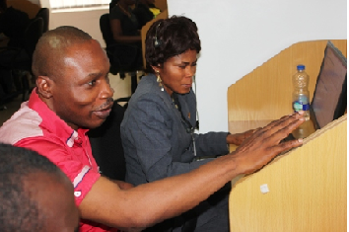
KEY LESSONS CONTINUED
Executive Director Mr. Akinola Opeolu was training a blind person employed by a bank to use CISCO customer interactive software in Lagos, Nigeria.
Mr Akinola Opeolu is the foremost self-trained assistive technologist in Nigeria with experience spanning over 2 and half decades. He is the founder and executive director heroes media.
www.heroesmediang.com

Slide 38
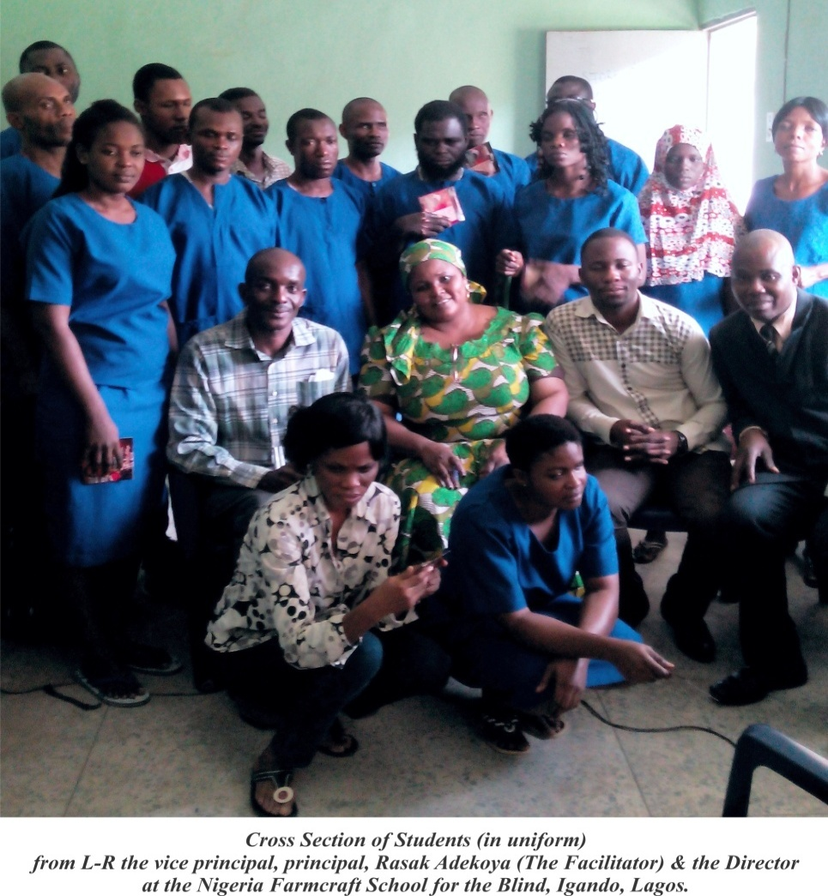
KEY LESSONS CONTINUED
Rasak Adekoya is a young and upcoming assistive technologist, inclusive leadership coach and brand strategies.
www.360connect.media

Slide 39
KEY LESSONS CONTINUED
The marginal level of E-access for persons with disabilities in Nigeria have been attained through strategic engagement between and among stakeholders including government, the private sector, disabled people’s organizations, ICT/Asssistive Technologists with disabilities, local and international development agencies, etc.

Slide 40
KEY LESSONS CONTINUED
For instance, prominent business organizations and development agencies have collaborated with disabled people’s organizations to set-up ICT training Centers and/or conduct ICT/Assistive Technology training programmes. Similarly, persons with disabilities are also collaborating with non-disabled ICT professionals to develop softwares and devices designed to enhance E-access for persons with disabilities.

Slide 41
KEY LESSONS CONTINUED
There are inherent financial and other difficulties which governments in low and middle income countries may encounter in implementing inclusive physical planning and urban development policies and programmes; especially considering the cost of reconstructing or rehabilitating hitherto inaccessible infrastructure.

Slide 42
KEY LESSONS CONTINUED
We find that providing for the inclusivity and accessibility rights, requirements and needs of persons with disabilities through robust and effective E-governance platforms which supports and delivers key services such as health, education, banking and finance, transport, lands and housing, traffic management, etc will, in a more sustainable way, guarantee inclusive and accessible towns and cities.

Slide 43
KEY LESSONS CONTINUED
Finally, the key lesson here is that in a country like Nigeria, it appears much easier to push for inclusive E-accessibility in E-governance platforms and processes than to ask that an inaccessible pedestrian bridge be pulled down. Therefore, if we can’t gain physical access, we must gain electronic access.

Slide 44
Thanks For Listening

