Slide 1
Singapore - Accessibility Master Plan to create a User-friendly Built Environment
By
Goh Siam Imm (Ms)
Technical Director (UD)
Building and Construction Authority
Singapore
14 June 2017

Slide 2
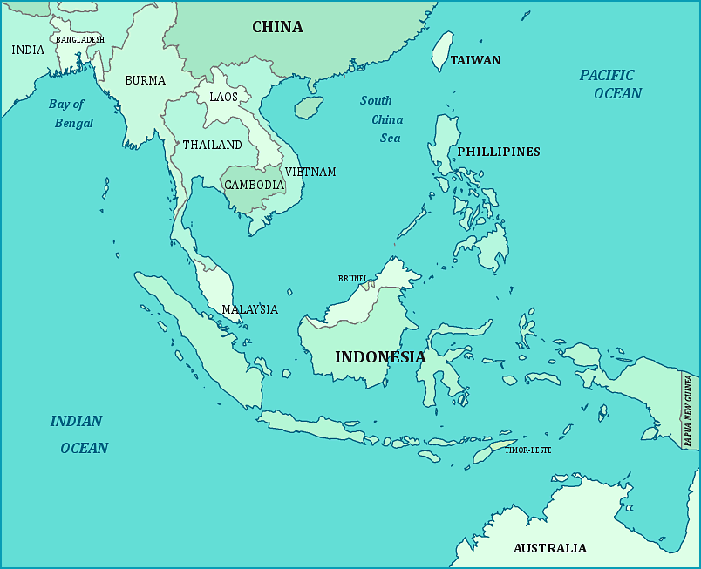
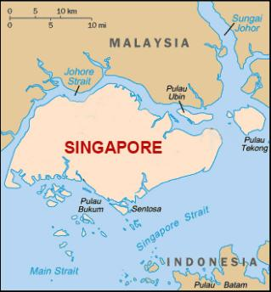
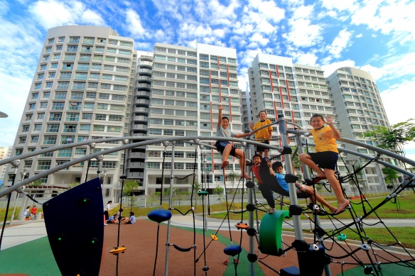
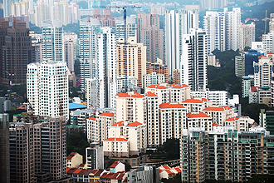
Singapore
Island city state of about 719 sq.km
Urban city,
High rise, high density
Population of 5.6 millions
Over 80% of residents live in high-rise public housings
Notes:
Singapore is a small city state of less than 800 sq m.
Eighty percent of the population lives in public housing

Slide 3
Provisions for the Persons with disability
Issue of a barrier-free access to buildings raised in 80s
Critical Milestone in 1990
Mandate the provision of barrier-free accessibility in buildings
Published Code on Barrier-free Accessibility in Buildings, 1990
To set the minimum standard for compliance
Main focus on the wheelchair access in buildings
Notes:
We first mandate the provision of barrier-free accessibility in buildings in the 1990. We published the Code on Barrier-free Accessibility to set the minimum standard for compliance.

Slide 4
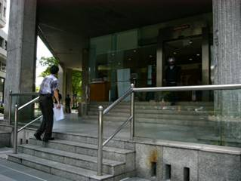
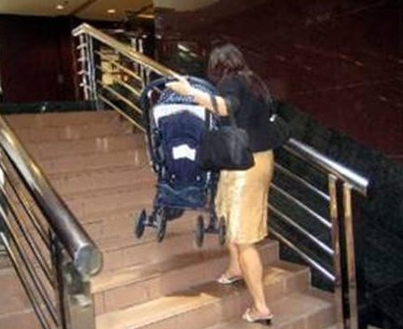
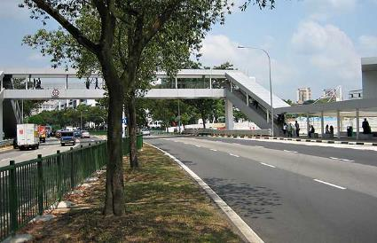
Challenges in the built environment
Pre-1990 buildings mostly not barrier-free
mandatory requirements imposed in 1990
Buildings are not UD
elder and family-centric provisions are lacking
Issues with inter-connectivity
from building to building
from building to infrastructure
Notes:
The fast ageing population raise the concern as to whether we have done enough.
Most of the building existing buildings built before the mandatory requirements are not barrier-free.
We have inter-connectivity issue

Slide 5
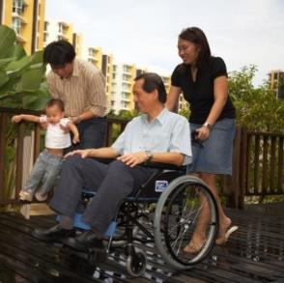
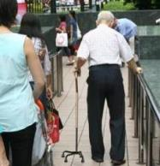
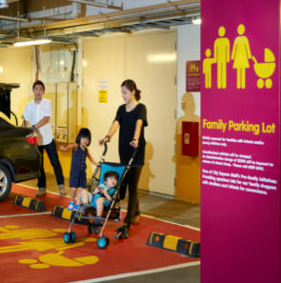
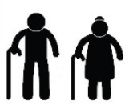
VISION
A City for All Ages
Steering towards
future-readiness
To address population issue Rapid Ageing
To pursue upstream goal Liveability
Notes:
With a vision of a City for all ages, we developed the Accessibility Masterplan in 2006 to
To address the Rapid Ageing issue; and
To pursue the upstream goal of Liveability

Slide 6
Accessibility Master Plan (2006-2015)
Enhance
Code on Accessibility
Accessibility
Fund
Government Building
Upgrading
UD Award
UD Mark Certification
4 Strategic Thrusts
Multi-agencies
Multi-levers
Mitigating EXISTING CHALLENGES
Tackling FUTURE CHALLENGES
Active Promotion
Engage Architects/ Developers
Maintaining EXISTING ACCESSIBLE PROVISIONS
Raising AWARENESS & CAPABILITIES
UD Assessors Course
BC Act amended for Continued compliance
Roving Exhibitions
Friendly Building Portal &
Accessibility Rating System (ARS)
Education/Raise awareness
Notes:
The Master Plan address accessibility concerns in Past, Present and Future developments through 4 strategic thrusts:
It is an holistic approach through multi-agencies and multi-levers effort

Slide 7
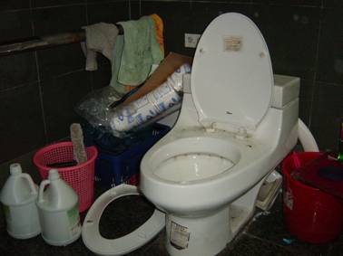
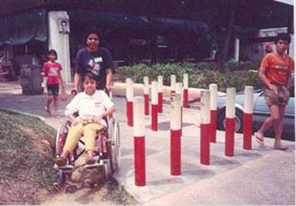
#1 - To maintain the accessible environment
Amended the Building Control Act
To ensure continued compliance with the regulations
To tackle the problem of misuse and removal of accessible features.
Notes:
To tackle the problem of misuse and removal of accessible features, we amended the Building Control Act to require the continued compliance with the building regulations

Slide 8
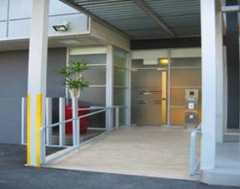
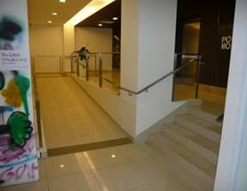
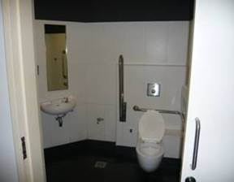
#2 - To mitigate existing challenges
5-Year accessibility program (2006-2011)
To promote and facilitate the upgrading of key buildings and key areas of both private and public sector to be accessible
With at least Basic Accessibility Features
Accessible Entrance Accessibility at 1st level Accessible toilet
Notes:
To mitigate the exising condition, we put up a 5-year Accessibility program to promote and facilitate the upgrading of key buildings and areas of both the private and public sector with at least Basic Accessibility Features
Basic Accessibility Feature means ;
Accessible Entrance, Accesibility at 1st level and at least one accessible toilet.

Slide 9
Public Sector Upgrading
By 2012, Close to 100% of Tier 1 Public sector buildings have at least basic accessibility (increase from 50% in 2007)
Public housing precincts were upgraded
Train stations and other road related infra structures were improved to enable barrier-free access to public transportation.
Notes:
9
Yes, we believe in the government departments taking the lead.
With the big effort by the public sectors we a more accessible environment.
By 2013, close to 100% of the Tier Public sector buildings have at least basic accessibility
All the public housing precincts were uprgraded. An ambitious lift upgrading programme was implemented to have barrier-free access at every floor
Train stations and other road related infra-structure were improves to enable barrier-free access to public transportation

Slide 10
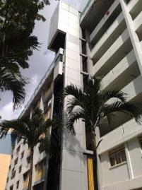
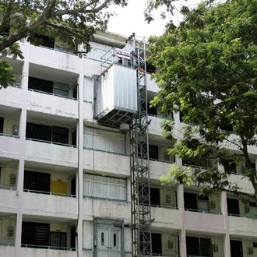
Public Sector Upgrading
Improvement to Public Housing Estates by HDB (Housing & Development Board) include
Lift Upgrading programme (2001-2014)
For lift access at every level
BFA Upgrading Programme (2006-2011) to all the estates (S$23 M)
New lift stack installed to existing building block
Barrier-free improvement in public housing estates

Slide 11
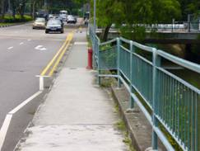
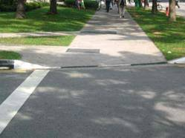
Public sector upgrading
Improvement to infra structures by Land Transport Authority (LTA)
Upgraded all the existing Train stations
Upgrading road related facilities within 400m of Train Stations
Walkways
Kerb-cut Ramps
Pedestrian Crossings
Bus Stops
Taxi Stands
Roads & Traffic signs
Bus Terminals
Pedestrian Overhead Bridges

Slide 12
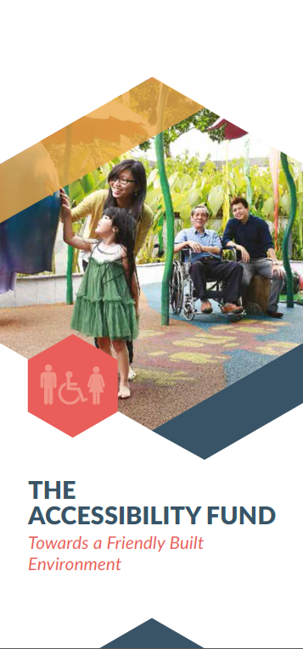
Private Sector upgrading
Promotion of voluntary upgrading
Capital Incentive
$40M Accessibility Fund
To co-pay up to 80% of basic accessibility features
Co-pay up to 40% of additional features
Cap of $300K per development
More than 130 buildings had benefitted
Target Key Areas such as Orchard Road .
Notes:
To encourage the voluntary upgrading by the private sector, we had put up a $40 million Accessibility Fund to co-pay up to 80% of basic accessibility features
We target key such as Orchard Road in our promotional effort.

Slide 13
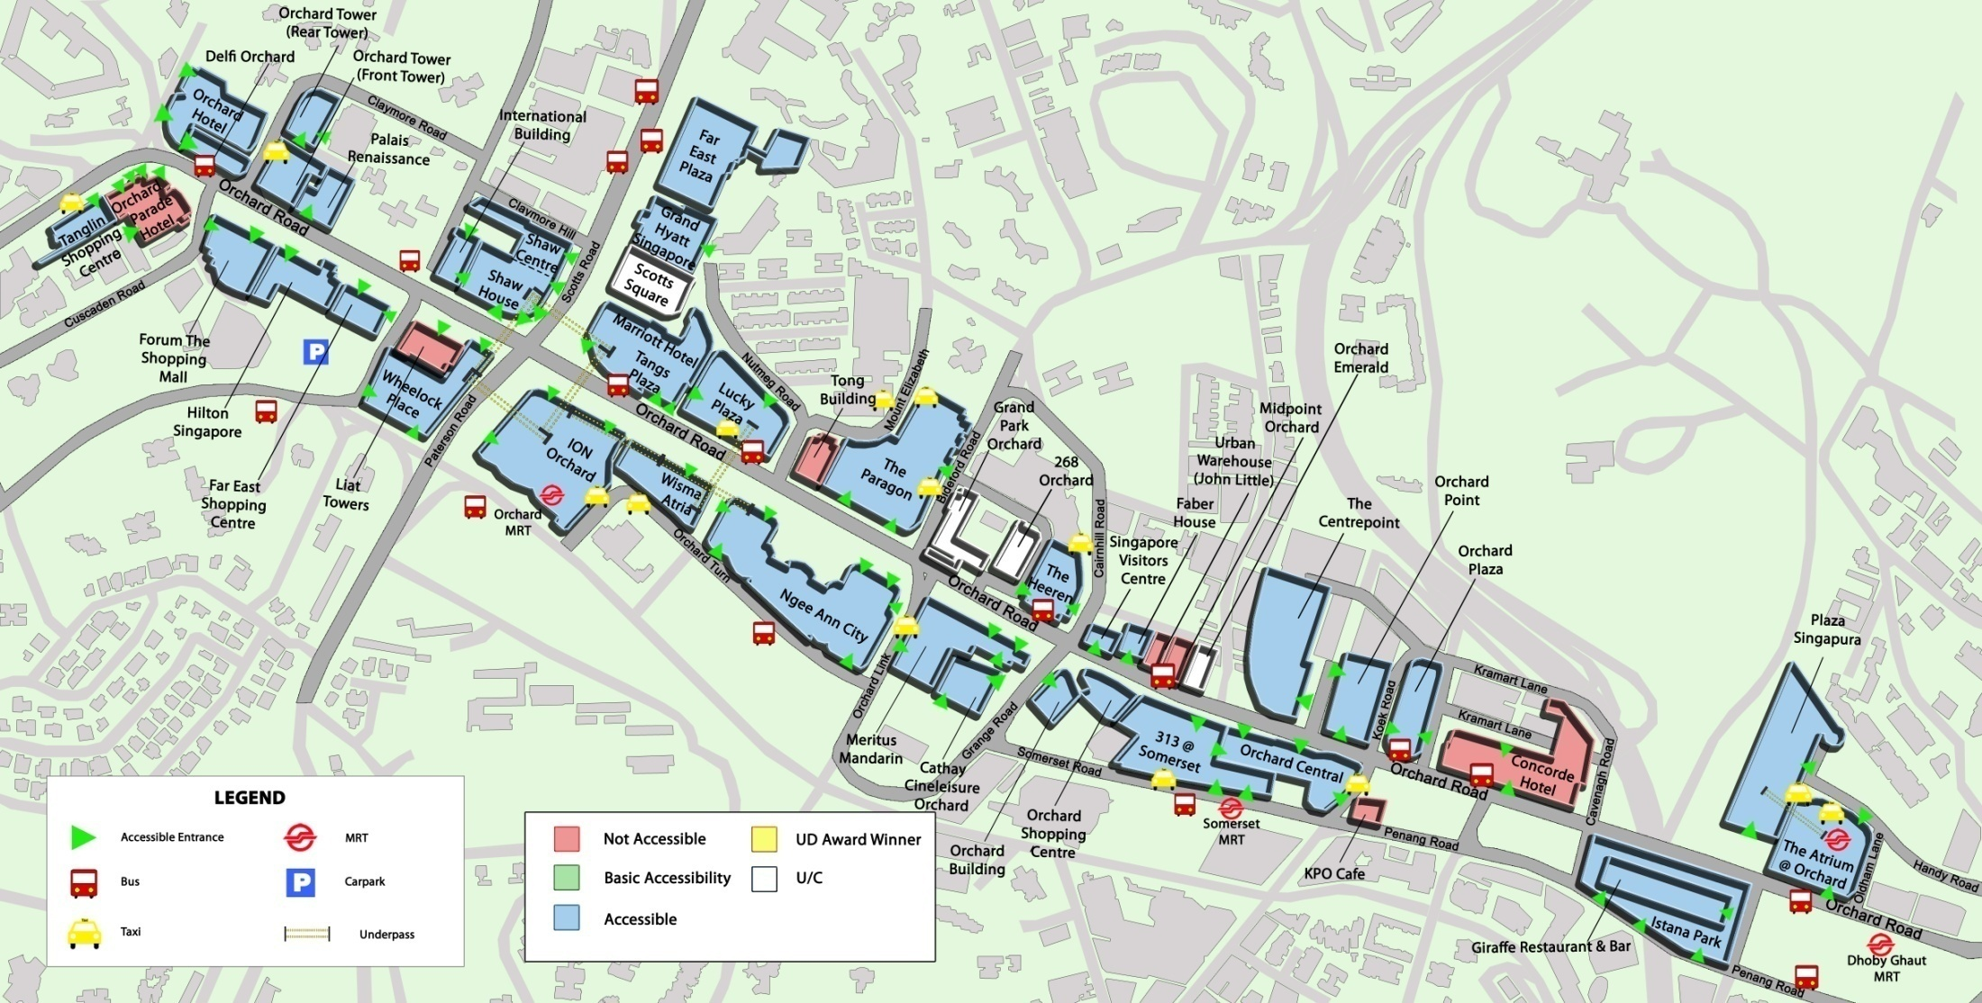
Orchard Road Upgrading
AF
Accessible
End 2006 – 41%
Feb 2012 – 88%
Now > 90%
AF
AF
AF
AF
AF
AF
AF
AF
Barrier Free
Non-Barrier Free
AF
Accessibility Fund Applicant
Potential Acessibility Fund Applicant
Notes:
Orchard Road, a well know shopping belt was selected as one Key area to improve accessibility. We literally went door knocking to get building owners to upgrade. The targeted effort saw great improvement from 41% accessibility in 2006 improved to 88% in 2012.

Slide 14
#3 To Tackle future challenges
Enhancing the Code on Accessibility
Raise the minimum standard for compliance
Promoting the adoption of Universal Design (UD) in the built environment
Encourage provision beyond Code Compliance
Notes:
To tackle the future challenges, we continue to raise the minimum standard for compliance.
Yet, just code compliance is not good enough, since 2006 we started to promote the adoption of Universal Design in the building and product designs.

Slide 15
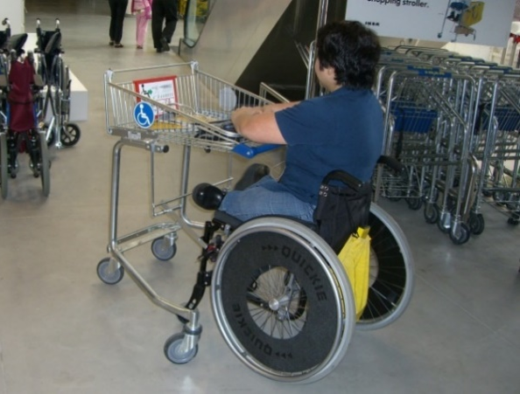
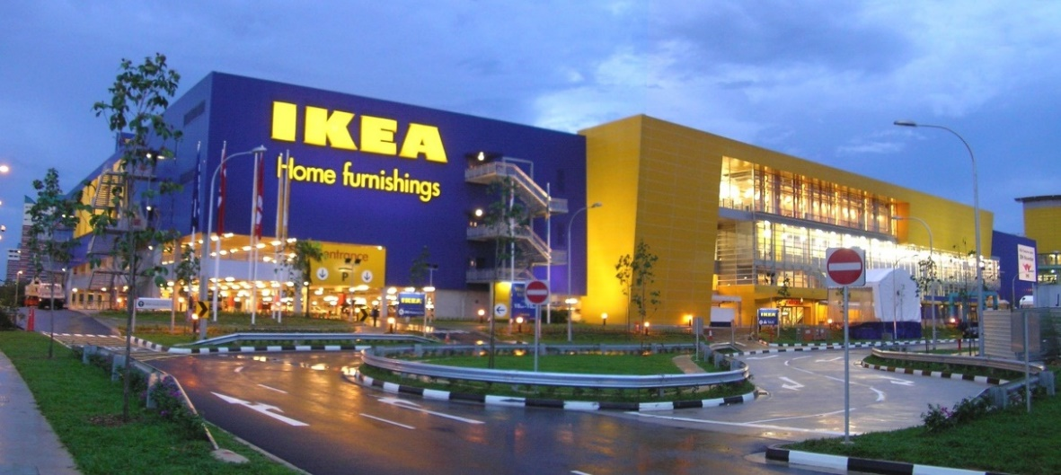
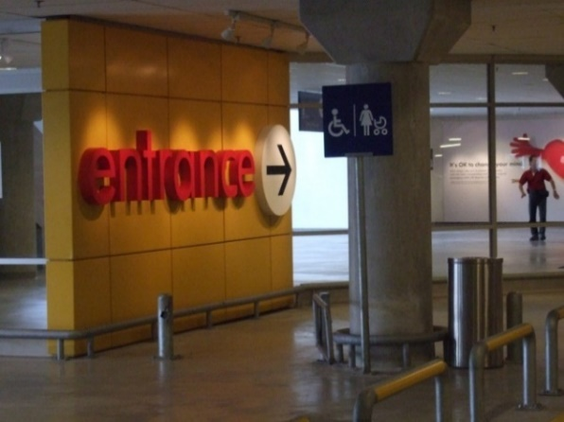
#4 -To raise awareness & capabilities
Annual UD Awards for the Built Environment (from 2007-2012)
To recognise designers/architects and building developers who had adopted UD concept in their buildings
First UD Award Gold Winner in 2007
Notes:
15
To raise public awareness and capabilities we organized the BCA UD Award to recognize designers since 2006.

Slide 16
Branding & Recognising UD
BCA UD Mark was launched in Oct 2012
Certification scheme
Upfront branding
For greater industry buy-in
Raise public awareness
Assessment through criteria checklists
More guidance and clarity for the industry
Notes:
To raise the bar in UD, we replace the UD Award with UD Mark Certification in 2012.
It provides a 2-stage assessment process which gives upfront credit for concept design and subsequent award affirmation in the form of a display plaque when the development is completed.
This encourages the developer/designers to go beyond Accessibility Code compliance and to think UD and accessibility at the early design stage.
As UD concept has always been abstract to many, the “self-help” checklists helps to make UD more tangible and easier to comprehend and implement.

Slide 17
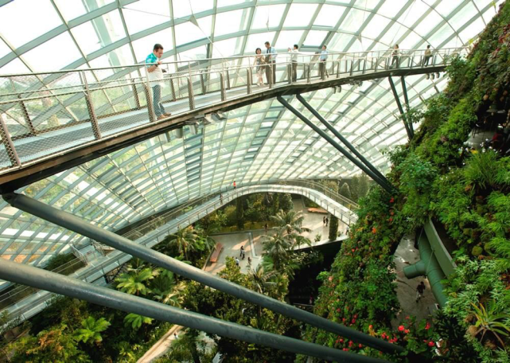
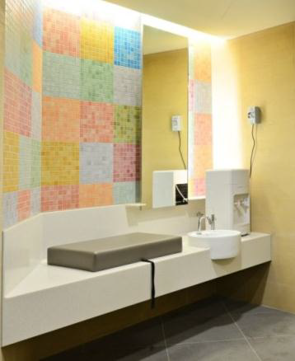
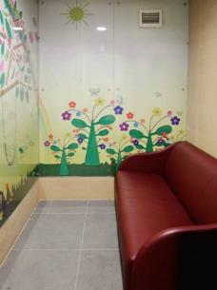
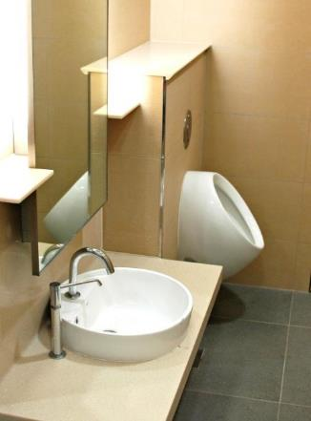
BCA UD Mark Certification –Platinum 2014
Gardens by the Bay (GB)
GB comprises 3 waterfront gardens and spans a total of 101 hectares – a place to foster an appreciation of plants & environment
Accessible and Inclusive Environment for all
Family-friendly features for mothers and children
Notes:
Some examples of developments that had obtained UD Mark Platinum
Gardens by the Bay where we could experience an accessible and Inclusive environment for persons with disabilities, older persons and families with young children

Slide 18
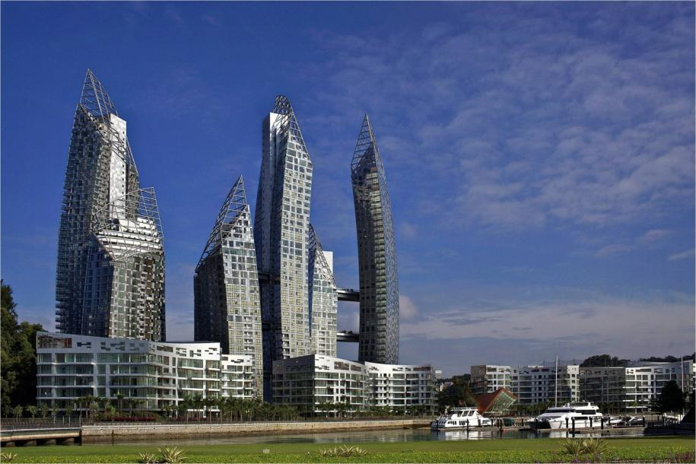
BCA UD Mark Certification- Platinum
UD Mark PLATINUM Award 2014
The Interlace
(Residential New Category)
Metropolitan Architecture
RSP Architects Planners & Engineers (Pte) Ltd
UD Mark PLATINUM Award 2013
Reflections at Keppel Bay
(Residential New Category)
Studio Daniel Libeskind/
DCA Architects Pte Ltd
High quality spaces
Conducive living environment for people of all ages and abilities
Notes:
Buildings by world-renown architects.
UD and Aesthetics can co-exists.

Slide 19
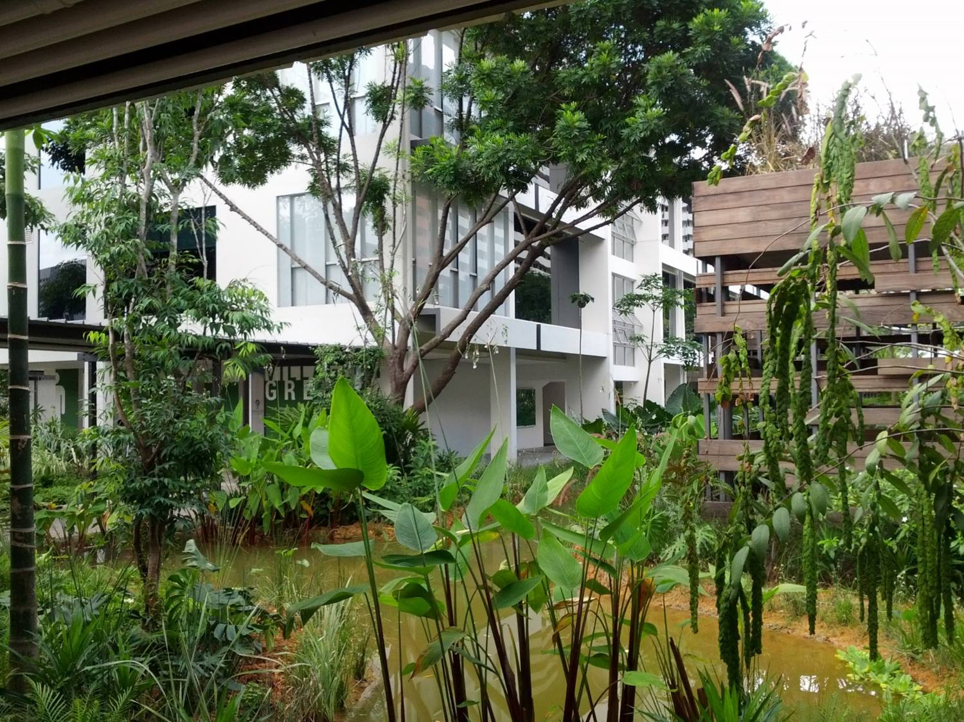
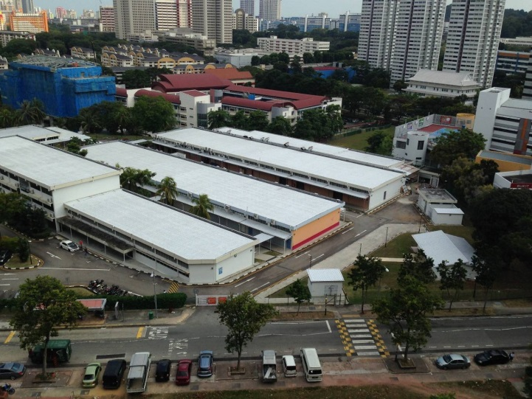
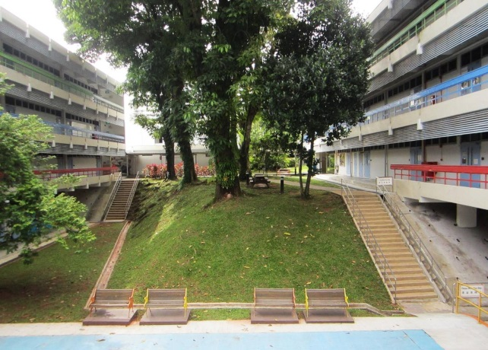
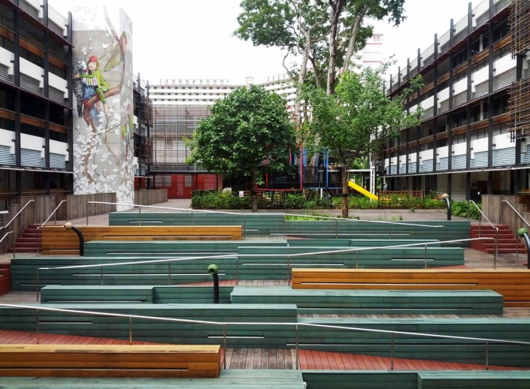
BCA UD Mark Certification –Platinum 2016
The Enabling Village
Transformation
Existing
Aesthetic +Function
Notes:
This is another example of how an existing buildings can be transformed with UD concept.

Slide 20
Key Points
We need a holistic approach to address Accessibility Issues
Whole of government effort
Multi-agency effort
Multi-levers
Involves the 3P sectors (people, private and public).
Universal Design in Built Environment
Is not boring
Does not cost more
Supports an inclusive society
Support Accessible tourism

