Slide 1
Asia-Pacific Experiences in Promoting Accessible Urban Development
Advancing Accessible and Inclusive Urban Development for All
14 June 2017
Nagesh Kumar
Director, Social Development Division

Slide 2
Context
Accessibility is a precondition for persons with disabilities to live independently and achieve full and equal participation in society.
Critical for achieving Leaving No One Behind
Notes:
Speaking Notes:
ESCAP’s position on accessibility supportsthat of the CRPD: Accessibility is a precondition for persons with disabilities to live independently and achieve full and equal participation in society. In other words, accessibility is a requirement for the rights of persons with disabilities to be fully recognized.
Also, accessible and inclusive development is not just for persons with disabilities, but should be the principle for all persons to be included. This is important in Asia and the Pacific considering that by 2050, one quarter of the population will be over 60. Accessibility is a matter of addressing multiple population needs at once.
Additional Notes:
Of those who will be over 60, 25% will be over 80 years old.

Slide 3
Asian and Pacific Decades of Persons with Disabilities (1993-2002, 2003-2012, 2013-2022)
Global Asia-Pacific Africa West Asia
Years
1980
1990
2000
2010
2020
UN Decade of Disabled Persons, 1983-1992
Asian and Pacific Decade of Disabled Persons, 1993-2002
African Decade of Disabled Persons, 2000-2009
Asian and Pacific Decade of Disabled Persons, 2003-2012
Arab Decade of Disabled Persons, 2004-2013
African Decade of Persons with Disabilities,
2010-2019
Asian and Pacific Decade of Persons with Disabilities, 2013-2022
Notes:
In response to these ongoing challenges, ESCAP has been initiating globally unique three consecutive disability-specific regional decades for three consecutive times.
Throughout these decades, we have also contributed to the CRPD drafting.
Currently, in 2017, we are at the Midpoint of the Asian and Pacific Decade of Persons with Disabilities, 2013-2022.

Slide 4
Incheon Strategy: Guiding Document for the 3rd Regional Disability Decade
http://www.maketherightreal.net/incheon-strategy/
Notes:
The Guiding document for the current Decade is the Incheon Strategy, adopted in 2012 in Incheon, Republic of Korea.
4

Slide 5
Incheon Strategy: World’s First Regionally Agreed Upon Set of Disability-Inclusive Goals, Targets, and Indicators
10
Goals
27 Targets
62 Indicators
Notes:
The Incheon Strategy is the world’s first disability-specific development goals with 10 inter-related goals and accompanying 27 targets and 62 indicators.

Slide 6
10 Incheon Strategy Goals
Goal 1: Reduce poverty & enhance work & employment prospects
Goal 2: Promote participation in political processes & in decision-making
Goal 3: Enhance access to the physical environment, public transportation, knowledge, information & communication
Goal 4: Strengthen social protection
Goal 5: Expand early intervention & education of children with disabilities
Goal 6: Ensure gender equality & women’s empowerment
Goal 7: Ensure disability-inclusive disaster risk reduction & management
Goal 8: Improve the reliability & comparability of disability data
Goal 9: Accelerate the ratification & implementation of the CRPD & the
harmonization of national legislation with the Convention
Goal 10: Advance subregional, regional & interregional cooperation
Notes:
Incheon Strategy’s ten inter-related goals cover key issues starting one on poverty reduction, employment, to political participation, accessibility, social protection, early intervention, education, gender equality, disability-inclusive disaster risk reduction, disability data and acceleration of the CRPD implementation, and advancement of subregional, regional, and inter regional cooperation.

Slide 7
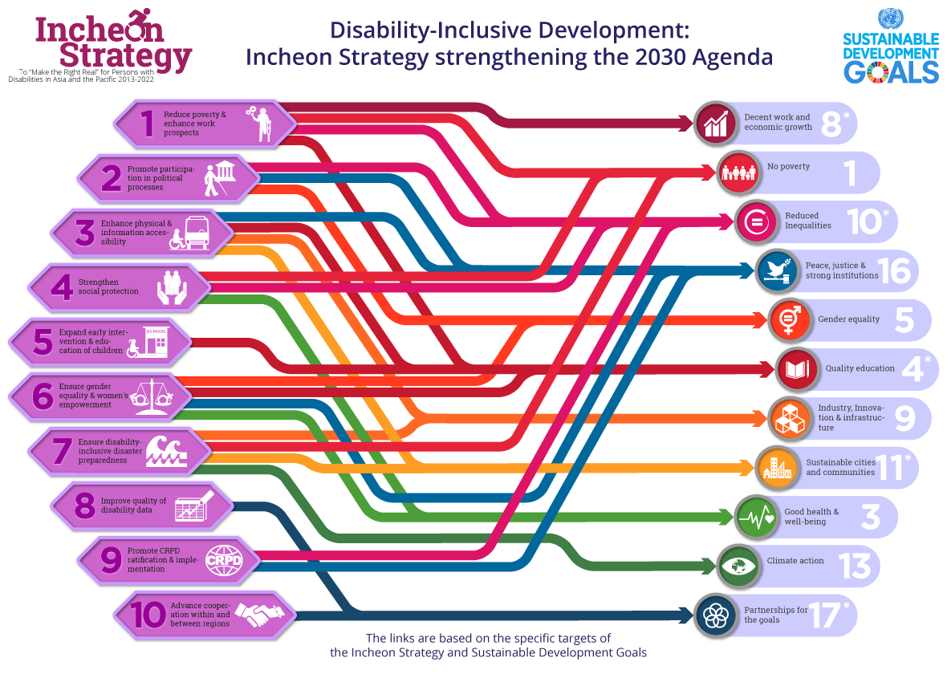
Notes:
In addition to facilitating CRPD implementation, the Incheon Strategy is also closely interlinked with the 2030 Agenda and the Sustainable Development Goals. 5 of the SDGs mention disability and an 6 additional Goals are also implicitly relevant to disability-inclusive development.
Therefore, the Incheon Strategy implementation bridges implementation of the SDGs and the CRPD.

Slide 8
Goal 3: Enhance access to the physical environment, public transportation, knowledge, information & communication
Targets
A: Increase the accessibility of the physical environment in the national capital that is open to the public
B: Enhance the accessibility and usability of public transportation
C. Enhance the accessibility and usability of information and communication services
D. Halve the proportion of persons with disabilities who need but do not have appropriate assistive devices or products

Slide 9
Key indicators on accessibility
Key IS indicators monitor proportion of:
Accessible polling stations; government buildings; international airports; emergency shelters and disaster relief sites
Daily captioning and sign language interpretation of public television news programme
Accessible and usable public documents and websites
Availability of mandatory technical standards for barrier free access that govern the approval of all designs for buildings that could be used by public, incorporating ISO standards
Notes:
Speaking Notes:
ESCAP’s work to promote accessible and inclusive development is guided by the Incheon Strategy, the guiding document of the current Asian and Pacific Decade of Persons with Disabilities.
Accessibility is noted in the Incheon Strategy as an overarching “Key Principle” of the document
In addition, the Incheon Strategy addresses accessibility across its document and requires member States to submit data on proportion of accessible polling stations; government buildings; international airports; emergency shelters and disaster relief sites; public documents and website, as well as daily captioning and sign language interpretations of public television news programme.

Slide 10
Midpoint Review
Highlight of gaps:
Consistent monitoring mechanism at the national level
Lack of national accessibility frameworks based on international standards
Accessibility audits by engaging persons with disabilities and their representative organizations
Notes:
Speaking Notes:
Since this year 2017 marks the midpoint of the Decade, we conducted a region-wide survey from Governments, and analyzing the results now.
I would like to highlight some gaps identified in this area from the survey:
Our member States, after ratification of the Convention and adoption of the Incheon Strategy, have adopted national strategies to improve accessibility. However, a consistent monitoring mechanism is not established in many countries.
Monitoring requires involving relevant stakeholders including DPOs, and based on a national framework consistent with international accessibility standards. Many countries in the region do not have adopted accessibility standards to evaluate accessibility with a common framework at the national level. Some countries do emphasize the physical accessibility for wheelchair users only.
As part of the monitoring, ESCAP encourages the conducting of accessibility audits where DPOs are engaged. However, a simple checklist form is used in many cases, and the form is completed by relevant authorities without DPO engagement.

Slide 11
Technical Assistance and Capacity Building
Activity: Disability-Inclusive Meetings: An Operational Guide
Impact: Support member states in holding disability-inclusive meetings with practical tips including a checklist
http://www.unescap.org/resources/disability-inclusive-meetings-operational-guide
Notes:
Speaking Notes:
In 2015, ESCAP published an operational guide to understanding, planning, and conducting disability-inclusive meetings to support meeting organizers in the planning process as well as during the meetings themselves. This guide includes an explanations of accessibility, inclusive design, and reasonable accommodation for meeting organizers to be aware of as well as concrete steps to make meetings as accessible as possible in order to facilitate participation by persons with disabilities.

Slide 12
Technical Assistance and Capacity Building
Activity: Accessibility for All: Good practices of accessibility in Asia and the Pacific to promote disability-inclusive development
Impact: Support policymakers
in promoting accessibility
at a policy and practical level
Supported by: The Government of China
http://www.unescap.org/publications/accessibility-all-good-practices-accessibility-asia-and-pacific-promote-disability
Notes:
Speaking Notes:
Secondly, in 2016, ESCAP published a book of good practices of accessibility in the region including policy and programme measures that have been undertaken by various member states.
This publication as well as the operational guide for meetings are available both in print and online.
12

Slide 13
Technical Assistance and Capacity Building
Collaborating with ICAO to update the Manual on Access to Air Transport by Persons with Disabilities
Notes:
Speaking Notes:
ESCAP is also participating in ongoing collaboration with the International Civil Aviation Organization to provide inputs to update the Manual on Access to Air Transport by Persons with Disabilities, published in 2013, by gathering inputs from members of the Working Group on the Asian and Pacific Decade of Persons with Disabilities regarding the requirements of persons with diverse disabilities.

Slide 14
ESCAP’s internal efforts
Accessibility Centre
Roadmap to improve accessibility within the ESCAP premises
ESCAP Accessibility guidelines
Notes:
<Speaking notes>
Not only for member States, we are internally intensifying efforts to improve accessibility.
First, since 2015, we have been managing the Accessibility Centre to provide assistive devices for participants of meeting held in our conference centre.
Second, we have an organizational commitment to the improvement of universal design based accessibility for the entire premise of ESCAP. Towards the aim, we are developing a roadmap this year with all internal divisions’ involvement, starting with accessibility survey of our premise and information set up this month.
Third, along with these efforts, we are developing an ESCAP accessibility guideline with specific actions to be taken to improve accessibility.

Slide 15
Thank you!
Get Counted to Count!
< www.unescap.org/our-work/social-development >
<www.maketherightreal.net>
Notes:
15

