Slide 1
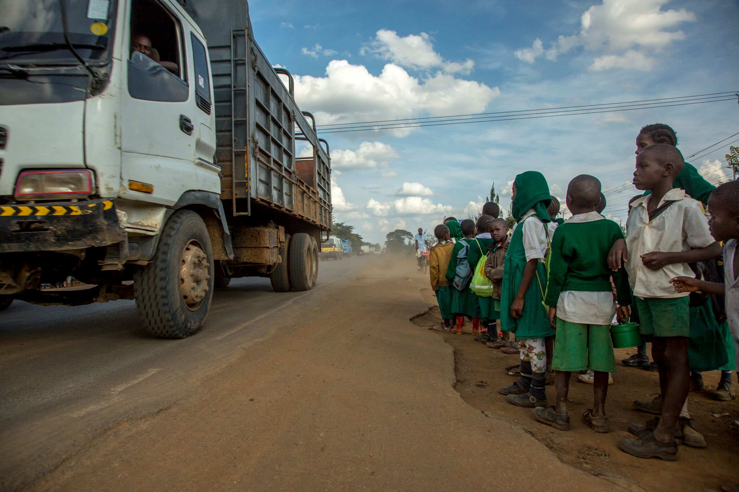


Investing in accessible, integrated and safe roads and transportation system as a public good and socio-economic imperative
Natalie Draisin, US Manager & UN Representative
Notes:
FIA Foundation is a UK based philanthropy that focuses on road safety and sustainable transport. We help manage the UN Decade of Action, and we work with WHO, World Bank, and UN to incorporate road safety into the SDGs and the NUA. Now, we’re aiming to implement those goals through advocacy and grants in over 80 countries.
At the FIA Foundation, we believe that promoting inclusion starts with the very thing that got you here today – and that is, safe, accessible, and inclusive mobility. __
based on what you noticed, how city/country /organisation are currently understanding accessibility and its potential socio-economic benefits ?
2. Why you think some cities/countries/entities have been successful ( or more successful compared to others) in increasing /promoting accessibility in one or more urban sectors- housing, transport or public services and in capturing envisaged socio-economic benefits of accessibility? 2-3 key lessons points from your case/s in this regard for furthering capturing and expanding these benefits in the future?

Slide 2
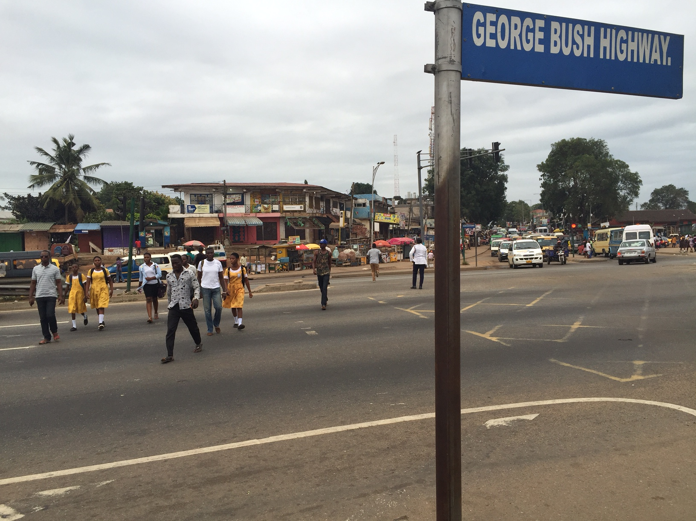
NOT JUST ‘ROAD SAFETY’:
INEQUALITY
BREACH OF CHILD RIGHTS
POLICY DYSFUNCTION
Notes:
Mobility is also what got our children to school today. We must make sure that that children of all backgrounds, income levels, and abilities have access to the education they deserve. It’s how we make sure these children can get jobs to help their families work their way out of poverty, and how we ensure that girls have the same opportunities as boys. This is why inclusion is about equality and social justice, too. One of the best ways to promote an inclusive future is to start with our future – our children.

Slide 3

HABITAT III NEW URBAN AGENDA
“We will promote the safe and healthy journey to school for every child as a priority.”
Notes:
To ensure that we make roads inclusive for children of all abilities, in the NUA, we successfully included this language. We believe this is at at the crux of improving access to education and economic opportunity. It reflects SDG 3.6, to half the number of deaths and injuries on the roads by 2020.

Slide 4


FOCUS ON YOUTH
Notes:
We felt it was important to include this language because so many children do not have safe journeys to school. Given that road traffic crashes are the leading killer of youth, it is crucial to focus on this immense carnage. These images are just the tip of the iceberg, millions more are left with disabilities because of road traffic injuries. Every four minutes, a child dies from a traffic crash. For every child that dies, another four are permanently disabled. 10 more are seriously injured.
Road injuries are the primary cause of head injuries, and it is estimated that 30% of all people injured on the roads remain permanently disabled. Road injury is not just a major cause of permanent disability – people with disabilities are also more at risk on the roads.

Slide 5










Notes:
It does not have to be this way. This is why we started the Global Initiative for Child Health and Mobility, with the founding partners you see here, including UNEP and UNICEF. The goal is to convince governments to put children at the center of their efforts. The Initiative has one clear goal – that all children have a safe and healthy route to school.

Slide 6





Notes:
Our initiative cuts across the SDGs and builds on these sustainable development goals.

Slide 7
“This translates into girls and boys with disabilities living in rural areas missing school because of the lack of safe and accessible transport, persons with disabilities giving up jobs because of the inability to commute to work, and the elderly with mobility impairments being unable to access essential healthcare services. This is detrimental not only for the affected individuals but also for Moldova’s social inclusion and cohesion and the country’s strive for sustainable development.”
-UN Resident Coordinator &
UNDP Resident Representative, Moldova
Dafina Gercheva
Notes:
One of our Initiative partners, the Eastern Alliance for Safe and Sustainable Transport, or EASST, is helping us understand the link between accessibility and socio-economics, and focusing on making roads inclusive in accessible and Belarus and Moldova.
In Moldova, 1 in every 20 people lives with a disability. This is an enormous challenge, as the former UN Special Rapporteur on Disability of the Commission for Social Development characterized Moldova as one of the least accessible countries he had ever visited during a 2014 visit.
In response, the UN Resident Coordinator, committed to leading by example by renovating the UN premises internally and externally to improve accessibility for persons with disabilities. It is an excellent lesson to others, when the UN ensures its own facilities are accessible.
EASST conducted a survey of 100 people with various disabilities to identify their road safety challenges. I encourage you to check out the more comprehensive report, but I’d like to highlight the issues students with disabilities experienced traveling to school. This includes dangerous road crossings, a lack of access ramps, inaccessible public transport, the need for assisted travel and (for parents) the challenges of transporting a child in a wheelchair. Challenges like these are the reason why after primary education in the few special schools, 93% of the young blind children disappear in society.
This translates into the challenge you see quoted here by the UN resident coordinator. This contributes to the reason why nearly one third of the 61 participants of working age were unemployed.

Slide 8
Study available at: http://www.easst.co.uk/news/news/707
Notes:
These findings were echoed in Belarus, where EASST surveyed 1000 people. Young children weren’t included in the survey, but the results also show the impact of poor mobility on participation in social and economic life.
I encourage you to check out both reports, which make suggestions to address this, such as addressing overcrowding, design changes, ensuring safe road crossings, better signage, and improvements to get the attention of drivers to ensure they stop.
But I want to touch on one recommendation that we see across both of these studies, and across all of our projects around the world, and that is speed reduction. Our projects which successfully manage speed see drastic reductions in injuries, including disabilities, and fatalities. Managing speed is critical to improving accessibility.

Slide 9
SPEED VACCINE CAMPAIGN
Notes:
Speed is an aggravating factor in all crashes. One of the main ways to make sure that schools are accessible to children of all abilities, and to prevent road traffic injuries, is by reducing speed to a level safe for children. Children’s movements are unpredictable, and to make it worse, they can’t sustain the same kind of impact we can. We know that a child hit by a car at 20 mph can survive, but hit at 50, they may die.
If we vaccinate our children against leading diseases, we should vaccinate them against the leading killer of youth – road traffic crashes. And the way to do that is by reducing speeds, hence the speed vaccine.

Slide 10
SPEED VACCINE CAMPAIGN
Join at childhealthinitiative.org, or at our July 14 lunchtime HLPF side event,
“The role of safe & sustainable mobility in eradicating poverty and improving health”
Notes:
The Global Initiative for Child Health & Mobility launched the Speed Vaccine advocacy campaign to urge governments, cities, urban and highway designers, policy leaders, and international lending institutions like the World Bank to ensure that all roads and streets used by children have traffic speed limits, sidewalks and crossings that are safe for children. Our vision is a safe and healthy journey to school for every child.

Slide 11
Notes:
We are asking everyone to sign onto this campaign, and we will have an opportunity for Ambassadors to do so publicly at our side event on July 14, “The role of safe & sustainable mobility in eradicating poverty and improving health” in the UN delegates dining room. If you are interested in attending, please let me know. Lunch will be served.

Slide 12
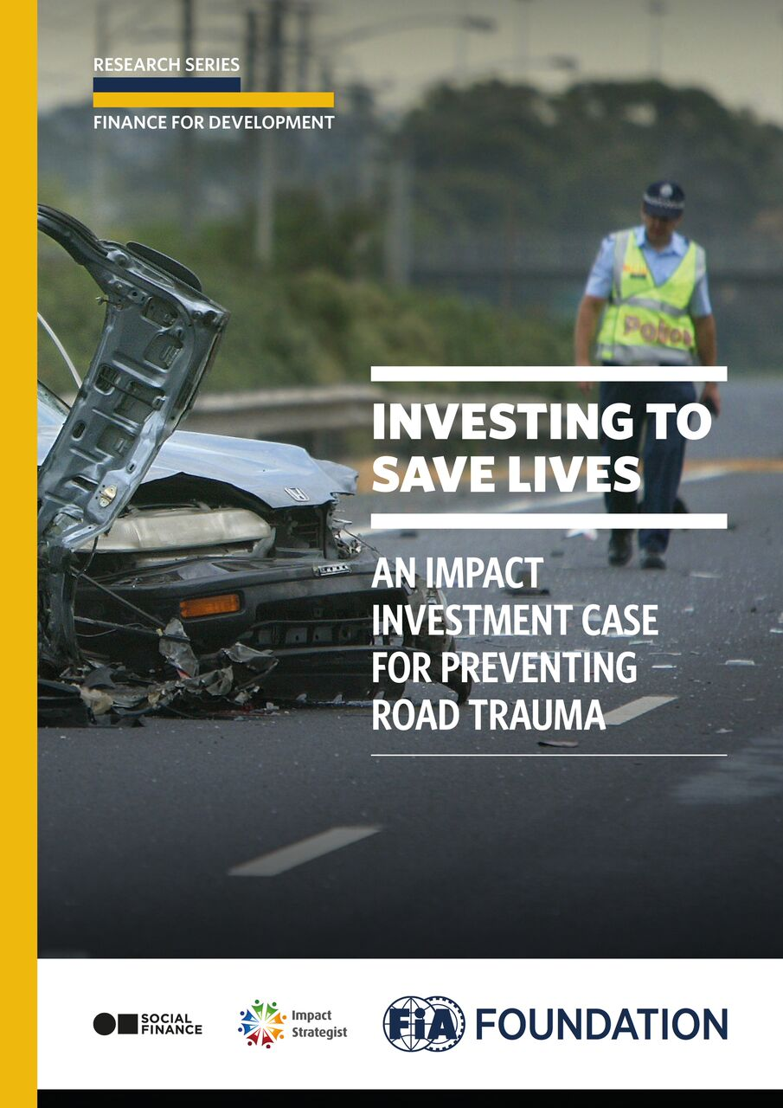
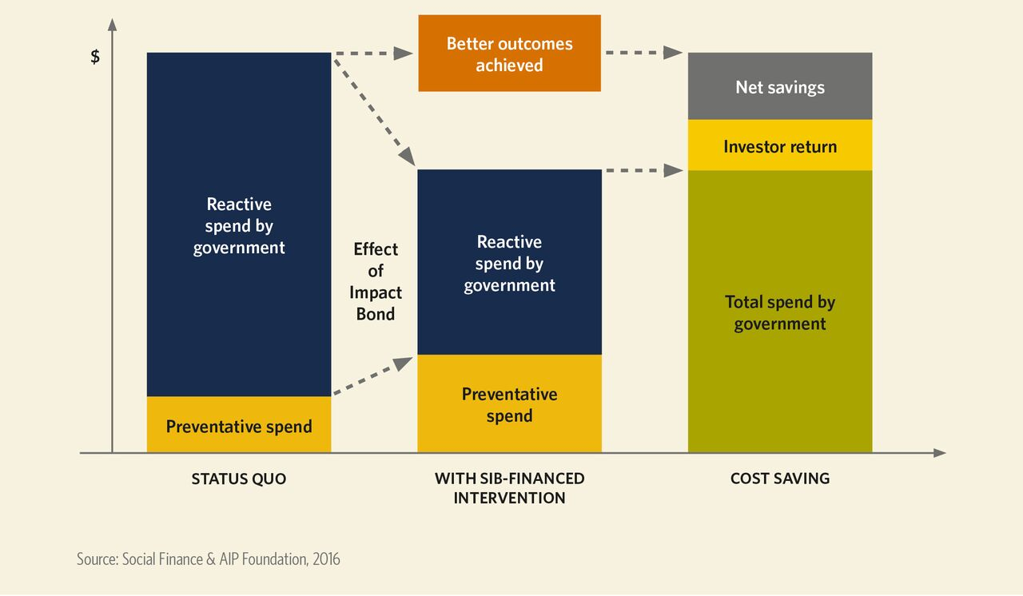
‘BUSINESS CASE’: FINANICAL BENEFIT OF INVESTING IN SAFER ROADS
Notes:
Finally, I want to leave you with one more resource. Across our projects, we capture our work in quantifying not just lives saved, but also money saved, in order to scale up our partners work. Some of our findings are presented our report, investing to save lives, available online. Here, we talk about social impact bonds, which is a sort of pay for prevention model of funding, to help increase preventive spending, reduce reactive spending, and result in a net savings. I encourage you to go online and check out this model. This is perhaps another lesson – to quantify benefits, and find creative ways to fund accessibility projects, through social impact bonds and other funding schemes.

Slide 13
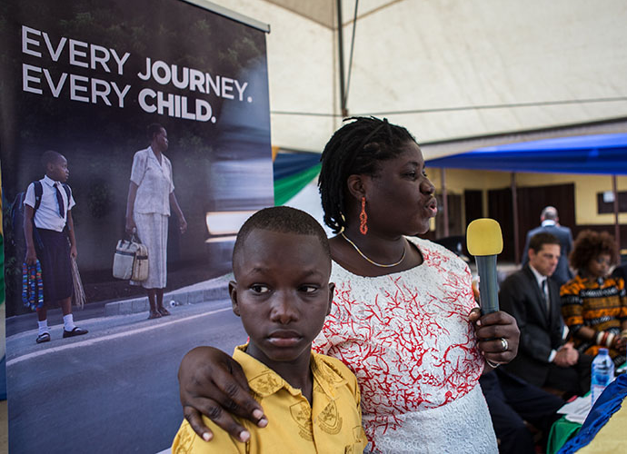
fiafoundation.org childhealthinitiative.org
fiafoundation.org childhealthinitiative.org
Notes:
If we make roads accessible for all, we’ll enable access to education and economic opportunity. Let’s make sure that everyone - regardless of your age, sex, race, or abilities - has access to safe, affordable, accessible, and inclusive mobility. Let’s use the New Urban Agenda to reorient policies to inclusively protect everyone.

