Slide 1
Energy and Disability
5th Expert Group Meeting on Monitoring and Evaluation for Disability-inclusive Development
13 December 2017
Sae Kajima
Associate Social Affairs Officer
Division for Social Policy and Development, UN-DESA

Slide 2
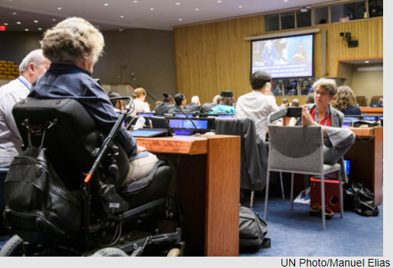
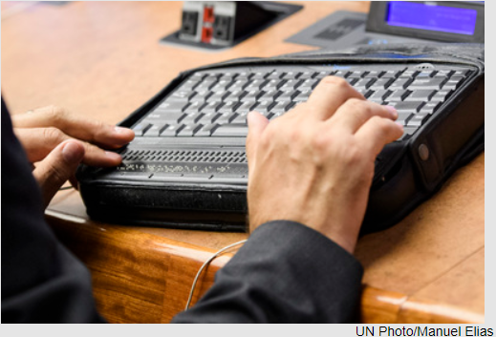
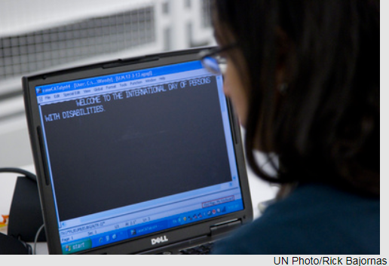
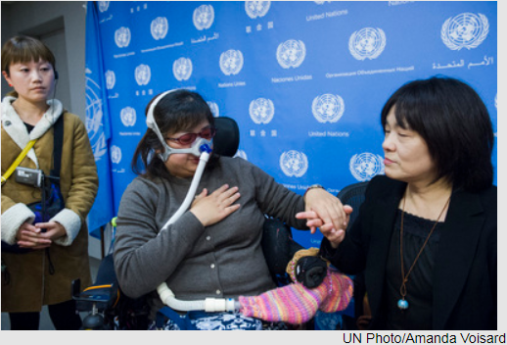
Disability and Energy : Why important?
Access to energy is fundamental for development
Persons with disabilities have higher energy needs
Use of Assistive technologies for independent living
Persons with mobility difficulties tend to spend long time at home
Annual energy bills of families with persons with disabilities: 50% more than families without persons with disabilities*
80% of persons with disabilities live in developing countries and many use traditional forms of energy inside the houses that have negative impact on health -> Need access to modern forms of energies
Many persons with disabilities live in low-income households
-> Need access to affordable energy
*Author’s elaboration based on the three case studies. (George, M., et al. “The Energy Penalty: disabled people and fuel poverty”, University of Leicester (2013). Pp.27-34)

Slide 3
Situation of persons with disabilities: lower access to electricity at a glance
In 87% of countries, households with persons with disabilities have lower access to energy.
For countries with less than 70% electricity access, gap between the two types of households increases
Source: Author’s elaboration based on data collected by: the DHS (Demographic and Health Surveys, Funded by USAIDS), SINTEF (Norwegian: Stiftelsen for industriell of teknisk forskning) studies and IPUMS (Integrated Public Use Microdata Series, USA)

Slide 4
Situation of persons with disabilities: lower access to electricity in numbers
80% of the persons with disabilities live in developing countries*
In Sub-Saharan Africa, only 47% of the total population had access to electricity in and only 27% in rural areas in that region (2014). **
In rural areas in the Pacific countries access is also low, with only 44% of the population having access to electricity. **
The low access to electricity will pose specific challenges to persons with disabilities who need electricity-run assistive technology devices to live independently and participate in society and development.
^{Source: *}
**Sustainable Energy For All Initiative (2017). Global Tracking Framework 2017 – Progress toward sustainable energy, Data Annex

Slide 5
Situation of persons with disabilities: Use of traditional forms of energy
Source: S. Bonjour and others (2013). Solid fuel use for household cooking: country and regional estimates for 1980-2010. Environmental health perspectives, vol 121, p. 784-790.

Slide 6
Energy demand: Priority Assistive Products
Examples:
Canes/sticks
Chairs for shower/bath/toilet
Hand rails/grab bars
Magnifiers (optical)
Orthoses
Prostheses
Walking frames/walkers
Wheelchairs (manual)
Fall Detectors
GPS locators
Recorders
Hearing aids (digital)
Personal digital assistant
Braille displays (note takers)
Screen readers
Simplified mobile phones
Wheelchairs (electrical)
Source: WHO, 2016. Priority Assistive Products List

Slide 7
International Frameworks
Target 7.1 Universal access to affordable, reliable and modern energy
Target7.a By 2030, enhance international cooperation to facilitate access to clean energy research and technology, including renewable energy, energy efficiency and advanced and cleaner fossil-fuel technology, and promote investment in energy infrastructure and clean energy technology
Target 7.b Expand infrastructure and upgrade technology for supplying modern and sustainable energy services for all in developing countries
Art.19 (independent, inclusion)
Art 20 (mobility)
Art.26 (Habilitation and rehabilitation)
Art.28 (adequate standard of living and social protection)

Slide 8
National Policies on disability and energy
Many countries offer some sort of disability benefit but typically do not consider the additional energy costs faced by persons with disabilities.
Social welfare programs directed at supporting the energy bills of persons disabilities do exist:
Example: UK
The Cold Weather Payment
GBP25 per 7 days of cold weather to households (low income, persons with disabilities)
The Warm Home Discount Scheme
One-off discount of GBP140 on electricity bill to low income households
Winter Fuel Payment
GBP100-300 tax free on heating bills for older persons
Example: US
Low Income Home Energy Assistance Program (LIHEAP)
Assists low-income households including persons with disabilities to pay electricity bills, energy crisis assistance, and weatherization and energy-related minor home repairs.

Slide 9
UN Initiatives on energy and disability Need to reach out to persons with disabilities
In 2012, the GA declared 2014-2024 the Decade of Sustainable Energy for All (A/RES/67/215)
GA resolution on “Ensuring access to affordable, reliable, sustainable and modern energy for all” (A/RES/71/233)
Reports of the Secretary-General on “Ensuring access to affordable, reliable, sustainable and modern energy for all” (A/72/160), “United Nations Decade of Sustainable Energy for All” (A/72/156)
A Public-Private partnership “Minimum Electricity Access” – promotes access to affordable, reliable, and sustainable off-grid renewable energy system in rural areas.
Supported programmes expanding electricity services to 4,300 town and villages in Ethiopia
Persons with disabilities are not included

Slide 10
Recommendations
More studies needed on disability and energy.
Social protection measures need to consider the extra energy costs that persons with disabilities are faced with.
Development activities/programmes on enhancing energy access needs to include persons with disabilities.
Close gaps in electricity access between households with and without persons with disabilities.
Reduce use of solid fuels to prevent negative impact on health.
Focus on countries with low electricity access, especially sub-Saharan Africa.

Slide 11
We need your advice
More data, evidence, research on extra costs on electricity that are met by persons with disabilities?
More examples of social protection measures/programmes to financially support persons with disabilities on paying electricity bills?
More examples of projects on energy that reach out to persons with disabilities?
Data, evidence, research on electricity consumption of each assistive product?

Slide 12
THANK YOU!
Sae Kajima
Associate Social Affairs Officer
Division for Social Policy and Development, UN-DESA
Email: kajima@un.org

