Slide 1
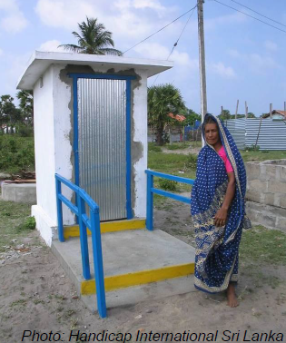
SDG6 and disability
Expert Group Meeting on Monitoring and Evaluation for Disability-inclusive Development
New York, USA
14 December 2017
Rifat Hossain (hossainr@who.int)
World Health Organization
Geneva, Switzerland

Slide 2
Sustainable Development Goals…
Tools of global governance
Measuring progress for the global community
Informing global investments
Objective: mobilize political support for neglected priorities
MDG experience: mobilized support for direct human development, focused on poverty, inequality neglected
SDG calls for: sustainability (economic, social and environmental) in development under good governance
Huge opportunities
Tremendous challenges, including on monitoring

Slide 3
Inequalities are intersectional
The SDGs must go beyond identifying inequality by wealth percentiles
The world’s poorest are disproportionately characterized by one or several exclusionary or discriminatory grounds
Caste
Ethnicity
Gender
Disability
Laws, policies, lengthy administrative procedures can also negatively impact on access to water and sanitation services.
Eg. People with disabilities are socially excluded unless special policies ensure their access in public spaces

Slide 4
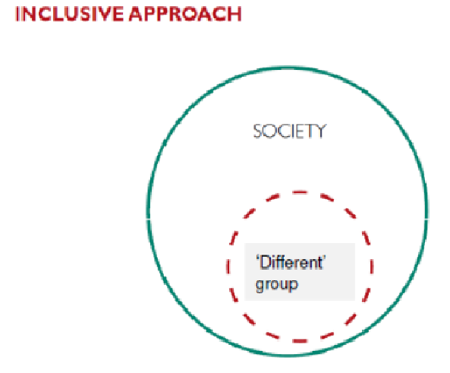
Social model of inclusion/exclusion

Slide 5
Using an inclusive approach
How can we use the social model to
analyse barriers to access and use
in the WASH sector?
What barriers or obstacles can we identify that would create difficulties for people with disabilities and others who are vulnerable or marginalised?

Slide 6
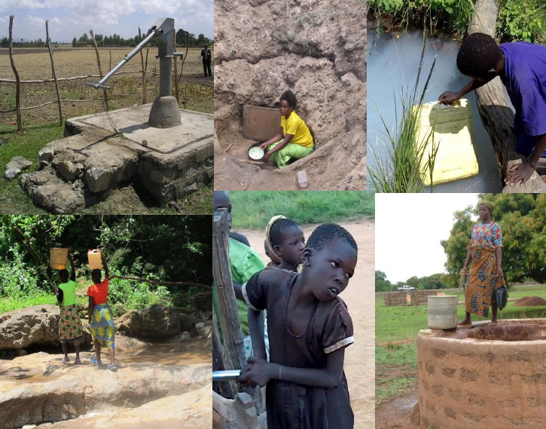
Barriers…access to water

Slide 7
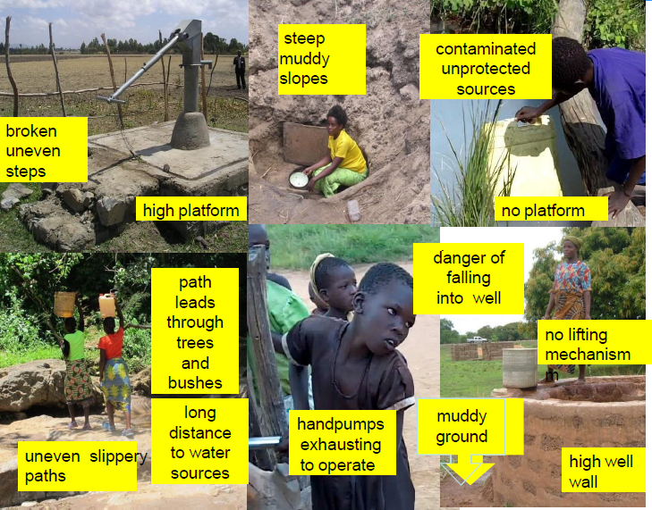
Barriers identified…access to water

Slide 8
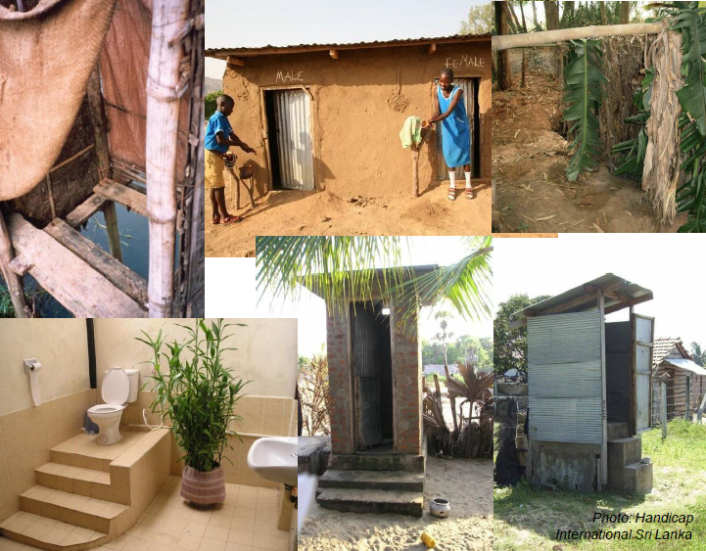
Barriers…access to sanitation

Slide 9
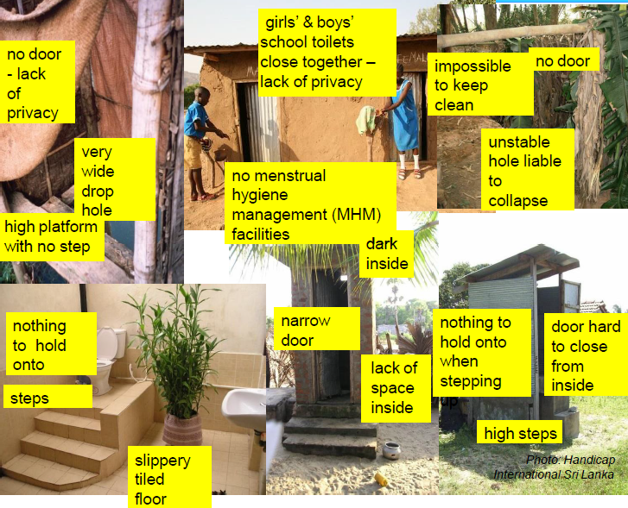
Barriers identified…access to sanitation

Slide 10
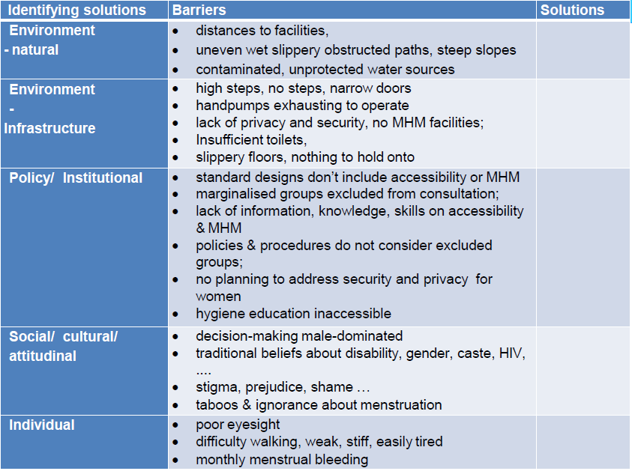
Identifying barriers gives us solutions

Slide 11
Getting in…assistive/adaptive approaches

Slide 12
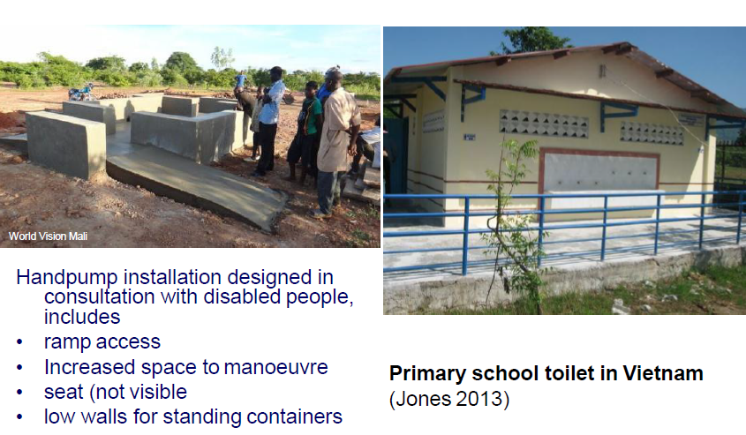
Examples of inclusive design approach

Slide 13
SDG WASH targets and indicators
Target: By 2030, achieve universal and equitable access to safe and affordable drinking water for all
Indicator: Percentage of population using safely managed drinking water services
Target: By 2030, achieve access to adequate and equitable sanitation and hygiene for all and end open defecation, paying special attention to the needs of women and girls and those in vulnerable situations
Indicator: Percentage of population using safely managed sanitation services including hand washing facilities with soap and water

Slide 14
SDG targets…'leave no one behind'
Disaggregate as relevant
income,
sex,
age,
race,
ethnicity,
migratory status,
disability and
geographic location,
or other characteristics of national relevance
Target elements
Universal (progressive realization)
equitable
safe
affordable
adequate
open defecation,
women and girls
vulnerable situations
Notes:
Fiona

Slide 15
Priorities and way forward…
Disaggregation | Priority for WASH SDG | Priority for JMP | In collaboration with | External collaboration
Income (WQ) | Yes | Yes | HHS
Affordability | Yes | Yes | WB, HHS
Sex | Yes | Yes | UNWOMEN, IAEG-gender
Race, ethnicity, religion, education… | Yes | Thematic | IER, etc. | Academia
Migratory status | Yes | Yes (?) | ? | Academia
Disability (incl age) | Yes | Yes | Disability com
Subnational (NTD, nutrition), informal urban | Yes | Yes | UNHABITAT
Extra household | Yes | Yes | WHO, UNICEF | Academia

Slide 16
Incorporating disaggregated indicators
The human rights to water and sanitation and the human rights principles of non-discrimination and equality inform the framework for monitoring inequalities
The Equity and Non Discrimination Working Group suggests a metric comparing advantaged groups with disadvantaged groups. in the following areas of monitoring:
Wealth based (rich-poor)
Geographic disparities (urban-rural)
Group-related inequalities (e.g. based on race, ethnicity and migratory status)
Intra-household inequalities (e.g. sex, age disability)
Service provision must also be monitored in institutions, the workplace and public spaces

Slide 17
Progressive elimination of inequalities = Progressive realisation of human rights
Progress among both groups can be followed. Disparity should ideally diminish through time
The world’s most disadvantaged groups must be given priority
Way of achieving other targets…

Slide 18
Access: people with and without disability
World Report on Disability used data from World Health Surveys from 50 countries.
Difference in access between people without and with disability (35 countries)
Disability: present data does not provide a clear picture of the nature or scale of this inequality
Quantifying differential access within households is difficult.

Slide 19
Identifying issues on WASH access for PWD
Washing body | no_difficulty | difficulty | Percent
Water sources
unimproved | 98.96 | 1.04 | 100
improved | 98.98 | 1.02 | 100
Total | 98.98 | 1.02 | 100
Carrying water | no_difficulty | difficulty | Percent
Water sources
unimproved | 92.89 | 7.11 | 100
improved | 94.64 | 5.36 | 100
Total | 94.52 | 5.48 | 100
Difficulty in using toilets | no_difficulty | difficulty | Percent
Sanitation facility
unimproved | 97.63 | 2.37 | 100
improved | 99.26 | 0.74 | 100
Total | 98.77 | 1.23 | 100

Slide 20
Issues for PWD in access…gender dimension
Indicator | Country | Disability level TOTAL SAMPLE |  |  |  | Disability level MEN |  |  |  | Disability level WOMEN
 |  | No | Mild | Moderate | Severe | No | Mild | Moderate | Severe | No | Mild | Moderate | Severe
% of persons reporting a lot of or extreme problems with toileting | Chile | 0.0 | 0.0 | 0.1 | 8.7 | 0.0 | 0.0 | 0.0 | 8.1 | 0.0 | 0.0 | 0.2 | 9.0
 | Sri Lanka | 0.0 | 0.0 | 0.9 | 16.2 | 0.0 | 0.0 | 1.0 | 19.0 | 0.0 | 0.0 | 0.8 | 14.3
 | Cameroon | 0.0 | 0.0 | 2.5 | 28.4 | 0.0 | 0.0 | 3.6 | 28.6 | 0.0 | 0.0 | 1.6 | 28.2
% of persons reporting that the toilet of the dwelling is hindering or very hindering* | Chile | 1.8 | 2.6 | 6.2 | 18.1 | 2.0 | 3.2 | 6.3 | 17.0 | 1.5 | 2.0 | 6.2 | 18.7
 | Sri Lanka | 0.8 | 0.6 | 1.8 | 22.3 | 1.4 | 0.7 | 1.3 | 24.2 | 0.2 | 0.4 | 2.2 | 21.0
 | Cameroon | 1.8 | 5.8 | 11.0 | 63.5 | 5.3 | 6.4 | 10.8 | 68.6 | 0.0 | 5.0 | 11.1 | 59.0

Slide 21
Issues for PWD in access…age dimension
 |  | Disability level AGE 16/17/18**-39 |  |  |  | Disability level AGE 40-59 |  |  |  | Disability level AGE 60+
indicator |  | No | Mild | Moderate | Severe | No | Mild | Moderate | Severe | No | Mild | Moderate | Severe
% of persons reporting a lot of or extreme problems with toileting | Chile | 0.0 | 0.0 | 0.1 | 8.2 | 0.0 | 0.0 | 0.0 | 5.1 | 0 | 0 | 0.2 | 11.1
 | Sri Lanka | 0.0 | 0.0 | 0.3 | 22.7 | 0.0 | 0.0 | 1.0 | 12.7 | 0 | 0 | 1.5 | 17.0
 | Cameroon | 0.0 | 0.0 | 1.6 | 20.0 | 0.0 | 0.0 | 2.7 | 30.4 | 0 | 0 | 6.5 | 33.3
% of persons reporting that the toilet of the dwelling is hindering or very hindering* | Chile | 1.8 | 3.4 | 7.4 | 16.5 | 1.9 | 2.3 | 6.8 | 19.0 | 1 | 1 | 4.1 | 17.9
 | Sri Lanka | 0.8 | 1.2 | 2.6 | 23.6 | 0.0 | 0.3 | 0.9 | 18.3 | 9 | 0 | 2.3 | 24.7
 | Cameroon | 0.0 | 8.0 | 12.0 | 53.3 | 0.0 | 3.4 | 10.8 | 78.3 | 25 | 0 | 9.7 | 56.7

Slide 22
Ways forward…
Disability inclusive programming, including designing of monitoring systems
Collect data
Use of various tools for household data collection (Washington Group questions, Model Disability Survey short and long forms, etc.)
Innovative ways of collecting data on intra-household disparities
PWD is not a homogeneous group
Types of disability
Age, gender and other dimensions are important

Slide 23
Thanks to the SDG6 Task Team…
Robert Bain, UNICEF (rbain@unicef.org)
Somnath Chatterji, WHO (chatterjis@who.int)
Alarcos Cieza, WHO (ciezaa@who.int)
Julia Fleuret, ICFI (Julia.Fleuret@icfi.com)
Louisa Gosling, WaterAid (LouisaGosling@wateraid.org)
Nora Groce, UCL, London (nora.groce@ucl.ac.uk)
Rifat Hossain, WHO (hossainr@who.int)
Chapal Khasnabis, WHO (khasnabisc@who.int)
Archana Patkar, WSSCC (Archana.patkar@wsscc.org)

Slide 24
THANK YOU
SDGs have been truly transformational…
To achieve the SDG aspirations we need to have another revolution…in maximizing monitoring efforts for evidence based decision making?
Rifat HOSSAIN
Email: hossainr@who.int

