Slide 1

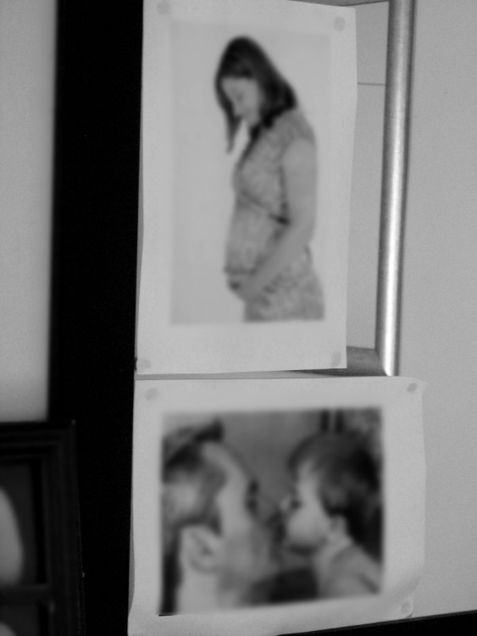
UN Flagship Report on Disability
Sexual Reproductive Health and Rights Chapter

Slide 2
Introduction-Why SRHR?
Unplanned pregnancies, sexually transmitted infections(STIs) including HIV/AIDS, gender-based violence, to which many persons with disabilities are exposed, are a major threat to their personal development, health and life quality
A growing body of data now confirms the fact that that persons with disabilities are as sexually active as their non-disabled peers and have similar needs for SRH services, and often have greater needs at the point of care.
Persons with disabilities are up to 3 times more likely to experience physical, sexual, and emotional violence
Notes:
misperceptions about persons with disabilities and the assumption that persons with disabilities are not sexually active has meant that, until recently, little attention and few resources have been devoted to ensuring persons with disabilities have equal access to SRH.
Challenges PWD are facing includes lack of access to sexual reproductive health services, contraception, comprehensive sexuality education, and are unable to exercise full autonomy and decision-making- which can result in forced procedures such as forced sterilization and abortion
A growing body of data now confirms the fact that that persons with disabilities are as sexually active as their non-disabled peers (e.g.,; Iezzoni, et al, 2013; Devine et al, 2017) and have similar needs for sexual reproductive health services, and often have greater needs at the point of care. For example, some disabilities can cause complications for pregnancies requiring greater attention and expertise from specialists, and healthcare facilities are frequently not fit for purpose because they are not accessible.
Persons with disabilities are up to 3 times more likely to experience physical, sexual, and emotional violence.
Source: (Sobsey D, Doe T. Patterns of Sexual Abuse and Assault. Disability and Sexuality, 1991; 9:243-259.)(Chenoweth L. Violence and Women with Disabilities: Silence and Paradox. Violence Against Women, 1996; 2:4:391-411.) (Nosek M, Howland C, Hughes R. The Investigation of Abuse and Women with Disabilities: Going Beyond Assumptions. Violence Against Women, 2001; 7:4:477-499) UNICEF, violence against children

Slide 3
Cross-Cutting Guidelines for Action
1. Creating an enabling legislative and policy environment 2. Programme development, implementation, and monitoring 3. Designing accessible facilities
GBV Services | SRHR Services
GBV prevention services Health services for GBV victims/survivors with disabilities Justice and policing services Social Services—protection services Social Services—rehabilitation services GBV services for women and young people with disabilities in institutional settings Adolescent- and youth-friendly GBV services | Contraceptive information, goods, and services Maternal and newborn health services Comprehensive Sexuality Education (CSE) and information Access to safe abortion services and post-abortion care Information, testing, and treatment services for sexually transmitted infections (STIs), including HIV Access to other women’s health information and services Adolescent- and youth-friendly SRH services
Notes:
This is the framework diagram from the global guideline UNFPA is developing- just to give you idea on key interventions for addressing SRHR and GBV

Slide 4
International legislation for persons with disabilities on sexual and reproductive health
Convention on the Rights of Persons with Disabilities (CPRD)
International Conference on Population and Development Programme of Action (ICPD PoA)
The Convention on the Elimination of All Forms of Discrimination Against Women (CEDAW)
Notes:
CPRD- In Article 25 the need to provide persons with disabilities with the same range, quality and standard of free or affordable health care and programmes as provided to all other persons, including in the area of sexual and reproductive health and population-based public health programmes, is underscored.
ICPD PoA- One of the first global agreements to specifically recognise the reproductive health needs of adolescents as a group. It called on states to recognise the rights of adolescents to ‘appropriate direction and guidance in sexual and reproductive matters’, and ensure they have access to the services and information they need to live healthy and fulfilling lives.
CEDAW- requires States to ensure that women and girls with disabilities have access to reproductive health care, and are protected from coercive pressures.

Slide 5
Situation of persons experiencing disability: status and trends
Structural/environmental barriers to sexual and reproductive health
Attitudinal barriers to sexual and reproductive health
Increased vulnerability to GBV, harmful practices
Unable to exercise full autonomy
Lack of data
Notes:
Structural/environmental barriers to sexual and reproductive health
healthcare facilities within low –and middle-income income countries are often physically inaccessible, lacking adjustments such as ramps or moveable equipment (Ahumuza, Matova, Ddamulira, & Muhanguzi, 2014; Mavuso & Maharaj, 2015) and frequently have long-waiting times (Vergunst et al., 2015). The need for some people with disabilities to have someone accompany them on the health visit not only increases transportation costs, but also raises issues of confidentiality for many.
barriers to SRH are exacerbated for people with disabilities during humanitarian emergencies. For example, a multi-country study of refugee communities found that people with disabilities could not access sexual and reproductive healthcare services, because there were no translators available for either spoken or sign-language (Tanabe et al., 2015).
Attitudinal barriers to sexual and reproductive health
There is a widespread belief that people with disabilities are asexual, are not desired as sexual partners, have few or no sexual rights, and do not derive the same benefit from sexual and reproductive healthcare as people without disabilities (Hunt et al., 2017). Healthcare professionals often share the negative attitudes about disability and sexuality that are entrenched within society (Pebdani, Johnson, & Amtmann, 2014; Tanabe et al., 2015) which can lead to distressing experiences for people with disabilities.
Vulnerability
One study in Australia found that among women with disabilities under the age of 50, 62 per cent had experienced violence since the age of 15, and women with disabilities had experienced sexual violence at three times the rate of those without disabilities. Stine Hellum Braathen, Sexual and Reproductive Health and Rights of Girls with Disabilities, SINTEF (June 2017).
Young women and girls with disabilities are as vulnerable to harmful practices such as early or child marriage or female genital mutilation as their non-disabled peers
Autonomy
Until recently, many women with disabilities, particularly those with intellectual disabilities, were subjected to national programmes of involuntary sterilisation, under erroneous eugenic justifications (Tilley, Walmsley, Earle, & Atkinson, 2012).
Lack of data
Lack of disaggregated data is also a challenge for evidence-based programming

Slide 6
Programme case studies/UN activities
WE DECIDE Global Programme - Young Persons with Disabilities: Equal Rights and a Life free of Violence (UNFPA)
W-DARE project (Women with Disability taking Action on Reproductive and sexual health) , sign language on SRHR (Kenya)
UNPRPD, WHO, UNICEF, UN Women
Notes:
WE DECIDE Global Programme
Global Study on Youth and Disability: Achieving rights for all - Access to sexual and reproductive health and rights and prevention of gender-based violence for young people with disabilities
Develop Guidelines for Providing Rights-Based and Gender Responsive Services for Women and Young People with Disabilities
Promote participation and social inclusion of young persons with disabilities :Work with Inter-American Institute on Disability and Inclusive Development (iiDi) and IDA
Strengthening country level response to Gender Based Violence and Sexual and Reproductive Health and Rights (Morocco, Mozambique, and Ecuador)
Strengthening disability statistics
W-DARE PROJECT
A three-year programme designed to improve access to quality SRH for women with disabilities in the Philippines (Vaughn et al., 2015). In this programme, several women with disabilities were recruited as co-researchers through DPO’s and were engaged by the core research team to run the W-DARE project intervention: peer-facilitated Participatory Action Groups that focused on sexual and reproductive health for women with disabilities. These groups were held fortnightly over a 20 week period with five groups of women with disabilities and had five main objectives (Devine et al., 2017,:57): increase participants’ sexual and reproductive health knowledge and awareness of their rights, as well as tosupport individual and/or collective action planning to further promote demand for sexual and reproductive health within the women’s communities , facilitate peer support amongst groups of women with disabilities.
Several positive outcomes of the programme were reported, such as increased knowledge and access about sexual and reproductive healthcare and increased participation.
UNPRPD- Some of the country-level joint programmes address SRHR . In 2016, UNPRPD supported a programme in Bolivia setting the National Technical Norms for Comprehensive Sexual and Reproductive Healthcare for persons with disabilities, which was adopted by a Ministerial Resolution, as well as the capacity building of Ministry of Health for improved delivery of SRH services to persons with disabilities, as well as the development of a Guide on Sexuality Education for persons with disabilities and for parents of children and adolescents with disabilities. The programme also supported Bolivian Ministry of Justice to develop a protocol on access to justice for persons with disabilities, with the Integral System of Prevention, Care, Punishment and Eradication of Gender-based Violence (SIPPASE).
WHO-supports improving the access to service across all health care programmes, including those on SRH, and has worked with user groups to audit accessibility in order to identify barriers that may prevent persons with disabilities from accessing health services, WHO and UNFPA developed “Promoting sexual and reproductive health for persons with disabilities” in 2009
UNICEF- supports promoting the participation of persons with disability, particularly adolescents and women, with a focus on addressing HIV/AIDS
UN Women- is increasing its attention to disability in a range of areas including gender equality, women's empowerment, and violence against women and girls with disability

Slide 7
Key Recommendations
Ensure access and inclusion in SRH services, including services for GBV survivors, eliminate physical and attitudinal barriers
Train policymakers, programme administrators and service providers in disability inclusion
Strengthen disaggregated data collection and research
M&E framework, budget allocation

