Slide 1
EMPOWER: Mainstreaming the Social Model among
Young People for Mutually-Empowering & Resilient Society
Satoshi Iiyama The University of Tokyo Empower Project
Kota Machida The University of Tokyo Empower Project Atsuro Tsutsumi Kanazawa University
Takashi Izutsu The University of Tokyo
Notes:
Thank you very much, Ambassador Gallegos.
Excellencies, ladies and gentlemen, it is my great honor that I can share our initiative on promoting support and accessibility for persons with disabilities through empowerment, today.
My name is Satoshi Iiyama, a student at The University of Tokyo.
I would like to thank UN DESA for giving me this special opportunity to represent young people and share a youth initiative.

Slide 2
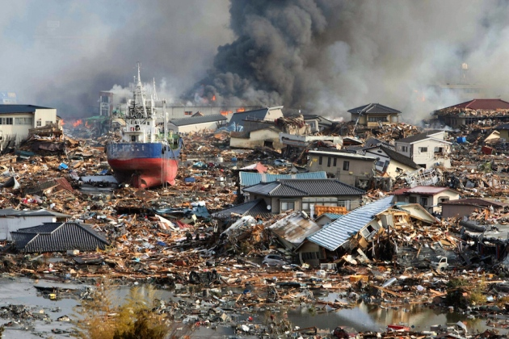
East Japan Great Earthquake (2011) ©nature.com
Notes:
These days, the number and complexity of mega-disasters are increasing worldwide.
Japan is one of the most disaster-prone countries, and accumulated various good practices and lessons learned.
At the time of East Japan Great Earthquake, persons with disabilities experienced lack of access to information, being left behind in Tsunami, being excluded from evacuation sites, and lack of inclusion in decision-making.
However, at the same time, there also have been many positive experiences accumulated. One of examples is provision of psychological first aid, PFA by aid workers and volunteers in communities.

Slide 3
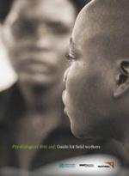
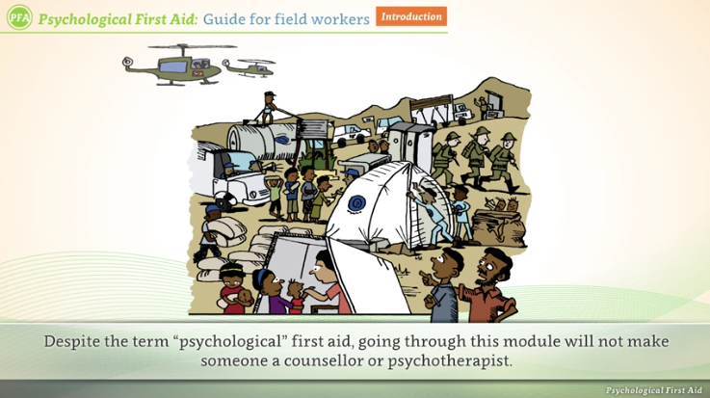
PFA Guide for Field Workers (2011) PFA e-Orientation (2017)
Notes:
PFA is humane, supportive and practical help to fellow human beings suffering serious crisis events. PFA is useful since it can be offered by anyone as an emotional and practical support, NOT depending on medical model. PFA respects self-determination of affected persons WITHOUT forcing support. After “PFA guide for field workers” was published by WHO in 2011, PFA has been very popular.
Japan is not an exception.
In order to make PFA available to more people, our University and the National Information Center for Disaster Mental Health, in collaboration with the UN University and the UN Staff Counsellors Office, developed an online version of the PFA orientation with a fund from Japan Agency for Medical Research and Development. This e-orientation which is accessible with captions and audio guide will be available for free on internet soon. Currently, we are developing an additional short e-orientation on the rights of persons with disabilities in emergency settings.

Slide 4
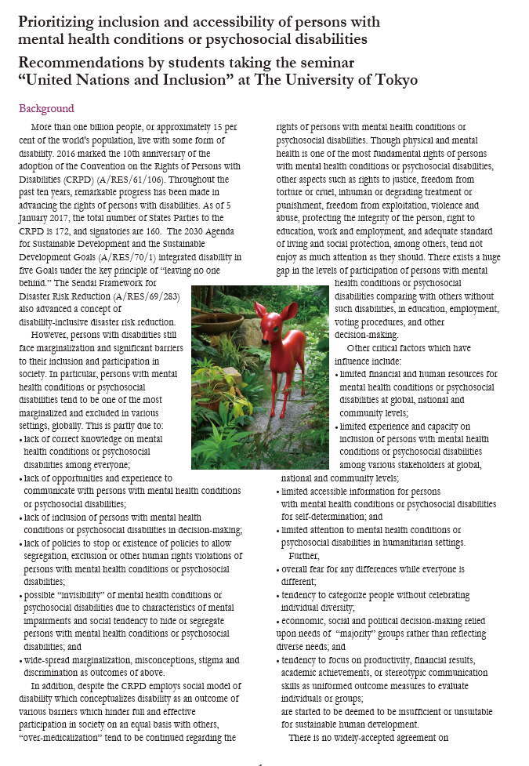
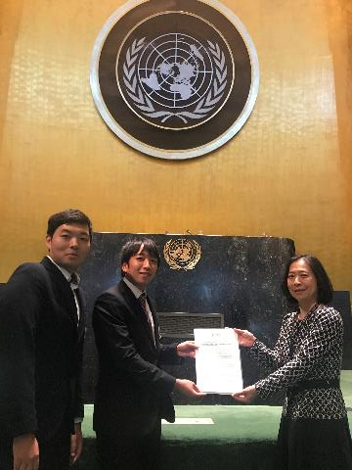
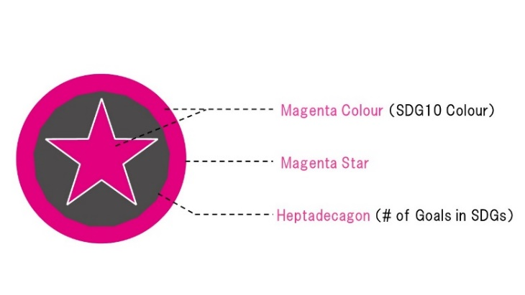
SDG10.2 empower and promote the social, economic and political inclusion of all, irrespective of age, sex, disability, race, ethnicity, origin, religion or economic or other status
Notes:
Based on lessons learned from these disaster responses, we started to feel that we need a transformative measure to overcome exclusion, in particular, among marginalized ones. Particularly, Japan will be hosting 2020 Olympic and Paralympic games, and ensuring accessible environment for all is a key priority.
So we, students at the university, together with persons with disabilities, and in close partnership with Dentsu, Japan’s biggest advertising agency, revisited the Social Model in the Convention. The social model understands disability as a result of social barriers due to lack of reasonable accommodation, not individual characteristics.
Partly based on our recommendations on inclusion of persons with mental health conditions or psychosocial disabilities which we submitted to the UN, we came up with an idea to promote awareness on social model and “coming out by supporters,” because the social model is NOT widely known outside of the disability community.
We named this initiative EMPOWER Project based on the SDG Target 10.2 empower and promote inclusion of all.
We developed a “Magenta Star” logo through which anyone can show his or her willingness to support others. We designed this project in a way young people can feel more accessible, particularly for those who are currently not very much interested in contributing to global or local cooperation. Especially, the logo was created with symbolic meanings, and aimed at what young people can integrate into their fashion.

Slide 5
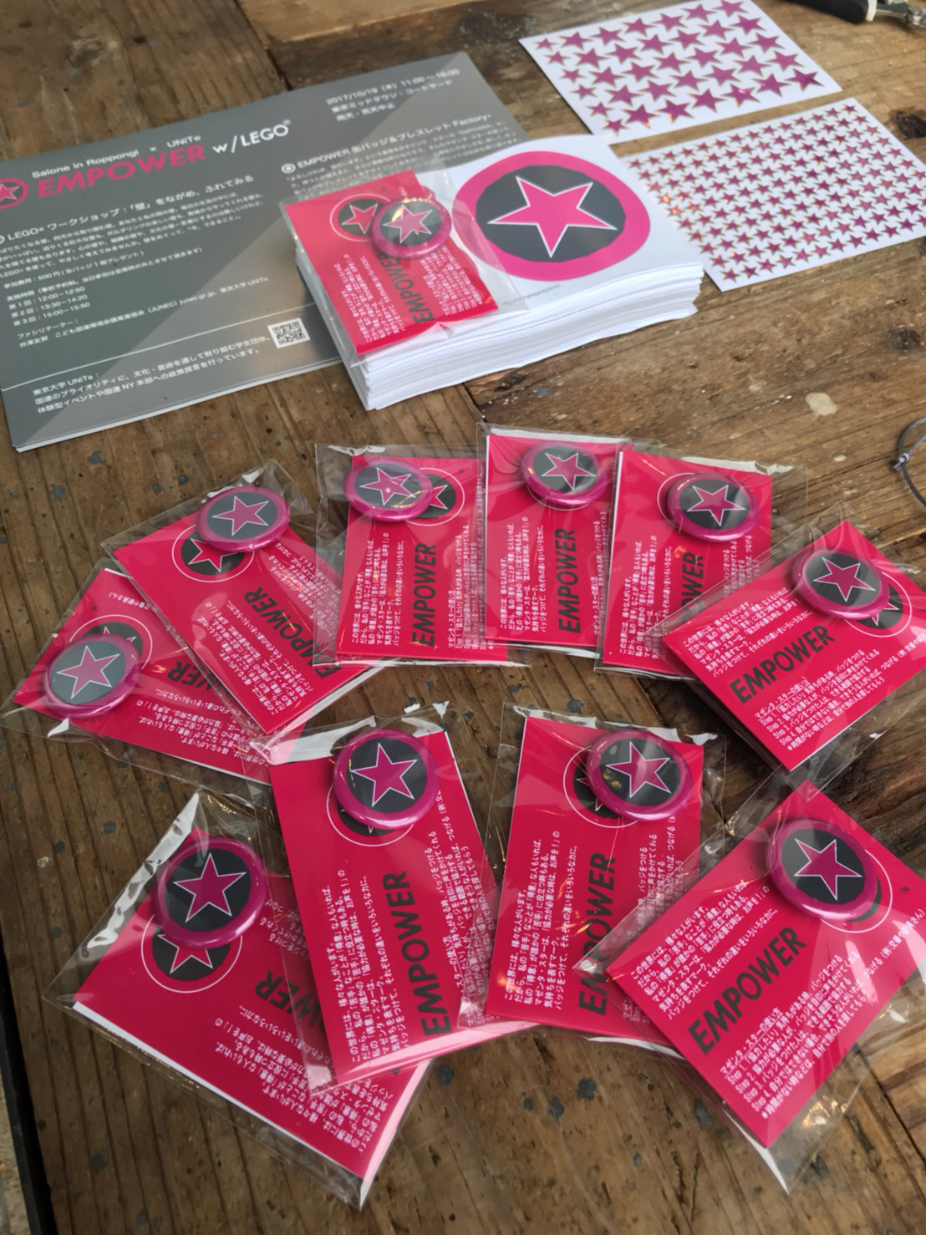
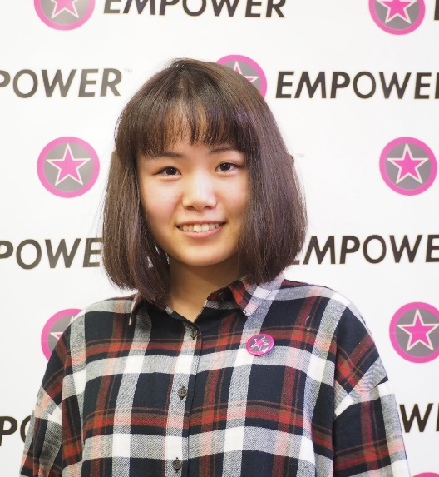
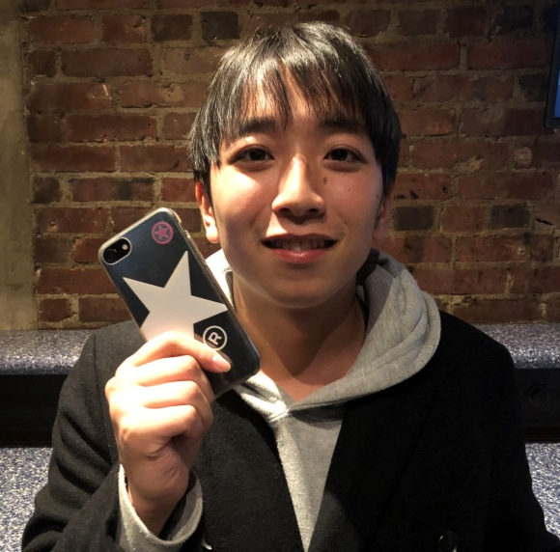
How to Use “Magenta Star”
Step 1. Put on a “Magenta Star” badge or sticker when you feel you can support others
Step 2. Those who want support will find you through “Magenta Star,” and ask for support
Step 3. Provide requested support if you can, in a respectful manner
Step 4. If needs are beyond your capacity, link with someone who might be able to support
* If you are in a rush etc., simply ask to find other supporters
Notes:
First, we put on a “Magenta Star” badge or sticker when we feel we can support others
Second, those who want support will find us through “Magenta Star,” and ask for support
Then, those who wear Magenta Star will Provide requested support if possible
If needs are beyond our capacity, we try to link with someone who might be able to support

Slide 6
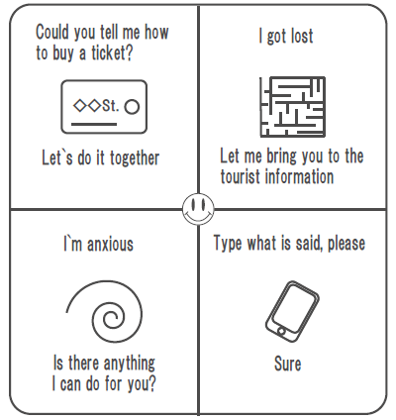
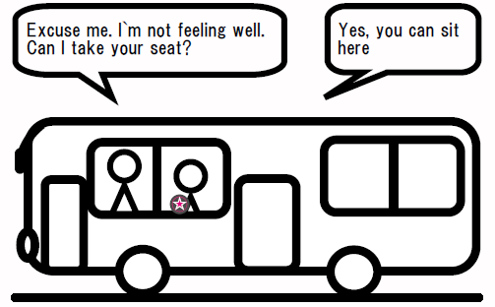
Notes:
Through promoting transformative culture where those who wish to support come out with “Magenta Star,” rather than taking coming out by those who want support for granted, we want to realize truly inclusive culture. Coming out by supporters is useful for those who do not hope to disclose their personal identity or conditions, and those who have invisible conditions such as mental or intellectual impairments, those who are not feeling well, and others. In addition, this will be helpful for those who want to offer support but wondering how to express, too. Therefore, “Magenta Star” is useful for both those who want support and those who want to support.
The EMPOWER Project is innovative in its focus on needs of individuals, with seeing differences based on age, gender or disability not as stereotypic barriers, but as “resources”. Simultaneously, anyone can need support when not feeling well or being in a foreign town. Likewise, anyone can become a supporter. This can contribute to promoting resilience and peace in communities including after emergencies.

Slide 7
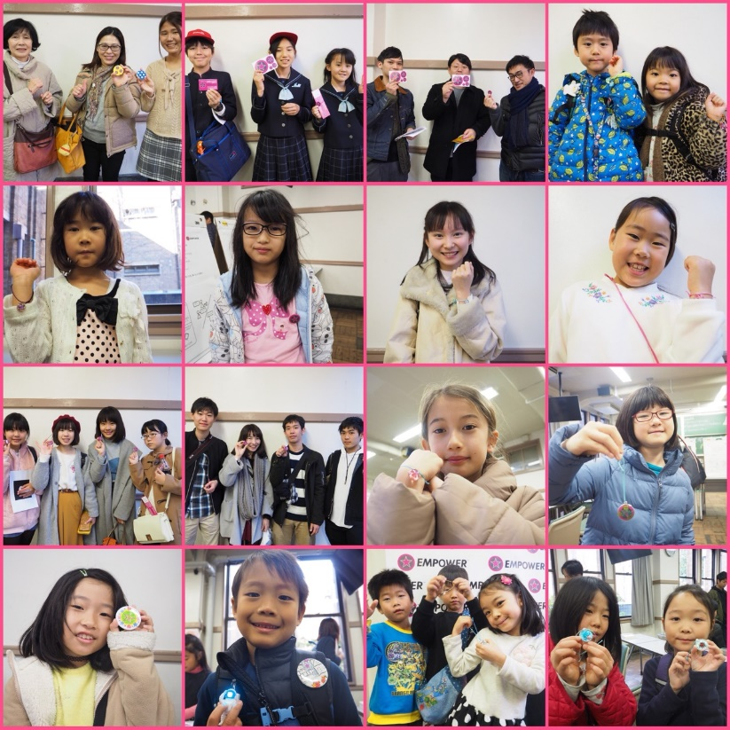
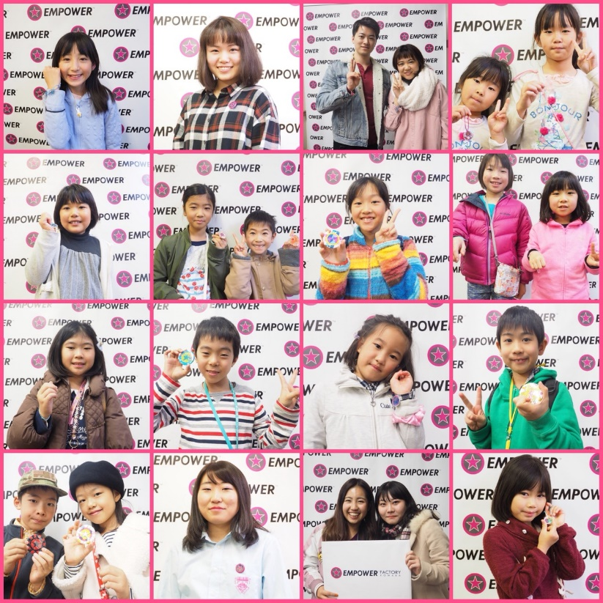
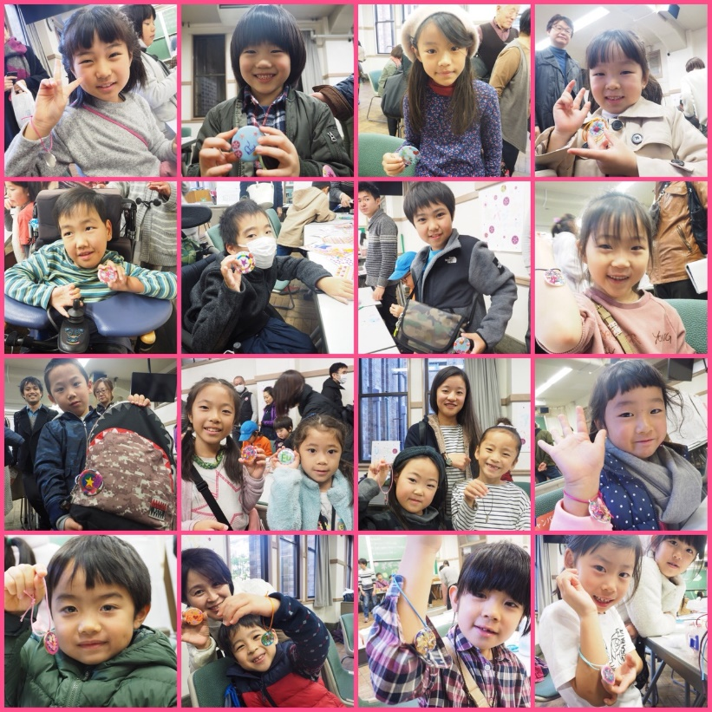
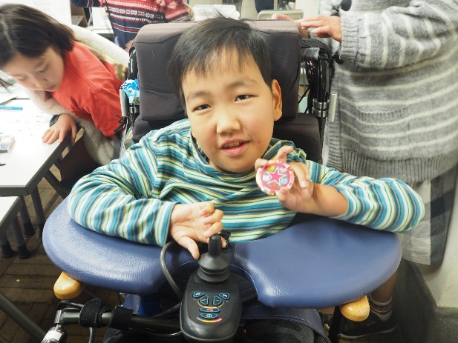
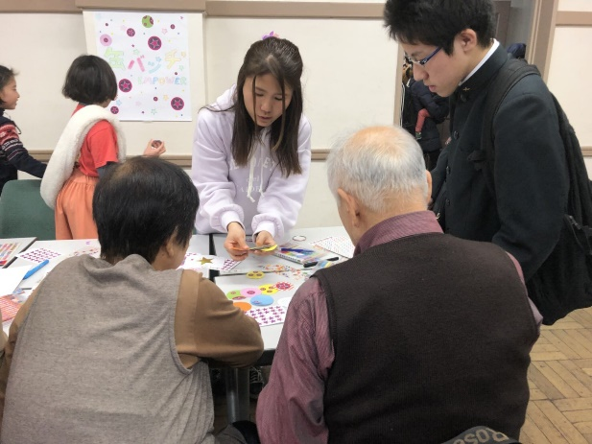
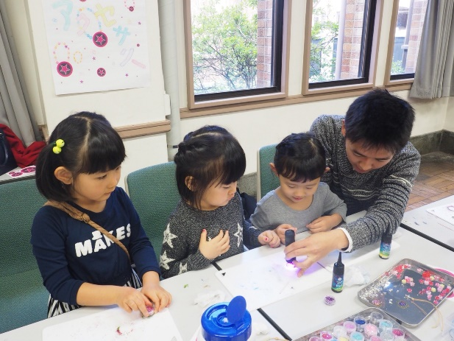
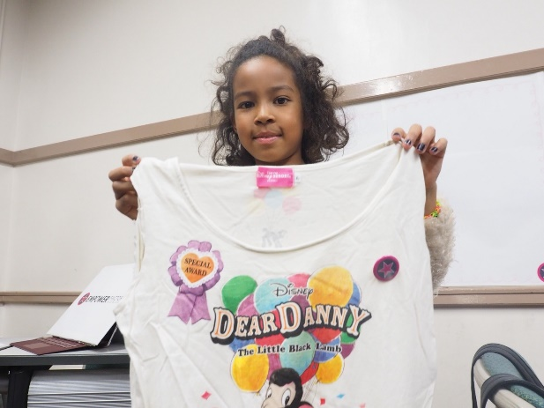
empower.mayi@gmail.com www.fb.com/UTempowerproject/
Notes:
We have started to spread this project at various occasions including:
at our university among students, at creative workshops among children, at a design event among influencers, and among persons with disabilities, as well as disaster-affected people in temporary housing.
So far, it has been very successful in transforming individuals as a change agent to promote accessibility.
We are planning to start working with young people in Malaysia, the Philippines, and other countries, too. We are also in process of developing a partnership with an organization of persons with autism.
We will continue to promote inclusion and accessibility worldwide through the EMPOWER Project in collaboration with various stakeholders including the UN system, Civil society organizations including organizations of persons with disabilities, private sector as well as young people including persons with disabilities.
I hope more partners join us and mobilize power of everyone. Since everyone is different anyway, mutual support might fill each other’s gap. Small support can be big enough, and mutual support must be a key factor for realizing inclusion, empowerment and resilience. Thank you very much.

