Slide 1


Accessible and Easy to Understand Information for Knowledge and Skills: Key Elements for Disability-inclusion in Disaster Risk Reduction
Hiroshi Kawamura
DAISY Consortium/Assistive Technology Development Organization
hkawa@atdo.jp
International Day of Persons with Disabilities 2017 Panel Discussion at UNHQ
Persons with disabilities as agents of change: lessons from disability-inclusive disaster risk reduction and humanitarian action for resilient and sustainable societies

Slide 2
Early Evacuation is the Key for Survival of Persons with Disabilities
EARLY WARNING
DISASTER IMPACT
EVACUATION
PREPAREDNESS DEVELOPMENT
RESPONSE
REHABILITATION
RE-INVENTION of Inclusive and Resilient Community
BUILD-BACK-BETTER

Slide 3
PEOPLE
(Stakeholders)
Participation
POLICY
Participation
SCIENCE
AND
TECHNOLOGY
Community-based
DiDRR

Slide 4
PEOPLE
All stakeholders including
Women
Children and youth
Persons with disabilities
Older persons
Indigenous peoples
Migrants
provide
specific knowledge and pragmatic guidance
(SFDRR)

Slide 5
POLICY
(local, national, regional and global levels)
Inclusive and Resilient Social Development
Convention on the Rights of Persons with Disabilities
New Urban Agenda
Sendai Framework of DRR
SDGs

Slide 6
SCIENCE
AND
TECHNOLOGY
Develop and Implement Accessibility Standards in Collaboration with Persons with Disabilities
Sharing Accessible and Easy to Understand Knowledge on Disasters
Development of Scientific Knowledge on Risks

Slide 7
3rd World Conference on DRR (3WCDRR)
Role play performance presented by stakeholders in Urakawa Town in Japan including representatives of community autonomous groups, the Town Authority and the Bethel’s House consisting of 150 residents with severe psycho-social disabilities who turned out as the first evacuees on 11th March 2011. The Urakawa Town was attacked by 2.8 meters tsunami and lost 3 million US dollars properties but there was no human casualties. It is believed that regular tsunami evacuation drills conducted by the Bethel’s House and other stakeholders in the town was effective which was supported by an accessible and easy to understand manual developed by an international research and development team including autism community in Japan and US, W3C SMIL working Group and the DAISY Consortium.

Slide 8
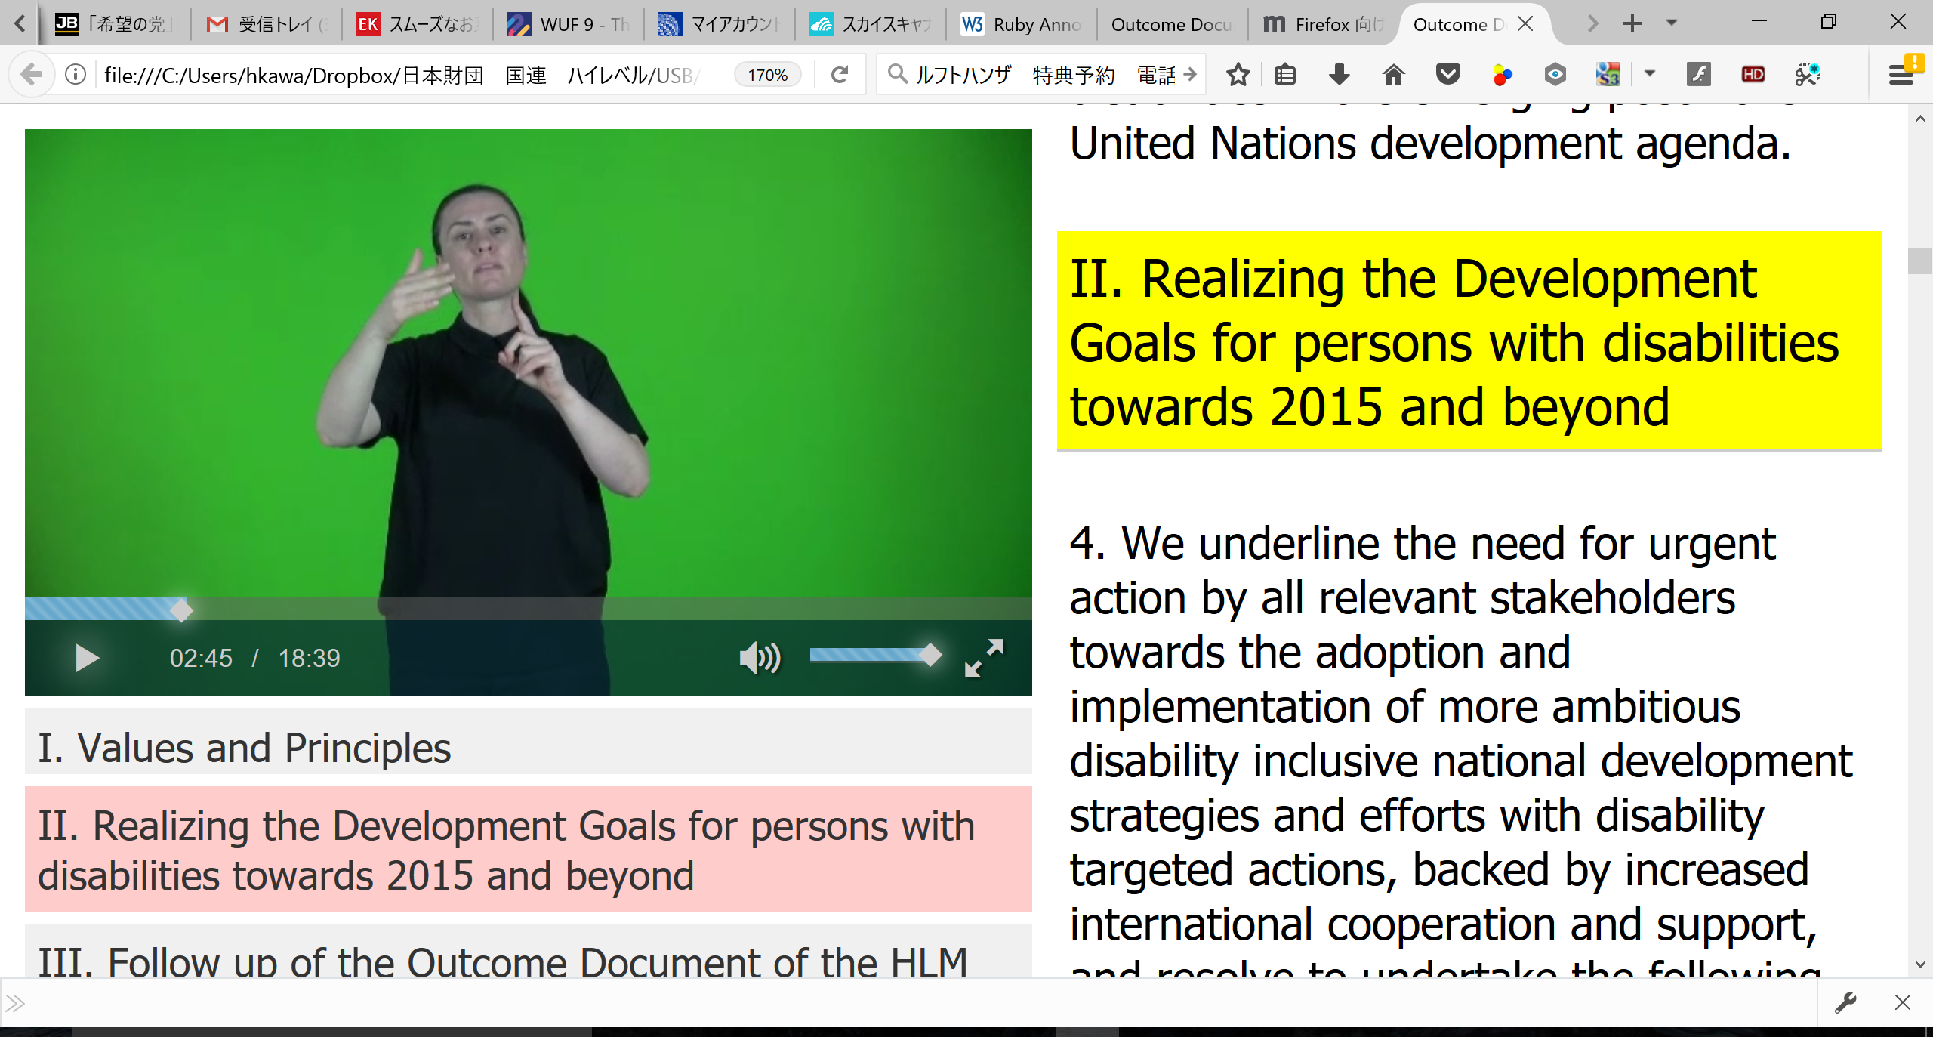
UN HLMDD outcome document http://www.un.org/disabilities/documents/hlmdd/daisy/Sign_Language/index.htm

Slide 9
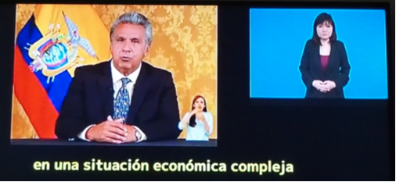
IPTV Accessibility Guidelines: ITU-T H.702
JICA Feasibility Survey on Deployment of Accessible IPTV for Build-Back-Better in Ecuador

Slide 10
For further information, please come to the Exhibition/Demonstration Booth near by the Vienna Café
Thank you very much.

