Slide 1
Mainstreaming Mental or Psychosocial Disabilities
into Efforts to Achieve the Agenda 2030 & SDGs
Takashi Izutsu, Ph.D. Atsuro Tsutsumi, Ph.D
The University of Tokyo Kanazawa University

Slide 2
Barriers
Persons w/ mental or psychosocial disabilities: Most marginalized & most at risk
Deprived of access to essential services to survive and live in dignity
"Invisibility": But 1 in 4 people experience a mental health condition
Stigma & Discrimination: Barriers to complete education
90% of persons with severe mental illnesses are unemployed
80% of persons w/ mental illness donot receive health services in developing countries
Human rights violation at health systems & over-medicalization
Can be abandoned or left behind in chain and locked in humanitarian crises
At risk of sexual violence, physical assault, and murder
Mental Health Action Plan, WHO. 2013; World Report on Disability, WHO. 2011; Out of the Shadows, World Bank Group & WHO. 2016
Notes:
As all of us know, the CRPD includes "those who have long-term physical, mental, intellectual and sensory impairments".
However, even after 10 years since CRPD was adopted, persons with mental or psychosocial disabilities are one of the most forgotten or ostracized in global, national and local communities including those efforts to promote the rights of persons with disabilities.
This has resulted in deprivation of access to information and to even essential services to survive or live in dignity in many part of the world.
Though mental or psychosocial disabilities might not be visible and tend to be believed to be small in scale, actually 1 out of 4 people will experience a mental health condition at least once in their life time.
And There still are a lot of stigma and discrimination which end up with severe human rights violation on the ground.
As a result, a lot of children and adolescents with mental or psychosocial disabilities have limited access to education in many countries.
And 90% of persons with "severe mental illness" are not employed.
In addition, 80% of persons with mental illness can not receive health services in developing countries.
Even in those countries where health services are available as an option, there are many occasions where severe human rights violations are continued even in health systems by health professionals.
These situations got worse in humanitarian emergencies.
For example, after humanitarian crises, persons with mental or psychosocial disabilities can be excluded from evacuation sites, and instead, locked in institutions without access to food, information, medical services, or minimum sanitation at times.
They might get left behind chained or constrained even others are evacuating from the dangerous area where Tsunami or bombs are approaching.
And they can be targets of sexual or physical violence, and murder.

Slide 3
Increasing Successes
Many good practices shared
Efforts by organizations of persons with psychosocial disabilities
Inclusion of mental well-being in SDGs (SDG3.4) as well as psychosocial support in the Sendai Framework for Disaster Risk Reduction
More people are getting involved (though we need more inclusion)
(C) UN
Notes:
However, at the same time, there are many success stories coming up regarding awareness raising, community-based inclusion, realization of dreams and so on.
For instance, there are more good practices started to be shared regarding mental or psychosocial disabilities worldwide.
Visibility and correct information has been helpful in mobilizing political support as well as addressing stigma and misconceptions.
In Japan, we have started to collect good practices and lessons learned regarding addressing barriers related to mental or psychosocial disabilities in the 2011 Great East Japan Earthquake and Tsunami.
And there have been a lot of great successes in various areas by "organizations of persons with psychosocial disabilities".
In many countries, activities by organizations of persons with psychosocial disabilities have been more and more active, and producing notable success in getting together, promoting awareness, realizing anti-discrimination, advocacy, and empowerment.
In addition, many global and local for a and strategies have started to look into mental or psychosocial disabilities.
For example, this years CRPD Conference of State Parties had several sessions on mental or psychosocial disabilities.
And importantly, the SDGs integrated "promotion of mental well-being" as a new priority, finally, as a great first step.
This is an outcome of joint efforts by member states, UN entities, CSOs including persons with mental or psychosocial disabilities.
Given the history in which some health system has done grave human rights violations, the inclusion of mental health and mental well-being in the global priority is a wonderful opportunity to ensure quality, human rights-based health system for all.
This includes prevention of cruel, inhuman or degrading treatment in health systems, provision of health services in communities, informed consent and self determination, and having as "many options to select" as possible.
From now on the global community will monitor the policies and implementation related to mental health services.
We should use this positively and strategically.
And the UN Sendai Framework for Disaster Risk Reduction also newly includes "provision of psychosocial services available for all people in need" as a priority.

Slide 4
Recent UN Efforts on Mental & Intellectual Disabilities
Policy Analysis on Mental Well-being and Development
(UN, WHO, 2010)
Int'l Day of Persons with Disabilities Panel Discussions on Mental Well-being & Disability (NY, 2013, 14, 15)
Expert Group Meetings (EGM)
1. EGM on Mental Well-being, Disability & Development (Kuala Lumper, 2013)
2. EGM on Mental Well-being, Disability & Disaster Risk Reduction (Tokyo, 2014)
3. EGM on Mental Well-being, Disability & Humanitarian Action (Manila, 2016)
Integration into Key Global Conferences
- World Conference on Disaster Risk Reduction (Sendai, 2015)
- World Humanitarian Summit (Istanbul, 2016)
- CRPD Conference of State Parties (NY, 2016)
- Habitat III (Quito, 2016)
Mental Health, Well-being and Disability: Key UN Resolutions & Documents (Utokyo & UN, 2015)
Notes:
In addition to SDGs and the Sendai framework, the UN system has been getting more and more active in shedding light on the promotion of rights of persons with mental or psychosocial disabilities.
I am not gonna go into details, but these are some examples.
I hope these initiatives would be continued with expanding its reach and inclusion, including more persons with psychosocial disabilities, NGOs, UN funds and programmes, and private sectors.

Slide 5
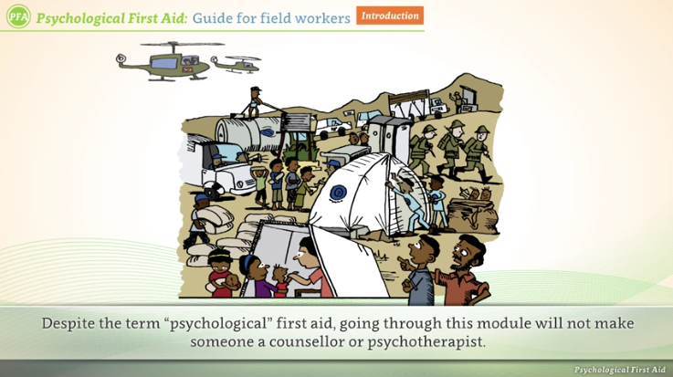
Psychological First Aid e-Orientation
2-3h self-administered e-Orientation re: how to psychosocially support each other after crises for general public (Supported by AMED)
Purposes include
1) To address misconceptions & raise awareness on mental or psychosocial disabilities
2) To address over-medicalization & promote humane/integrated approach
3) To promote social support & empowerment
4) To promote do no harm principles
Notes:
This is a small local example from our initiatives in Japan.
Currently we are developing an e-orientation module on "psychological first aid after disasters" using our governmental AMED funding, since, as you know, we have a lot of disasters in Japan.
This might not be directly related to mental or psychosocial disabilities, but the purposes of this initiative includes
Addressing misconceptions & raising awareness on mental or psychosocial disabilities
to address over-medicalization & promote humane/integrated approach among community members
And to promote social support & empowerment rather than unnecessary psychiatric interventions after disasters
And to ensure interventions would not cause any harm.

Slide 6
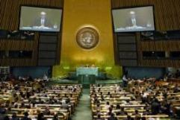
Action to be Taken
Move from health-only approach to integrated social model
(Health is important but education, employment, etc. too)
Common Terminologies & Strategies
(Including strategic link with SDGs4, 8, 10, 11 & 17 + 3 and others)
Integration of mental or psychosocial disabilities in all the accessibility/universal design related efforts
Integration of "targets" & "indicators" on mental or psychosocial disabilities in disability frameworks
Inter-agency group on mental well-being & disability
Common terminology guidelines like UNAIDS guidelines?
Notes:
These are the action points that I think is important for us now.
First of all, we need to ensure that we shift from the "health-only approach" or "medical approach" to "integrated social model approach" to mental or psychosocial disabilities too, which is unfortunately not yet realized in many parts of our world.
Just like all the disabilities, rights of persons with mental or psychosocial disabilities are universal.
Health is very important part of it, but we need to ensure access to eduction, employment, social protection, reproductive rights, social life and others too.
One of the possible unique barriers to mental and psychosocial disabilities is that we do not have common agreement on terminologies and strategies yet in various settings.
For example, some people prefer to use mental disabilities while others prefer psychosocial disabilities. And we have not yet a common agreement. It is important to come up with an easy-to-understand common languages and common strategies to be successful.
And Now we have SDGs and the Sendai Framework and others, it is important to strategically utilize this momentum.
We need to come up with strategies on how to ensure all the disability-related SDGs, SDGs 3.4 on mental health and well-being and other SDGs such as education & employment SDGs, will contribute to persons with mental or psychosocial disabilities.
For that, it is very important to further mobilize knowledge and experience in constructive diplomacy and politics, and most importantly positive multi-stakeholder partnerships for psychosocial disabilities at the UN as well as at national and local levels.
And, we need to ensure that all the efforts related to accessibility and universal design will integrate perspectives of mental or psychosocial disabilities. Currently, unfortunately, voices of persons with psychosocial disabilities tend to be unheard or forgotten in many occasions.
Not paying attention to mental or psychosocial disabilities in accessibility and universal deign is not consistent with the concepts of "universal" or "leaving no one behind"
Lastly, due to these marginalization, it is very important to ensure that we will have targets and indicators to monitor inclusion and accessibility of persons with mental or psychosocial disabilities in the UN disability monitoring frameworks, just like women, children or older persons are highlighted in most of monitoring schemes.
For instance, the SDGs monitoring framework will most probably employ depression and suicide-related indicators.
These SDGs indicators will be helpful to monitor health aspects of mental or psychosocial disabilities, but it won't be enough to monitor and change this Extremely delayed progress in inclusion of persons with mental or psychosocial disabilities.
Yesterday we heard about wonderful development by the Washington Group, and based on their great work, it is important to have a few specific indicators for psychosocial disabilities in the disability monitoring framework at the UN, we believe.
To come up with these common terminologies, strategies, and targets and indicators, it would be very useful to develop an inter-agency group on mental well-being and disability among UN agencies together with persons with mental or psychosocial disabilities. And we will work together.
It might be a good idea to start with trying to develop a terminology guidelines for overall disability-inclusive development just like UNAIDS periodic terminology guide which has contributed to addressing various barriers.

Slide 7
Way Forward:
Constructive & Coordinated Multi-stakeholder approach
Disability community (including persons with mental or psychosocial disabilities)
Health sector
Social & community services
Human rights community
Education & employment sectors
Development community
Financial sector
Disaster risk reduction stakeholders
Peace & security community
Private sector & innovative young generations
Let's work together to end exclusion of mental or psychosocial disabilities
and realize "universal access"
Notes:
In conclusion, now is the time that the whole disability community work as one together with UN and other stakeholders to change the situation where progress related to mental or psychosocial disabilities are way behind compared to other disabilities even after 10 years since CRPD.
We need to streamline various vertical or in-sylo efforts in disability commmunity, health community and development community, into concerted, coordinated and visible actions beyond differences.
Namely, we need a comprehensive and multi-stakeholder approach including development, financial, disaster risk reduction as well as peace and security stakeholders and health communities, and of course, human rights sector.
And together, I hope we can come up with a monitoring mechanism and common inter-agency strategy to ensure persons with mental or psychosocial disabilities are not left behind in all countries.
I hope we can develop an friendly and constructive inter-disciplinary and inter-agency partnership for mainstreaming mental or psychosocial disabilities.
Thank you.

Slide 8
Sustainable Development Goals (SDGs) (UN, 2015)
Goal 3. Healthy lives & promote well-being for all at all ages
3.4 Reduce mortality from non-communicable diseases and
promote mental health and well-being
3.5 Strengthen prevention & treatment of substance abuse
Notes:
For example, in the 2030 agenda and SDGs, in addition to 5 goals related to disability, we can utilize the Goal 3 Target 4 which is about promoting mental health and well-being. This is a newly added target after a lot of persistent efforts and advocacy by some member states, UN system, DPOs, and persons with mental and intellectual disabilities and their families worldwide.

Slide 9
World Conference on Disaster Risk Reduction Sendai Framework for DRR (UN, 2015)
Priority 4: Enhancing disaster preparedness for effective response, and to ‘Build Back Better’ in recovery, rehabilitation and reconstruction.
33 (o) To enhance recovery schemes to provide psychosocial support and mental health services for all people in need
(C) UN
Notes:
In addition, the Sendai Framework for DRR 2015-2030 adopted at the World Conference on DRR last year includes “provision of psychosocial support and mental health service for all people in need” as part of priorities.

Slide 10
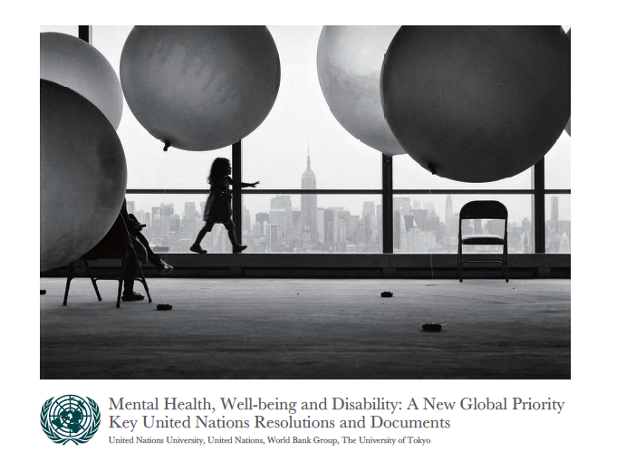
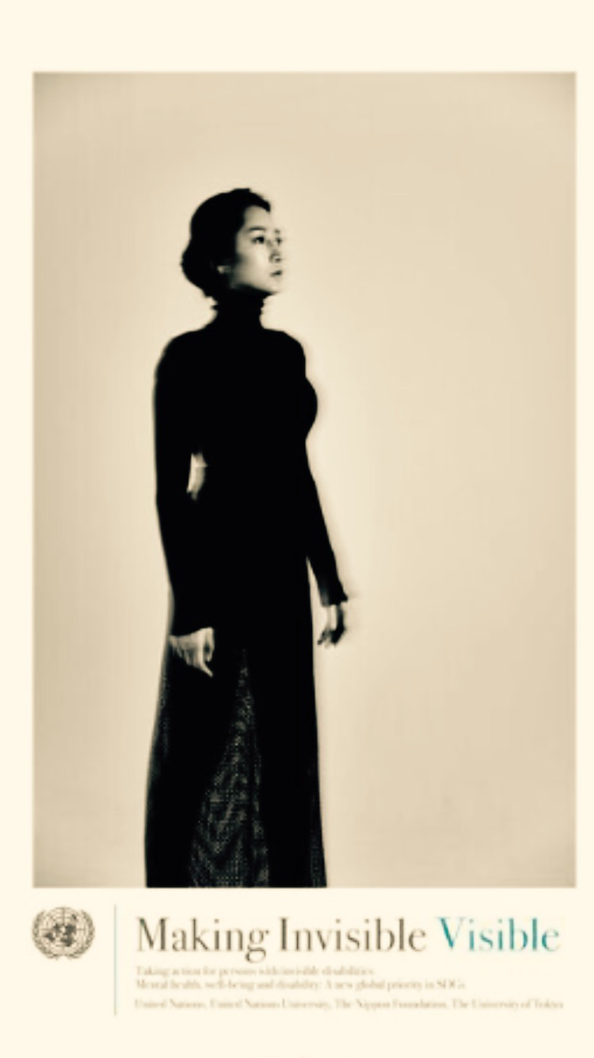
IASC Guidelines on Mental Health and
Psychosocial Support in Emergency Settings (IASC, 2007)
mhGAP Humanitarian Intervention Guide (WHO, 2015)
Psychological First Aid: Guide for Field Workers (WHO et. al., 2011)
Mental Health, Well-being and Disability: A New Global Priority: Key UN Resolutions & Documents (UTokyo & UN, 2015)
Comprehensive Mental Health Action Plan 2013-2020
(WHO, 2014)
Making Invisible Visible: Taking Action for Invisible Disabilities
(Utokyo & UN, 2016)
Notes:
There also are useful guidelines and resources developed by the UN system and partners.
For example, the IASC Guidelines on mental health and psychosocial support in emergency settings includes a lot of important principles and action points related to mental and intellectual disabilities in crisis situations.
WHO's mhGAP Humanitarian Intervention Guide also includes key principles on human rights protection of persons with mental illness.
Psychological First Aid Field Guide can raise awareness among general public and strengthen individual and community resilience.
Mental Health, Well-being and Disabilities: Key UN Resolutions and Documents as well as the WHO Comprehensive Mental Health Action Plan will be useful in promoting this agenda at the policy level.
Making Invisible Visible which is a report of the UN panel discussion at the last year's International Day of Persons with Disabilities might be also useful in raising awareness among broader stakeholders.
We must leave no one behind including persons with mental and intellectual disabilities.
Persons with mental and intellectual disabilities are important contributors to realize reconstruction, recovery, and peace.
All of us, disability community, persons with mental, intellectual, or psychosocial disabilities, human rights and health communities, and all others need to work as one now.
I hope we can further collect good practices and lessons learned on inclusion of mental and intellectual disabilities in humanitarian settings and come up with collective and innovative systems to ensure dignity, well-being and humanity for all.

