Slide 1
Measurement of Disability to inform the 2030 Agenda for sustainable Development: Uganda’s experience
Presented the 3rd Expert Meeting on Monitoring and Evaluation for Disability-inclusive Development
28-29 November 2016, UN Head quarters- New York
By Pamela Nabukhonzo Kakande

Slide 2
Contents
Introduction
Best practices
Disability data collection efforts
Progress in addressing development frameworks
Future M& E of implementation of the CRPD
Challenges
Conclusion

Slide 3
Introduction
Uganda Bureau of Statistics is the principal data collecting and disseminating agency responsible for coordinating, monitoring and supervising the National Statistical System (NSS).
Vision
“Centre of excellence in statistical production, development and dissemination in Africa”
Mission
“To provide quality and demand driven statistics that support policy, decision making, research, and development initiatives”.

Slide 4
THE NATIONAL STATISTICS SYSTEM
Ministries, Departments & Agencies
Data Producers
Policies, Principles, procedures, & Statistical production practices
Institutional Framework
Research Training Institutions
Data Users
Households, Businesses, Individuals
Data Suppliers

Slide 5
Best Practices
Inclusive growth and development is reflected in the 2nd National Development Plan with a strategy for PWDs geared towards equalization of opportunities, rehabilitation and inclusion of PWDs in their communities.
The Bureau’s strategic Plan for Statistics is in turn guided by NDP II.
The Bureau is guided by the UN principles and guidelines for collection of official statistics
The Bureau has used internationally agreed comparable measures for disability.
Adopted the WG short set of disability measures of disability with the primary purpose of informing policy on equalization of opportunities.

Slide 6
Disability data Collection Efforts
However, the WG leading question: Because of a health problem…does (NAME) have any difficulty….
was removed on the basis that disability is not a health problem.
a long term Census and Survey programme that defines all anticipated programme areas to ease planning and resource mobilization.
disability prevalence in 3 consecutive UDHS (2006, 2011, 2016) can therefore can get trends
included in the National Labour Force & Child Activities Survey for 2016/17
include in the 2014 census so will get data disaggregated to the lowest administrative level
Seeing
Hearing
Walking
Cognition
Communication
Self care

Slide 7
To take care of the interests of the stakeholders
Tested the analysis criterion based on Number of questions and question wording:
Compare the prevalence based on the 4 WG SS and the difference is not substantial
Included a generic question on disability in the PES to show that question wording can affect prevalence and to meet stakeholders’ demands
2016 UDHS added: Does [NAME] have any other difficulties that have lasted or are expected to last 6 months or more? To take care of the children from 2 years
The Administrative data is being supported to ensure availability of quality data.
3 ministries are compiling administrative data i.e Gender, Health, education
Seeing
Hearing
Walking
Cognition
Communication
Self care

Slide 8
Available statistics regarding persons with disabilities
data exists on the prevalence but is not cross tabulated by other socio economic characteristics
2014 Population census, the disability prevalence rate was:
Age variation:
2 years and above: 12%
5 years and above: 14%
Sex differentials:
Men: 10%
Women: 15%
Place of residence
Rural area: 15%
Urban area: 12%

Slide 9
Progress made in addressing the SDGs
put in place a coordination structure for the SDGs developed according to institutional mandate, thematic areas, and inclusiveness (CSOs).
Uganda has integrated the SDGs into its NDP II and sector mandates.
It has developed a National Standard Indicator list as an intersection of NDP II and SDGs indicators.
Produced a State of preparedness report for the High Level Political Forum.
Harmonized list of priority indicators for Gender Equality.
Development of baselines for SDGs is ongoing.

Slide 10
Progress made in addressing the CRPD
to promote the rights of PWDS
include the reservation of 5 seats in Parliament to PWDS
the provision of a special grant to support income-generating activities for PWDS
The Committee on the Rights of PWDS expressed concern about the varying definitions of disability throughout its legislation, the Bureau plans a stakeholder meeting to discuss and agree on one definition including the questions and cut off during analysis.
The bureau has not collected data to inform the monitoring of the CRPD .

Slide 11
Challenges of data collection on PWDS
complexity of the disability concept has resulted in the production of statistics on disability that are neither comparable nor easy to interpret.:
actual questions used differ depending the purpose of data i.e whether to estimate the prevalence of physical impairments or to plan for the provision of services
There is no consensus on what constitutes disability
Administrative data systems across most of the Ministries, Departments and Agencies are under developed

Slide 12
Challenges of data collection on PWDS
6 WG questions are not able to;
generate data on disability for children below 5 years ;
measure health related disability because the focus of the WG is on assessment of equalization of opportunity.
cover all domains of disability so as “to leave no one behind” e.g. albinism, little people etc so demand is not satisfied.
use of proxy respondents in surveys & censuses: may not be very knowledgeable about the level of severity therefore distort the actual prevalence coupled with respondent fatigue and non-response
Difficulty to get good quality data collectors in a census as well as ensuring their adequate training in order to enable collection of reliable data.
Available data on the SDG indicators as they are now, they are not sufficient enough to know who and where the most marginalized persons are to form a baseline.

Slide 13
Challenges of data collection on PWDS
There are existing capacity gaps in moving beyond data collection to promoting the more effective analysis of data with a lens of leaving no one behind.
limited appreciation of data and data collection by policy makers, this in turn leads to limited allocation of resources to data production.
Lack of resources to generate sub national indicators which limits geographical disaggregation
“funding for statistics has not kept pace with the increasing demand for statistics in terms of scope, quantity and quality” as stated by Prof. Ben Kiregyera. E.g there is need for detailed data on PWDs but priority has been given to data for mainly economic indicators

Slide 14
Future M&E of the implementation of a disability-inclusive SDGs
Develop a harmonized list of priority indicators for disability disaggregation including localizing the 10 gold standard indicators.
Sensitize, lobby and seek support from Government and Development Partners to fully commit resources to statistics to inform SDGs. Specifically, for administrative data management
Enhance statistical planning and support the design and implementation of Sector Strategic Plans for Statistics.
Annually produce a data status report using its Plan for National Statistical Development Strategy framework.

Slide 15
Future M&E of the implementation of a disability-inclusive SDGs
Disseminate - Make statistics accessible to all users to inform research, advocacy, policies and programmes, and promote accountability.
Need for technical assistance from UNSD, the WG and other relevant organizations regarding review of national questions and other materials for collection, processing and analysis of data on disability.
The Bureau Plans to undertake a fully-fledged disability survey to provide the information required for addressing the CRPD and other programmes.

Slide 16
Conclusion
NSOs need to prepare a clear roadmap for meeting the statistical challenges of leaving no one behind through a balanced understanding of the likely data demands for the 2030 agenda.
Ensure sustainable funding for production of statistics to inform the SDGs by:
Having sustained advocacy among high level politicians;
Mainstreaming statistics in policy, planning and budgeting;
Creation of a National Statistics Fund;
Providing the right statistics to the right people in the right form and at the right time.
Statistical laws to make it mandatory for the NSS to always provide for data on population sub-groups including new areas and different data sources

Slide 17
Conclusion
Strengthening Administrative data and adopting measurement of disability on a regular basis in all surveys will go a long way in availing disaggregated data for the SDGs.
Statistics is now a development issue, not just a technical issue.
Quote from The Emerging Data Revolution in Africa: Strengthening the Statistics, Policy and Decision-making Chain

Slide 18
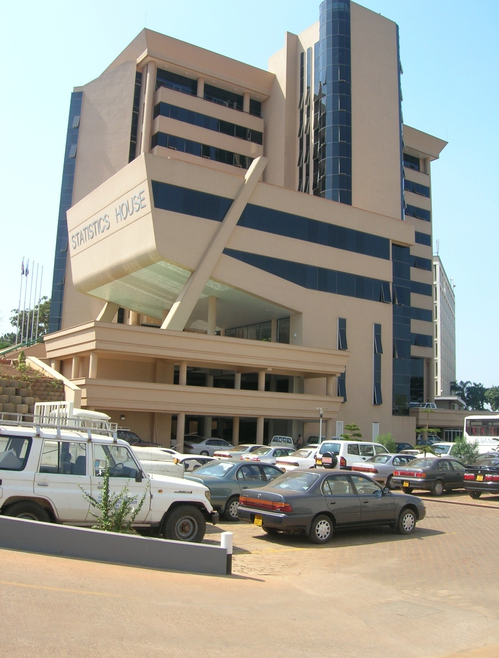
PLOT 9
COLVILLE STREET
P.O BOX 7186
KAMPALA
TEL.
041-706000
FAX
041-237553
E-MAIL
ubos@ubos.org
Website
www.ubos.org
Thank You

