Slide 1
Access for All Access for People with Disabilities in the United States.
Presented by Nancy Bolt
Nancy Bolt & Associates
International Federation of Library Associations

Slide 2
Today’s Presentation
Commitment of Libraries to Accessibility for All
Laws and Resources for Serving People with Special Needs
Some Examples

Slide 3
International Federation of Library Associations
75 years old
1300 members in 140 countries
Library Services to People with Special Needs
Libraries Serving Persons with Print
Disabilities

Slide 4
IFLA Support of UN 2030 SDGs

Slide 5
Commitment of Libraries Key Values of US Libraries
Libraries, 120,000 of all types, public, school, academic, government, corporate, are an essential component of the national information infrastructure, and are critical leaders in their communities. We stand for freedom, learning, collaboration, productivity and accessibility. We are trusted, helping to address community concerns and championing our core values, including democracy, diversity, intellectual freedom, and social responsibility.
Jim Neal, Incoming ALA President

Slide 6
Key US Library Values
Accessibility for all
Diversity
Privacy
Education and lifelong learning
Service
Social Responsibility
Meet community and individual needs
Cooperate to meet needs

Slide 7
US Commitment to Accessibility Americans With Disability Act
ADA signed into law on July 26, 1990
Prohibits discrimination
Guarantees opportunities as everyone to participate in the “mainstream of American life”
Covers employment, purchase of goods and services, participation in State and local government programs and services.
An "equal opportunity" law for
people with disabilities.

Slide 8
Association of Specialized and Cooperative Library Agencies Tip Sheets http://www.ala.org/ascla/standards
Assistive Technology
Autism & Spectrum Disorders
Children with Disabilities
Mental Illness
Deaf & Hard of Hearing
Developmental Disabilities
Learning Differences Multiple Disabilities
Physical Disabilities
Service Animals
Vision
Staff
Management
Volunteers with Disabilities
What Trustees Need to Know

Slide 9
ASCLA Tip Sheets
Each Tip Sheet includes
:
Overview with definitions
Tips for service
Assistive technology suggestions
Resources

Slide 10
Library Service to Children with Disabilities
Example from ASCLA Tip Sheet
Expect every child to learn to read.
Approach each child and teen with an open mind. Treat each patron as an individual.
Communicate directly with the patron, rather than the caregiver or interpreter.
Defer to the patron’s preferred communication method.
Ask, “What was the last book that you read and liked?” Don’t rely on the child or teen’s age, or grade, to determine reading level.
Support the choice of book.
Offer books in all types of formats, including audiobooks,
Pre-load MP3 players, electronic books, audiobook-print book sets, and large-print and Braille books.

Slide 11
Library Service to the Blind and Physically Handicapped
Sponsored by the Library of Congress
Through a national network of cooperating libraries, NLS administers a free library program of braille and audio materials circulated to eligible borrowers in the United States
Available in all 50 states
Provides multiple media
People who are blind, dyslexic, physically handicapped so cannot hold a book

Slide 12
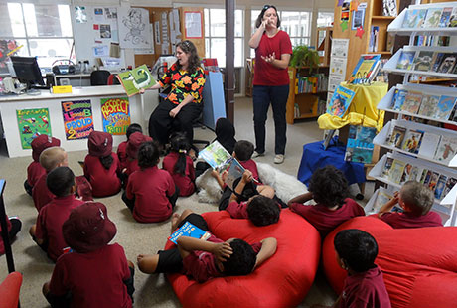
Nashville Public Library Service to People who are Deaf Nashville Public Library, Tennessee
Signed puppet shows
Signed story hours for children
Coffee chats for adults in sign language
Deaf Night Out

Slide 13
Library Service to People who are Dyslexic Brooklyn Public Library, NY
Opportunities for success outside of reading
Use multiple intelligence approach
Online read-along narration
Work with parents and caregivers
Improve self-esteem
Database of
resources

Slide 14
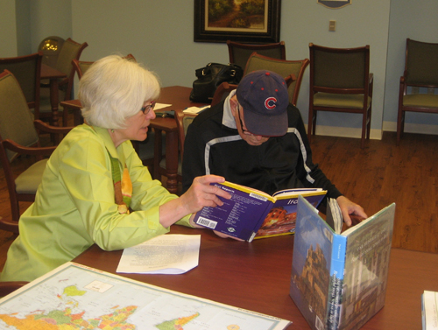
Library Service to People with Dementia and Alzheimer's Bordon Public Library, Illinois
Volunteers visit nursing homes
Learn how to interact with clientele
Maintain eye contact
Use simple language
Listen carefully
Work with caregivers
Work with community agencies

Slide 15
Resources
www.ifla.org
http://www.ala.org/ascla/
https://www.loc.gov/nls/
Nancy Bolt
Nancy Bolt & Associates
nancybolt@earthlink.net

