Slide 1
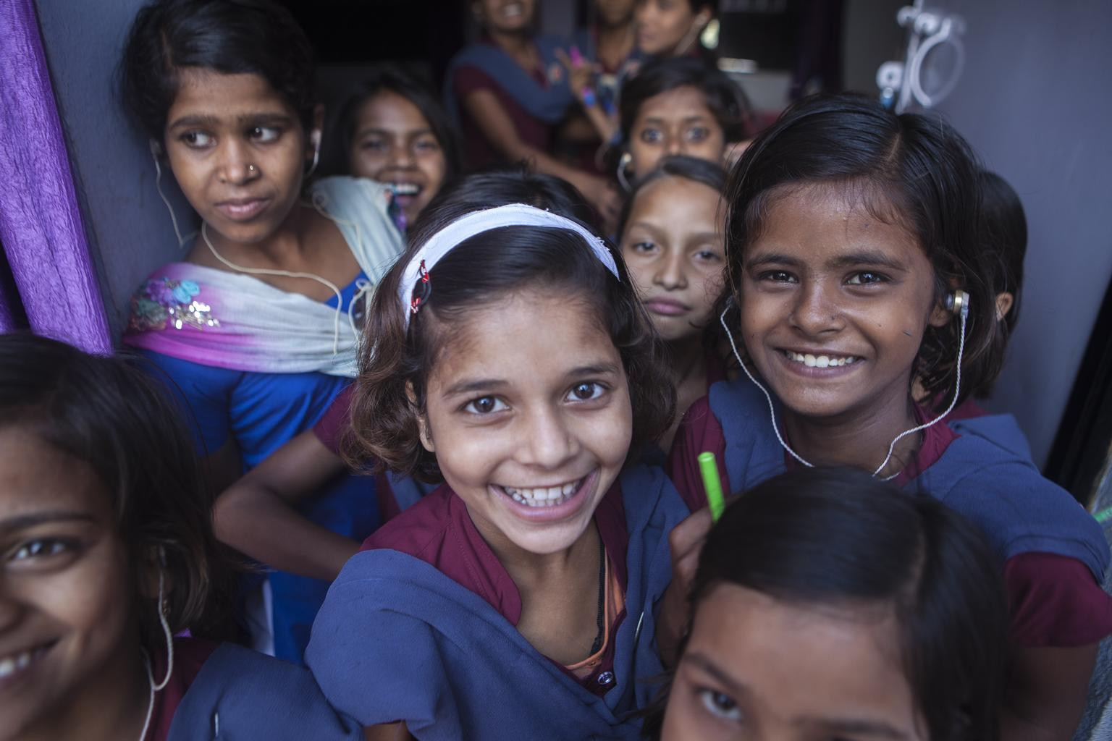
Inclusive Education for Children with Disabilities
Notes:
1
1
Moved your contacts at the end

Slide 2
What is Inclusive Education?
It is NOT
Keeping children with disabilities out of school
Segregated special education schools
Separate classes integrated into regular schools
It IS
Including all children in mainstream schools
Exclusion
Segregation
Integration
Inclusion
Notes:
2
2
Define Inclusive Education so that everybody is on the same page; many countries/governments are still confused by what inclusive education means (ALL children in the same school AND classroom, when possible...not just in the same school).

Slide 3
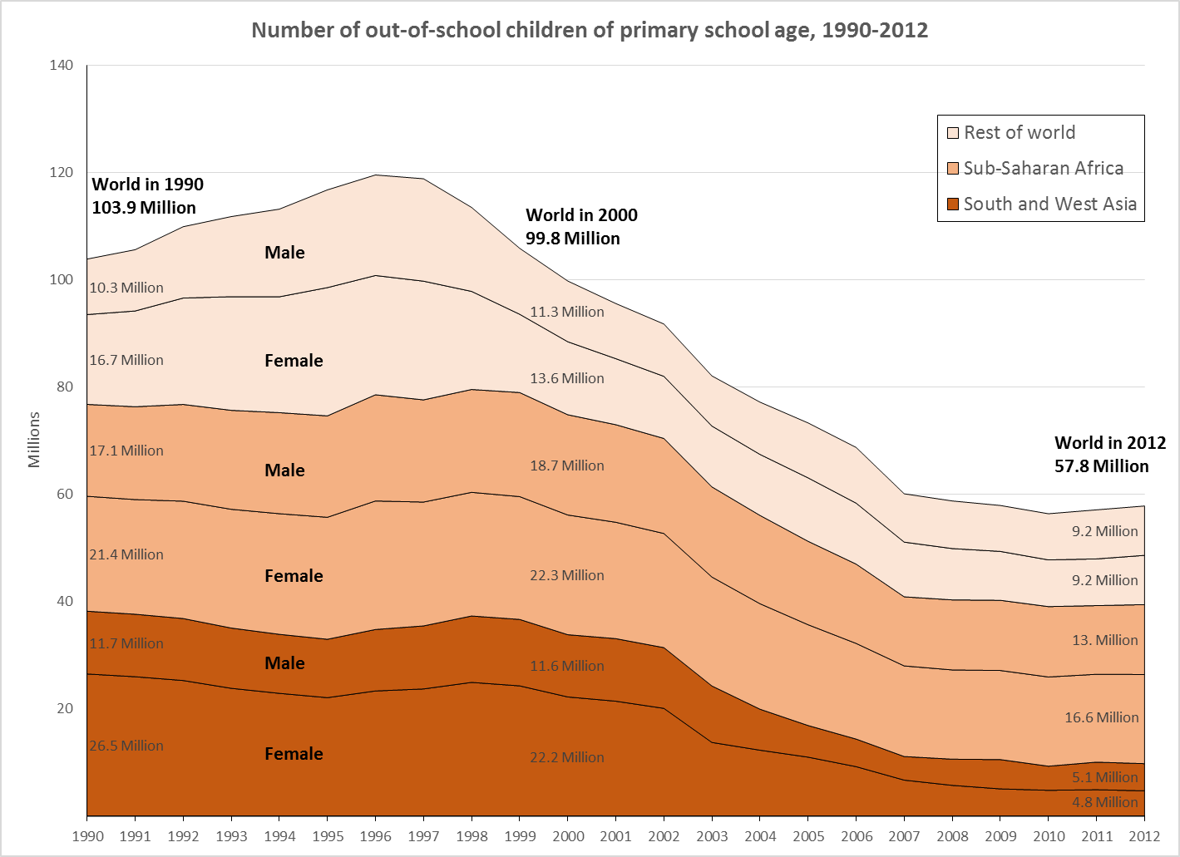
Why is Inclusive Education important?
It’s a right (CRC, CRPD)
It’s a global commitment (MDG2, SDG4)
It’s good economics (Lamichhane, Mizunoya)
It’s good socially
Children with disabilities are always the last to go to school
Notes:
3
3
4 reasons for IE
Global OOSC trends show that progress has stagnated
Household survey data show that, as countries approach universal enrolment, the proportion of children with disabilities who are out of school increases.
Conclusion that CwD are always the last to be included.

Slide 4
… for example …
Notes:
4
One of Hiro’s wonderful graphics …

Slide 5
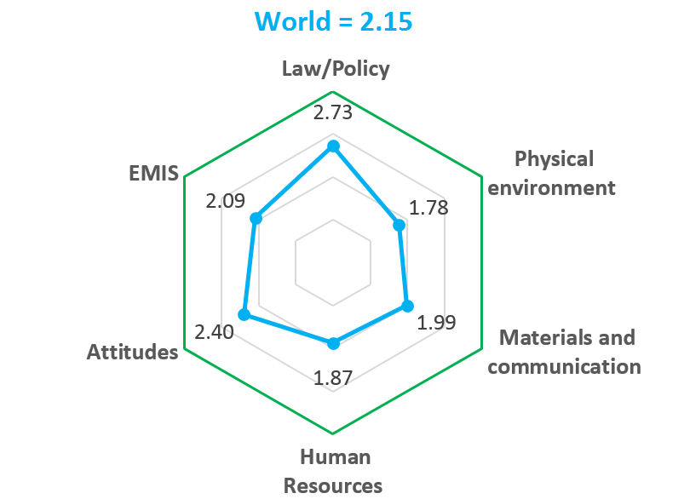
What progress has been made?
Annual UNICEF Standard Monitoring Questions survey of over 140 countries
Moderate progress
Legislation and policies
Still some way to go
Data collection
Attitudes
Serious Weaknesses
Teacher training
Accessible schools
Learning materials
1 = bad; 2 = poor; 3 = fair; 4 = good
Key issue is implementation at school level.
Notes:
5
5
Explain that this is a little subjective, but has been proved in practice over many years.
Gives valuable info on where faster progress is needed – particularly at school level (teachers, classrooms, materials)
Again – important to make sure that everyone means the same by inclusive education (and all the other categories – for example, accessibility – it’s not just access to the buildings, for example.

Slide 6
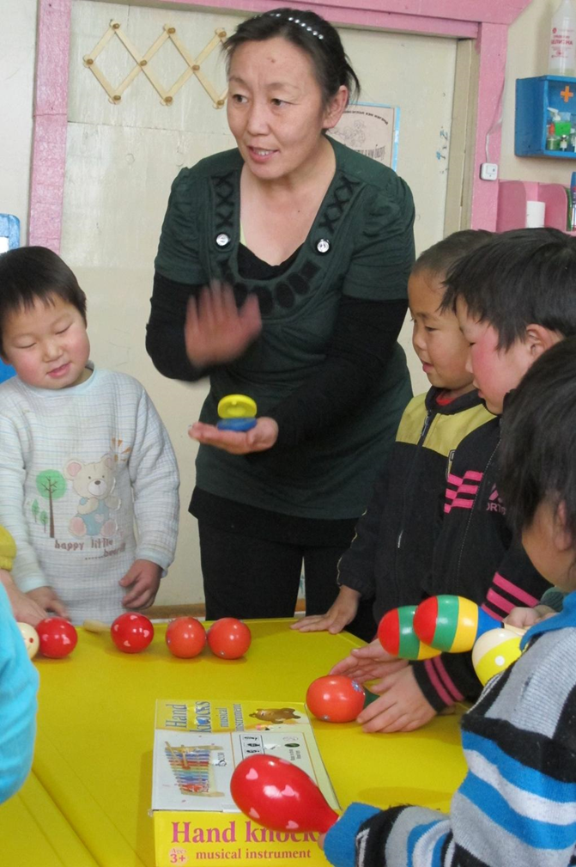
How is UNICEF working?
Strategies
Knowledge generation and data collection
Dissemination of evidence and advice
Development of guidance and tools
Advocacy and promotion
Partnerships
Building capacity
Supporting implementation
Notes:
6
6

Slide 7
What is UNICEF doing?
14 technical booklets + webinars
Inclusive EMIS guide
MICS6 module on Child Functioning
Inclusive education programme guidelines
Chapter in Education Sector Analysis Methodological Guidelines
Accessible learning materials initiative
Training courses and workshops
Regional and global events
Country Office support to Ministries of Education
Notes:
7
7
Explain 14 technical booklets – focus on data collection, infrastructure, teachers
Programme guidelines for low income countries
Items in italics are planned for the future ...

Slide 8
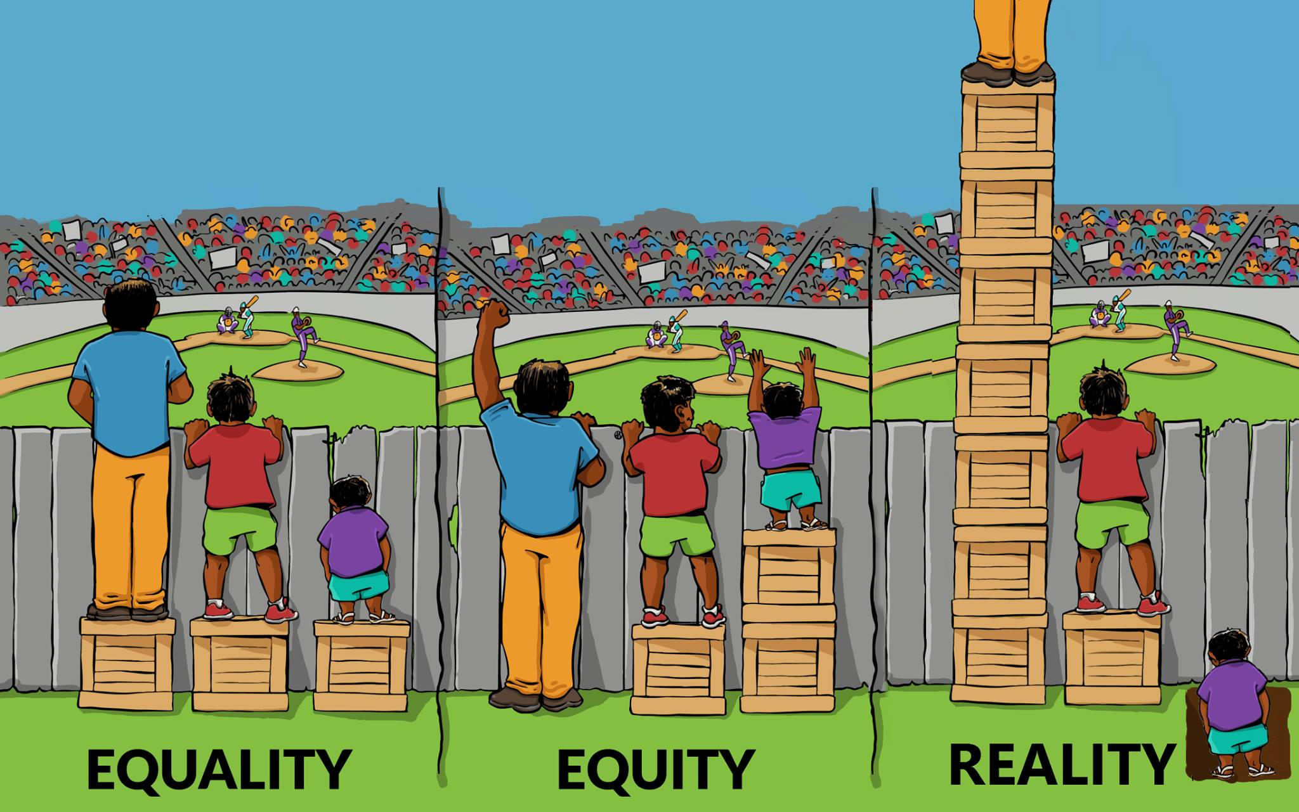
Why is equity important?
Notes:
8
8
Distributing resources equally does not provide everyone with equal opportunities.
Resources need to be allocated according to need.
In reality, the children in the greatest need often receive the least resources.

Slide 9
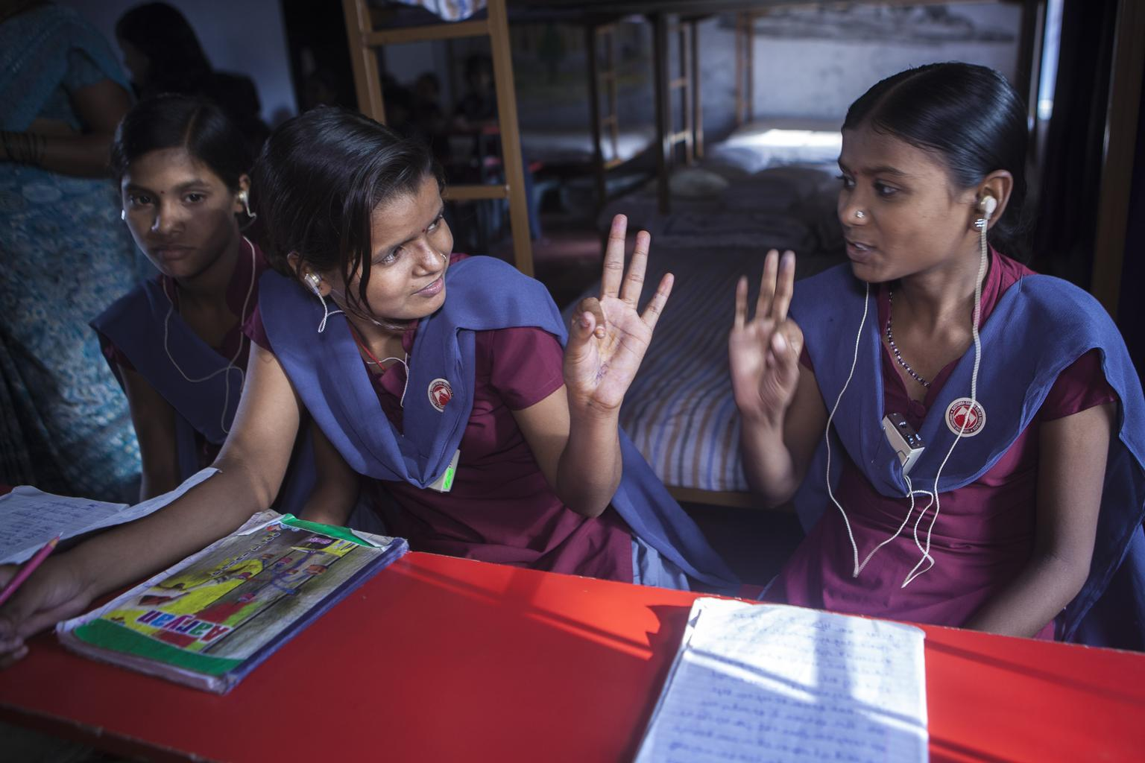
Mark Waltham
Senior Education Adviser, UNICEF
mwaltham@unicef.org
Notes:
9
I think you can just say thank you let people know how to contact you

