Slide 1


Inclusive Education and Employment Policies for Persons with Disabilities in Peru and APEC Member Economies
Andrew Lange, Fulbright-Clinton Fellow
Expert Meeting on Monitoring and Evaluation for
Disability-inclusive Development
28 November 2016

Slide 2
Overview
US-APEC Technical Assistance to Advance Asia-Pacific Regional Integration, US Dept. of State and USAID
Surveyed APEC Member Economies (21) on public and private sector efforts to engage, enable and encourage employment of persons with disabilities.
Research report on economy-level and Asia-Pacific regional efforts to advance the employment of persons with disabilities
Fulbright-Clinton Fellowship – Inclusive Education in Peru
External evaluation of Peru’s Special Education Results-based Budget;
Demand-driven model for education-to-employment transitions.

Slide 3
US-APEC Technical Assistance to Advance Asia-Pacific Regional Integration Project, US Dept. of State and USAID
This report reviews disability employment laws, regulations, and policies in APEC economics, including their practical application and impact. The report reviews employment practices including recruitment, supported and sheltered employment, and incentives to employers. Additional topics include educational support, self-employment and business development, accessibility issues, the engagement of civil society, and coordination with the private sector.
Information was gathered through a survey of APEC member economics and a variety of studies and reports on the employment of persons with disabilities. The report provides a picture of the current situation including successful measures, best practices, and challenges economies face in supporting persons with disabilities to seek and maintain gainful employment.

Slide 4
US-APEC Technical Assistance to Advance Asia-Pacific Regional Integration Project, US Dept. of State and USAID
General background questions:
Does your economy have specific policies or laws on the employment of people with disabilities? If so, can you briefly describe those employment policies, how they are developed, and who is responsible for implementing them?
Public Sector Employment questions:
What specific programs/assistance does your economy provide to support the employment of people with disabilities?
What types of training programs are offered?
Are employment services provided to people with disabilities to locate jobs?
Do you provide support/funding for physical accommodations, assistive devices, or other similar support in the workplace to accommodate people with disabilities?
How are people with disabilities made aware of these programs?
Who is responsible for the implementation of these programs/assistance?

Slide 5
US-APEC Technical Assistance to Advance Asia-Pacific Regional Integration Project, US Dept. of State and USAID
Job Preparedness and Work Environment questions:
Does your economy offer educational programs for children with disabilities to prepare them to enter the job market in the future? If so, please describe the details of these programs, how many children participate, are they focused on specific skills, and other relevant information.
Interaction with the Disability Community questions:
Does your economy engage with local civil society and advocacy organizations on disability issues? If so, can you describe the mechanism for interaction and collaboration to encourage and support employment of people with disabilities.

Slide 6
US-APEC Technical Assistance to Advance Asia-Pacific Regional Integration Project, US Dept. of State and USAID
Conclusions and Recommendations:
Work with private business and public employers to encourage hiring and address concerns and overcome myths about productivity and costs of accommodations.
Encourage member economies to offer more incentives such as tax breaks, wage subsidies, and reimbursements for accommodation costs
Provide better employment/job placement services and information to make persons with disabilities aware of those services.
Ensure that persons with disabilities are paid the same wages as their non-disabled peers and in no case, less than minimum wage.
Address the gendered aspects of employment to over wage gaps, vulnerable situations, and promote the employment of women with disabilities.
Encourage the establishment of systems to transition people with disabilities from education to employment, such as technical or vocational skills training opportunities.

Slide 7

Fulbright-Clinton Fellowship in Peru
FCFs serve in professional placements in foreign government ministries for 10 months and gain hands-on public sector experience while simultaneously carrying out an academic research or study project.

Slide 8
Fulbright-Clinton Fellowship in Peru
Consejo Nacional de Educación (CNE) is an autonomous office within the Ministry of Education which guides national education policy.
CNE is composed of a technical advisory team and an honorary committee of experts.
My placement on the technical advisory team is focused on inclusive education and transitions from education to employment for youth with disabilities in Peru.

Slide 9
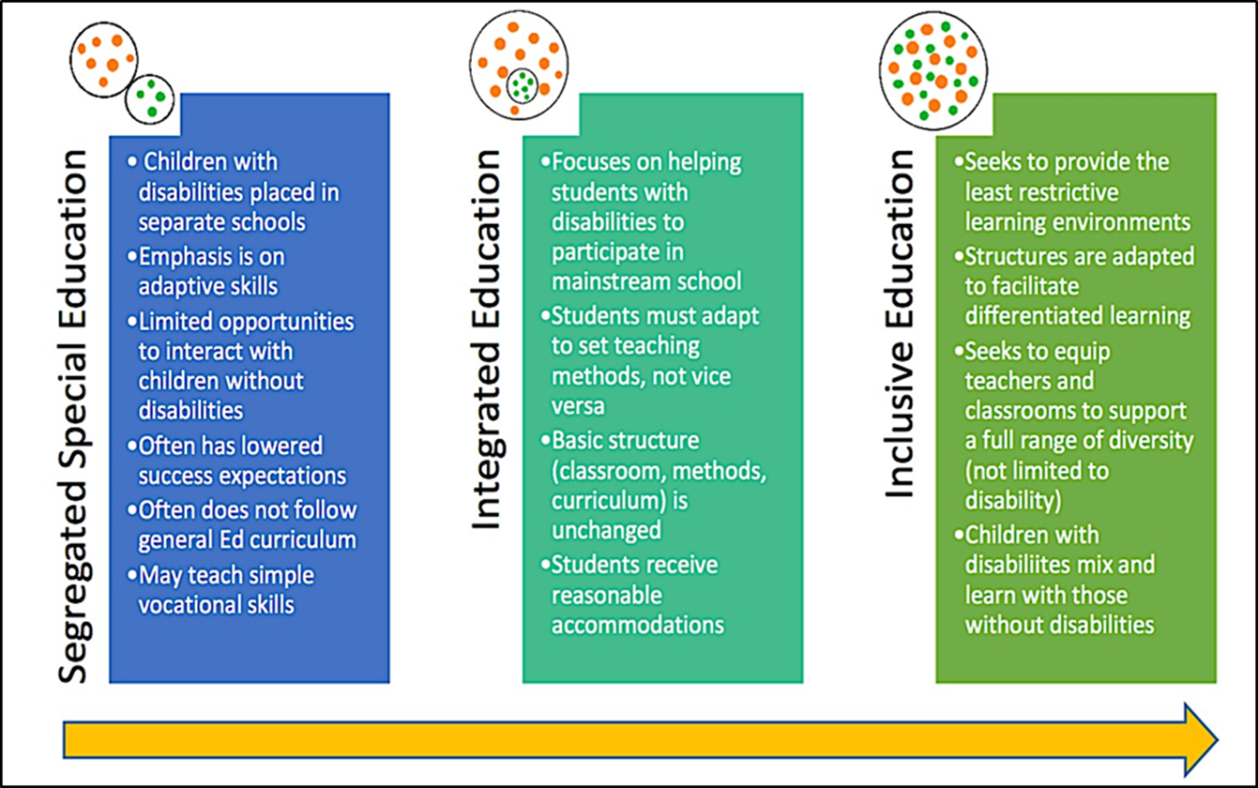
Fulbright-Clinton Fellowship in Peru
The educational model for youth with disabilities in Peru is focused on special education.
At best, some schools have integrated education however this is distinct from truly inclusive education.

Slide 10
Fulbright-Clinton Fellowship in Peru
CEBE (Centros de Educación Básica Especial): Attends to youth with severe intelectual disabilities or those with multiple disabilities from 3 to 20 years old.
SAANEE (Servicios de Apoyo y Asesoramiento para la Atención de Necesidades Educativas Especiales): Teams of professionals, who are both teachers and non-teachers, who offer help and advice to Regular Basic Education, Alternative Basic Education and Tecnical Productive Education institutions for students with light or moderate degree of disabilities from 3 to 29 years old.
PRITE (Programas de Intervención Temprana): Provide educational attention outside of the classroom to children under 3 years of age with disabilities or at risk of aquiring a disability, as well as advice and support to families for their own support and development.
CREBE (Centros de Recursos de la Educación Básica Especial): Provide logistical support to CEBEs, SAANEEs y PRITEs, and pedagogical support to teachers of students with disabilities.
CETPRO (Centro de Educación Técnico Productiva): Provides skilled training for improved employment outcomes of persons with disaiblities.

Slide 11
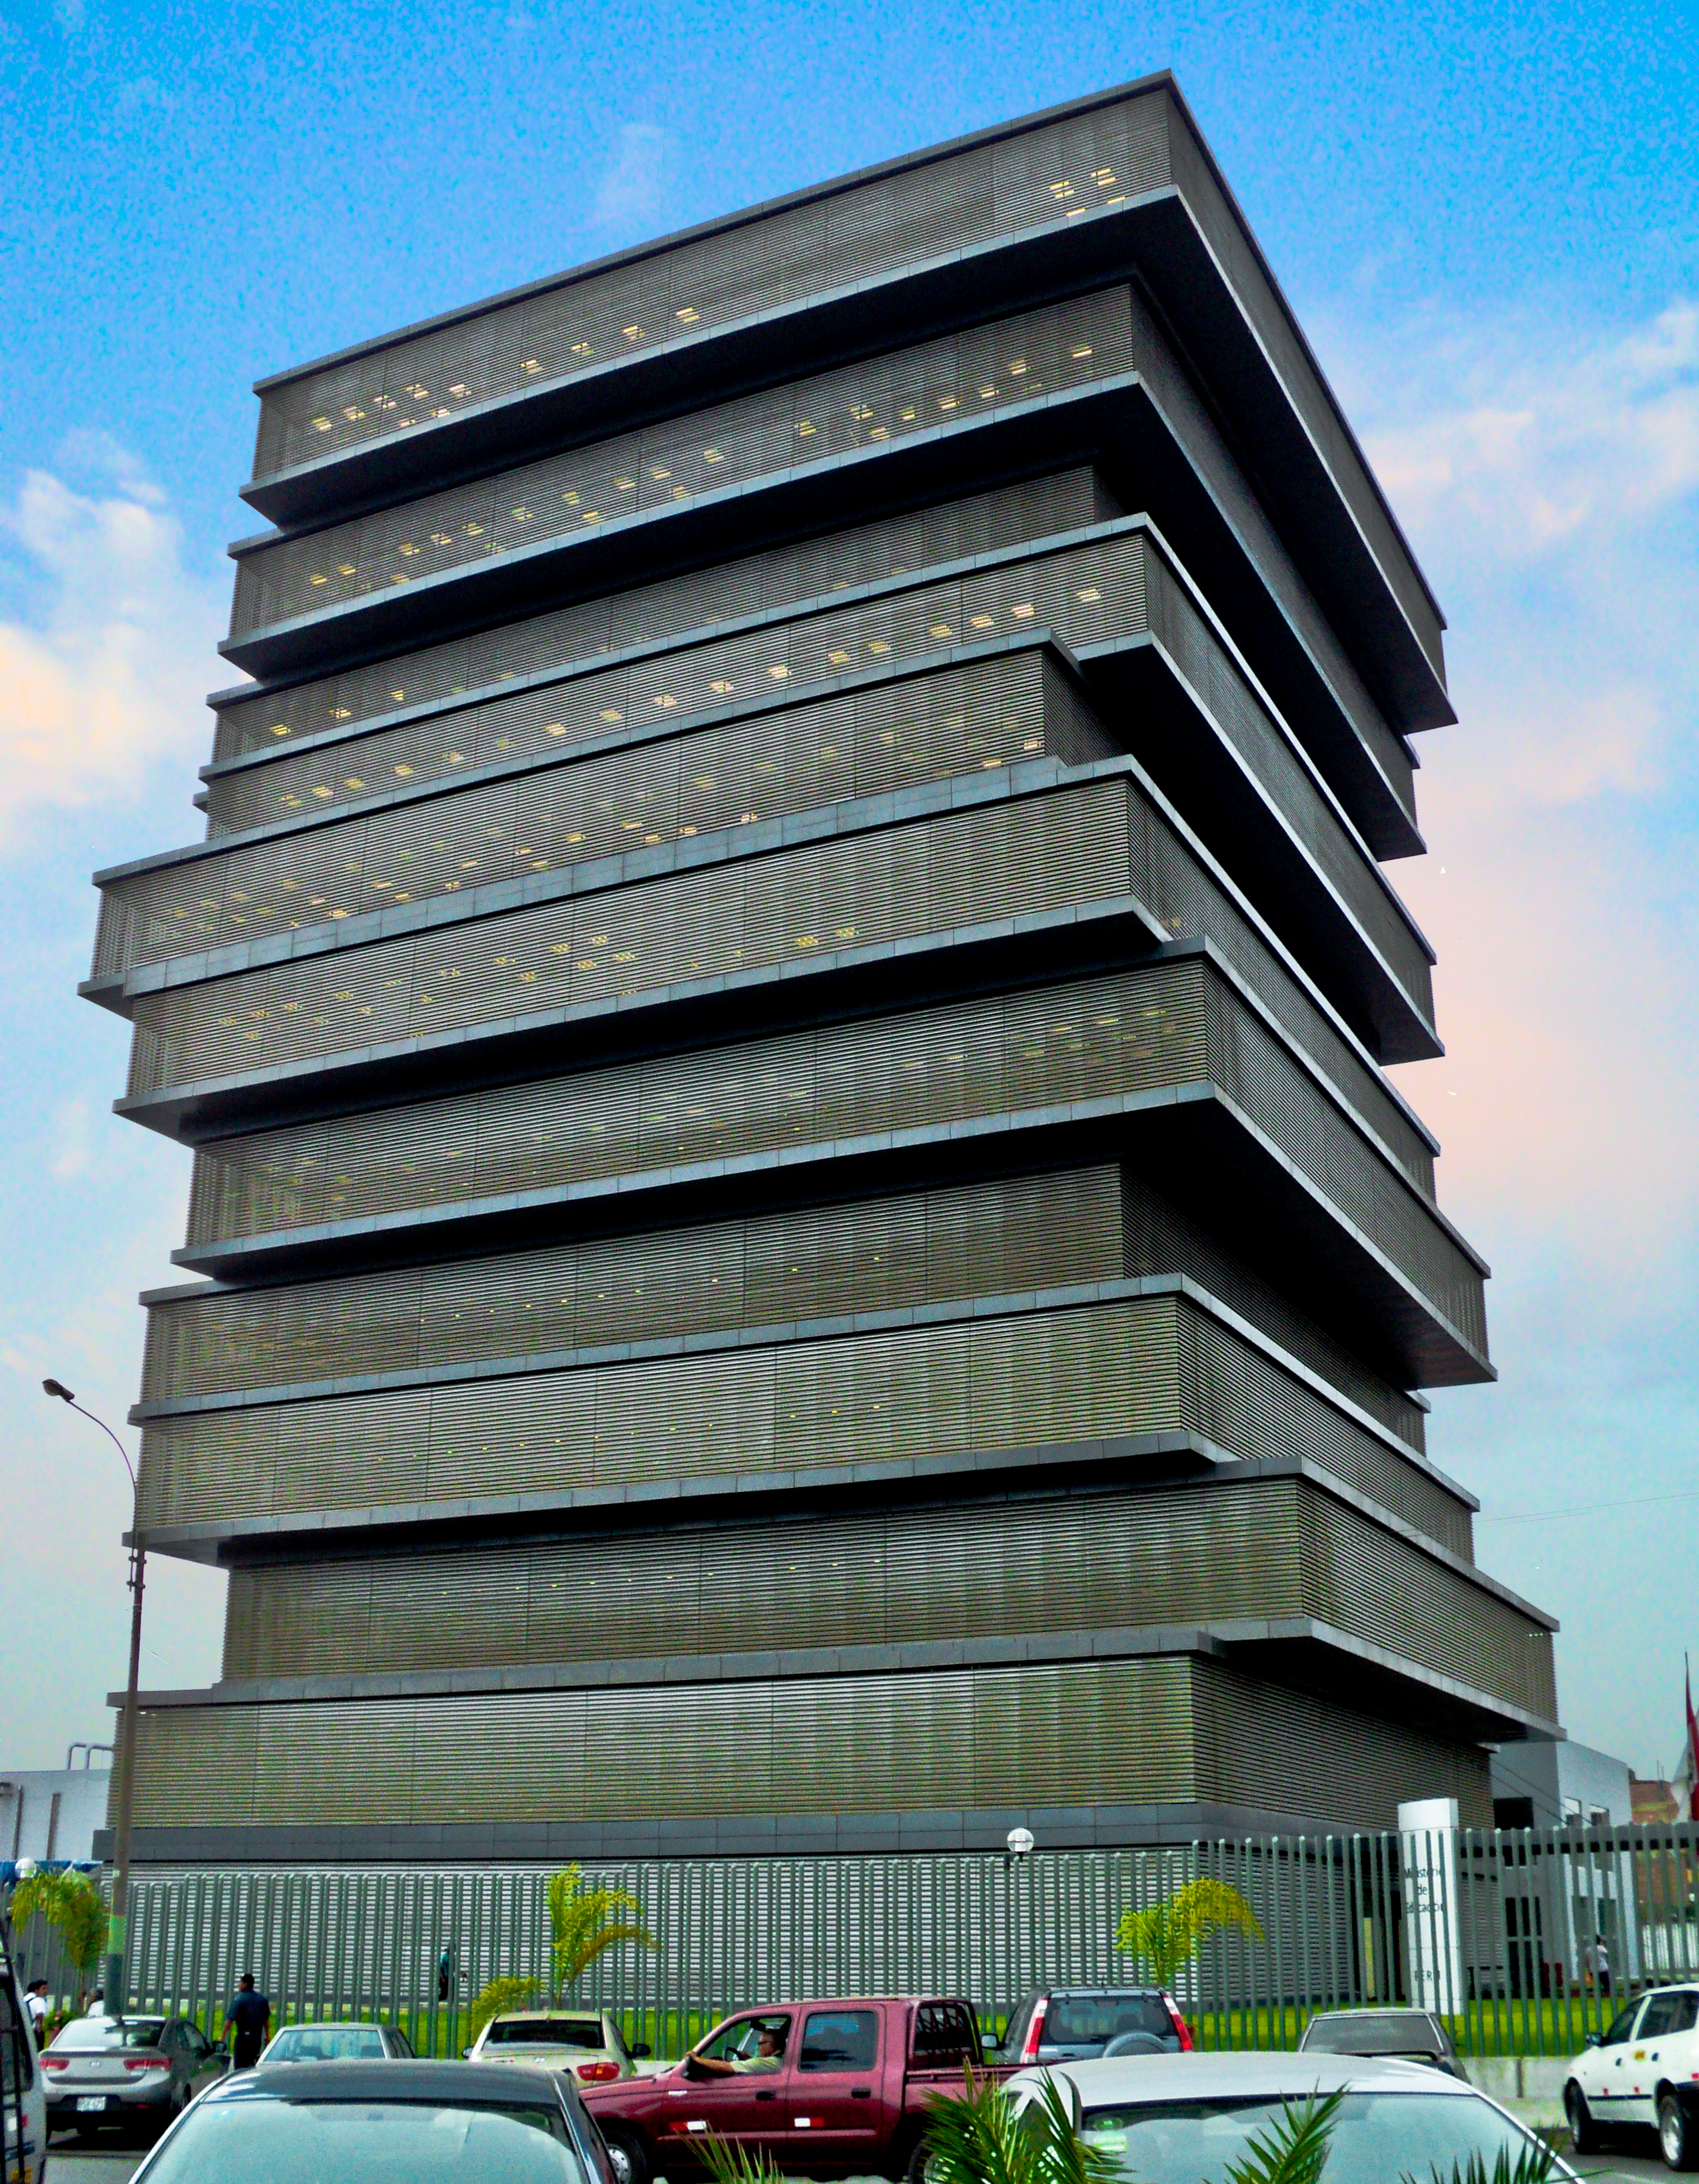
Fulbright-Clinton Fellowship in Peru
The special education model in Peru is based on a results-based budget (Presupuesto por Resultados – PpR), which is a total of about $50 million USD and accounts for about 0.6% of the entire Mininstry of Education budget.
Currently, 84% of the budget is oriented toward special education.

Slide 12
Proposal: External Evaluation of the Results-based Budget for Special Education and Demand-driven Model for Education to Employment Transitions
Conduct an evalution of the results-based budget for special education, including its logic matrix, goals, and objectives.
The evaluation will aim to reform the logic matrix, with a special focus on strengthening inclusive education in mainstream schools and to support the creation of inclusive education policy.

Slide 13
Proposal: External Evaluation of the Results Based Budget for Special Education and Demand-driven Model for Education to Employment Transitions
In collaboration with the Ministry of Special Education, Ministry of Labor, Human Rights Ombudsman, ILO and GRADE, we are developing a demand-driven employment model using the latest national household survey on disability (ENEDIS 2012), to identify a town or community in Peru with a high prevalence of disability.
We will then collect information on the public and private sector employment demand in this community in order to identify what, if any, skills training is needed for the people with disabilities in that community to meet the employment demand.
Finally, we will work with a CETPRO institution to pilot the necessary skills training before transitioning the participants into places of employment.
Depending on the results, we may recommend this demand-driven employment model in the evaluation for the special education results-based budget for youth with disabilities who don’t seek to pursue higher education.

Slide 14
Fulbright-Clinton Fellowship in Peru
Anticipated goals:
Propose reform recommendations for the results-based budget for special education and support the creation of inclusive education policy for youth with disabiliteis in mainstream schools;
Include the demand-driven employment model in the budget recommendations as an option for children with disabilities who don’t pursue higher education.

Slide 15
Thank you!

