Slide 1

Linkages between the SDGs and the CRPD
May 3, 2016
Elizabeth Lockwood, Ph.D.

Slide 2
CRPD-SDGs Infographic

Slide 3
SDGs and CRPD
The 2030 Agenda is a global political commitment, but the CRPD is legally binding and can make governments accountable
The CRPD needs to be the guiding framework, along with other human rights treaties, for implementation at a national level
The CRPD needs to be the foundation also for the wider 2030 Agenda processes, including financing for development

Slide 4
Background
The purpose of the infographic is to:
  Illustrate that there are important linkages between the CRPD and the SDGs in a visual way
  Stimulate further discussions on the matter
  Show how human rights must underpin the implementation of the SDGs
  Provide a starting point for further in-depth analysis and reflection
  It is not intended to provide a full analysis of all existing linkages between the CRPD and the SDGs

Slide 5
Background
If broadly interpreted, all SDG targets could be linked to the CRPD
This infographic is based on the analysis of the exact text of the CRPD and the exact text of the Sustainable Development Goals and targets and interpreted in the most conservative way.
Where there is overlap, this is where the dots on the rainbow appear.
There are plenty of examples of inferred references to many other CRPD articles, but these are not explicitly stated in the SDGs and thus not included in this particular infographic.
Notes:
If broadly interpreted, all targets could be linked to the CRPD

Slide 6
Analysis
The CRPD was used as the base and word-for-word phrases were matched to the SDGs, including:
  persons with disabilities
  disability
  for all
  vulnerable
  access
  equal access
  universal access
  gender equality
  harmful practices
  violence
  equal rights
  equality
  representation
  inclusive
  non-discrimination
Notes:
Sustainable Development Goals and targets only, not the entire 2030 Agenda.
Consequently, this is a conservative interpretation.

Slide 7
Analysis
For articles 11: Situations of risk and humanitarian emergencies and 32: International cooperation the phrases used include:
  least developed countries
  international cooperation
  natural disasters
  early warning
Targets without the aforementioned phrases were not included in the matching

Slide 8
Analysis
In addition to matching exact text, the following assumptions are made in this infographic:
  References of equal in the SDGs are linked to CRPD article 5 (equality and non-discrimination)
  References of for all in the SDGs include all persons with disabilities:
    women with disabilities (CRPD article 6)
    children with disabilities (CRPD article 7)
    people with different types of disabilities and support requirements

Slide 9
Analysis
  All references to access or inclusion in the SDGs can be fulfilled by CRPD article 9 on accessibility which requires governments to take action to ensure persons with disabilities the right to independent living and participate in all aspects of life.
  All references to those in vulnerable situations in the SDGs include the right of protection and safety of persons with disabilities in situations of risk, natural disasters and humanitarian emergencies (CRPD article 11).
  All progress made by the SDGs must be monitored through disability disaggregated data (CRPD article 31).
  All references to development and/or least developed countries in the SDGs relate to international cooperation and partnerships (CRPD article 32).

Slide 10
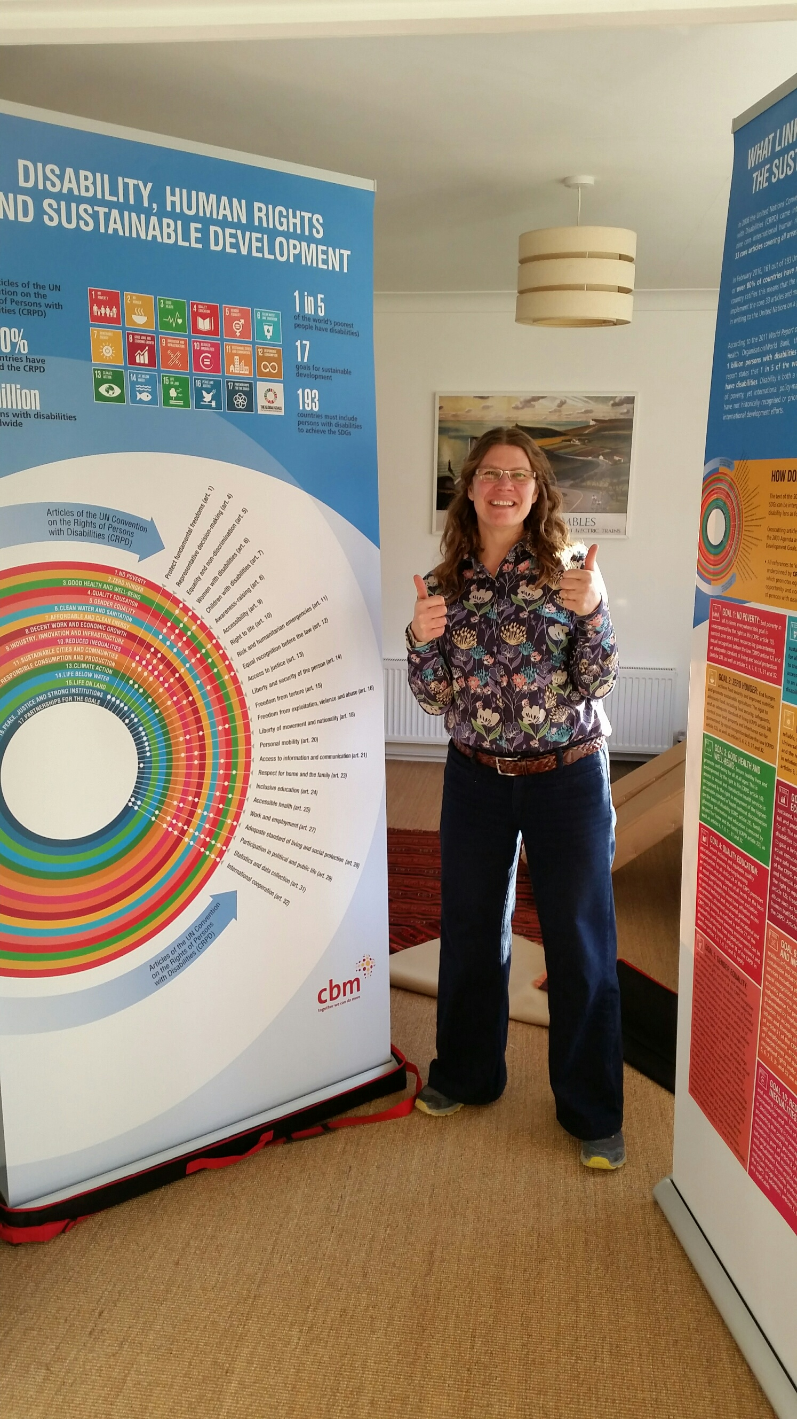
Resources
http://www.cbm.org/article/downloads/54741/CRPD-A4LEAFLET-2-inhouseprint.pdf

