Slide 1
Inputs for Sweden's implementation of the Agenda 2030 - national and international
Arvid Lindén, Agency for Participation, Sweden

Slide 2
The presentation
The Agency for participation
Swedish disability policy
Agenda 2030
Monitoring disability policy
The webbpanel

Slide 3
About the Swedish Agency for participation
What do we do?
We work for everyone to be fully involved in the community regardless of ability to function
We promote and follow up the implementation of the disability policy
Evaluation and monitoring. Analyzes. Development issues. Standardization. Procurement. International expansion. Assistive Technology. Research and innovation.

Slide 4
National objectives 2000
Creating a society with diversity and equality as a basis
Identify and remove barriers
Preventing and combating discrimination
Give the conditions for independence and self-determination

Slide 5
Policy areas
Employment
Education
Social
Health
Physical accessibility
Transport
IT
Culture, Media and Sport
Legal system
Consumer affairs

Slide 6
22 strategic agencies and 290 municipalities
Notes:
22 centrala och strategiska myndigheter har ett särskilt ansvar att inom sin samhällssektor förverkliga målen i funktionshinderspolitiken
Myndigheterna skapar sina egna mål

Slide 7
What's up? (2015)
It goes in the right direction but it takes time
Men and women receive different amounts of support
It matters if the family helps
The agencies are working for accessibility
Notes:
Se lättläst sammanfattning av Hur är läget 2015, sidan 12-13!

Slide 8
When is the best?
The disability policy works when it is inclusive. Early universal thinking that people are different. For example:
When making a recruitment policy / procedure
When new trams will be procured
Designing education based on that pupils are different
Notes:
Mest effektivt och systematiskt är det funktionshinderspolitiska arbetet då det integreras.
Att tidigt tänka in att människor är olika. Till exempel:
När man tar fram en anställningspolicy/rutin – ta med att intervjuer ska ske i tillgängliga lokaler, ange hur en annons ska se ut, säkerställ rutiner för ex teckenspråkstolk vid intervjun.
När nya spårvagnar ska upphandlas, ställ krav på tillgänglighet i upphandlingen, då blir det ”rätt från början” och dyra åtgärder i efterhand är ett minne blott
Att utforma utbildning utifrån att elever är olika. Bred kompetens hos lärare, tillgänglighet i lokaler och kommunikation, möjlighet till hjälpmedel och stöd. Att inte utgå ifrån en ”normal-elev” blir dyrt i längden, för alla parter.

Slide 9
Assignments to the MFD
Suggest a more efficient and systematic disability policiy - both in the implementation and monitoring
Suggest the orientation of the disability policy after 2016 inline with the CRPD and Agenda 2030
Consult with the disability organizations and collaborate with all stakeholders

Slide 10
The Government's ambition for Agenda 2030
Give priority to implementing the new sustainability goals
For Sweden is to be a leader in the implementation of the Agenda
The Prime Minister has taken the initiative for an international high-level group along with eight other countries
Crown Princess Victoria appointed by the UN Secretary General to a 16 "SDG Advocates
•

Slide 11
Ministers responsibe for..
coordinating the national implementation of the Agenda 2030
the international implementation of the Agenda 2030
identifying strategic actions to be taken in the future in order to secure long-term effective / efficient implementation of the Agenda 2030

Slide 12
Monitoring disability policy
Arvid Lindén, Agency for Participation, Sweden

Slide 13
UNOHCHR model
 | Structure | Process | Outcome
National survey on the living conditions
Web panel 1800 PWD
Municipalities work
Governmental agencies work
Qualititative studies
Strategic agencies reports

Slide 14
What happens with the results?
Feedback to municipalities and authorities
Presentation of results
open comparisons
Basis for government decisions
Development processes
Useful for DPO:s etc.
Reporting UNCRPD, Agenda 2030, Council of Europé and EU

Slide 15
A web panel with persons with disabilities about how they experience their daily lives.
Four to six times yearly the panel answer questions related to accessibility and living conditions in areas important in daily life
Answers show how the disability policy works in practice. The goal is to gain knowledge of what works well or badly and what changes need to be made for persons with disabilities to participate fully in the society.

Slide 16
Participants of the panel
2000 participants
important to give feedback
the same distribution as the national living condition survey regarding gender, age and disability
Ongoing recruitment

Slide 17
Areas of the webbpanel
Employment
Personal assistants
Legal system
Culture, sport and physical activity
Consumer
Media. it
Elections and political participation
Public transport

Slide 18
So accessible as possible
sign language interpretation
screen readers
regardless of platform
few questions
short surveys
no multi-dimensional questions
combine with open text responses

Slide 19
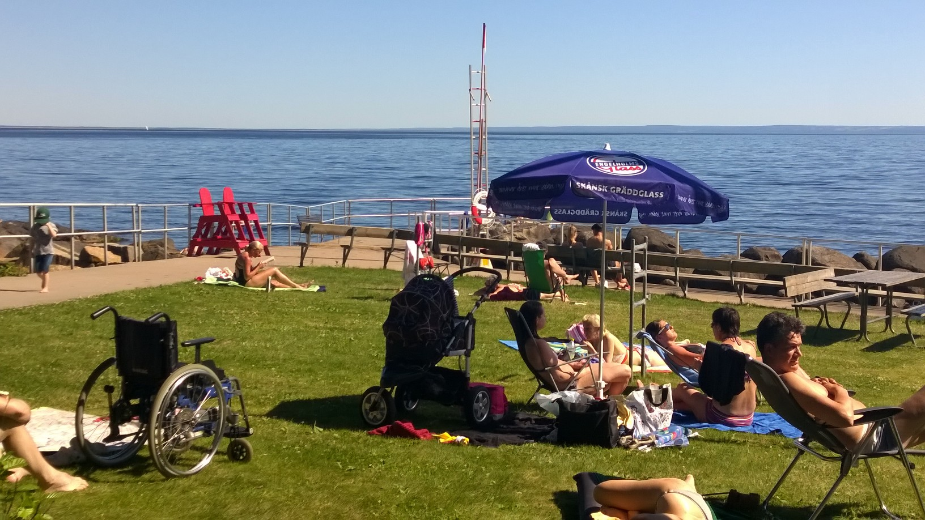
The Swedish Agency for Participation
04 May 2016
Arvid.linden@mfd.se

