Slide 1
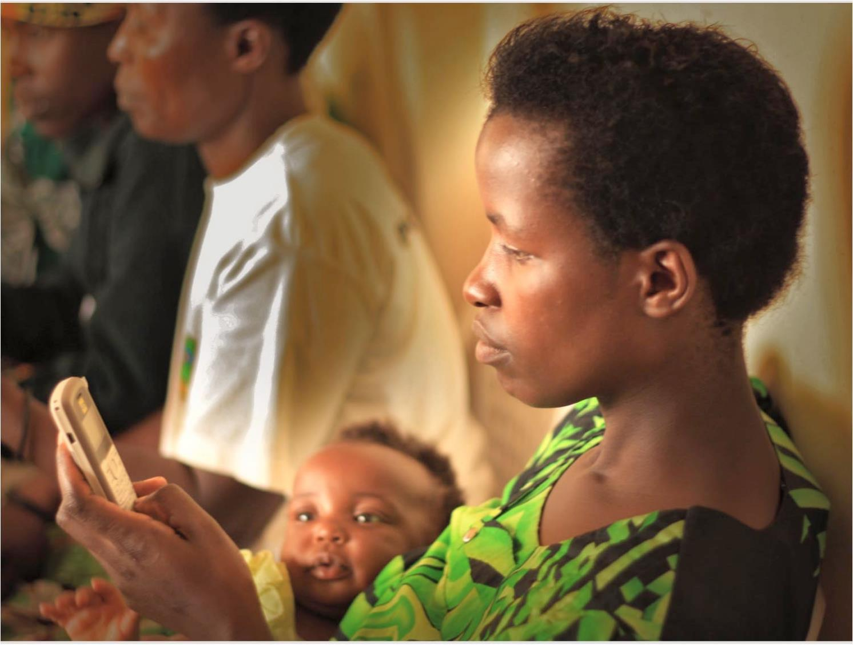
U-Report
Improving Programme Results through Technology
Notes:
Some very brief background why UNICEF in Uganda is trying to improve results through technology

Slide 2
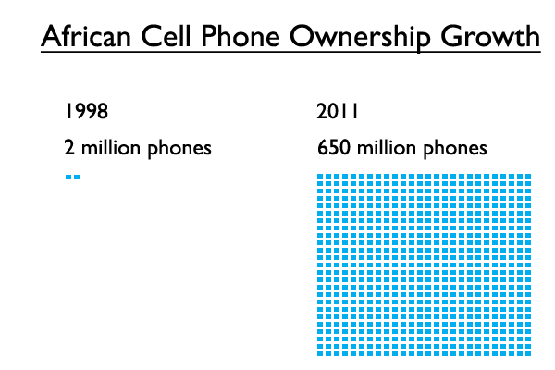
Infrastructure
The adoption of mobile phones has occurred at perhaps the fastest rate and to the deepest level of any consumer‐level technology in history
More mobile phone subscriptions than people on the planet – ITU
African Cell Phone Owners Growth- ITU, World Bank eTransform Report 2011
Notes:
Recent increase of mobile phones and access to mobile phone has been extremely fast. Currently mobile phone penetration is very high, nearly 100 % of Ugandans have access to mobile phone

Slide 3
Turning Management Information Systems into Information FOR Management
Government service monitoring in real – time
Real – time citizen reporting
Improved Service Delivery via Decentralized Monitoring & Planning
Notes:
UNICEF Uganda is not trying only to change how we collect data in Uganda, but also what is is been collected for and how it’s been used.

Slide 4
Notes:
TITLE SLIDE: The background colour of this slide can be changed to Red, Green, Blue or Black.

Slide 5
Voluntary joining via sms, free messaging
Available across various channels depending on context including Facebook messenger, Twitter, web portal
Issues polled include among others health, education, water, sanitation and hygiene, youth unemployment, HIV/AIDS, disease outbreaks; social welfare sectors.
Results and ideas are shared back with the community AND decision makers
Data received can be disaggregated by age, gender and district in real time
Notes:
How does Ureport work. Polling takes place weekly at national level and follow-up questions may go more often

Slide 6
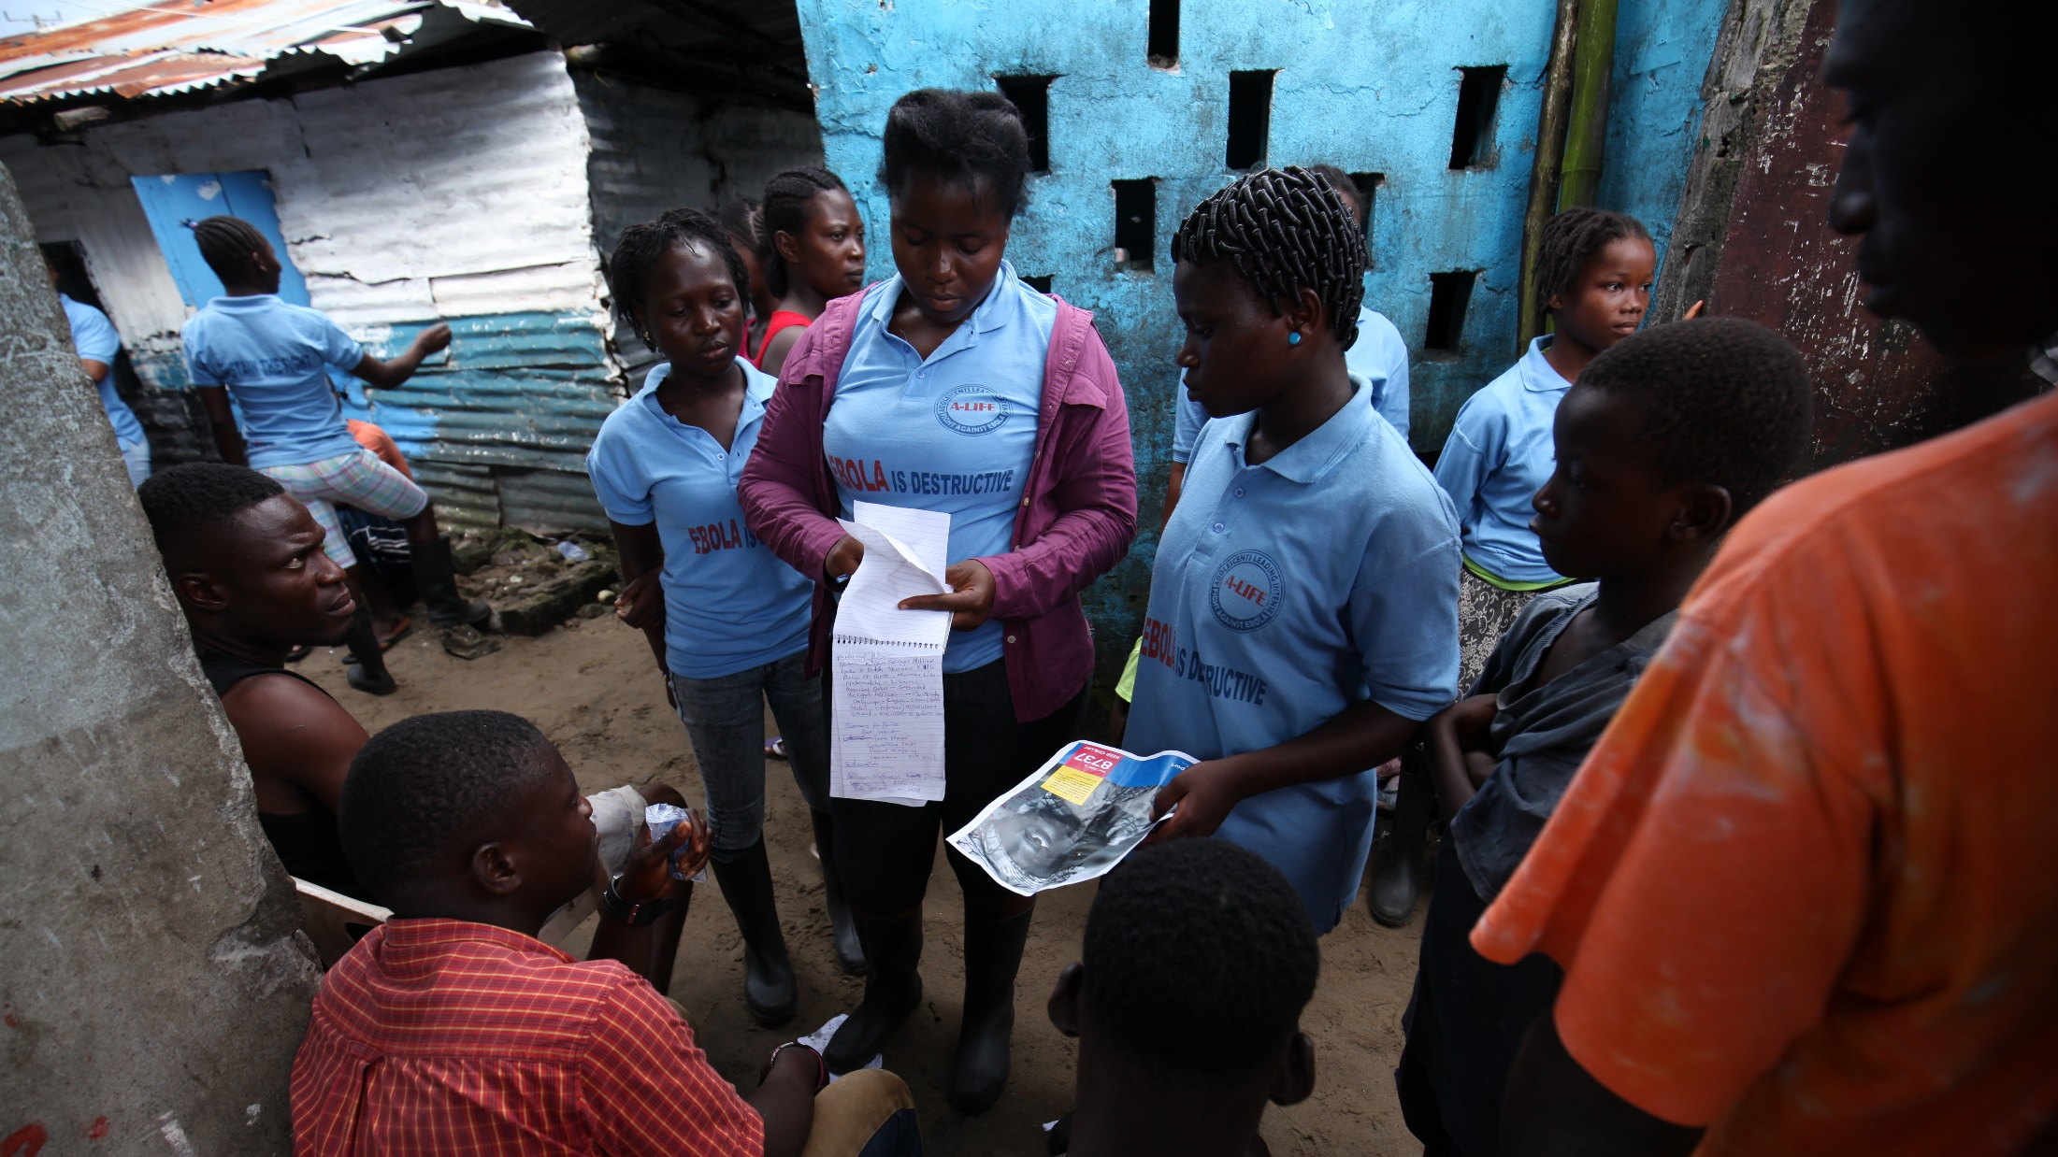
2013
198,000
2
2016
2,066,125
19
U-Reporters
U-Report Countries
U-Report

Slide 7
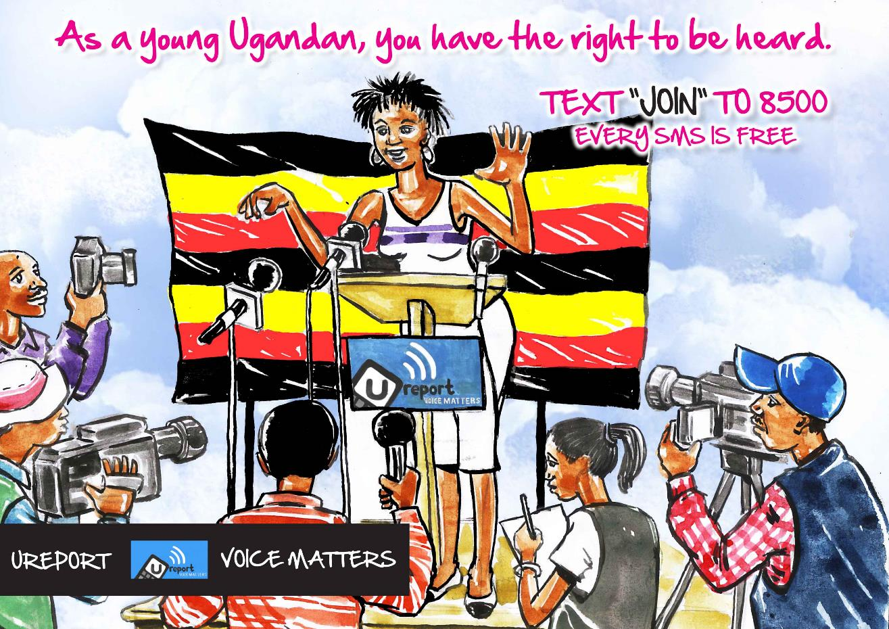
Notes:
U-Report is a free SMS social monitoring tool for community participation, designed to address issues that people care about.

Slide 8
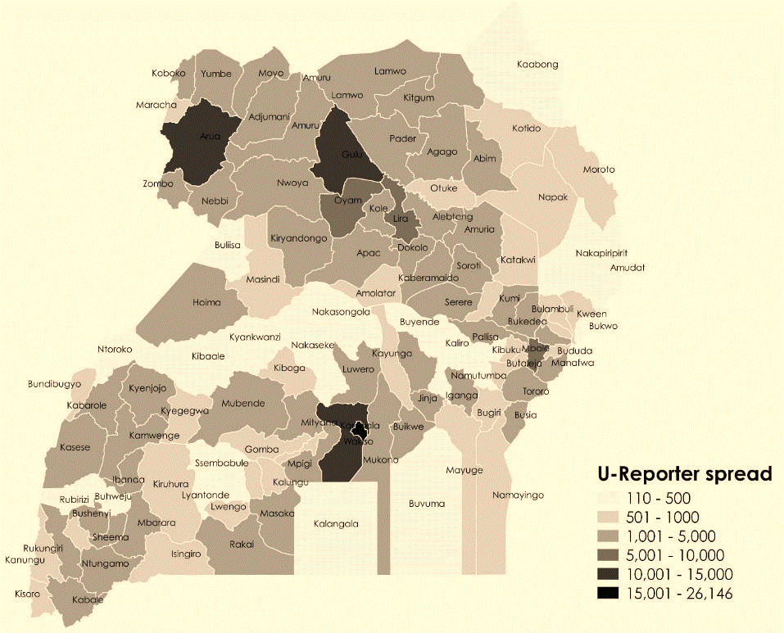
Background
Notes:
A quick background on U-Report e in Uganda…
As you can see, we have almost 300,000 U-Reporters spread all across the country, and in all age ranges. U-Reporters are currently 36% female, although we are undergoing efforts to try to make this gender balance more equal.
The majority of these U-Reporters are active in 25 partner organizations – such as the Uganda Scouts, Marie Stopes International, the faith-based organizations, Uganda Civil Society Youth Coalition, etc.

Slide 9
Notes:
SMS, Twitter, exploring whatsapp, facebook messenger,

Slide 12
Situation of children with disabilities in Uganda
Uganda ratified the Convention on the Rights of persons with Disabilities (CRPD) in 2008.
The child disability prevalence is approximately 13%, or about 2.5 million children live with some form of disability in Uganda.
About 9% of with disabilities of school going age attend primary school and only 6% of them continue studying in secondary school.
Notes:
Statistics from the situation analysis for children with disabilities 2014

Slide 13
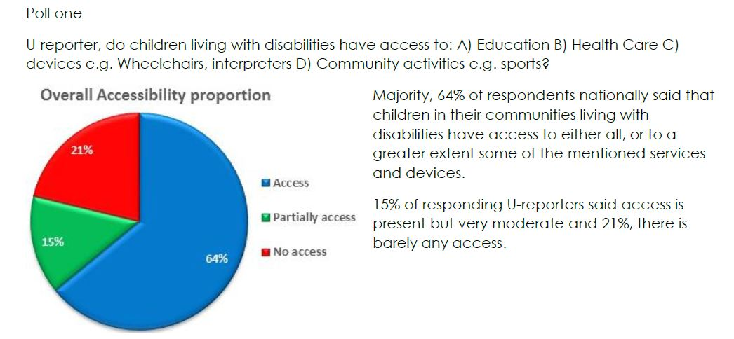
UReport and disability specific question
Notes:
A series of disability-related polls between 2012-2014 initially for advocacy purposes, in 2014 to validate the CwD situation analysis findings. Perceived access to services, mainly to education is interestingly very high – quite a contrary to the real situation. The follow-up polls indicated poverty and lack of resources are the biggest perceived barriers preventing access. This might be explained with the limited understanding of disability in Uganda

Slide 14
UReport for CwD programming
2016-2020 Country Programme has stronger focus on equity – disability featuring strongly in education programme
A poll to compare perceived access – even higher % considered the access to be adequate nationally. UReport can help us to assess why
30 focus districts – UReport data will be used (April-Dec 2016) to analyze key bottlenecks in focus districts for better programming: attitudes, access, human capacity?

Slide 15
Notes:
UNPRPD project - Project on improved use of ICT for CwD within education

Slide 16
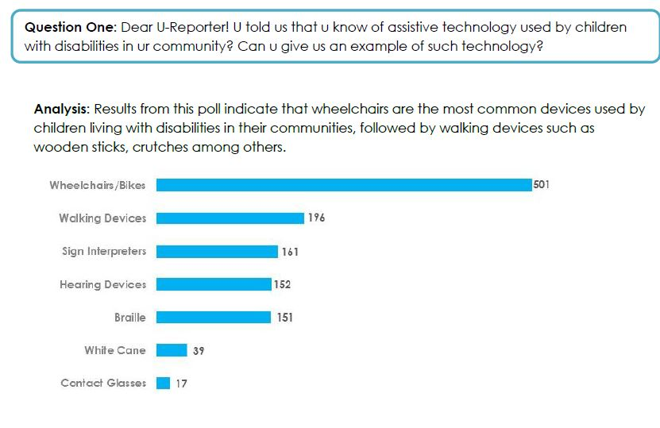
Ureport within UNPRPD project
Notes:
To establish what’s currently in use we did an assessment in the focus districts but also utilized Ureport to assess the situation. Also Ureport findings confirmed 9as per the graph) – there is NO ICT anywhere commonly used and even basic assistive devises are rare

Slide 17
Potential uses of UReport
Key medium- and long-term opportunities for UNICEF in Uganda:
Citizen engagement to influence implementation of SDGs
Implementation of CRC OP3 allowing children and caregivers to report on individual violations of child rights
Civil Society Organizations using U-Report data for child rights advocacy at sub-national level

Slide 18
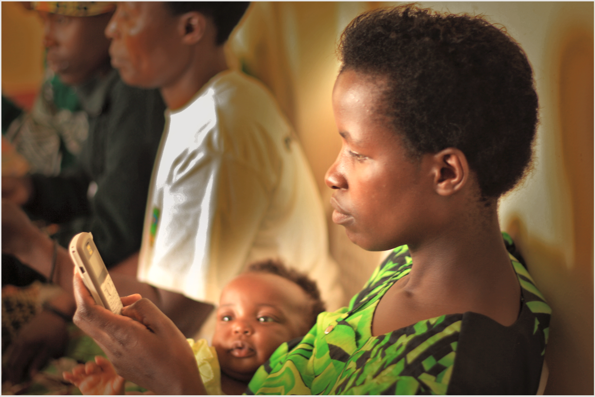
Thank you!

