Slide 1
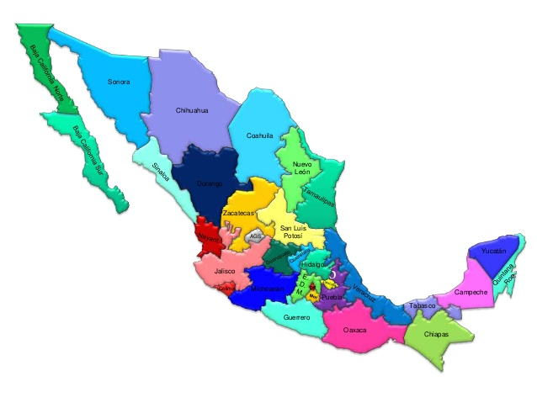
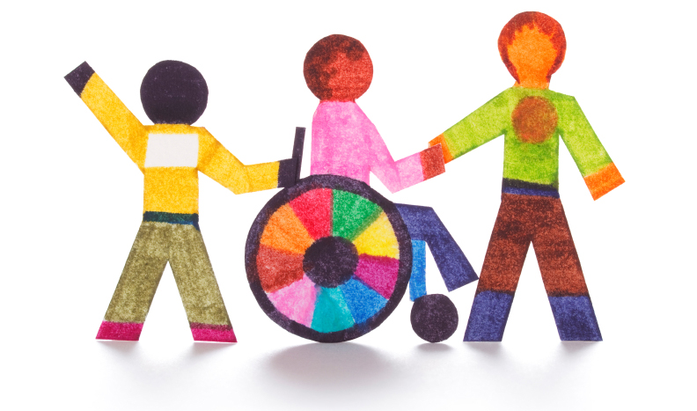
Mexico's experience in collecting data on disability
M.D. Héctor Javier García Contreras
National Institute of Statistic and Geography (INEGI). México
2nd meeting of the Global Network for Monitoring and Evaluation for Disability-inclusive Development (MEDD),
3-4 May 2016; New York. U.S.A.

Slide 2

The measurement in Mexico
In Mexico it has census data from 1895, however, the issue of disability becomes important in the early twentieth century.
In censuses of 1900, 1910, 1921, 1930 and 1940, captured information for this population (measurement of the population with mental and physical defects).
Censuses for 1950, 1960 and 1970, the issue was not caught.
The 1980 census identifies not attending school for disability in the children of 6-14 years.
the census of 2000 and 2010 included a question on disability status.
In household surveys from 2012, identification of disability status is included using different parameters.

Slide 3
Sources of information since 2010

Slide 4
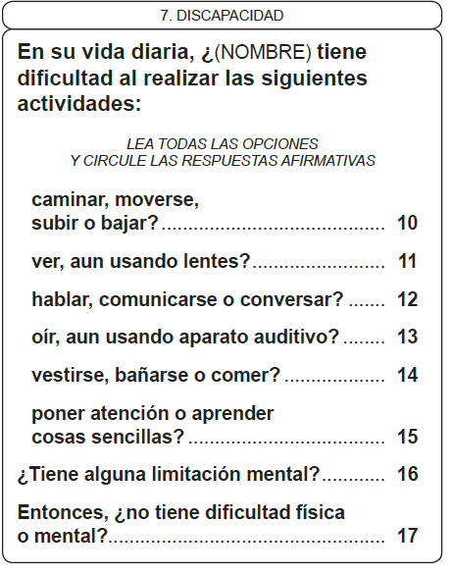
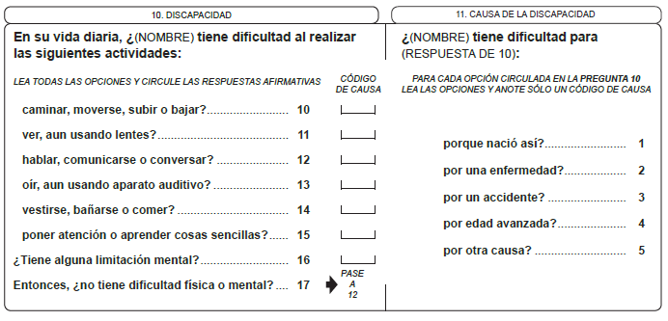
Population and Housing Census 2010
Short form
Long form
To identify disability:
Disability (difficulty): Those who reported having difficulty in at least one of the activities.
No disability (difficulty): Not have physical or mental difficulty.

Slide 5
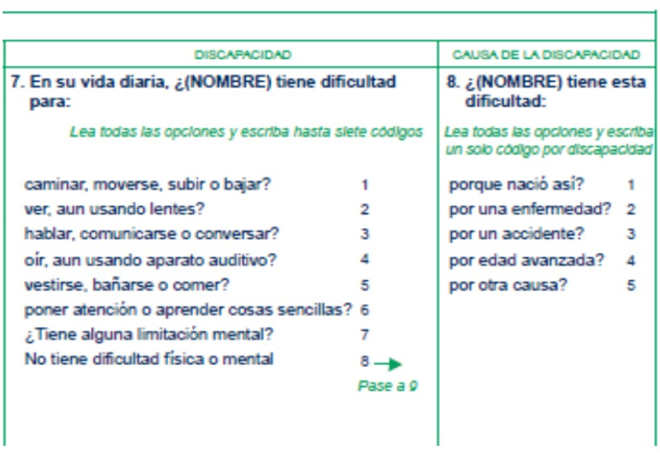
National Survey of Mexican Household Income and Expenditures (ENIGH) 2014
To identify disability:
Disability (difficulty): Those who reported having difficulty in at least one of the activities.
Non disabled (difficulty): Not have physical or mental difficulty.

Slide 6
National Household Survey (ENH) 2014

Slide 7
National Household Survey (ENH) 2014
To identify disability or limitation:
Disability: Those with much difficulty or can not do at least one of the four activities.
Limitation: Those who have "some difficulty" for at least one of the four activities which are not included in the previous group.
Without limitation or disability: Those who not have difficulty performing the four activities wondering.

Slide 8
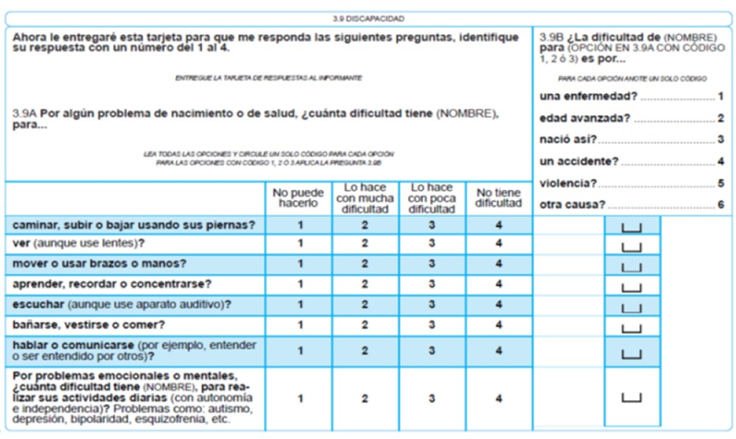
National Survey of Demographic Dynamics (ENADID) 2014
To identify disability or limitation:
Disability: Those with much difficulty or can not do at least one of the four activities.
Limitation: Those who have "some difficulty" for at least one of the four activities which are not included in the previous group.
Without limitation or disability: Those who not have difficulty performing the eight activities wondering.

Slide 9
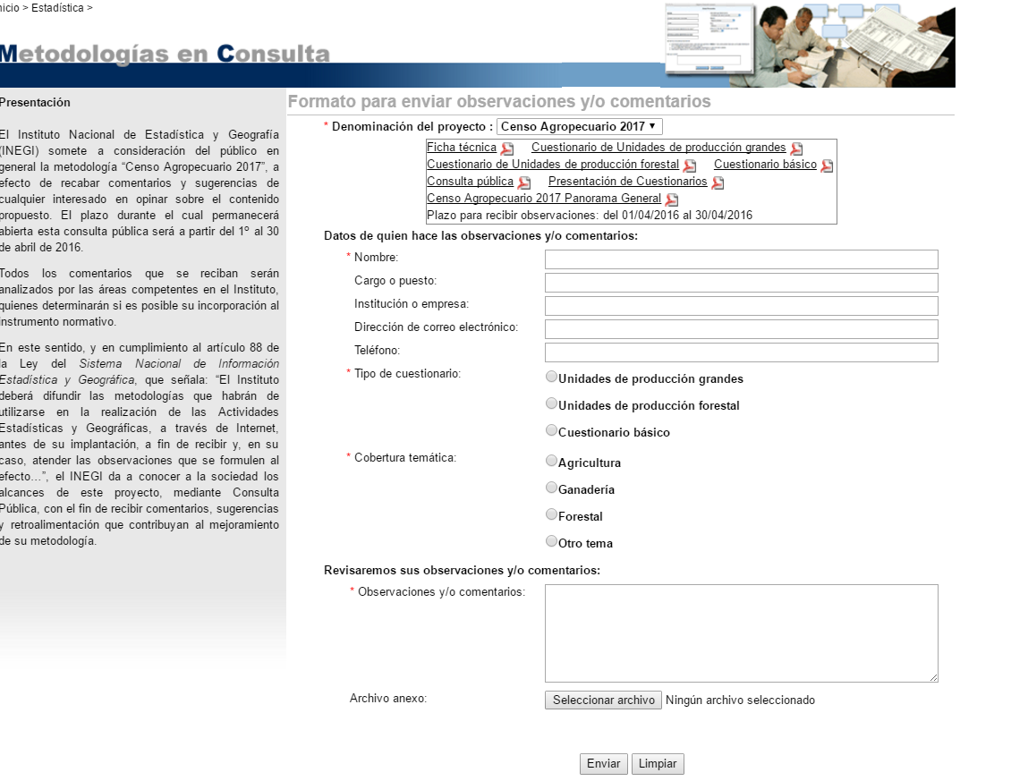
Participation of society
Consultation with Organized Civil Society; Academics and the general public.
INEGI opens a period of suggestions, opinions or requests for change in methodology, questionnaires and other aspects related to the gathering of information.
The relevance of the application is evaluated and proceeds to respond to the user.

Slide 10
Project: National Registry of Persons with Disabilities (RENADI)
There are a questionnaire for adults (18 and over) and one for children (0-17 years), both were approved by the Pan American Health Organization.
Questionnaires include all components of IFC that are needed to identify disability in a person.
In 2014, two pilot tests were conducted in urban areas.
Socio-demographic information | Medical Information and IFC components
Module Location | Body functions
Identification of persons with disabilities (including geo-reference addresses) | Body structures
Respondents information (if necessary) | Activity and participation
Health indicators | Environmental factors
Social programs (government) | Medical diagnosis
Education indicators | Referral to health services
Employment indicators | Doctors’ information (medical registries)
Notes:
Mensajes principales:
En base a la información estadística que nos enviaron, preparamos perfiles nacionales. La próxima tarea sería revisar/actualizar esta información.

Slide 11

Developing survey (UNICEF/INSP)
NIPH (INSP) is responsible for implementing the ENIM 2015 in collaboration with UNICEF and with the support of a Steering Committee.
Questions used for adult are not always appropriate for children
The module is composited by two questionnaires: one for children 2-4 aged - another for children/youth 5-17 aged.
a) 2-4 years 8 domains.
Vision, hearing, walking, communication/comprehension,
learning, behavior, playing, dexterity/fine motor.
b) 5-17 years 12 domains.
Vision, hearing, walking, communication/ comprehension, learning, behavior, remembering, attention, relationships, self-care, emotions and coping with change
Response categories are: 1) No difficulty 2) Some difficulty 3) A lot of difficulty 4) Cannot do at all.
Performance and disabled child / teenager (2 to 17 years aged)
*Is used a card where the response according to section appear to facilitate understanding by the respondent

