Slide 1
Disability and Poverty in Vietnam
Daniel Mont
Center for Inclusive Policy and
UCL - LCDDC Center
MEDD Meeting
May 2016

Slide 2
Series of Quantitative Studies on Disability and in Vietnam
Relation between disability, poverty, employment and education (Mont and Nguyen)
Spatial variation in disability rates and the disability poverty gap (Mont and Nguyen)
Household responses to onset of disability (Mitra, Palmer, Mont, and Groce)

Slide 3
Disability Prevalence by Poverty Status
 | Low Threshold | High Threshold
Poor | 8.5 | 4.5
Near poorest | 7.9 | 3.8
Middle | 7.5 | 3.7
Near Richest | 7.0 | 3.1
Richest | 7.3 | 3.3

Slide 4
Disability and Poverty by Gender, Agea and Extra Costs of Disability
 | No adjustment |  | With Extra Costs
 | No disability | Disability | Disability
All | 15.1 | 17.2 | 22.3
Male | 14.6 | 17.5 | 22.6
Female | 15.6 | 16.9 | 22.1
Ages
5-18 | 19.3 | 31.1 | 36.2
19-40 | 15.1 | 24.7 | 31.4
41-62 | 9.9 | 11.9 | 15.3
63+ | 14.5 | 17.1 | 22.8

Slide 5
Age of Onset
Coefficient from consumption regression | Before age 18 | Since age 18
No Control Variables | -.24*** | -.05**
Control Variables | -.12*** | -.01
Control Variables plus district fixed effects | -.13*** | -.01

Slide 6
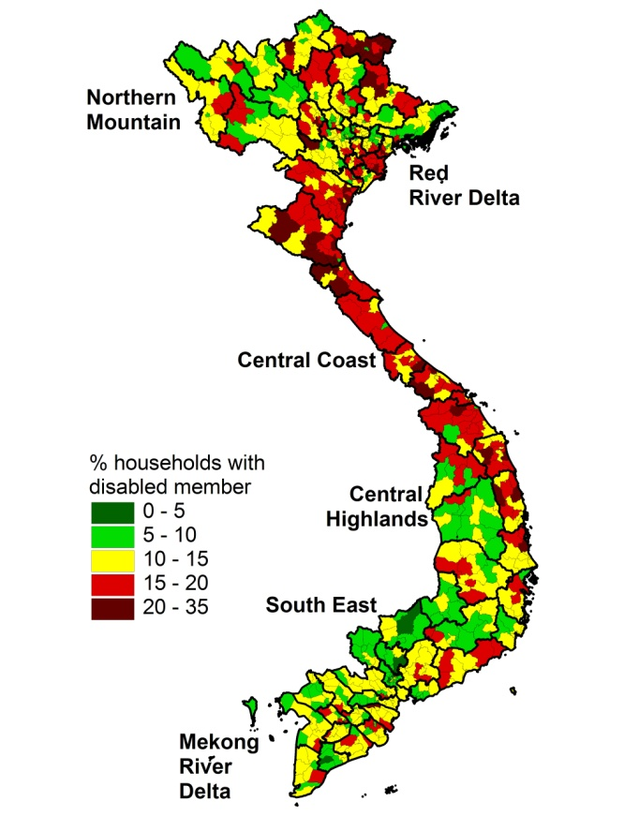
Disability Rates Vary by District

Slide 7
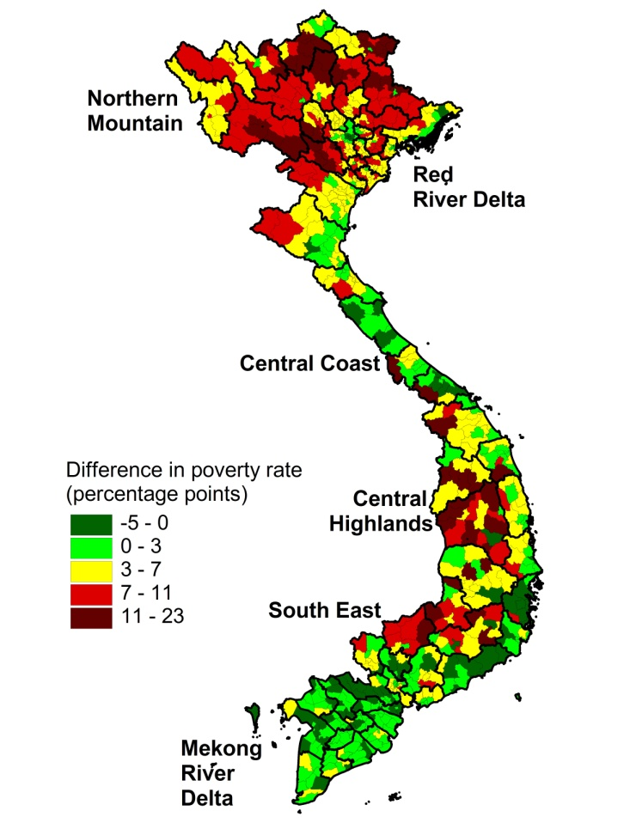
Poverty Gap Between Disabled and Non-Disabled Households Varies by District

Slide 8
Explanatory Variables: | Coefficient of Spatial Regression
per capita district expenditures | -0.3395***
squared per capita district expenditures | 0.0055***
# communes in district | 0.1245***
% commune roads are concrete | -0.0539***
# communes having loudspeaker | -0.0538***
# doctors in commune health centers | -0.0273**
# nurses in commune health centers | -0.0106*
population density | 2.3049

Slide 9
Impact of Health Shocks
Used panel data, but disability questions only on one round, so for onset of disability used three different definitions of health shocks

Slide 10
Impacts
Significant increase in health expenditures
Yet, households able to maintain consumption expenditures in short term
However, they do this by jeopardizing future consumption

Slide 11
Methods for Maintaining Consumption
Increased loans
Sale of assets
Reduction in education expenditures

Slide 12
Conclusions
Relation of poverty to disability is complex, depending on age, age of onset, measure of poverty, region of residence
  Not shown in this presentation impact on education, employment and household structure - or impact on family members.
Short term impacts different from long term impacts because of coping mechanisms
Better infrastructure and services may mitigate the impact of disability on poverty

Slide 13

Thank You!
Cảm ơn nhiều!

