Slide 1
Using the Model Disability Survey to monitor inequalities in the context of the
SDGs
Alarcos Cieza, MSc, MPH, PhD
Coordinator
Disability and Rehabilitation

Slide 2
WHO Multi-Country Survey Study 2000-2001
71 SURVEYS in 61 countries 185,369 respondents
Household: 14
Brief Face to Face: 27
CATI: 2
Postal surveys: 28
Overlaps: HH/Postal: 5 - BFTF/Postal : 4 -CATI/Postal: 1
Notes:
The boundaries and names shown and the designations used on this map do not imply the expression of any opinion whatsoever on the part of the World Health Organization concerning the legal status of any country, territory, city or area or of its authorities, or concerning the delimitation of its frontiers or boundaries. Dotted lines on maps represent approximate border lines for which there may not yet be full agreement.
© WHO 2002. All rights reserved
The boundaries and names shown and the designations used on this map do not imply the expression of any opinion whatsoever on the part of the World Health Organization concerning the legal status of any country, territory, city or area or of its authorities, or concerning the delimitation of its frontiers or boundaries. Dotted lines on maps represent approximate border lines for which there may not yet be full agreement.
© WHO 2002. All rights reserved

Slide 3
WHO - World Health Surveys
WHS 2002
70 SURVEYS
Household - long
Household - short
CATI
Notes:
The boundaries and names shown and the designations used on this map do not imply the expression of any opinion whatsoever on the part of the World Health Organization concerning the legal status of any country, territory, city or area or of its authorities, or concerning the delimitation of its frontiers or boundaries. Dotted lines on maps represent approximate border lines for which there may not yet be full agreement.
© WHO 2002. All rights reserved
The boundaries and names shown and the designations used on this map do not imply the expression of any opinion whatsoever on the part of the World Health Organization concerning the legal status of any country, territory, city or area or of its authorities, or concerning the delimitation of its frontiers or boundaries. Dotted lines on maps represent approximate border lines for which there may not yet be full agreement.
© WHO 2002. All rights reserved

Slide 4
For all these years disability was assessed as …
… the consequence of decrements in health
Commonly used questions:
Because of your health, how much difficulty do you have with …

Slide 5
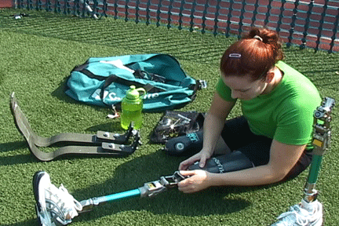
Health
(health conditions & impairments)
Disability
Capacity

Slide 6
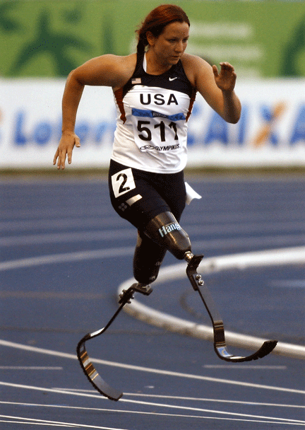
Health
(health conditions & impairments)
Disability
Environment
(physical, social, attitudinal and political)

Slide 7


Model Disability Survey (MDS)
Disabling barriers – Break to include

Slide 8
Model Disability Survey
Modular structure with 3 essential modules to capture disability
Household survey
  Representative sample of a population
  One household member selected randomly
Section 3000
Environmental Factors
Section 4000 Disability
Section 5000
Health Conditions & Capacity

Slide 9
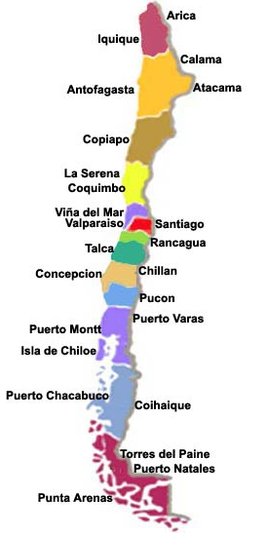
CHILE (N=12265)
Ministry of Social Development
(National Disability Service)
Ministry of Health
National Statistical Office
Data Collection:
June to August 2015
Notes:
I will go through measurement using data of the first two national implementations of the MDS, carried out in 2015.
In Chile five modules of the MDS were implemented in the national disability survey called ENDISC II.
The survey was carried out by the Ministry for Social Development in collaboration with the MoH and the national statistical office.
The sample included 12265 adults.
In Sri Lanka the complete MDS was implemented in a collaborative effort between the Ministry for Social services and the World Bank.
The sample included 3000 adults.

Slide 10
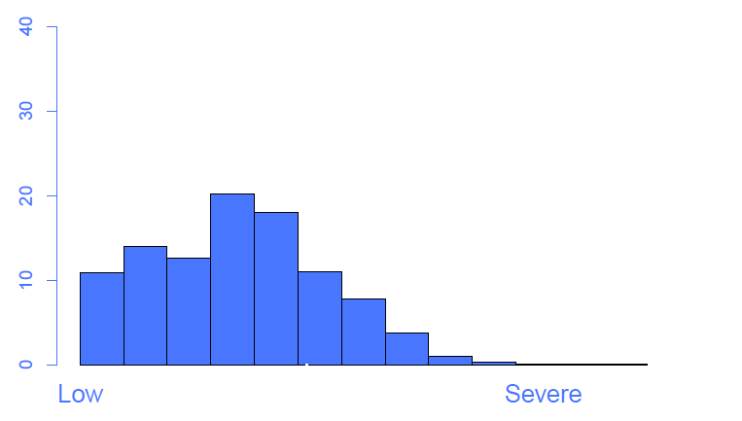
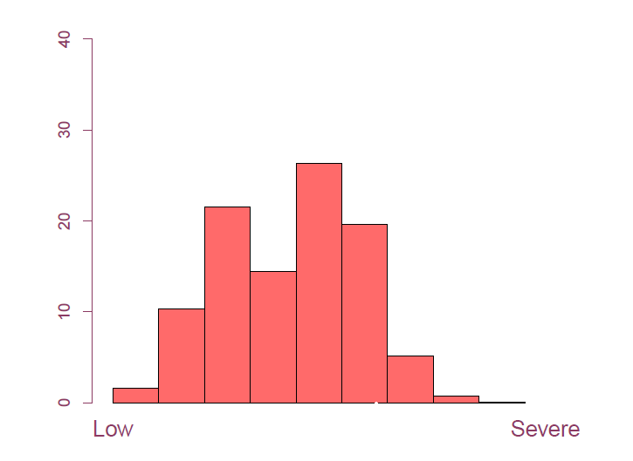
“Capacity”
Disability
8.3%
12.5%
21.4%
8.9%
Notes:
What we get is a scale of capacity difficulties for each country, ranging from low to high levels.
Please remember that what you see here is the distribution of a general population sample.
Who are the persons with severe difficulties?

Slide 11
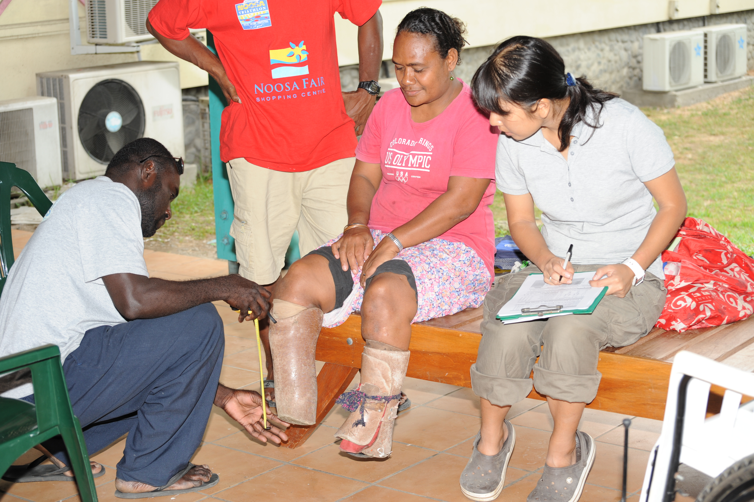

Slide 12
Capacity
Disability
8.3%
21.4%
8.9%
Notes:
What we get is a scale of capacity difficulties for each country, ranging from low to high levels.
Please remember that what you see here is the distribution of a general population sample.
Who are the persons with severe difficulties?

Slide 13
Capacity
Disability
21.4%
8.9%
Notes:
What we get is a scale of capacity difficulties for each country, ranging from low to high levels.
Please remember that what you see here is the distribution of a general population sample.
Who are the persons with severe difficulties?

Slide 14
Section 1000
Socio-demographic Characteristics
Section 2000
Work History and Benefits
Section
3000 (A+B)
Environmental factors
Section 4000 Functioning
Section 5000
Health Conditions &
Capacity
Section 6000
Health Care Utilisation
Section 7000
Well-Being
Section 8000
Empowerment

Slide 15

Provisional Proposed Tiers for Global SDG Indicators
as of March 24, 2016
230
indicators
80
relevant for disaggregation
15
collected
in the MDS

Slide 16



Sri Lanka
GOAL 6
6.2.1 Proportion of population using safely managed sanitation services
% who find hard or very hard to use the toilet of the dwelling
Sri Lanka

Slide 17
Provisional Proposed Tiers for Global SDG Indicators
as of March 24, 2016
230
indicators
80
relevant for disaggregation
15
collected
in the MDS

Slide 18

33
articles
26
relevant for disaggregation
23
addressed
in the MDS

Slide 19
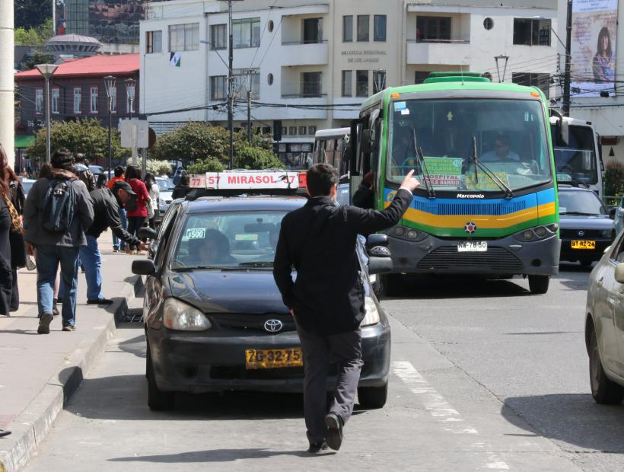
Monitoring inequalities - Chile
Problems using transportation
“Disability as health consequences”
Capacity
11%
38%
85%
13%
26%
57%
Experienced barriers
Notes:
What we get is a scale of capacity difficulties for each country, ranging from low to high levels.
Please remember that what you see here is the distribution of a general population sample.
Who are the persons with severe difficulties?

Slide 20
Monitoring inequalities - Chile
Capacity
Working
How much of a problem do you have with getting things done at work?
4%
25%
65%
Barriers at work
3%
10%
31%
Notes:
Article of CRPD: 27. “…Prohibit discrimination on the basis of disability with regard to all matters concerning all forms of employment…”
Connection with SDG: goal 8- decent work and economic growth
Question functioning: I4044 How much of a problem do you have with applying for and getting a job?
Question environment: I3001 Does your workplace or educational institution make it easy or hard for you to work or learn?

Slide 21
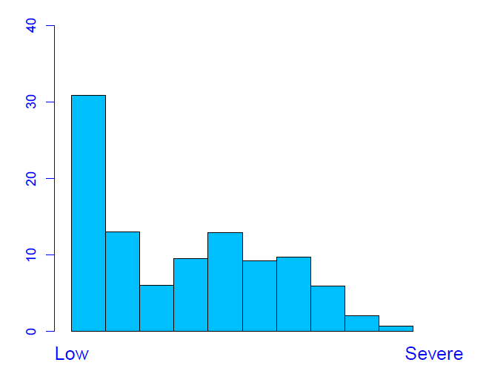
Monitoring inequalities – Sri Lanka
Capacity
Working
How much of a problem do you have with getting things done at work?
16%
56%
86%
Barriers at work
2%
23%
60%
Notes:
Article of CRPD: 27. “…Prohibit discrimination on the basis of disability with regard to all matters concerning all forms of employment…”
Connection with SDG: goal 8- decent work and economic growth
Question functioning: I4044 How much of a problem do you have with applying for and getting a job?
Question environment: I3001 Does your workplace or educational institution make it easy or hard for you to work or learn?

Slide 22
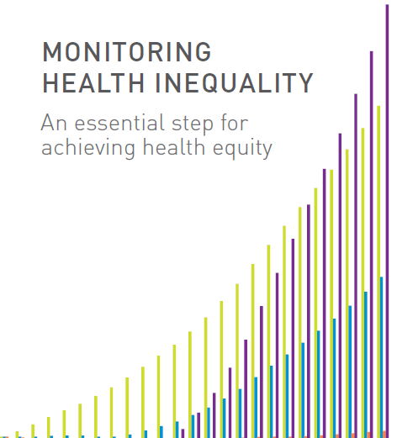
MONITORING INEQUALITY
TOOL
http://apps.who.int/gho/data/view.wrapper.HE-VIZ07?lang=en&menu=hide

Slide 23
Messages
The MDS collects comprehensive information on capacity and disability as the outcome of the interaction with the environment
Monitoring disability inequalities in the context of the SDGs needs to be:
  a coordinated action among stakeholders
  complemented by the monitoring of the CRPD
Information on the environment will be fundamental for policy recommendations

Slide 24
Alarcos Cieza, MSc, MPH, PhD
Coordinator
Disability and Rehabilitation (DAR)
World Health Organization
Avenue Appia 20
1211 Geneva 27
Switzerland
Tel.: +41 22 791 1998
Fax: +41 22 791 4874
Email: ciezaa@who.int
Website: www.who.int/disabilities/

