Slide 1


Economics of (un-)sustainability in global fisheries
U. Rashid Sumaila
Fisheries Economics Research Unit
Sea Around Us project
UBC Fisheries Centre
r.sumaila@fisheries.ubc.ca
World Oceans Day Panel Presentation, United Nations, Headquarters, New York, June 8, 2010

Slide 2
Outline of talk
Why are ocean fisheries considered to be un-sustainable?
Why should we strive for sustainability in ocean fisheries?
What are the elements of sustainability in ocean fisheries?

Slide 3
Overview of sustainability

Slide 4
Origins of sustainability
Many would trace the origins of sustainability to the Brundtland Report: WCED (1987):
  development that "meets the needs of the present generation without compromising the ability of future generations to meet their own needs”.
But there is a longer history …

Slide 5
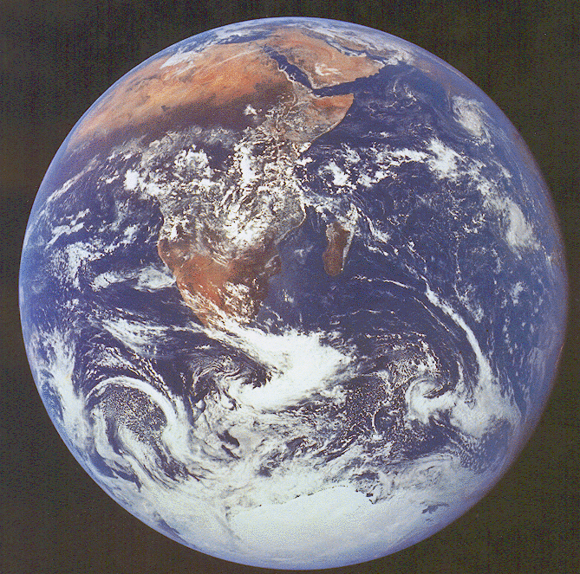
“The Earth and the fullness of it belongs to every generation, and the preceding one can have no right to blind it up from posterity”
(Adam Smith, 1766 Lecture on Jurisprudence).
Photo: NASA

Slide 6
The sustainable development challenge
How to reconcile society’s development goals with the planet’s environmental limits over the long term:
  Fish protein;
  Jobs and income;
  Profits.

Slide 7
Ocean fish sustainability
Sustainability focuses on the dynamic interactions between nature and society – in our case, the interaction between fish & fishers:
  Example: how vulnerable are different parts of the ocean?

Slide 8
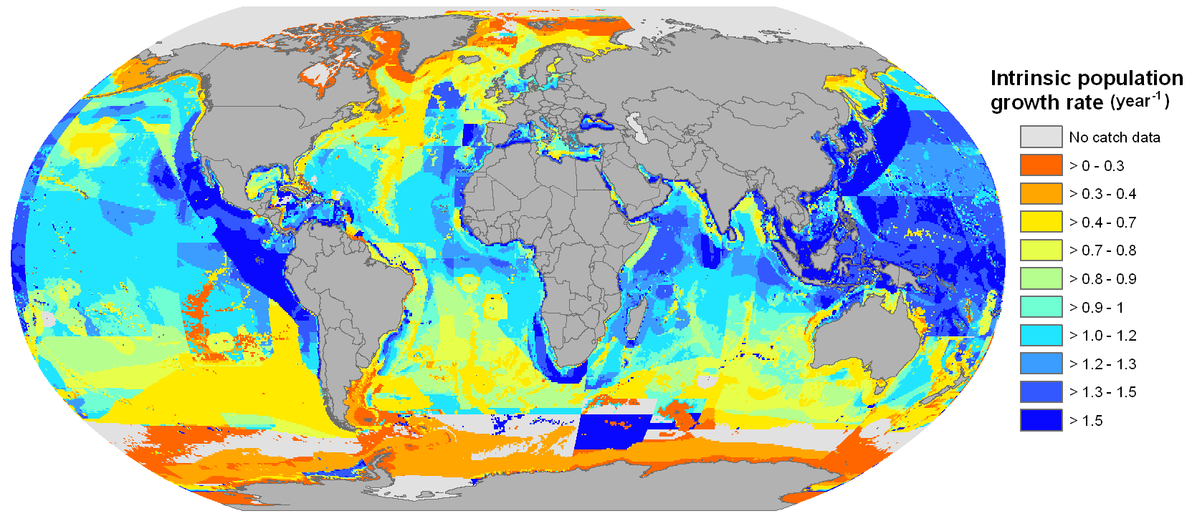
Intrinsic growth rate as indicator
of vulnerability
Sumaila, Cheung et al. (in prep.)

Slide 9
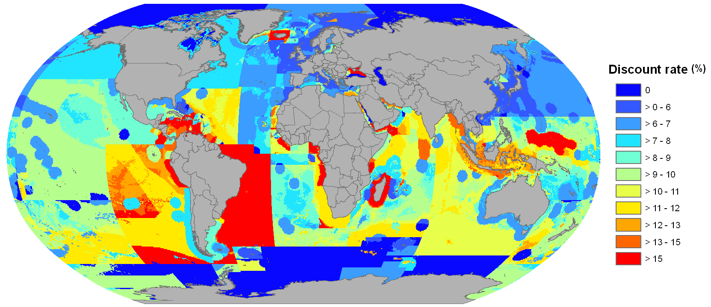
Official discount rates as indicator of vulnerability
Sumaila, Cheung et al. (in prep.)

Slide 10
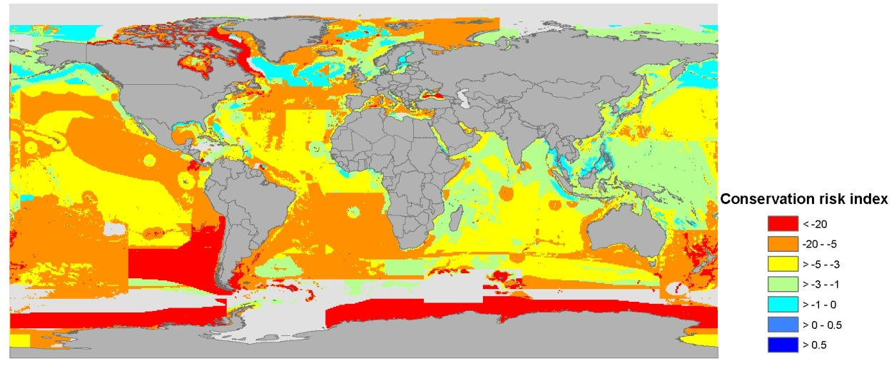
Conservation indices for all fish species, globally
Includes all fish species (assumed private discount rate).

Slide 11
Ocean fish sustainability
Sustainability pays attention to how social and economic change shape the environment and how the environmental change shapes society;
  Example: fisheries subsidies: payments by governments to fishing sector.

Slide 12
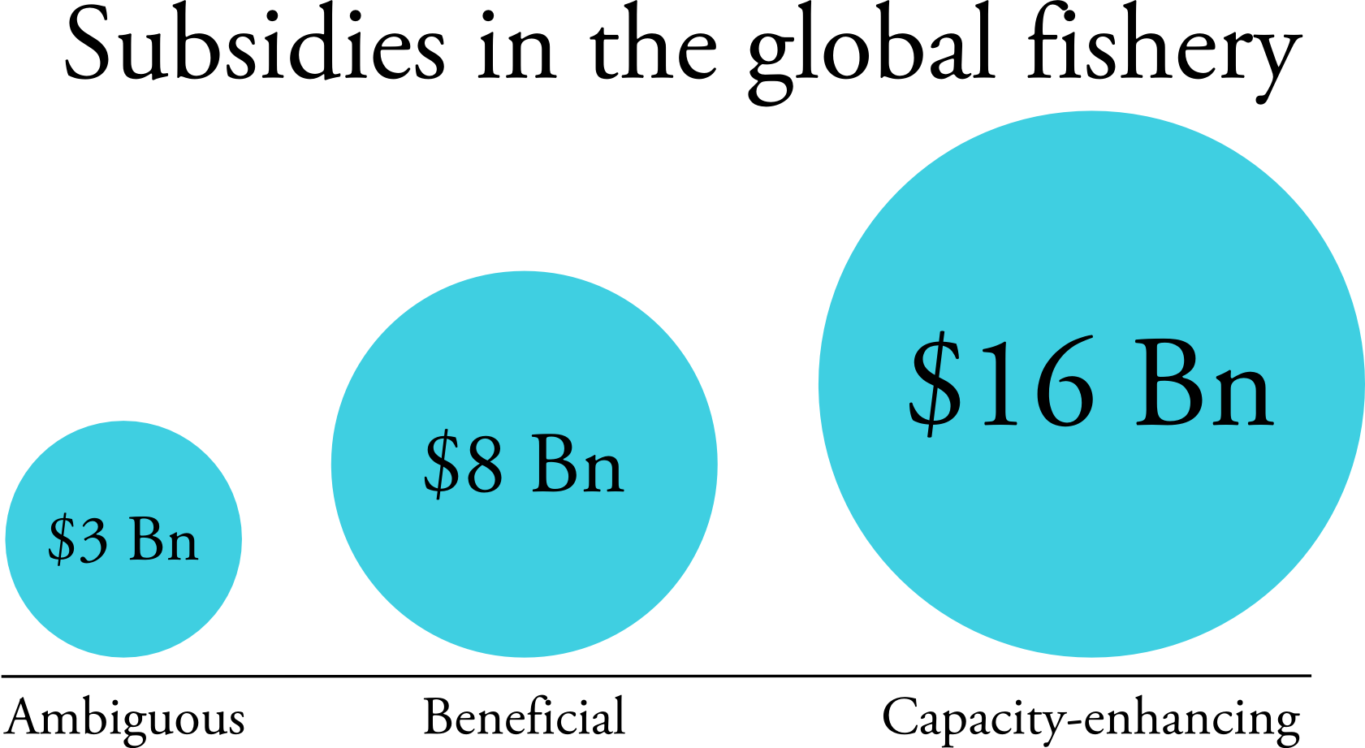
Sumaila et al. (2010)

Slide 13
Ocean fish sustainability
Sustainability is problem-driven, with the goal of creating and applying knowledge in support of decision-making for sustainable development;
  Example illegal fishing.

Slide 14
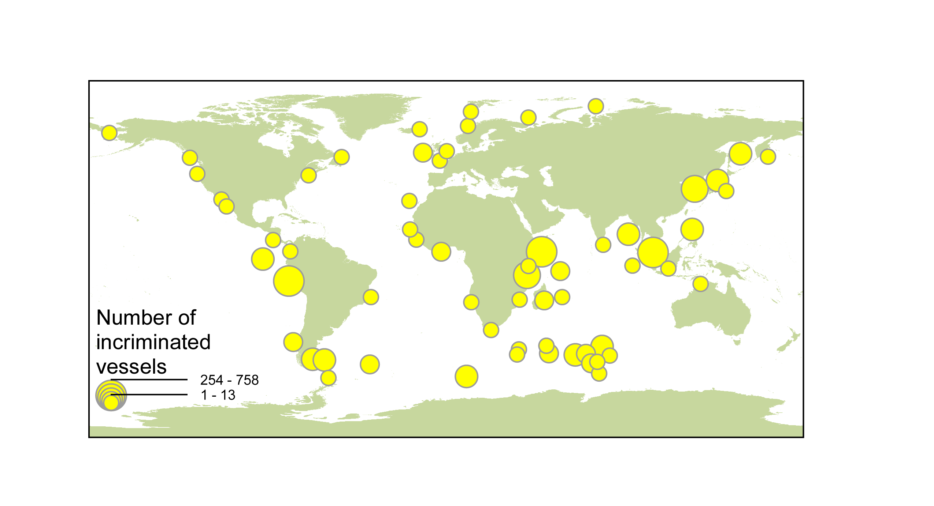
Number of incriminated vessels fishing illegally between 1980 and 2003
Sumaila et al. (2006)

Slide 15
Costs and benefit aspects of risks inherent in IUU activity
Arresting Country | Fishery | Expected Revenue (USD) | Expected Penalty (USD) | Total Cost (USD) | Total Cost / Expected revenue
Australia | Patagonian toothfish | 504 000 | 87 000 | 526 091 | 1.04
Japan | Crab | 38 256 | 1 483 | 31 131 | 0.81
Mexico | Shrimp | 22 060 | 1 091 | 16 428 | 0.74
Russia | Alaska pollack | 8 818 | 234 | 4 539 | 0.51
Mauritius | Patagonian toothfish | 352 000 | 480 000 | 786 667 | 2.23
Sumaila et al. (2006)

Slide 16
Ocean fish sustainability
Sustainability is grounded in the belief that for the knowledge of nature-society interaction to be truly useful, they have to be ‘co-produced’ through close collaboration between scholars, managers, fishers, industry, and policy makers at different scales:
  Example this meeting.
NRC (1999); Clark and Dickson (2003)

Slide 17
The need to strive for sustainability

Slide 18
Ocean fisheries activities
Capture fisheries
Aquaculture
Fishing ports and jetties
Seafood processing
Ocean fish populations
Management cost
Marine research
Marine manufacturing & services, boat building
Recreational fisheries & tourism

Slide 19
Input – output results
Fisheries are a primary or ‘base’ industry
  Source of resources out of which much economic activity grows.
How much economic activity throughout the economy is sourced from fisheries output?
Dyck & Sumaila (2010)

Slide 20
Economic impact of world fisheries output
 | Landed Value ($ billions) | Economic Impact ($ billions) | Average Multiplier
Africa | 2 | 5 | 2.59
Asia | 50 | 133 | 2.67
Europe | 11 | 36 | 3.12
S. & C. America | 7 | 15 | 2.05
N. America | 8 | 29 | 3.52
Oceania | 5 | 17 | 3.27
World Total | 84 | 235 | 2.8
Dyck & Sumaila (2010)

Slide 21
Income effect of world fisheries output
 | Landed Value ($ billions) | Income Effect ($ billions) | Average Multiplier
Africa | 2 | 1 | 0.62
Asia | 50 | 35 | 0.71
Europe | 11 | 9 | 0.76
S. & C. America | 7 | 4 | 0.56
N. America | 8 | 10 | 1.22
Oceania | 5 | 4 | 0.73
World Total | 84 | 63 | 0.75
Dyck & Sumaila (2010)

Slide 22
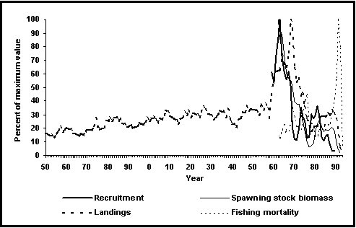
Catch data: individual fisheries

Slide 23
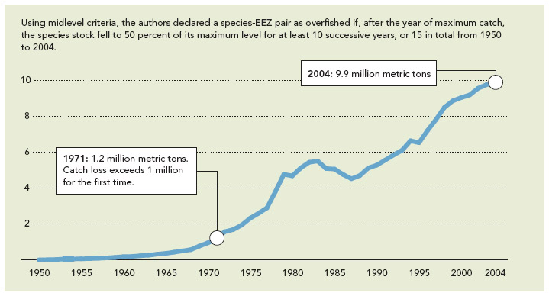
Global Potential Catch Loss
(in million tonnes)
Srinivasan et al. (2010)

Slide 24
Food security implications of overfishing
Our analysis shows that eliminating overfishing could create food to avert undernourishment for about 20 million people mostly in countries with very high levels of undernourishment in their populations (e.g., Liberia, Sri Lanka, Grenada, Guatemala).
Srinivasan et al. (2010)

Slide 25
Elements of sustainability

Slide 26
Elements of sustainability in fisheries
Recognize that there are limits to the amount of fish that the ocean can provide;
Acknowledge that rebuilding overfished stocks is needed so they can deliver maximum sustainable yield through time for the benefits of all generations;

Slide 27
Elements of sustainability in fisheries
Essential fish habitats need to be protected and preserved;
Fishing and related activities are carried out to minimize the release of greenhouse gases;
Education, education, education.

Slide 28
Elements of sustainability in fisheries
Global governance:
  sustainability based on the ecosystem approach such as the use of marine protected area;
  Subsidies disciplines;
  Joint management of shared stocks, e.g., high seas fish stocks;
  Make it economically costly to engage in IUU fishing;
  Encourage co-management of fisheries;
  Define access rights to communities, etc.

Slide 29
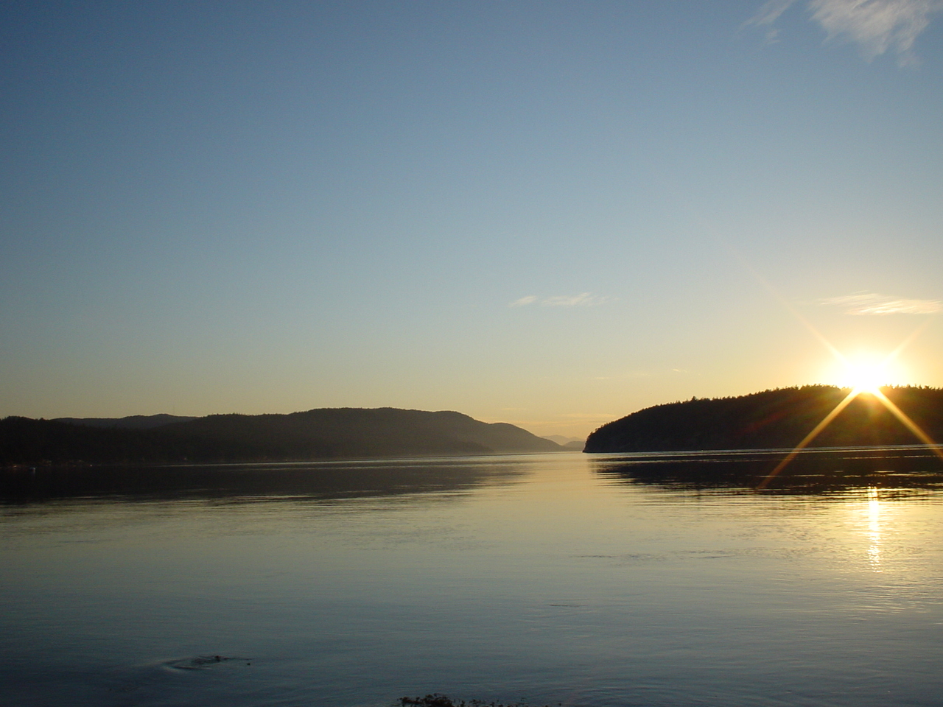

Thanks for your attention

